Slide 1

International Real Estate Investments
Real estate investment was traditionally a local business with investors focused on nearby markets they knew well. Today, cross-border capital flows have increased in all asset markets, with real estate following suit.
This presentation explores markets, strategies, and implementation of international real estate investments.

Slide 2

The Global Real Estate Capital Market
Growing International Market
The global real estate market is expanding through increased capital flows and market institutions.
Top Destinations
China, United Kingdom, and United States are the main recipients of international capital flows.
Regional vs. Global
UK and US attract truly global flows, while China's capital is almost exclusively regional.

Slide 3





Institutions of Globalization
Public Markets
Growth of REITs and property shares makes international investment easier.
Data Providers
Research consultants supply local data and performance benchmarks.
Professional Organizations
Establishing standards in information quality, governance, and professionalism.
Transparency
Increasing transparency in mature markets, though emerging markets still lag behind.

Slide 4






Rationales for Going International
Diversification
Markets move in non-synchronized ways, providing risk reduction benefits.
Return Opportunities
Better returns outside home country, especially from emerging markets with high growth.
Managerial Expertise
Exporting superior portfolio management or development expertise to emerging markets.

Slide 5
Structural Return Opportunities
Economic Development
Urbanization
Emerging markets show higher economic growth, spurring demand for commercial property.
Rapid urbanization creates huge investment opportunities in housing, industrial, and office space.
China, India, and Central Europe have shown stronger growth than mature economies.
Cities attract migration, requiring warehouses, factories, and housing for new urban populations.

Slide 6
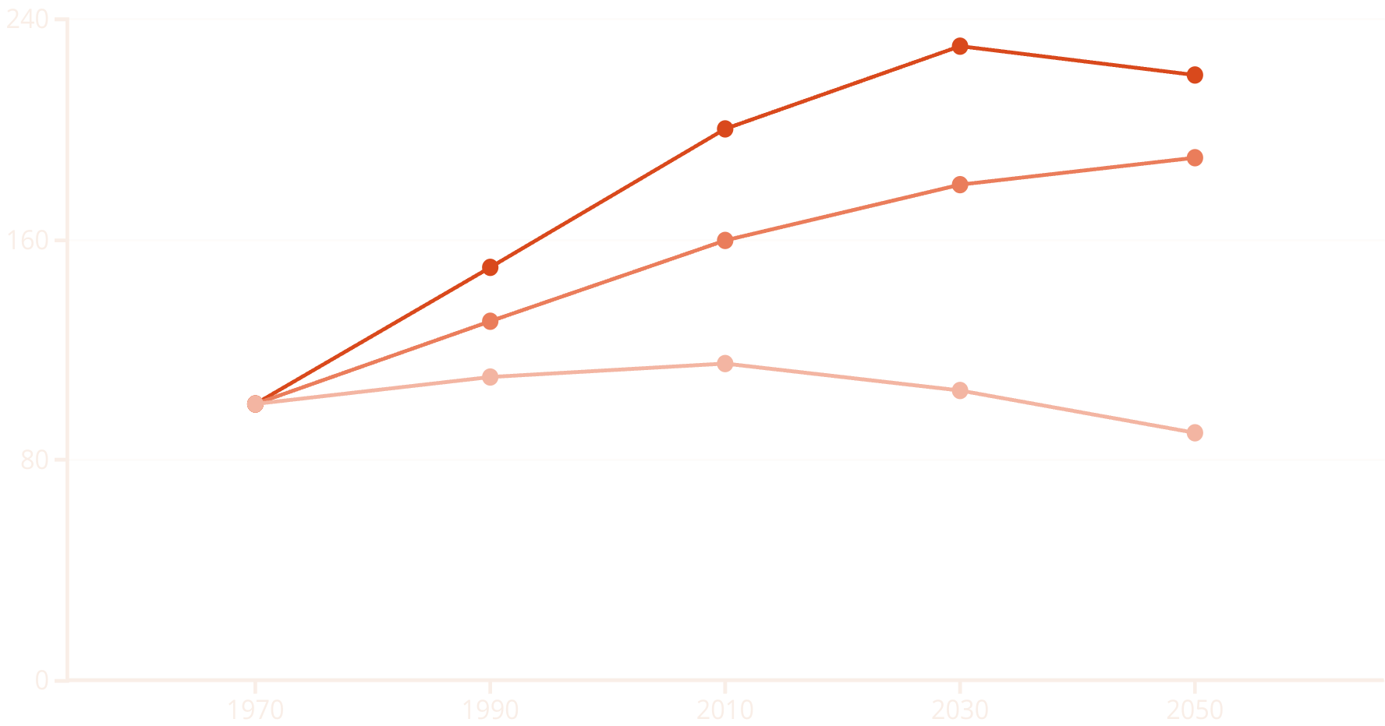
Demographic Trends: Labor Force Availability
Asia
North America
Europe
Labor population trends vary dramatically across regions. Asia shows fastest historic growth but will top out around 2045. North America continues growing through 2040. Europe has already peaked and is projected to fall below 1970 levels by 2060.

Slide 7

Population Growth Projections
15%
-28%
-13%
US Growth by 2070
Japan Decline by 2070
China Decline by 2070
Continued but slower population growth, depending on immigration policies
Peaked in 2009
Peaking around 2031
34%
Global Growth by 2070
Uneven distribution across regions

Slide 8

Property Type Exposure to Demographics
Office Space
Retail Space
Depends on working-age population. Already affected by demographic decline in Europe and parts of Asia. Work-from-home trends accelerated by COVID further reduce demand.
Driven by population size and purchasing power. E-commerce capturing increasing share of retail sales, limiting growth in physical retail space needs.
Housing
Driven by household formation. Smaller household sizes can offset population decline. Emerging economies show strong potential as family sizes decrease.

Slide 9
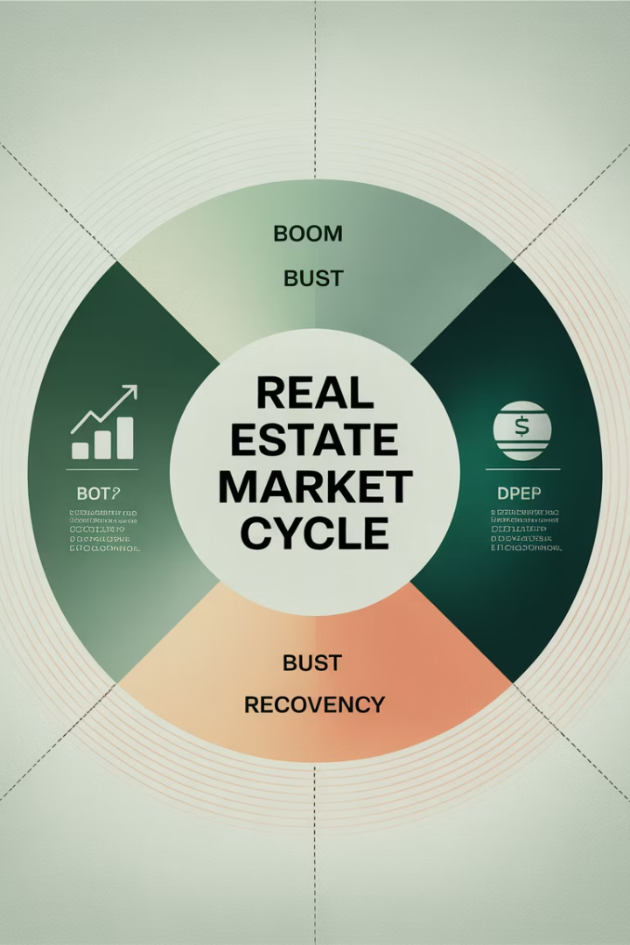
Cyclical Return Opportunities
1
Market Timing
Property markets around the world are at different phases of their cycles at any given time.
2
Challenges
Cycles need to be predictable to implement tactical allocation policies.
3
Information Disadvantage
Foreign investors face difficulties making accurate predictions from afar.
4
Local Partnerships
Finding local partners can help align interests and navigate market cycles.

Slide 10








International Diversification Benefits
Lower Portfolio Risk
Non-synchronized market movements reduce overall risk
Exposure to Different Economic Bases
Countries have varying economic foundations
Different Supply Drivers
Local capital availability, interest rates, and zoning rules vary
Diverse Rental Contracts
Different cash flow streams and risk exposures

Slide 11
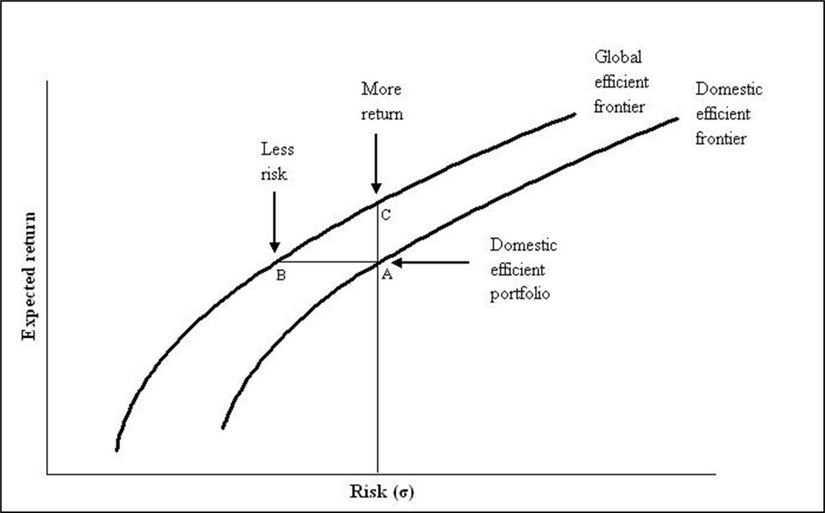
International Correlations
GDP Growth Correlations
Generally Low
Within Europe
Higher Correlations
Across Continents
Lower Correlations
During Crises
Correlations Increase
Long-term Trend
Regional Integration
Low correlations between international markets provide strong diversification potential and this may lower risk at a given return target as show above to the left. Continental factors are becoming more important, with correlations increasing within regional blocks but not between regions.

Slide 12



Managerial Considerations
Exporting Expertise
Value of investment management know-how in emerging markets
Following Customers
Servicing global corporate clients across markets
Sector Dependence
Logistics and distribution more global than retail or residential

Slide 13





Obstacles to International Investment
Transaction Costs
Higher transfer taxes, agents' fees, and legal fees in many foreign markets.
Information Costs
Foreign investors at an informational disadvantage relative to local competition.
Currency Risk
Exchange rate volatility can exceed property market volatility.
Political Risk
Foreign investors vulnerable to regulatory changes and ownership restrictions.

Slide 14
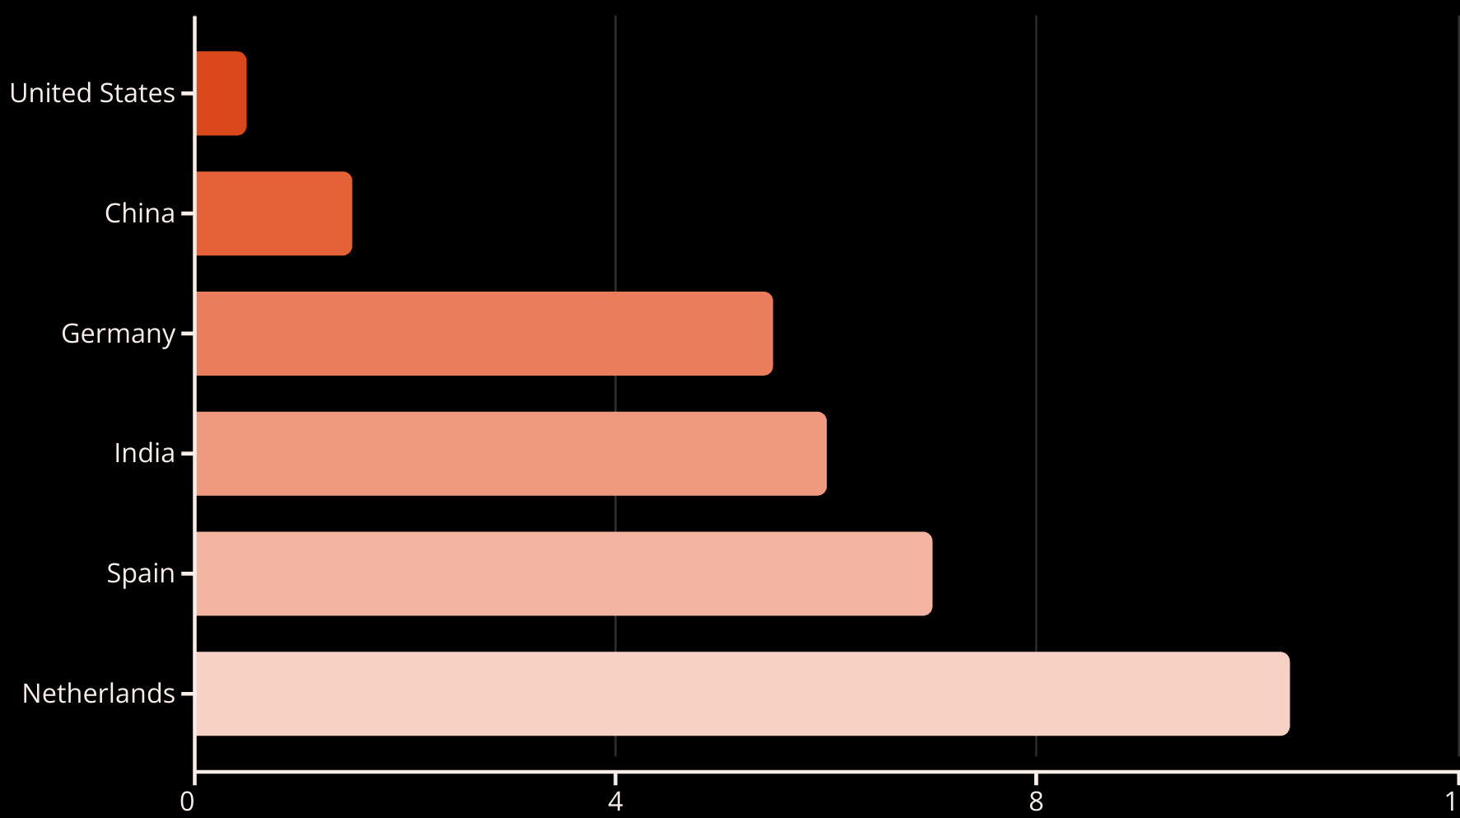
Transaction Costs Comparison (% of Purchase Price)
Transaction costs vary widely across markets. Total costs for buying and selling property in countries like France, Brazil, and Spain can reach about 10% of property value.

Slide 15








Foreign Investing Information Disadvantage
Performance Impact
Lack of Information
International property companies underperform local investors by 2.7% annually
Foreign investors often lack critical local market knowledge
Local Solutions
Property Issues
Establishing local offices or partnerships can help but adds costs
Far-away investors often pay too much and face higher vacancy rates

Slide 16





Currency Risk Management
Unpredictable Movements
Natural Hedges
Currency Overlay
Liquid Markets
Local borrowing can reduce currency exposure to just the equity position.
Focus hedging on liquid currency pairs to minimize costs.
Currency movements follow a random walk and are difficult to predict.
Analyze portfolio as a whole, including diversification effects.

Slide 17
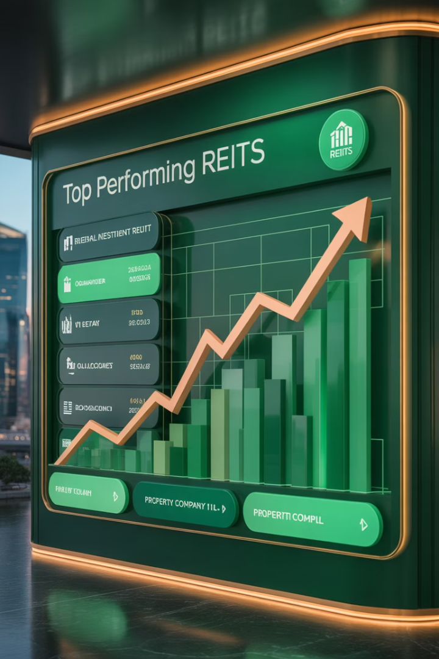
Public Real Estate Investment
Lower Transaction Costs
REITs and property shares have much lower transaction costs than direct property.
Reduced Information Asymmetry
Public markets are more efficient, allowing uninformed investors to make well-informed bets.
Better Liquidity
Easier entry and exit, especially important during market downturns.
Fewer Ownership Restrictions
Share ownership typically faces fewer barriers than direct property ownership.

Slide 18
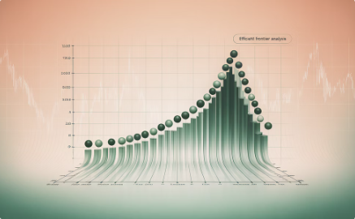

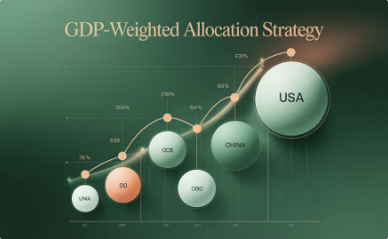
Determining Country Allocation
Modern Portfolio Theory
Using Markowitz framework to find optimal diversification,
though results can be period-specific with corner solutions.
Index Tracking
Following global indices like FTSE EPRA/NAREIT, though market weights
may not reflect economic importance.
GDP Weighting
Allocating based on economic size, often combined with market index
weights for balanced approach.

Slide 19
The Home Market Concept
Information Advantage
Strategic Approach
Investors typically have better information in their home markets, enabling outperformance in direct real estate.
Concentrate direct property investments in markets where you have an information advantage.
The "home market" can be defined by geography or property type where the investor has expertise.
Use REITs and property shares for international exposure outside home markets.
Different optimal strategies exist for intermediary investors versus end-investors.

Slide 20



Implementation Strategies
Intermediary investors (like REITs) should focus on their home markets where they have information advantages. End-investors (like pension funds) should combine direct investment in home markets with global REIT exposure for diversification.

