Slide 1
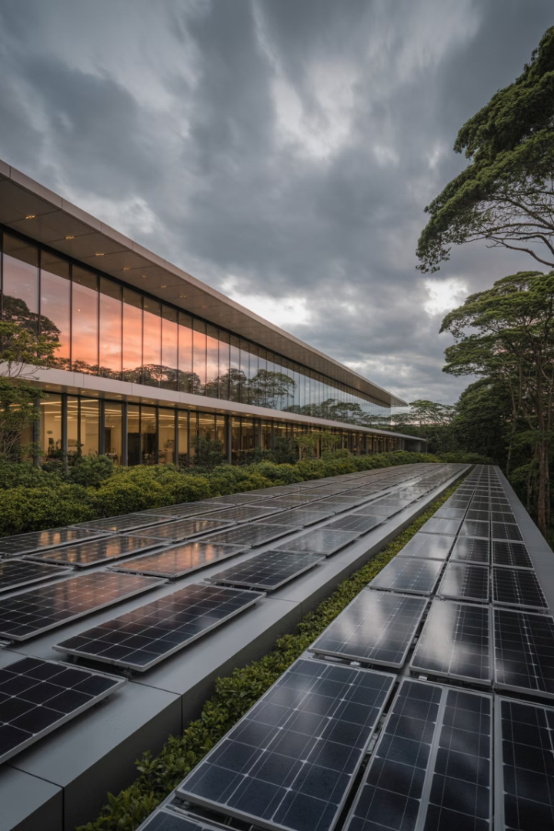
Real Estate, Sustainability, and Climate Risk
Real estate has a significant impact on climate change and faces increasing climate risks. The construction and operation of buildings produce substantial CO2 emissions, but the industry can also be part of the solution.
This chapter explores the relationship between real estate and sustainability, examining both the financial considerations of energy efficiency and the physical climate risks facing the industry.

Slide 2





Real Estate's Environmental Impact
Major Contributor
The real estate sector accounts for 30-40% of global energy demand and greenhouse gas emissions.
Construction Emissions
Cement and concrete production emits significant CO2 during building construction.
Operational Impact
Buildings emit CO2 through gas heating and electricity consumption during use.
Change Potential
The industry has substantial potential to reduce climate risks through improved practices.

Slide 3
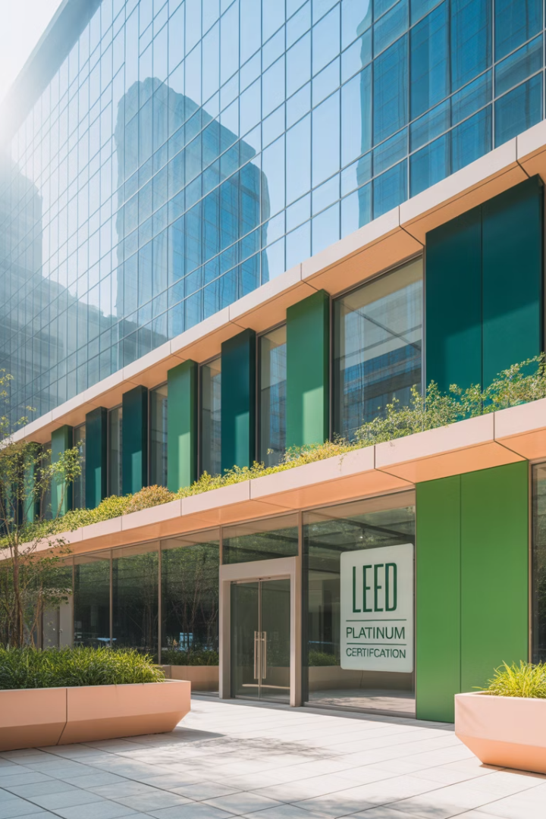




Market-Based Environmental Measures (Others exists in several countries)
BREEAM (1990)
First environmental performance yardstick for buildings, established in the UK.
LEED (1998)
US-based certification system with four levels from Certified to Platinum.
Green Star
Australian system measuring performance across nine environmental categories.
GRESB
Portfolio-level benchmark measuring energy performance of property companies and funds.

Slide 4








Corporate Sustainability Drivers
Workforce Pressure
Talent Attraction
Corporate Responsibility
Employee expectations drive companies toward sustainable workplaces.
Sustainable buildings help attract top talent in competitive markets.
Companies choose sustainable buildings as part of their social ESG responsibility policies.
ESG = Environmental, Social and Governance.
Stable Cash Flow
Energy-efficient buildings reduce exposure to volatile energy prices.

Slide 5
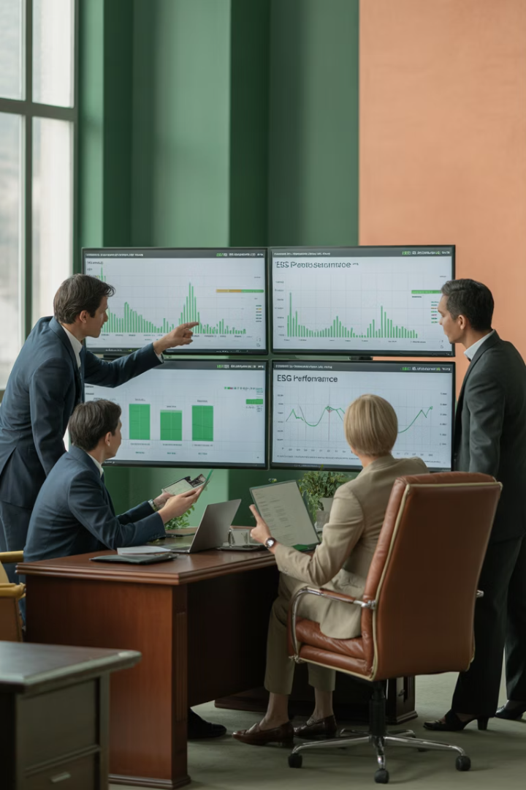
Institutional Investor Focus
ESG Policies
Portfolio Assessment
Energy performance is a cornerstone of institutional investors' Environmental, Social, and Governance policies.
Investors use tools like GRESB and CRREM to evaluate sustainability performance of property investments.
Engagement Strategy
Information drives engagement with property companies to improve environmental performance.

Slide 6
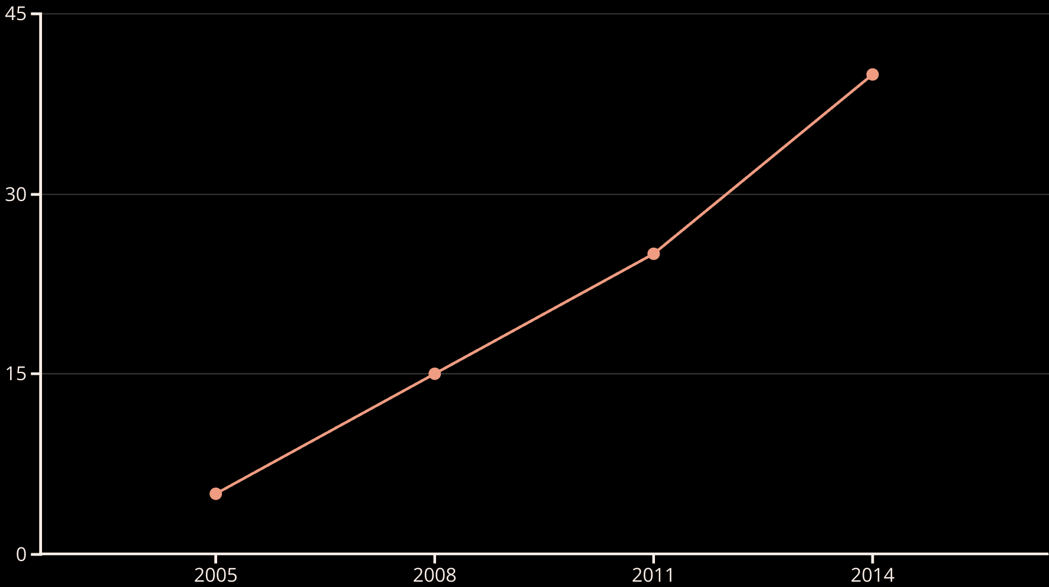
Market Penetration (%) of Green Certification
LEED certification in the US office market rose steadily from just 5% in 2005 to 40% in 2014 and continues to grow.
Market penetration is strong in US retail but remains a challenge in Asia, Latin America, and Africa.

Slide 7
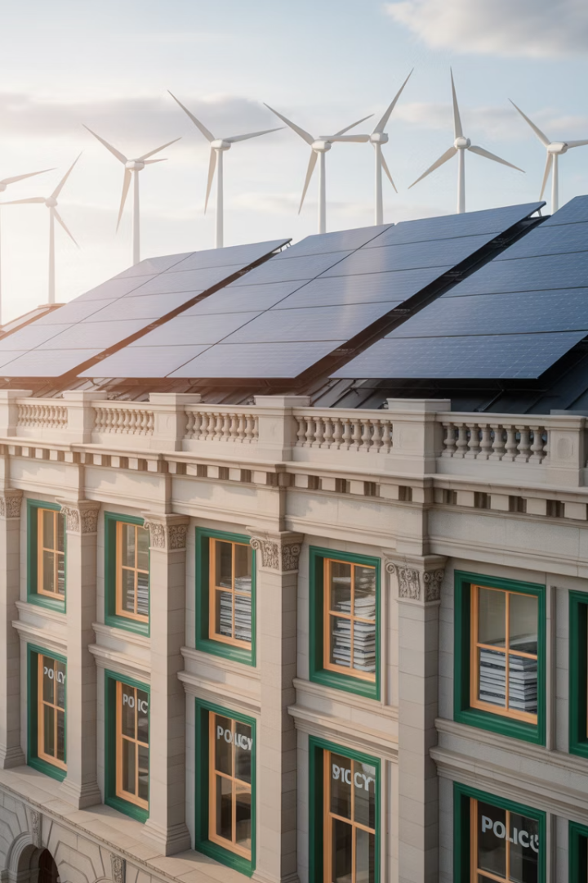




Government Regulatory Approaches
Carbon Tax
Makes CO2 emissions expensive, allowing market forces to drive emission reductions.
Cap-and-Trade
Sets emission limits and allows trading of emission permits between companies.
Subsidies
Provides financial incentives for green investments, though effectiveness varies. This may include tax credits or property tax reductions.
Building Codes
Prescribes minimum energy efficiency standards for new construction.

Slide 8



Transition Risk for Property Investors
Stranded Assets
Buildings that fail to meet evolving standards risk becoming obsolete.
Brown Discount
Non-green buildings may only be rentable at significant price reductions.
Regulatory Pressure
Stricter government regulations increase compliance costs for older buildings.

Slide 9
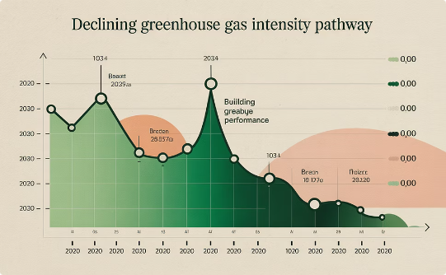
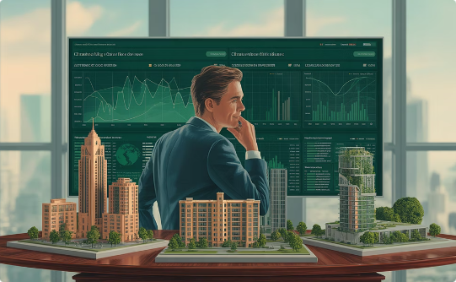
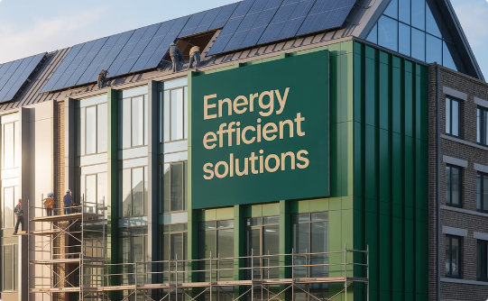
The CRREM (Carbon Risk Real Estate Monitor)
Tool for Transition Risk
CRREM Tool: roadmap for the decarbonisation of real estate
Risk Assessment
Decision Support
Implementation
CRREM provides a pathway to the 2050 energy efficiency target based on Paris climate goals.
Helps investors determine when buildings will face transition risk and plan refurbishments.
Used by leading institutional real estate owners globally to manage transition risk.

Slide 10






Financial Value of Energy Efficiency
Net Present Value
The correct framework for evaluating energy investments
Multiple Value Drivers
Affects rents, occupancy, costs, and discount rates
Building Performance
Higher energy efficiency typically increases financial value
Building owners should use the net present value rule to evaluate energy efficiency investments, not simple payback period. This approach accounts for all cash flow effects and the time value of money.

Slide 11

Evidence: Green Building Premiums from Research
6%
8.2%
5.4%
7.6%
Average Rental Premium
Residential Premium
Commercial Premium
Sales Value Premium
Green buildings command higher rents across markets.
Green homes see significant rental advantage.
Offices and retail spaces benefit from certification.
Green buildings sell for more than conventional ones.

Slide 12
Risk Reduction Benefits
Improved Liquidity
Stable Occupancy
Lower Cost of Capital
Green properties sell faster, especially in down markets.
Higher and more consistent tenant retention rates.
Reduced financing costs for green buildings.
Shorter time on market
Lower vacancy risk
24-29 basis points lower mortgage rates
Broader buyer interest
Reduced turnover costs
More stable transaction volume
More predictable cash flows
35-40 basis points lower cost of equity
34% lower chance of mortgage default

Slide 13








Timing Energy Efficiency Investments
Evaluate Technology
Compare Rates
Consider current efficiency of green building technology
Weigh discount rate against speed of technological improvement
Consider Building Cycle
Make Decision
Align with natural maintenance/redevelopment schedule. Retrofits are often done after the loss of a major tenant while the building is fully or partially vacant.
Invest now if discount rate exceeds technology improvement rate

Slide 14
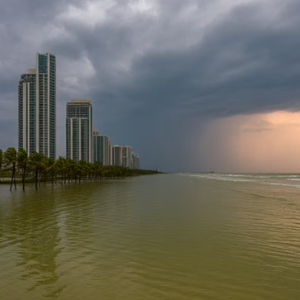
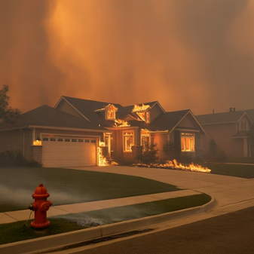
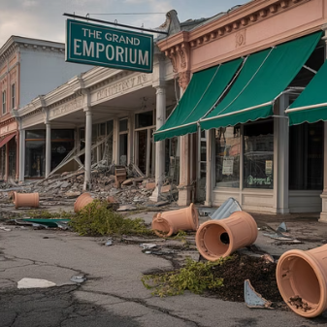
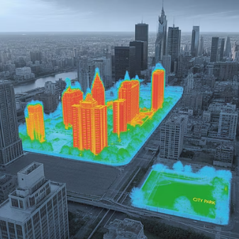
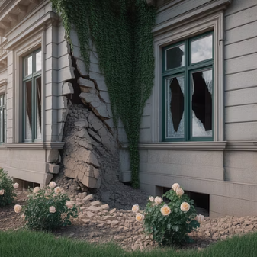
Physical Climate Risk and Real Estate
Physical climate risk is both specific and systematic. It can affect individual properties differently even at small distances but also adds an undiversifiable layer of risk to all real estate investment.

Slide 15




The Big Wet Climate Risks
Rising Sea Levels
Already up 35cm globally, projected 40-100cm by 2100 even with Paris agreement compliance.
River Flooding
Changing rain patterns create more unpredictable and severe flooding events.
Hurricanes/Typhoons
Increasing in frequency, severity, and geographic range due to warming oceans.

Slide 16
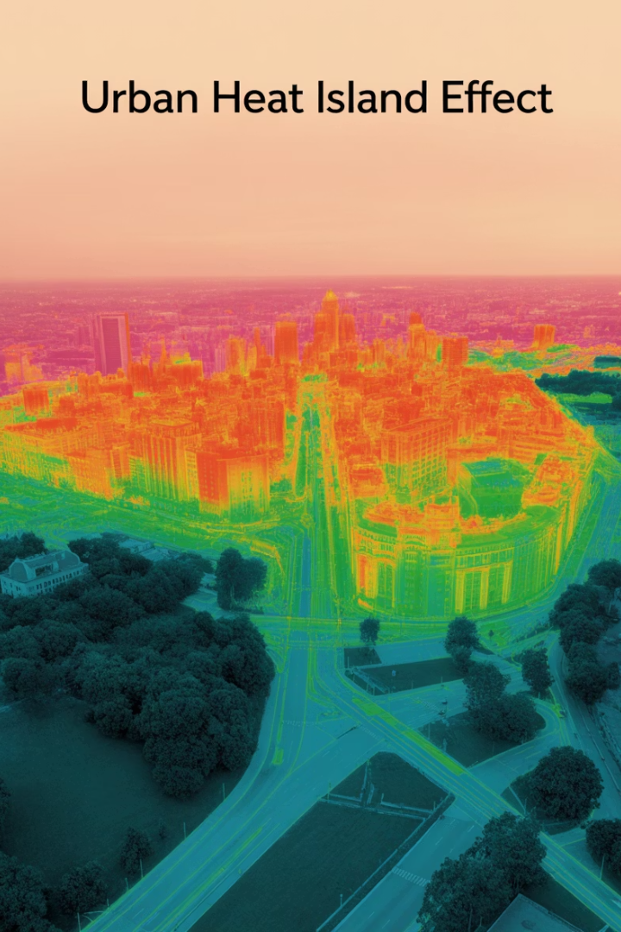



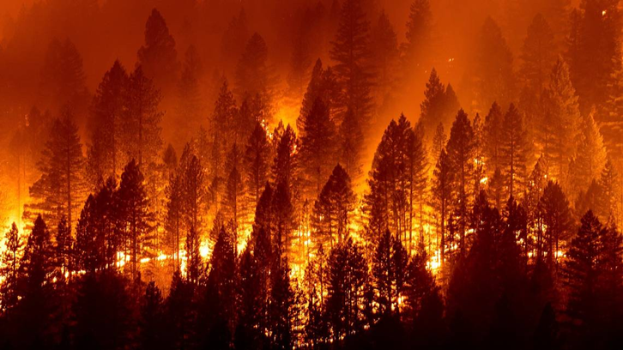
Additional Physical Climate Risks
Wildfires
Heat Stress
Soil Subsidence
Unprecedented frequency in traditional and new locations due to longer, more severe droughts.
Urban heat islands intensify impact, affecting health and increasing energy demands.
Drought creates unstable soil, destabilizing buildings and infrastructure.

Slide 17

Climate Risk Measurement Tools
Government Maps
FEMA flood maps, wildfire risk zones, often limited in detail and lag the market, so they are generally out of date.
Financial Providers
Moody's, SwissRE, S&P Global, MSCI, Bloomberg offering climate risk scores.
Specialized Services
ClimateCheck, FirstStreet Foundation, Jupiter Intelligence, Sustainalytics
Limitations
Low correlation between different providers' risk scores, inconsistent methodologies

Slide 18

Effects of Physical Climate Risk
First Order Effects
Immediate physical damage and business disruption, largely insurable but with rising premiums.
Second Order Effects
Medium-term impacts on property values, occupancy rates, and regional economies.
Third Order Effects
Long-term large-scale relocation of people and businesses from repeatedly affected areas.

Slide 19
Insurance Challenges can significantly lower
property values
Changing Risk Profiles
Market Withdrawal
Financing Impact
Climate change makes risks less predictable and more frequent.
Insurance companies pulling out of high-risk areas.
Property financing depends on insurance availability.
Higher probability of events
California wildfire zones
Collateral requirements
Greater severity of damage
Coastal flood zones
Loan-to-value restrictions
New locations affected
Hurricane-prone regions
Development feasibility

Slide 20
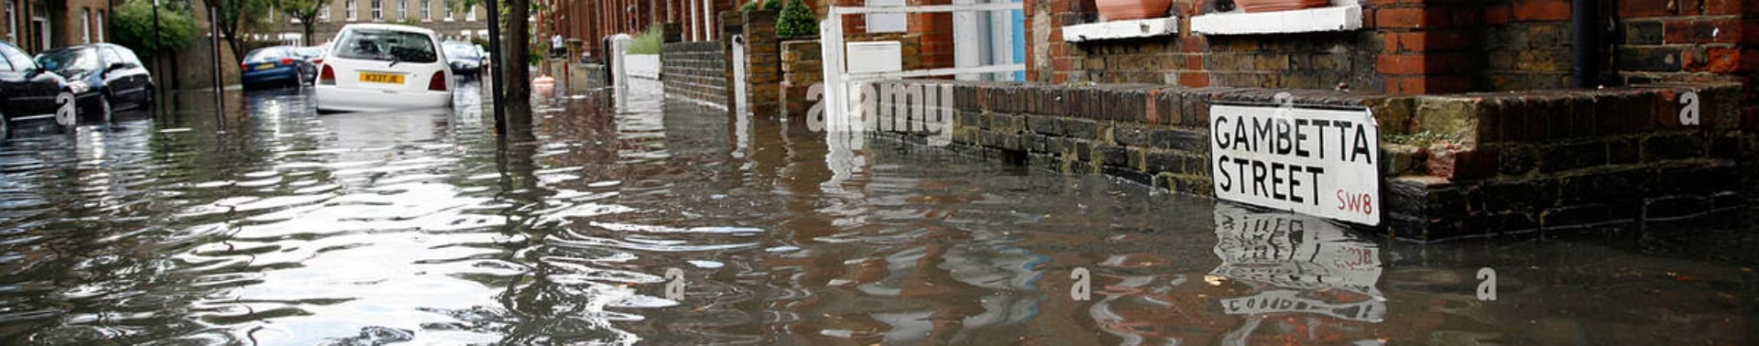




The Path Forward is challenging
Financial Value
Timing Matters
Energy efficiency investments generally add value and are good business opportunities.
Delay only makes sense when technology improvement outpaces discount rate.
Risk Management
Collective Action
Physical climate risk requires diversification and adaptation strategies.
Avoiding the "tragedy of the commons" requires industry-wide commitment to sustainability.

