Slide 1
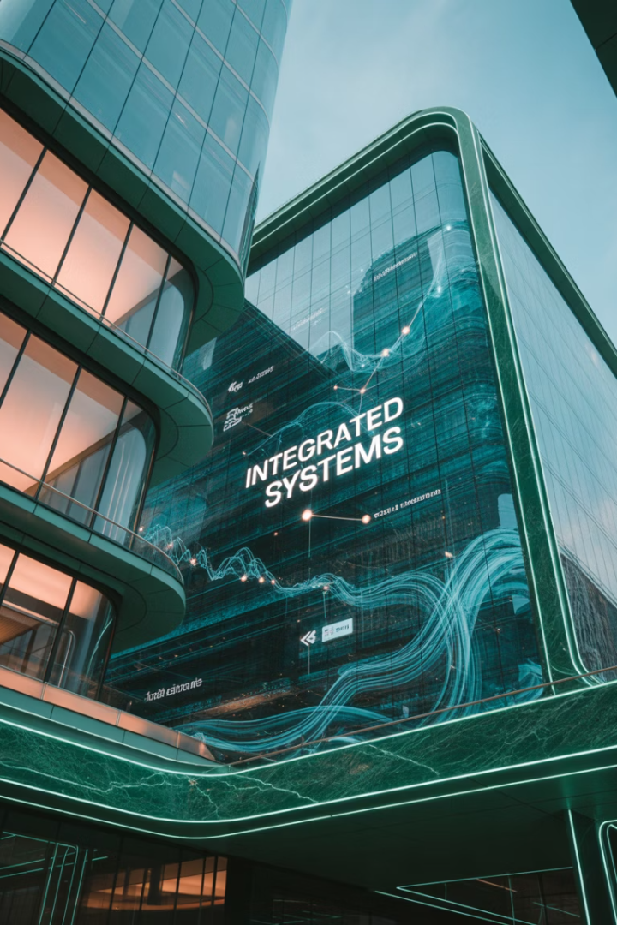
Technology and Real Estate: A Synthesis
Property is fundamentally a form of technology—a primal innovation that shelters us from the elements and provides a foundation for human survival. It is the original platform upon which layers of other technologies have been built.
What we often mean by "Proptech" today is the infusion of information technology into this age-old concept, transforming how we interact with, manage, and utilize property in an era defined by data, connectivity, and automation.

Slide 2
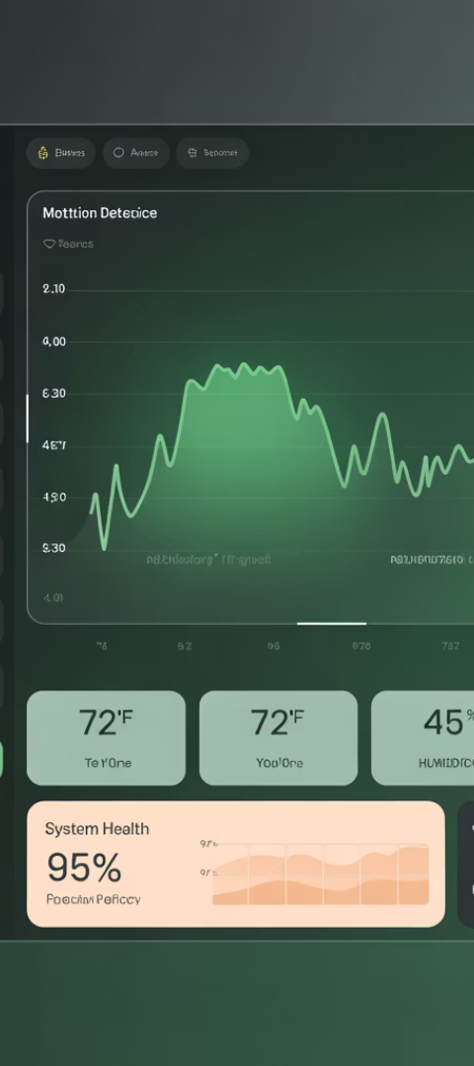




What is Proptech?
Property Technology
The application of information technology to real estate, addressing frictions in the market.
Market Evolution
Gradually aligning real estate with mainstream investments through technological innovation.
Continuous Innovation
Not new in concept, but accelerating in scope and impact across the industry.
Value Creation
Enhancing real estate's unique qualities to create more efficient, equitable property markets.

Slide 3










The Proptech Ecosystem
Finance & Investment
Crowdfunding, tokenization, automated valuation
Operations
Data & Analysis
Building management systems, energy optimization
Property data, transaction records, market analytics
Design & Construction
Transactions
BIM, Digital Twins, project management
Marketing, leasing, sales platforms

Slide 4




Adoption Challenges
Vendor Selection
Thousands of competing vendors make choosing difficult. Most will not survive five years.
Some will change the Industry and raise the standards.
Capital Requirements
Vendors need sufficient funding to reach profitability. Great apps may not always survive.
Integration Needs
Apps must work with existing systems and platforms, otherwise there are too
Many disparate systems to control.
Timing Considerations
Early adoption risks vs. waiting for price decreases and proven
apps.

Slide 5
Example: Building Information Modeling (BIM)
What is BIM?
Applications
Digital representation of a three-dimensional physical structure, including all functional systems within a building.
BIM enables efficient design, construction, and management of buildings. Eliminated the need for physical models.
Started in the 1970s
Project management
Includes plumbing, electrical, HVAC
Construction staging
Shows structural components
Interior design
Identifies system conflicts
3D virtual tours

Slide 6

Digital Twins & The Metaverse
Digital Twins
Metaverse Applications
BIM applied to existing or planned buildings, creating exact digital replicas that mirror real-world structures and systems.
Digital-only buildings that exist solely in virtual space, allowing people to play, socialize, and collaborate as if together.
Augmented Reality
Combining digital elements with physical spaces to enhance visualization of alternatives or provide additional information.

Slide 7
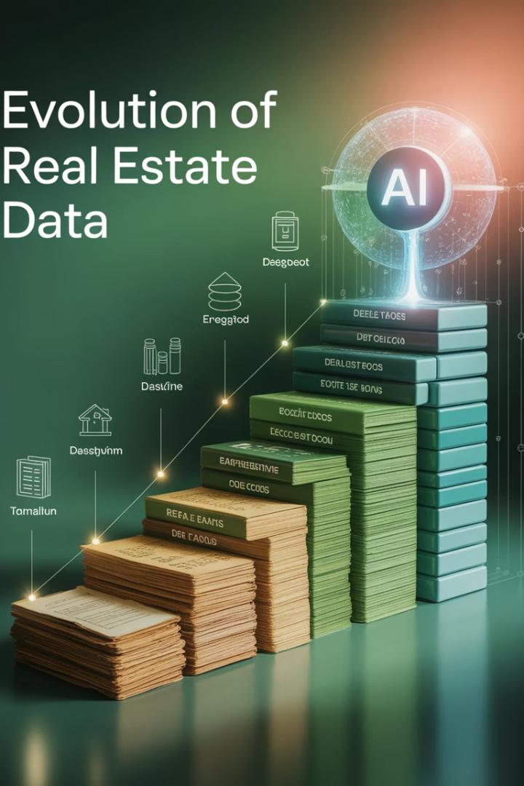




Data Revolution in Real Estate
Pre-Computer Era
Fragmented, non-standardized data requiring physical access to records
Digital Records
Digitization of property records, but still limited integration
Cloud Integration
Aggregation of public and private data sources
AI & Machine Learning
Automated analysis and pattern recognition in complex datasets

Slide 8
Data Source Examples and Integration Challenges
Public Data
Private Data Vendors
Integration Challenges
Census data
CoStar (commercial property)
Standardization of formats
Bureau of Labor Statistics
MSCI/RCA (institutional property)
Error filtering
Banking system records
Geographic identifiers
Property tax records
CoreLogic (property data)
Time period alignment
Federal Housing Finance Agency
Moody's/REIS (market analytics)
Zillow, Redfin (residential)

Slide 9
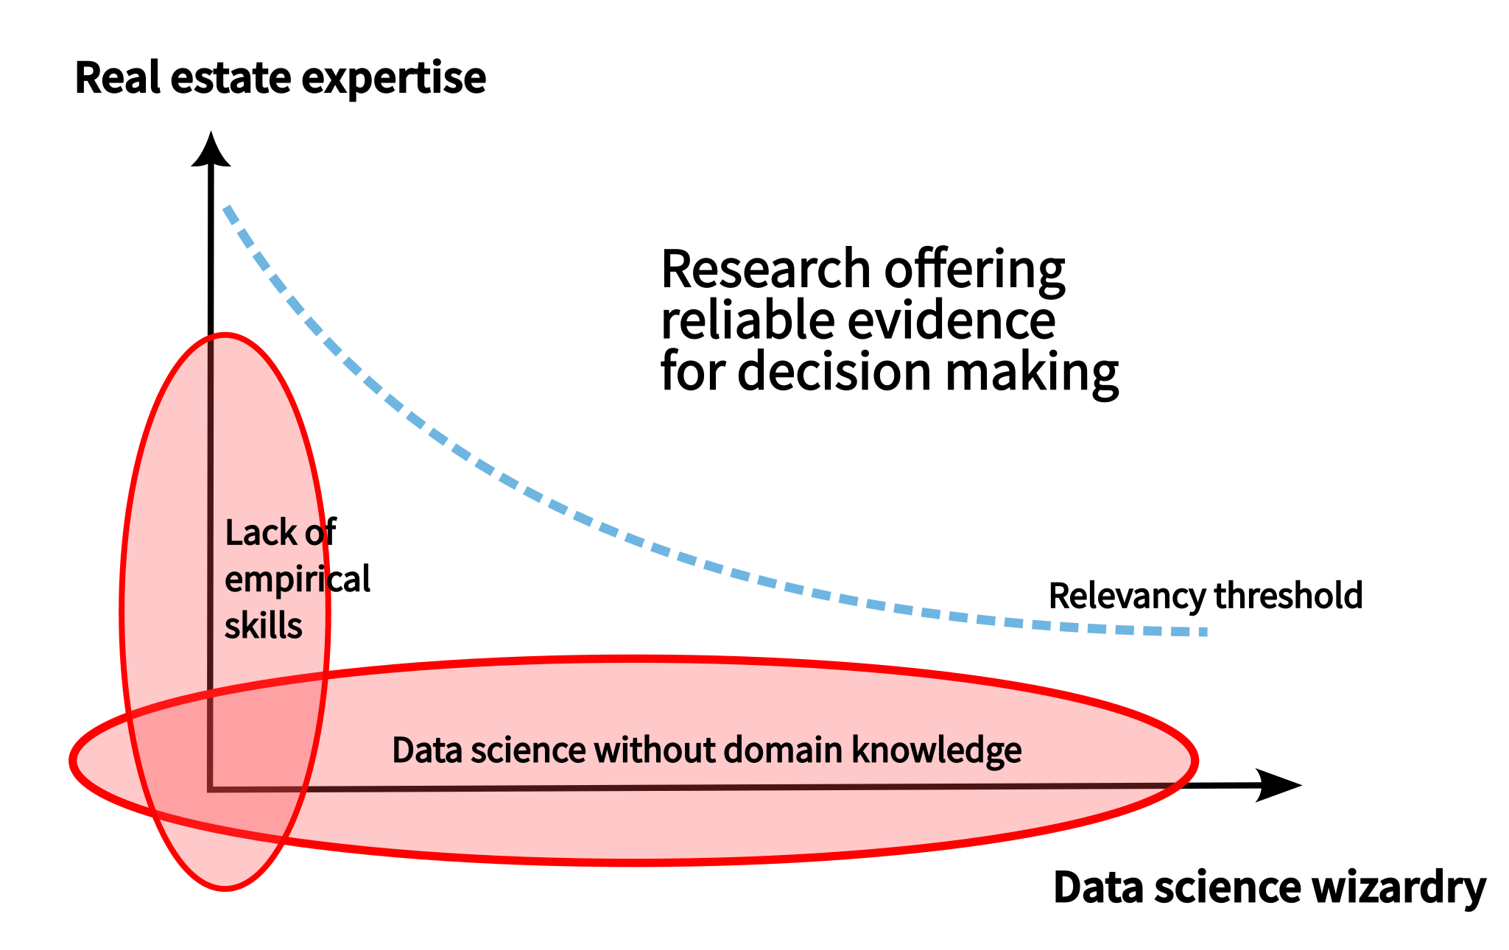
Machine Learning in Real Estate Works Best When Real
Estate Experts work with Tech Experts or Vice Versa
Optimal Applications
Complex patterns in high-dimensional data with large numbers of observations.
Analytical Power
Beyond traditional linear models
Data Requirements
Rich, complex datasets
Machine Learning truly shines when applied to high-dimensional data abundant in the built environment. The uniqueness of real estate assets often resists reduction into rigid spreadsheet formats. ML's power diminishes when applied to overly simplified data where relationships are linear. The combination of real estate expertise and empirical skills is needed for evidence base decision making.

Slide 10
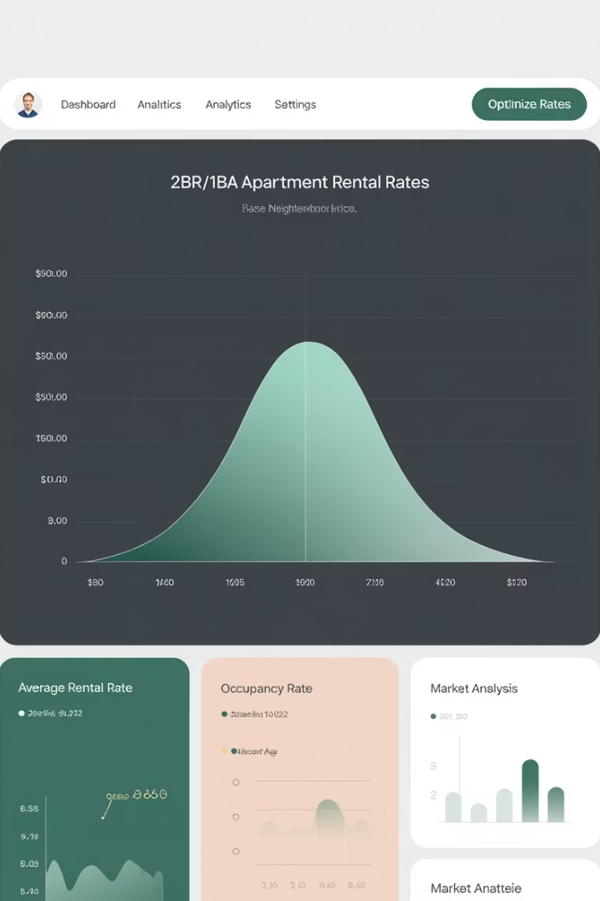
Real-Time Data and Dynamic Pricing Example
7M+
100K+
24/7
Housing Units
Data Points
Market Monitoring
Managed using RealPage software
Analyzed per market for pricing recommendations
Continuous analysis of rental trends
Real-time data collection enables dynamic pricing similar to hotels and airlines. This makes markets more efficient but raises questions about market power when many landlords rely on a single data provider.

Slide 11
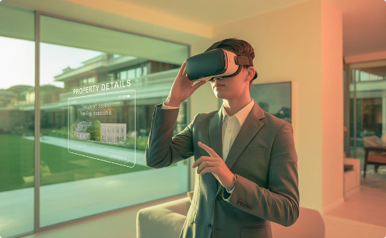


Marketing Technology
Virtual Touring
Listing Platforms
Augmented Reality
Self-guided digital property tours enable remote viewing and evaluation of spaces.
Comprehensive search engines with universal coverage and advanced filtering.
Overlay digital elements on physical spaces to visualize potential changes.

Slide 12
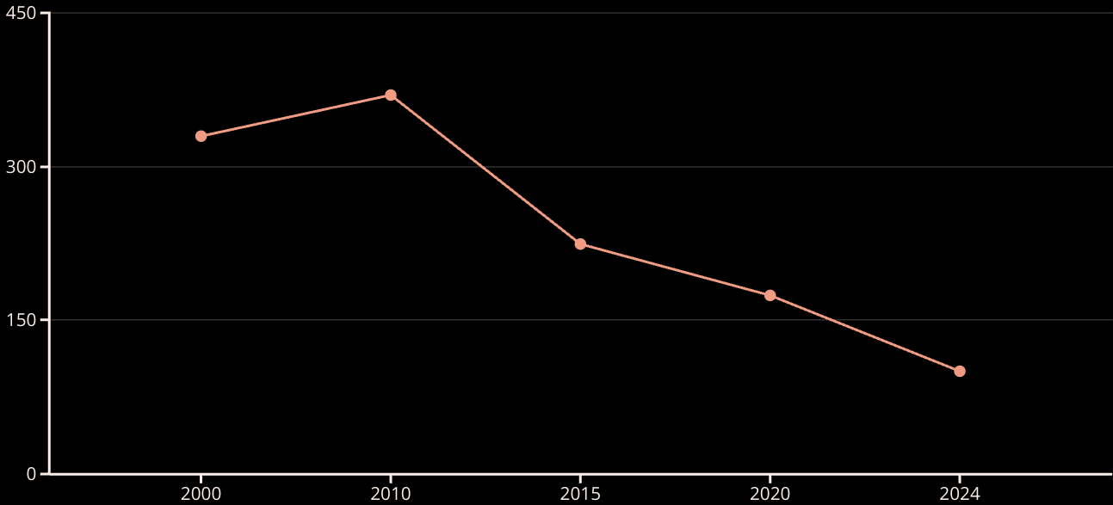
Technology for More Efficient Use of Space (Sq Ft Per Employee has been going down over time as we share standardized space and store everything digitally)
Since 2010, space per worker has steadily decreased with unassigned workstations and remote work. COVID accelerated work-from-home trends, flattening bid rent curves and benefiting secondary markets.

Slide 13
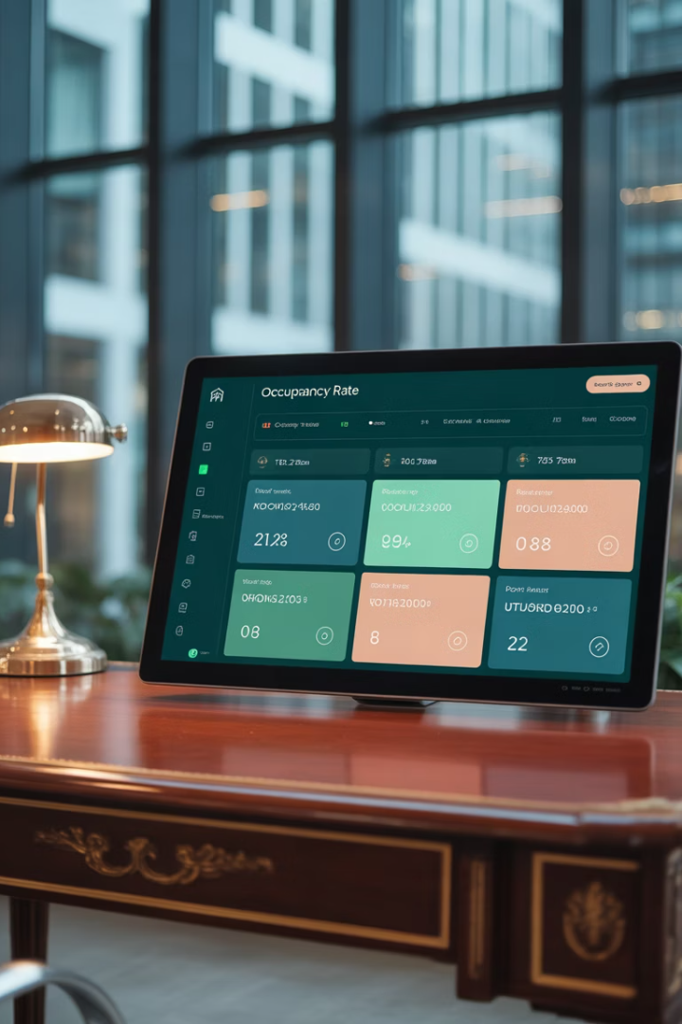




Occupancy Management Technology
Occupancy Monitoring
Space Reservation
Tenant Services
Apps allow booking of unassigned workstations and meeting rooms as needed.
Concierge applications provide amenities from childcare to restaurant reservations.
Sensors track building occupants to optimize energy use by turning off systems in empty areas.
Maintenance Management
Digital systems for reporting and scheduling repairs and maintenance tasks.

Slide 14
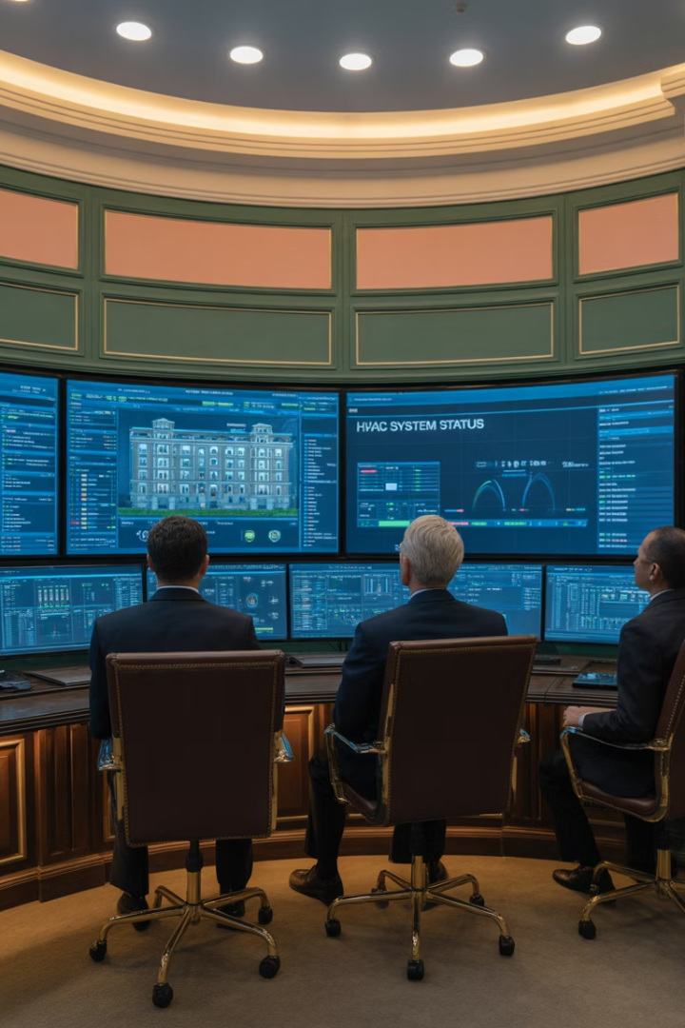




Building Management Systems
HVAC Control
Automated temperature and ventilation management based on occupancy and conditions.
Lighting Systems
Smart lighting that adjusts based on natural light and occupancy patterns.
Security Integration
Access control, cameras, and intrusion detection in one system.
Energy Management
Monitoring and optimization of power, water, and gas consumption.

Slide 15

Elevator Optimization Example
Data Collection
Pattern Analysis
Monitor which floors receive the most requests by minute and hour.
Create frequency tables of elevator
usage patterns.
Results
Optimization
Less waiting time and
reduced energy
consumption.
Position elevators at high-demand floors based on time patterns.

Slide 16
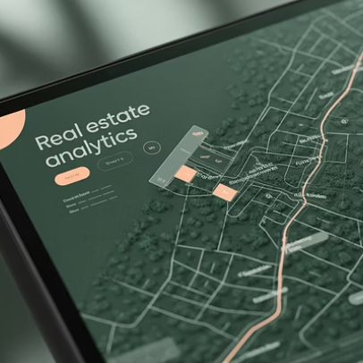
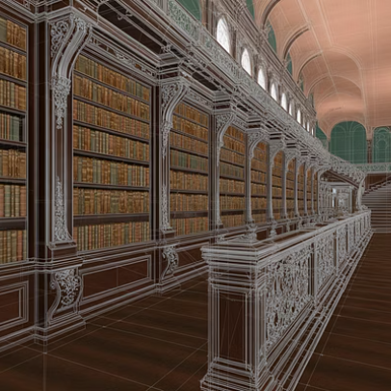
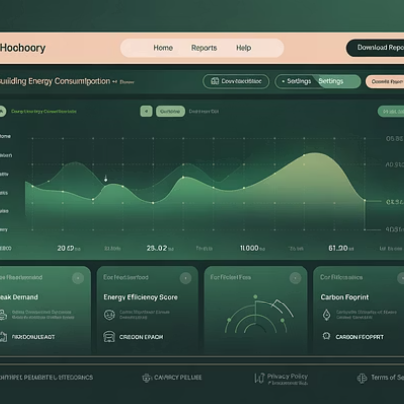

Measurement and Analysis Technology
Technology has revolutionized how we measure and analyze real estate. Geographic information systems, 3D scanning, energy monitoring, and security systems generate valuable data for decision-making.

Slide 17
Evolution of Ownership Forms Using Blockchain
Traditional Partnerships
REITs (1960s)
Syndications with general and limited partners, limited to a few hundred investors.
Real Estate Investment Trusts offering tax advantages and greater investor participation.
Crowdfunding (2013)
Tokenization (Most recent)
JOBS Act enabled smaller investors to participate in real estate investments.
Blockchain-based ownership allowing fractional interests and improved liquidity. It skips the need for local government recording of ownership interests.

Slide 18
Crowdfunding and Tokenization
Crowdfunding
Tokenization
Established by the JOBS Act in 2013, enabling smaller investors to participate in real estate.
Breaking properties into small digital ownership pieces using blockchain technology.
Platforms: RealtyMogul, CrowdStreet
Improved liquidity potential
Average investments: $4,000-$10,000
Lower transaction costs
Billions raised since inception
Fractional ownership
Smart contracts define rights
Market is still evolving and no significant secondary
currently exists.

Slide 19

Transaction Management Technology
Remote Closings
Automated Valuations
Electronic signatures and digital document management have eliminated the need for in-person closings with all parties present.
AVMs and CAVMs provide rapid property valuations without traditional appraisal delays for standard properties.
Virtual Due Diligence
Remote inspections using drones, virtual tours, and digital records reduce the need for physical presence.

Slide 20



The Future of Proptech is Bright
Mixed-Skills Teams
Successful proptech requires both domain experts who understand real estate and technical specialists with data science skills.
Integration Power
The transformative potential lies in multiple gradual improvements working together, not single innovations.
Market Efficiency
Better data and technology will continue to make real estate markets more transparent, efficient, and accessible.

