Slide 1

Present Value Mathematics for Real Estate
This presentation introduces the foundational mathematics of present value, a core concept for real estate valuation. We'll explore the time value of money, including discounting, compounding, and growth rates, with practical applications for real estate investment analysis.
NM

Slide 2

The Time Value of Money
Money Has Time Value
Real Productivity of Capital
Dollars today are worth more than dollars in the future, even without inflation.
Capital can be invested to generate returns over time.
Risk Considerations
Comparison Tool
Future dollars are less certain than present dollars.
Present value mathematics helps compare dollars at different points in time.

Slide 3





Single-Sum Formulas
Single-Period Discounting
PV = FV / (1 + r)
Single-Period Growing
FV = PV × (1 + r)
Multiple Periods
PV = FV / (1 + r)^N
Solving for Return
r = (FV/PV)^(1/N) - 1

Slide 4
Simple vs. Compound Interest
Simple Interest
Compound Interest
Interest calculated only on the initial principal.
Interest calculated on both principal and accumulated interest.
Example: $100 at 15% simple interest for 2 years = $130
Example: $100 at 15% compound interest for 2 years = $132.25
($100 + $15 + $15 = $130)
($100 × 1.15 × 1.15 = $132.25)

Slide 5

Effective vs. Nominal Rates
Nominal Annual Rate (i)
Effective Annual Rate (EAR)
Relationship
The stated annual interest rate without considering compounding frequency.
The actual annual yield after accounting for compounding frequency.
EAR = (1 + i/m)^m - 1, where m is the number of compounding periods per year.

Slide 6








Bond vs. Mortgage Equivalent Rates
Mortgage Equivalent
Bond Equivalent
Based on monthly compounding (m=12)
Based on semiannual compounding (m=2)
Common in real estate transactions
Standard in bond markets
Comparison
Conversion
Mortgage equivalent rates are lower than corresponding bond equivalent rates
Convert by equating the effective annual rates

Slide 7

Continuously Compounded Interest
Applications
Formula
Used in sophisticated financial analyses and certain banking products.
Definition
PV = FV × e^(-kT), where k is the continuously compounded rate and T is time in years.
Interest compounded at every instant rather than at discrete intervals.

Slide 8
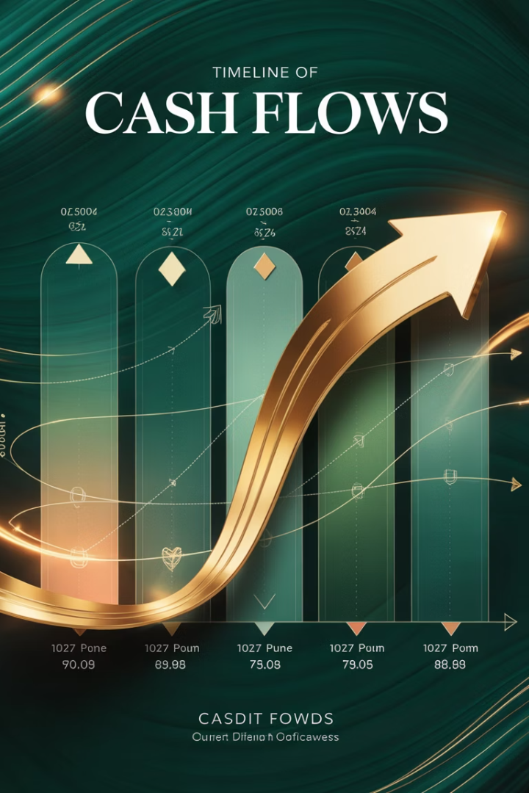



Multiperiod Cash Flows
Single Sums
Basic building blocks for all present value calculations.
Regular Patterns
Cash flows with consistent patterns allow for simplified formulas.
Combined Approach
Sum the present values of each future cash flow.

Slide 9

The Geometric Series Formula
The foundation for valuing annuities and perpetuities:
Where:
S
a
Sum of the series
First term in the series
d
N
Common ratio between terms
Number of terms

Slide 10
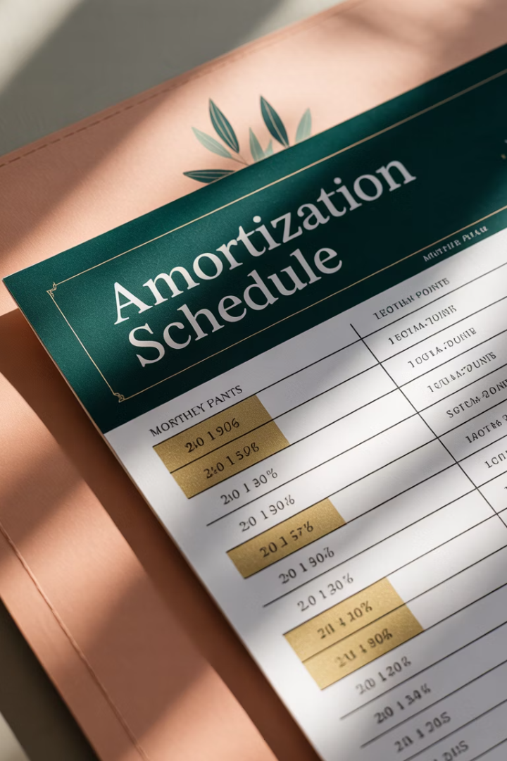



Level Annuity in Arrears
Definition
Equal payments made at the end of each period.
Formula
PV = PMT × [1 - 1/(1+r)^N] / r
Application
Classical mortgage payments structure.

Slide 11



Level Annuity in Advance
Definition
Equal payments made at the beginning of each period.
Formula
PV = PMT × (1+r) × [1 - 1/(1+r)^N] / r
Application
Common in rental payments and leases.

Slide 12





Constant-Growth Annuity
Growing Cash Flows
Each payment grows at a constant rate g
Formula
PV = CF₁ × [1-((1+g)/(1+r))^N] / (r-g)
Real Estate Application
Leases with escalation clauses

Slide 13

Constant-Growth Perpetuity
∞
CF₁
r-g
Infinite Time Horizon
Initial Cash Flow
Denominator
Starting point for growth
Difference between discount and growth rates
Cash flows continue forever
The formula simplifies to: PV = CF₁/(r-g)

Slide 14
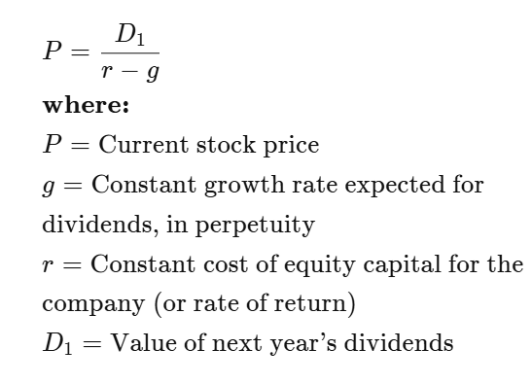
The Gordon Growth Model, GGM, aka Perpetuity Model Combines the current
income yield and growth rate and can be used to generate a cap rate, R, where
R = Discount Rate or Yield – Expected Growth Rate in Income
The total yield expected is approximately equal to the current income % plus the growth rate %.
GGM applied to Stocks
GGM applied to Real Estate
Value = NOI/(Discount Rate – Growth Rates of NOI)
The Gordon Growth Model applies the constant-growth perpetuity formula to value income-producing assets. For commercial real estate, it reveals that the cap rate equals the discount rate minus the growth rate (r-g).

Slide 15







Long-Term Leases
Intralease Rates
Interlease Rates
Lower risk due to contractual obligations
Higher risk due to market uncertainty
Two-Step Valuation
4
Building Value
Value each lease, then value the series of leases
Perpetuity of successive annuities

Slide 16
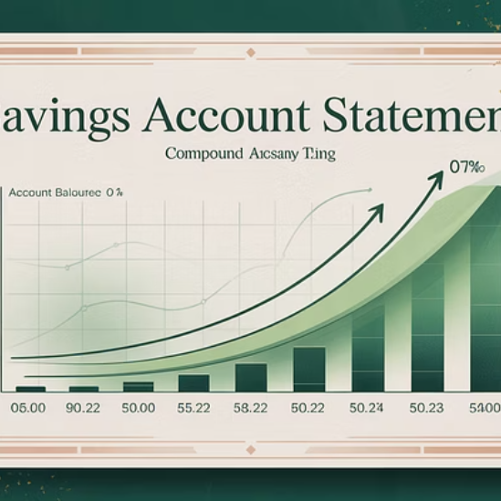

Future Value of Annuities
The future value of an annuity equals the present value multiplied by (1+r)^N. This calculation is useful for retirement planning, college savings, and other future financial goals.

Slide 17



Solving for Cash Flows
Mortgage Payments
Loan Amortization
Savings Goals
PMT = PV × r × (1+r)^N/[(1+r)^N-1]
Calculate payments needed to fully repay a loan over time.
Determine periodic contributions needed to reach a future value.

Slide 18

Mortgage Mathematics
Loan Type
Cash Flow Pattern
Formula Components
Fully Amortizing
Level annuity only
PV = PMT × [1-1/(1+r)^N]/r
Partially Amortizing
Annuity + balloon payment
PV = PMT × [1-1/(1+r)^N]/r + FV/(1+r)^N
Interest-Only
Interest payments + principal at end
PV = PMT × [1-1/(1+r)^N]/r + PV/(1+r)^N

Slide 19
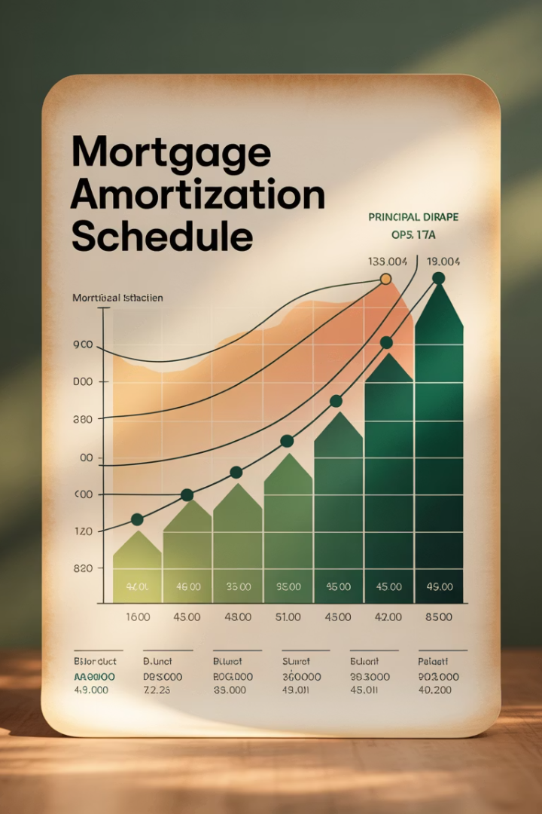
Outstanding Loan Balance
After q payments on a loan with monthly payment PMT, the outstanding loan balance is:
$80,000
$822.89
$74,734
Original Loan
Monthly Payment
Balance After 10 Years
30-year mortgage at 12%
Fixed for the life of the loan
Still 93% of original principal

Slide 20




Key Takeaways
Time Value Fundamentals
Money has time value due to productivity of capital and risk.
Formula Flexibility
Single-sum formulas are building blocks for complex cash flow patterns.
Real Estate Applications
Present value mathematics is essential for property valuation and investment analysis.
Cap Rate Insights
The perpetuity model reveals cap rate equals discount rate minus growth rate.

