Slide 1

Measuring Investment Performance: The Concept of Returns
This presentation explores how return and risk are measured in real estate investment analysis. We'll cover the basic building blocks of investment performance measurement, including periodic returns, multiperiod returns, and how to account for risk and inflation.

Slide 2
Two Fundamental Types of Return Measures
Periodic Returns (HPR)
Multiperiod Returns (IRR)
Measure investment growth within single periods, assuming cash flows occur only at beginning and end.
Give a single return number for longer periods with intermediate cash flows.
Used for short, regular periods (daily, monthly, quarterly, annually).
Don't require knowing asset values at intermediate points.

Slide 3

Time-Weighted vs. Money-Weighted Returns
Time-Weighted Return (TWR)
Money-Weighted Return (IRR)
Averages periodic returns across time, ignoring the size of cash flows.
Reflects different amounts of money invested at different times.
Insensitive to timing of capital flows, making it ideal for evaluating investment managers without control over cash flow timing.
Better for evaluating managers with control over capital flow timing.
When to Use Each
TWR: For macro-level analysis, comparing asset classes, evaluating managers without cash flow control.
IRR: For individual properties, development projects, evaluating managers with cash flow control.

Slide 4




Components of Total Return
Income Return
Appreciation Return
Total Return
Cash flow paid to owner during period as fraction of asset value.
Change in asset market value during period as fraction of initial value.
Sum of income and appreciation returns.
The total return is the most important measure because it's more complete than either component alone. Converting between yield and growth is possible but may be more difficult with real property than with financial securities.

Slide 5

Calculating Periodic Returns
Total Return Formula
Where CF_t is cash flow during period t, V_t is asset value at end of period, and V_{t-1} is value at beginning.
Income Return
y_t = CF_t / V_{t-1}
Appreciation Return
g_t = (V_t - V_{t-1}) / V_{t-1}
Key Relationship
r_t = y_t + g_t

Slide 6
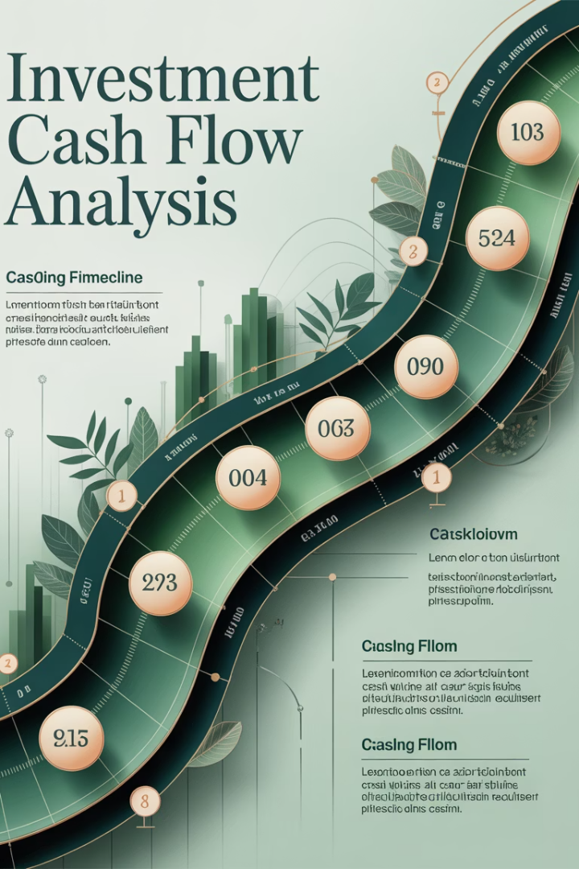

Time-Weighted Investment
When cash flows occur within periods, we need to adjust the simple HPR formula:
$100
$10
10.71%
Beginning Value
Cash Flow
Adjusted Return
Asset worth at start of quarter
Paid at end of first month
Using time-weighted denominator

Slide 7








Real vs. Nominal Returns
Nominal Return
Inflation
Return measured in current dollars, including inflation
Loss of purchasing power as prices rise over time
Relationship
Real Return
Real Return ≈ Nominal Return - Inflation Rate
Return net of inflation, measured in constant-purchasing-power dollars

Slide 8

Example: Real vs. Nominal Returns
2023 Property value
$1,000,000
2024 Cash flow
$80,000
2024 Property value
$1,020,000
2024 Inflation
3.33%
10%
6.46%
-1.29%
Nominal Return
Real Return
Real Appreciation
Income (8%) + Appreciation (2%)
After adjusting for inflation
Property value didn't keep pace with inflation

Slide 9








Measuring Risk in Returns
Standard Deviation
Most widely used measure of investment risk
Volatility
Dispersion of returns around expected return
Normal Distribution
Approximates shape of typical return distributions
Quantification
Higher standard deviation means greater risk

Slide 10
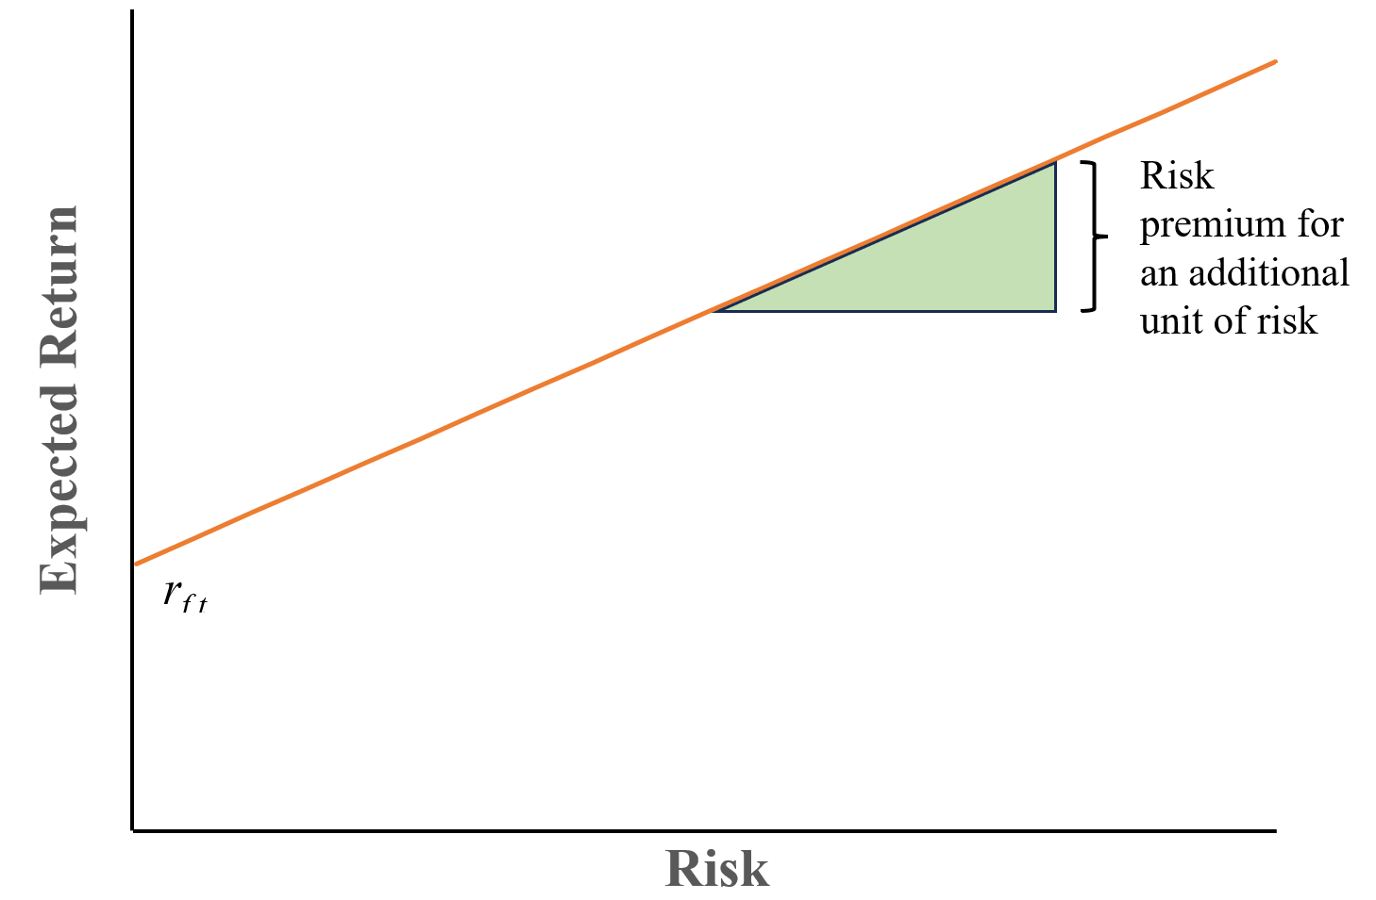
Risk Premiums: Capital Market Line
Return %
Asset A (No Risk)
Asset B (Low Risk)
Asset C (High Risk)
Asset A has a certain 10% return (standard deviation = 0%). Asset B has an expected return of 10% with 1% standard deviation. Asset C has an expected return of 10% with 5% standard deviation, meaning returns could range from -3% to 23%.

Slide 11
Risk Distribution Examples: Where Asset A has no risk and Asset C has high risk.
Asset A has a certain 10% return (standard deviation = 0%). Asset B has an expected return of 10% with 1% standard deviation. Asset C has an expected return of 10% with 5% standard deviation, meaning returns could range from -3% to 23%.

Slide 12
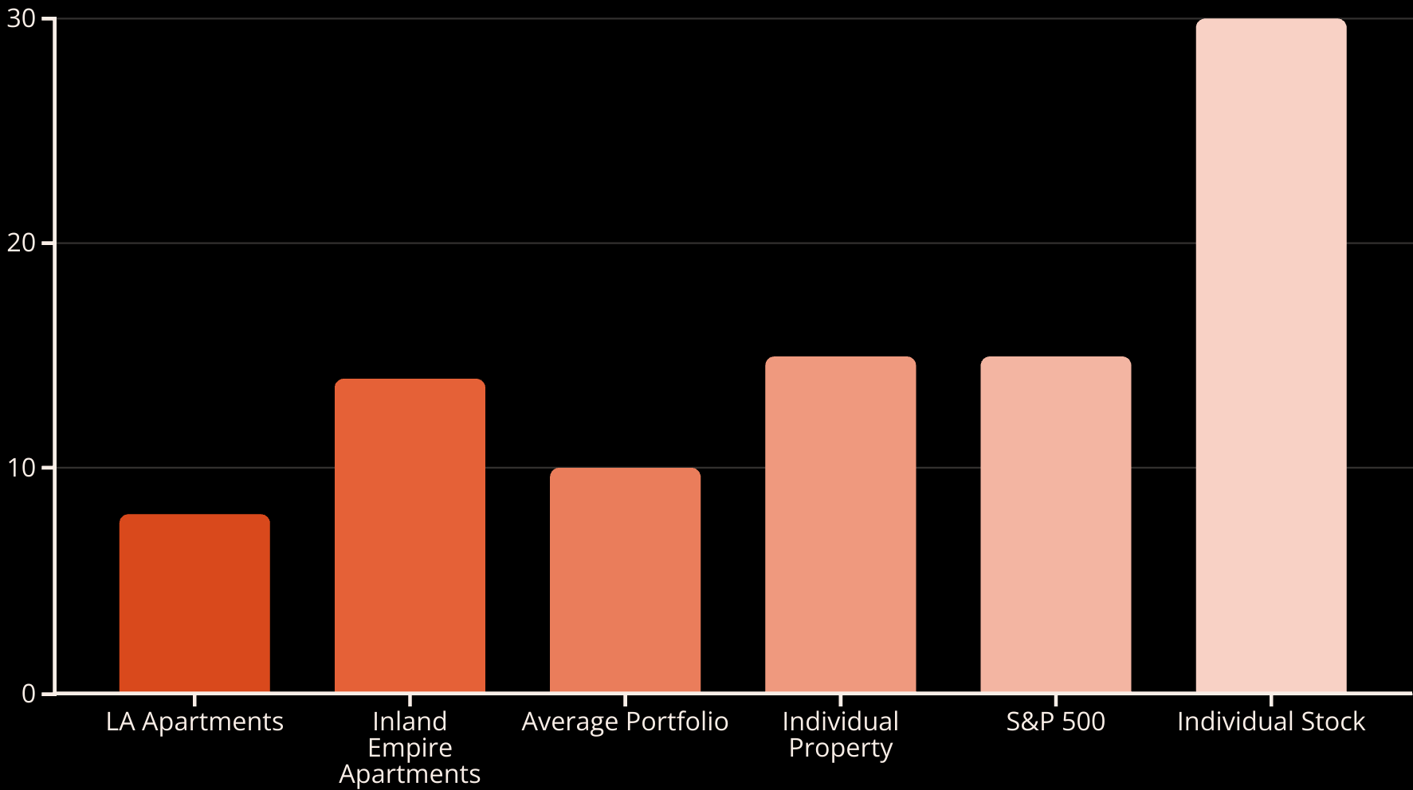
Volatility in Commercial Real Estate Based on Standard Deviations
of Historical Returns
Volatility varies by market and property type. A diversified real estate portfolio typically has around 10% annual volatility, while individual properties have higher volatility at 15% or more.

Slide 13



Relationship Between Risk and Return
Risk-Free Rate
Return from riskless assets like government bonds
Risk Premium
Additional return required for taking on risk
Risk-Return Tradeoff
Higher expected returns come with higher risk
This fundamental principle of financial economics states that expected returns are greater for riskier assets. Investors require compensation for taking additional risk.

Slide 14
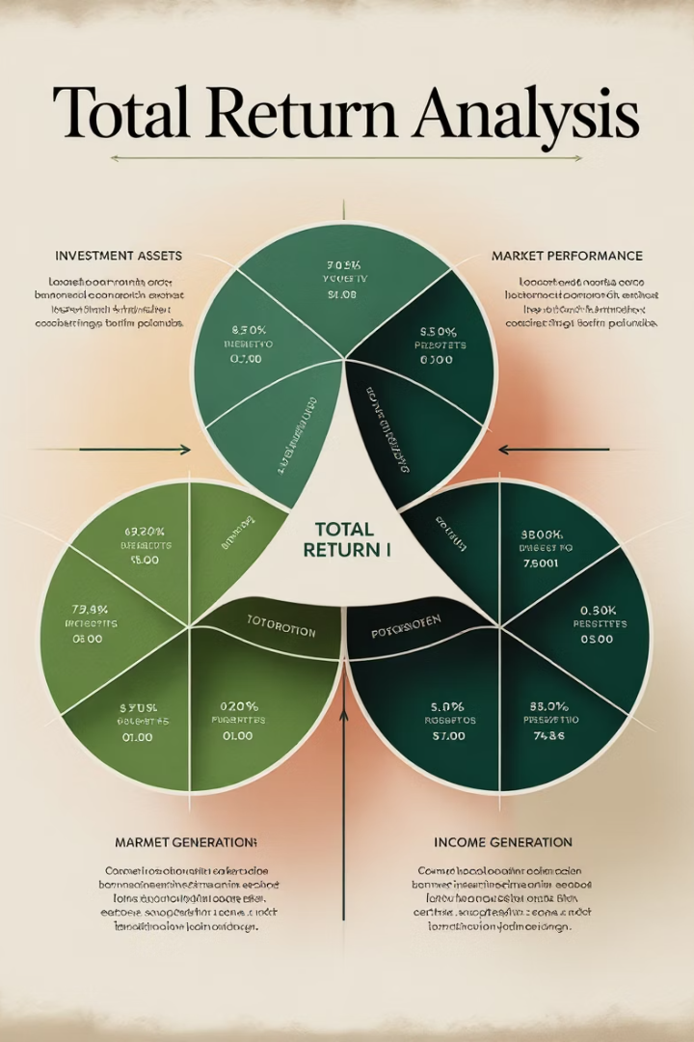
Three Ways to Break Down Total Return
1
Income + Growth
r = y + g
Total return equals income return plus appreciation return
2
Risk-Free Rate + Risk Premium
r = rf + RP
Total return equals risk-free rate plus risk premium
3
Real Return + Inflation
r = R + i
Total return approximately equals real return plus inflation
These three breakdowns provide different perspectives on investment returns, helping investors understand the sources of their returns and make better decisions.

Slide 15
Time-Weighted Average Return
Arithmetic Mean
Geometric Mean
Simple average of periodic returns
Reflects compounding of returns
Best for forecasting future returns
Better represents growth rate over time
Components sum to total return
Independent of volatility
Affected by volatility
Components don't sum to total
Example: (10% + 10% + 13%) ÷ 3 = 11%
Example: (1.10 × 1.10 × 1.13)^(1/3) - 1 = 10.99%

Slide 16
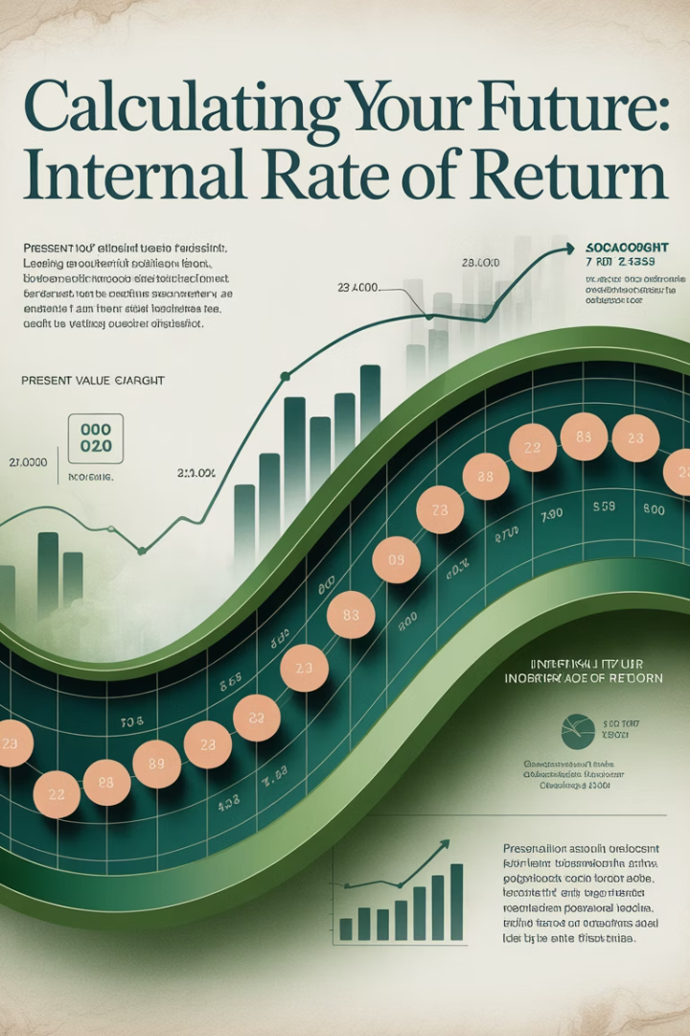




Internal Rate of Return (IRR)
The IRR is the discount rate that makes the net present value of all cash flows equal to zero:
Classical Measure
No Intermediate Values
Timing Sensitive
Traditional performance measure in real estate investment
Doesn't require knowing property values between purchase and sale
Captures effect of capital flow timing on performance
Money-Weighted
Reflects amount of capital invested during each period

Slide 17

IRR Example: Timing Impact
Year 1: 10% Return
Year 3: 13% Return
Initial $100 investment grows to $110
Different scenarios based on cash flow timing
1
2
3
Year 2: 10% Return
$110 grows to $121
11.69%
10.60%
10.99%
Add $200 in Year 3
Withdraw Half in Year 3
No Changes
IRR exceeds time-weighted return
IRR below time-weighted return
IRR equals geometric mean

Slide 18






IRR Characteristics
Internal Measure
Includes only returns earned while capital is invested in the project
Cash Flow Based
Based purely on cash flows, not differentiating between investment and return
Timing Blind
Doesn't indicate when return was generated within the overall time span
Special Case
Equals time-weighted return when no intermediate cash flows occur
In real estate appraisal, IRR is often called "total yield." The expected IRR when investing is called the "going-in IRR."

Slide 19








Choosing the Right Return Measure
Purpose
Available Data
What are you trying to measure?
What information do you have?
Comparability
Control
What are you comparing against?
Who controls capital flow timing?
The choice between TWR and IRR depends on your specific situation. Consider who controls capital flows, what data is available, and what you're trying to measure.

Slide 20
Real Estate Return Volatility Drivers
Income Return Stability
Appreciation Return Volatility
A 20% drop in property value directly translates to a
20% decrease in appreciation return.
Income returns are typically more stable
than appreciation returns.
Asset values are the primary driver of return volatility
in normal markets.
And leveraged property will result in more sensitivity
to appreciation or depreciation.
Example: A 20% drop in income ($100,000 to $80,000) on a $2M property only reduces income return from 5% to 4%.
A property with 75% leverage that declines in value by 25% will wipe all 100% of the equity.
Asset Value Changes
Income Fluctuations
Other Factors

Slide 21
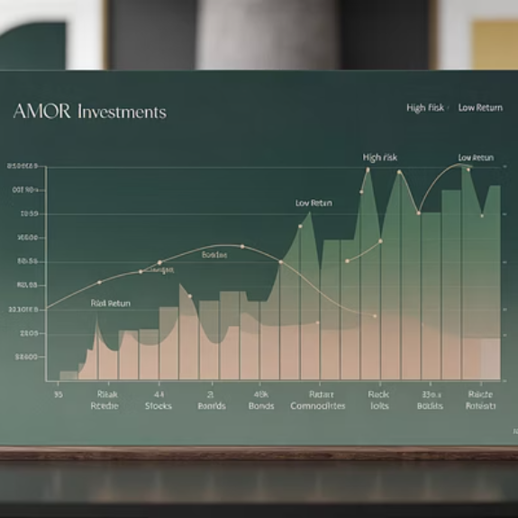

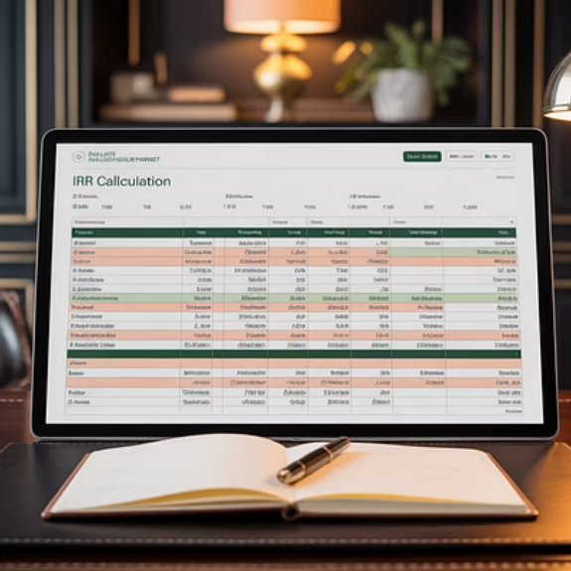
Key Takeaways
1
Two Return Types
2
Return Components
Periodic returns (HPR) and multiperiod returns (IRR) serve different purposes.
Total return can be broken down into income and appreciation, risk-free rate and risk premium, or real return and inflation.
Risk-Return Relationship
Measure Selection
3
Higher expected returns come with higher risk - the fundamental principle of financial economics.
4
Choose between TWR and IRR based on purpose, available data, control over cash flows, and comparability needs.

