Slide 1

Micro-Level Valuation of Real Estate: DCF & NPV
At the micro-level of real estate investment, the primary question is: How much is the asset worth? Each side in a potential deal will be willing to "do the deal" at some price. We'll explore how to determine that price using three fundamental economic principles: opportunity cost, market equilibrium, and wealth maximization.

Slide 2

The Link Between Returns and Property Values
Inverse Relationship
The prices investors pay for properties determine their expected returns. Future cash flow is independent of today's purchase price.
Market Factors
Future rents are determined by supply and demand in the space market, not by your purchase price.
Avoiding Bubbles
The "Greater Fool Theory" leads to disconnection between asset prices and cash flow potential, creating price bubbles.

Slide 3

The Discounted Cash Flow Model
Discount Cash Flows to Present Value
Ascertain Required Total Return
Forecast Expected Future Cash Flows
Apply the discount rate to convert future cash flows to present value.
Determine the appropriate discount rate based on risk and opportunity cost.
Predict the net cash flows the property will generate over time.

Slide 4




DCF Formula and Application
The DCF formula calculates property value by summing all discounted future cash flows:
Cash Flows (CF)
Net cash flow generated by the property in each period.
Discount Rate (r)
Expected average multiperiod total return, the opportunity cost of capital.
Terminal Period (T)
Final period including terminal value from property sale.

Slide 5

Numerical Example: Office Building Valuation
Year
2024
2025
2026
2027
2028
2029
Cash Flow
$1,000,000
$1,000,000
$1,000,000
$1,500,000
$1,500,000
$16,500,000
With an 8% discount rate, this property's estimated market value is $15,098,000. At this price, the buyer gets an expected 8% return. A lower price would yield a higher return for the buyer but be unfair to the seller.

Slide 6

Single Blended Discount Rate
Different Risk Levels
Intralease vs. Interlease
In theory, cash flows with different risk levels should be discounted at different rates. Contractual lease payments have lower risk than future market rents.
Intralease discount rate applies to contractual cash flows. Interlease rate applies to future leases and reversion, reflecting higher risk.
Practical Simplification
In practice, a single blended rate is typically used for all cash flows, especially for properties with multiple leases expiring at different times.

Slide 7








Cash Flow Growth Rate Simplification
Constant Growth Rate
Formula Application
Using a single growth parameter (g) simplifies forecasting.
E₀[CFₜ] = CF₀(1+E₀[g])ᵗ
Risk Adjustment
Long-Run Average
Uncertainty in cash flows is captured by the discount rate, not the forecast.
Cash flows fluctuate short-term but tend to revert to long-run averages.

Slide 8

Real Estate as a Perpetual Investment
Long-Lived Assets
Real estate is extremely long-lived. Buildings may be demolished, but land remains and new structures are built. Even cities destroyed in war are typically rebuilt.
Commercial real estate in central urban areas has proven remarkably durable throughout history.
The mathematical impact of distant cash flows diminishes significantly in present value calculations. Cash flows beyond 60 years contribute minimally to current value.

Slide 9



Terminal Value and Gordon Growth Model
Terminal Value Concept
The expected sales price of the property at the end of the holding period.
Gordon Growth Model
Note that the going in cap rate is approximately equal to the total yield less the growth rate of the income flow.
V = CF₁/(r-g)
Direct Capitalization
Dividing first year's cash flow by the cap rate (r-g).
The Gordon Growth Model provides an elegant formula for valuing a perpetual cash flow stream. A property with higher initial cash flow, higher growth rate, or lower discount rate will be more valuable.

Slide 10

Cap Rate vs. Discount Rate
8%
2%
6%
Discount Rate
Growth Rate
Cap Rate
Total return including growth
Expected annual increase
Discount rate minus growth
In real estate practice, the cap rate is not the same as the discount rate. The cap rate equals the discount rate minus the long-run expected growth rate (r-g). This represents the current cash yield of the property.

Slide 11
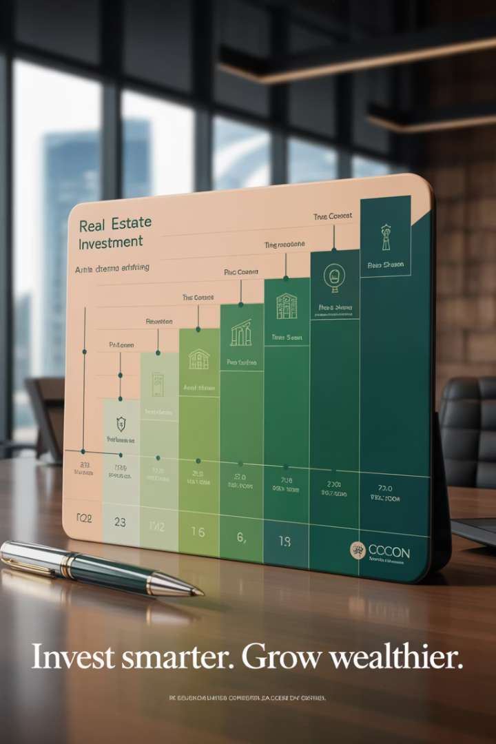
Multiperiod Analysis Horizon
Choosing Terminal Period
The final period in analysis is typically 5, 7, or 10 years, modeled as if the property would be sold then.
No Commitment Required
The property need not actually be sold at that time; it's simply the horizon for analysis.
Value Independence
Changing the final period doesn't impact the current value of the investment.
Appraisal Terminology
Direct capitalization often corresponds to the "market method" while multiperiod DCF corresponds to the "income method."

Slide 12






Terminology Clarification
Opportunity Cost of Capital (OCC)
Expected return in the market for similar risk investments. Gives economic meaning to the discount rate.
Discount Rate
Internal Rate of Return (IRR)
A mechanical term used to translate value amounts across time. No specific economic meaning by itself.
The discount rate that equates future cash flows to present value. Can be used ex-ante ("going-in") or ex-post.
In a DCF valuation, the discount rate, OCC, and going-in IRR will all be the same if the present value equals the market value of the property.

Slide 13

The NPV Investment Decision Rule
Rule Components
Wealth Maximization
1. Maximize NPV across all mutually exclusive alternatives.
The NPV rule is based directly on the fundamental wealth maximization principle. Any other rule leaves money on the table.
2. Never choose an alternative with NPV < 0.
Formula Application
If buying: NPV = V - P
If selling: NPV = P - V
Where V is property value and P is price.

Slide 14




Zero NPV Deals Are Acceptable
Normal Profit Included
Market Equilibrium
Buyer-Seller Balance
Zero NPV doesn't mean zero profit. The discount rate includes the normal expected return.
In well-functioning markets, most deals will have approximately zero NPV from a market value perspective.
For both buyer and seller to benefit, the NPV must be zero for both sides.

Slide 15
Choosing Among Zero-NPV Investments
Investment Value vs. Market Value
Other Considerations
A property may have higher value to a specific investor due to unique abilities or synergies with other properties.
Portfolio diversification objectives
Expertise in specific markets
This creates positive NPV from the investor's perspective even when market value NPV is zero.
Target investment amounts
Preferred business relationships
Information quality differences

Slide 16




Hurdle Rate Decision Rule
Maximize IRR Difference
Choose projects with highest spread between expected IRR and required return.
Minimum Threshold
Never do deals with expected IRR less than required return.
Equivalent to NPV
Typically gives same results as NPV rule when applied properly.
The hurdle rate is the minimum acceptable rate of return for an investment, equivalent to the opportunity cost of capital including risk premium.

Slide 17






Potential Issues with Hurdle Rate Rule
Scale Differences
Ignores project size when comparing alternatives
Risk Adjustment
May not properly account for different risk levels
Mathematical Issues
IRR can be indeterminate in some cash flow patterns
Example: Project A ($15M investment, 15% IRR) creates more wealth than Project B ($5M investment, 20% IRR) despite lower percentage return. NPV of Project A is $2.5M versus $1.67M for Project B.

Slide 18
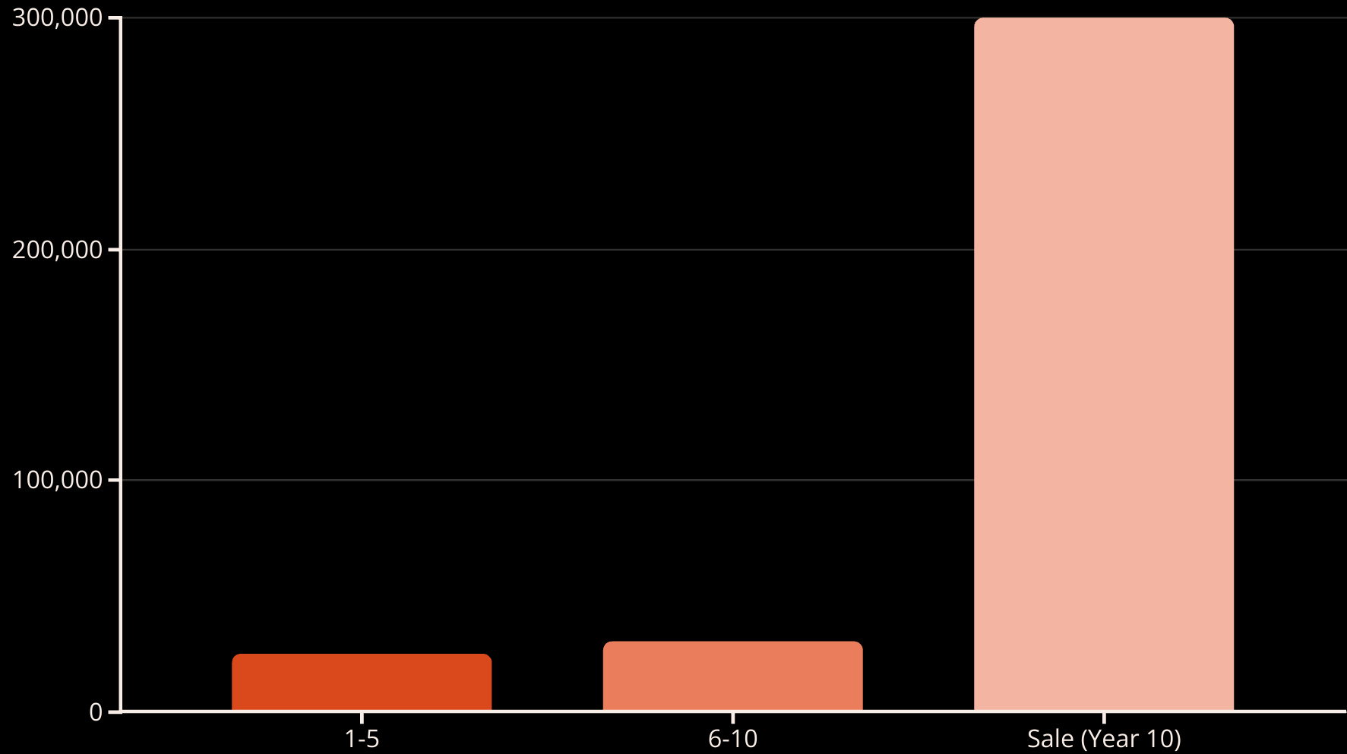
Numerical Example: Summit Heights Plaza with a $260,000 purchase price.
Present Value of these flows is $248,075 when a 12% return is required.
Projected Sale Price of $300,000
$25,000 per year
$30,000 per year
With a 12% required return, the present value is $248,075. At an asking price of $260,000, the NPV is -$11,925, indicating the investment falls short of the required return. The IRR at this price is 11.24%.

Slide 19

Sensitivity Analysis
6.36%
2.65%
11.24%
Discount Rate Impact
Growth Rate Impact
Actual IRR
At $260,000 purchase price
Value increase when rate drops from 12% to 11%
Value increase with 25% vs. 20% growth after year 5
Small changes in key assumptions can significantly impact property valuation. A one percentage point decrease in discount rate increases value by 6.36%, while higher cash flow growth increases value by 2.65%.

Slide 20
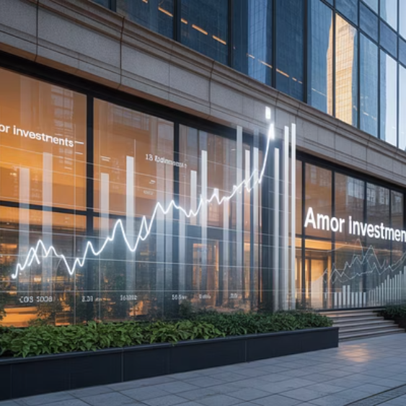
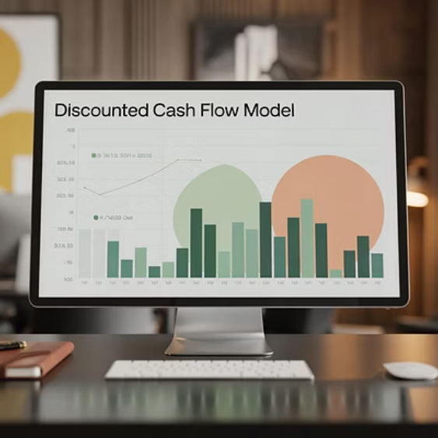
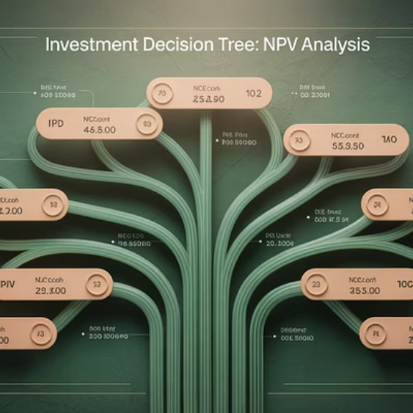
Key Takeaways
Value-Return Relationship
DCF Fundamentals
Decision Rules
Property prices determine expected returns because future cash flows are independent of purchase price.
Forecast cash flows, determine discount rate, apply Gordon Growth Model for terminal value.
Use NPV or hurdle rate rules to maximize wealth, remembering that zero-NPV deals are acceptable.

