Slide 1

Property Income Analysis: Nuts and Bolts
This presentation explores how property income is analyzed in commercial real estate investments. We'll examine cash flow components, understand rent determination, and learn how to evaluate property-level performance.

Slide 2

The Proforma: Foundation of Investment Analysis
Definition
A detailed forecast of property cash flows, typically projected over 5-10 years.
Importance
The single most important document when analyzing commercial real estate investments.
Purpose
Provides the numerator in DCF evaluation - the forecasted net cash flows.
Components
Contains operating cash flows (regular income) and reversion cash flows (from property sale).

Slide 3








Operating Cash Flow Components
Potential Gross Income (PGI)
Maximum possible rental income if fully occupied
Effective Gross Income (EGI)
PGI minus vacancy allowance
Net Operating Income (NOI)
EGI plus other income minus operating expenses
Property-Before-Tax Cash Flow (PBTCF)
NOI minus capital expenditures

Slide 4
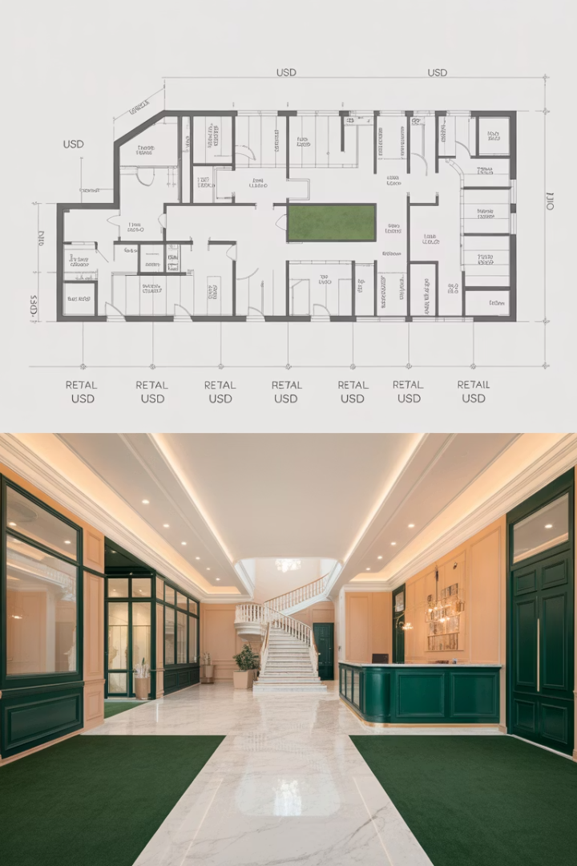
Potential Gross Income (PGI)
Definition
Calculation
The maximum rental income a property could generate if fully leased at market rates.
Rentable area (square feet) multiplied by rent per unit of space.
Also Known As
Often called the "rent roll," especially in multi-tenant properties with long-term leases.

Slide 5
Building Area Measurements and Terms
Construction Gross Area (CGA)
1
Includes all occupiable and non-occupiable spaces.
Gross Area (GA)
2
Like CGA but excludes non-occupiable spaces.
Rentable Area (RA) aka Leasable Area
3
Tenant's area plus share of common spaces.
Net Assignable Area (NAA)
4
Spaces specifically assigned to people or programs.

Slide 6
Vacancy and Effective Gross Income
Vacancy Allowance
Effective Gross Income (EGI)
Properties cannot realistically be fully leased at all times. Vacancy allowance accounts for expected vacant periods.
EGI = PGI - Vacancy Allowance
Represents the actual rental income expected after accounting for vacancy.
For apartments: typically calculated as a percentage of PGI (e.g., 5%).
May also include a collection allowance (0.5-1.5%) for tenant defaults.
For commercial: often forecast for each rental unit based on lease expirations.

Slide 7





Other Income Sources
Parking Operations
Vending & Laundry
Billboard & Antenna Rental
Solar Energy
Income from selling excess electricity generated by solar panels.
Revenue from parking facilities in office or retail buildings.
Income from machines in apartment buildings.
Revenue from renting roof or exterior space.

Slide 8










Operating Expenses (OpEx)
Utilities
Property Management
Water, electricity, gas, internet
2-10% of EGI depending on property size
Insurance
Property and liability coverage
Property Taxes
Local government assessments
Maintenance & Repair
Regular upkeep of the property

Slide 9
Fixed vs. Variable Expenses
Fixed Expenses
Variable Expenses
Costs that remain the same regardless of occupancy levels.
Costs that change in proportion to occupancy levels.
Utilities
Property taxes
Cleaning services
Insurance premiums
Some maintenance costs
Some maintenance contracts

Slide 10
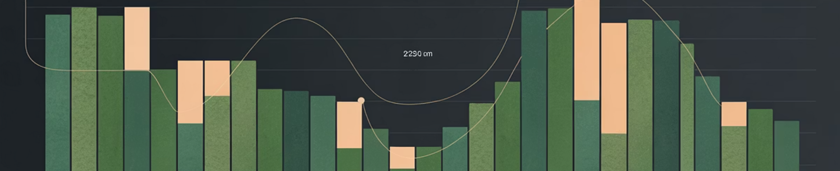
Net Operating Income (NOI) % of PGI, example:
100%
92%
67%
45%
PGI
EGI
NOI
PBTCF
Potential Gross Income
After 8% average vacancy
After operating expenses
After capital expenditures

Slide 11





Capital Improvement Expenditures (CapEx)
Building Improvements
Tenant Improvements (TIs)
Major expenditures that maintain or add value to the property over the long term.
Customized physical improvements provided to tenants when signing leases.
Leasing Commissions
Timing Characteristics
Fees paid to brokers for securing tenants, typically 1-8% of lease value.
Occur less frequently and at irregular intervals, with considerable owner discretion.

Slide 12




Property-Before-Tax Cash Flow (PBTCF)
NOI
Net Operating Income
Subtract
Capital Expenditures
Equals
PBTCF
PBTCF represents the true free-and-clear cash flow available to property owners before debt service and income taxes.

Slide 13

Reversion Cash Flows
Definition
Components
Cash flows that occur when the property is sold, typically at the end of the holding period.
Expected resale price minus selling expenses such as broker fees and transaction costs.
Importance
Must be included in any complete investment analysis, even if there are no immediate plans to sell.

Slide 14

Forecasting Property Value at Sale
Project Future NOI
Forecast the NOI for one year beyond the analysis period (e.g., Year 11 in a 10-year analysis).
Determine Terminal Cap Rate
Estimate the appropriate cap rate at time of sale (going-out cap rate).
Calculate Terminal Value
Divide the projected NOI by the terminal cap rate: TV = NOI ÷ Cap Rate.
Subtract Selling Costs
Deduct selling expenses (typically 2.5-10% of sale price) to find net proceeds.

Slide 15
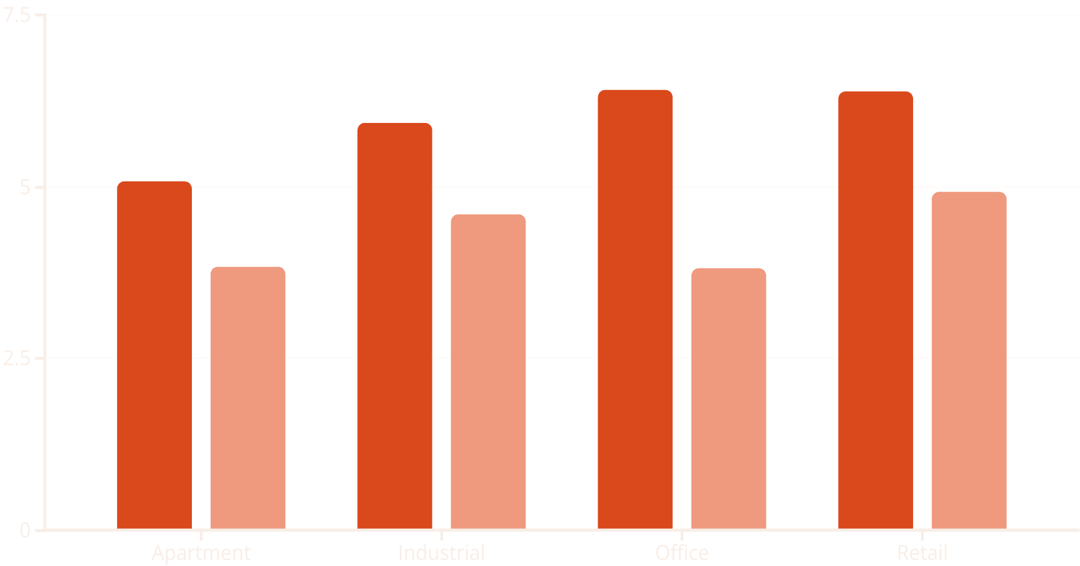
Cap Rates vs. Income Yields
Cap Rate
Income Yield
Cap rates (NOI/Value) are typically higher than income yields (PBTCF/Value) due to capital expenditures. The gap is smallest for industrial properties, which often have lower CapEx requirements.

Slide 16





Selling Expenses
Property Assessment
Appraisal
Brokerage Fees
Professional valuation to set realistic asking price.
1-8% of selling price depending on property size and type.
Engineering firms evaluate the property's condition.
Closing Costs
Legal fees and title clearance expenses.
Total selling costs typically range from 2.5% to 10% of the sales price, with larger properties having relatively lower percentage costs.

Slide 17

Sample Proforma Cash Flow Projection
Year
1
2
3
4
5
PGI
$103,000
$106,090
$109,273
$112,551
$115,927
Vacancy
$5,150
$5,305
$5,464
$5,628
$5,796
OpEx
$20,600
$21,218
$21,855
$22,510
$23,185
NOI
$77,250
$79,568
$81,955
$84,413
$86,946
CapEx
$15,450
$15,914
$16,391
$16,883
$17,389
PBTCF
$61,800
$63,654
$65,564
$67,531
$69,556
This sample shows a 5-year projection with 3% annual growth in PGI, 5% vacancy rate, and OpEx at 20% of PGI. CapEx is 20% of NOI.

Slide 18





Discounted Cash Flow Valuation
Project Cash Flows
Forecast PBTCF for each year of the holding period.
Estimate Terminal Value
Calculate property value at sale using cap rate method.
Determine Discount Rate
Find appropriate opportunity cost of capital.
Calculate Present Value
Discount all cash flows and sum to find property value.

Slide 19












Key Inputs for Property Valuation
OpEx & CapEx Estimates
Discount Rate (r)
Opportunity cost of capital
Projected property expenses
Terminal Cap Rate
Growth Rate (g)
Expected increase in rental income
Cap rate at time of property sale
Current PGI & Vacancy
Starting point for cash flow projections
Selling Costs
Expenses associated with property sale

Slide 20

Summary: Property Income Analysis
Proforma Construction
Building accurate cash flow projections is fundamental to sound investment decision-making.
Key Sensitivities
Property valuation is most sensitive to rent growth assumptions, terminal cap rate, and discount rate.
Cash Flow Components
Understanding the relationship between PGI, EGI, NOI, and PBTCF is essential for accurate analysis.
Looking Forward
Next chapters will explore how to forecast rental growth and understand market dynamics.

