Slide 1
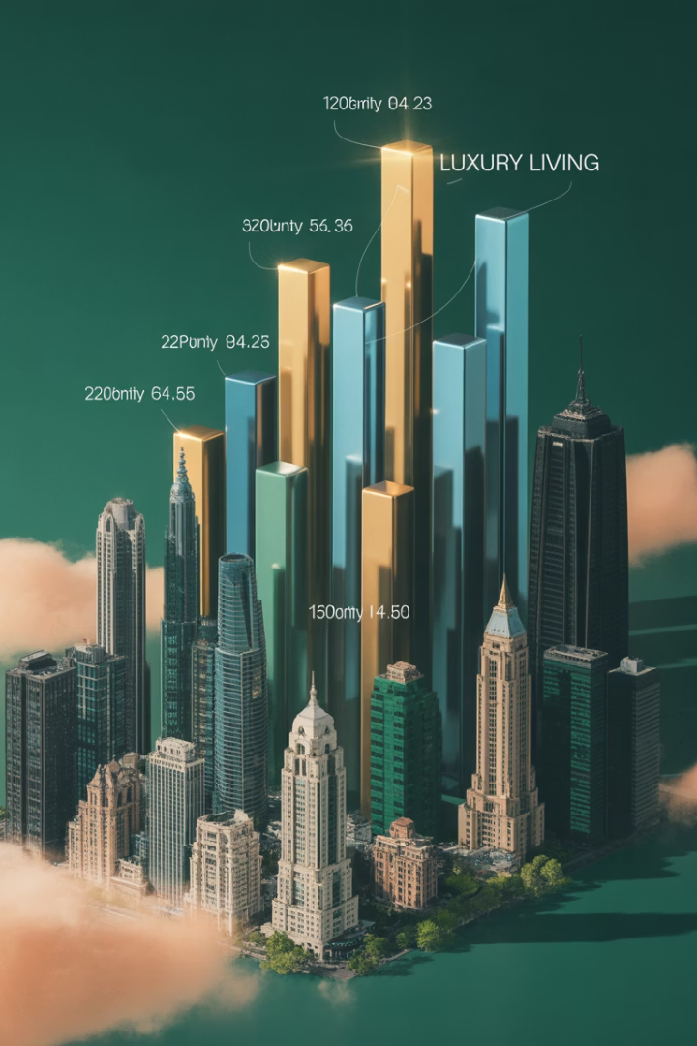
Determinants of Rent: Market Level
This presentation explores how urban economics principles determine property income streams. We'll examine how location, transport costs, and land value influence urban rent distribution, and how the space market connects with asset markets and development.

Slide 2

Urban Economics Foundation
Location Value
Land derives value through derived demand. People pay for land because it's necessary to obtain other valuable things.
Residual Nature
Land value is what remains after mobile factors (labor, capital, materials) have been paid their market rates.
Transport Costs
Location influences profitability by determining costs of accessing resources, markets, and labor.

Slide 3





The Residual Theory of Land Value
Production Value
Total revenue from goods or services produced on the site.
Mobile Factors Paid
Labor, capital, and materials must receive market rates or they'll "run away."
Residual Remains
Only what's left after mobile factors are paid is available to the landowner.
Land Value Determined
This residual determines what the land is worth in the market.

Slide 4
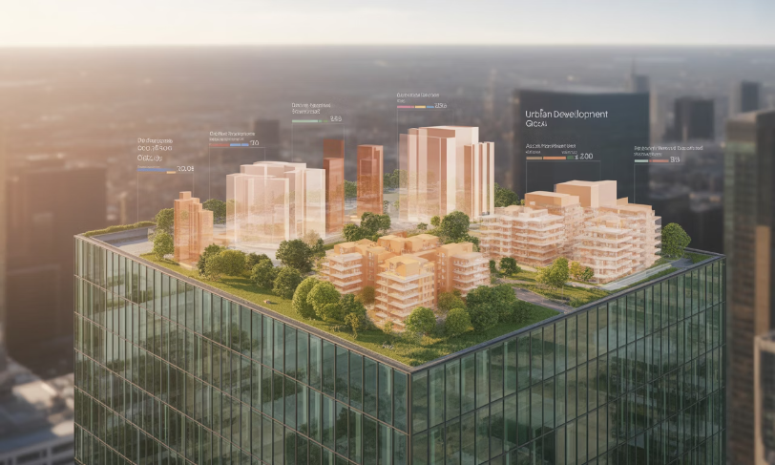
Highest and Best Use (HBU)
Competitive Markets
In well-functioning markets, competition ensures each site is used for its most productive purpose.
This maximizes the total rent earned by all land, optimizing societal productivity.
Each potential land use has a different residual value it can generate from a particular location.

Slide 5




Bid-Rent Curves
Maximum Willingness to Pay
1
The bid-rent is what a potential user would pay for a specific location.
Central Point Value
2
Value is highest where transportation costs are minimized for that use.
Declining with Distance
3
Bid-rent falls as transportation costs rise with distance from the central point.
Different for Each Use
4
Each land use has its own bid-rent function (level and slope) based on its sensitivity or location productivity and transport costs.

Slide 6



Transport Costs Shape Cities
Direct Monetary Costs
Fuel, vehicle maintenance, transit fares.
Time Value
Often the most important component, especially for high-income individuals.
Disutility
Stress, discomfort, and inconvenience of travel.

Slide 7

The Monocentric City Model
Simplified Reality
Circular Form
A theoretical city with one central point where all jobs are located. All residents commute to this center.
The city extends in a circle from the central business district (CBD) to an agricultural boundary.
Equilibrium Rents
Housing rents rise toward the center at exactly the rate that transportation costs fall.

Slide 8
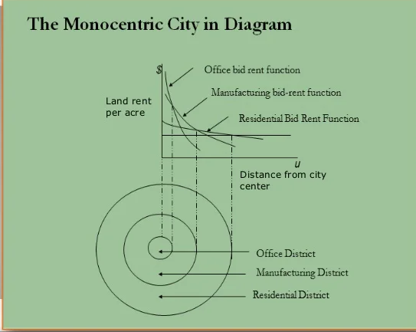
Circlopolis: A Model City: old simple model
Agricultural Opportunity Cost
Construction Cost Rent
Location Premium
In our model city with 1 million residents at 2 persons per acre, the city radius is 16 miles. The rent gradient is $500 per mile, creating an $8,000 location premium at the center.

Slide 9




Population Growth Effects
Higher Average Rents
1
Larger cities have higher average location rents.
Area vs. Density Growth
2
Cities can grow by expanding outward or increasing density.
Geographic Constraints
3
Coastlines, mountains, and lakes limit expansion and increase rents.
Higher Incomes
4
Larger cities must offer higher incomes to offset higher housing costs.

Slide 10
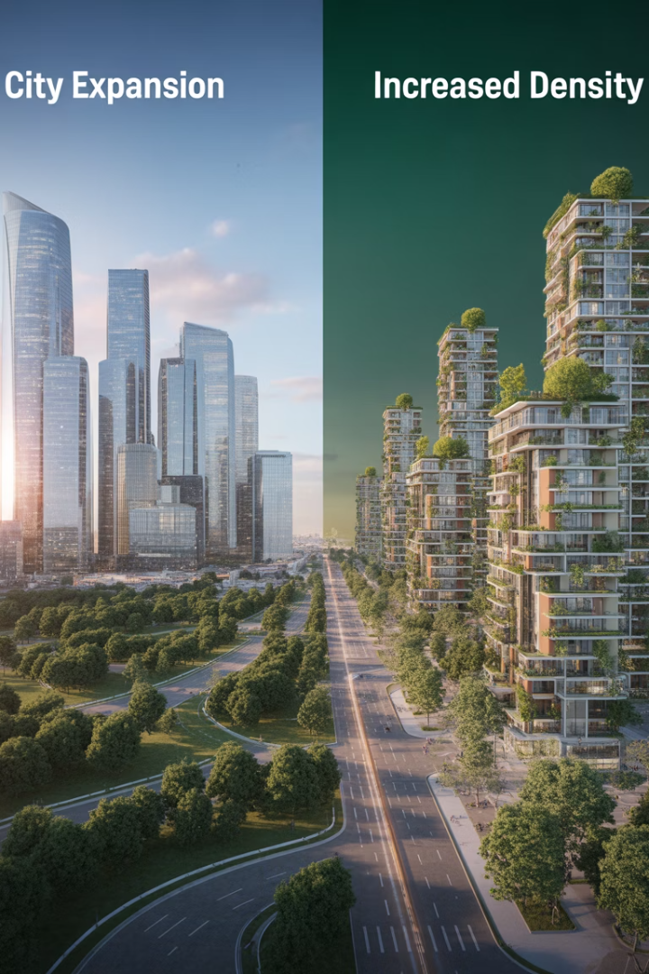
Growth Pattern Impacts, Ex:
3.8%
2.2%
22%
Peripheral Rent Growth
Central Rent Growth
Density-Driven Growth
Percentage increase at city boundary with 10% population growth.
Percentage increase at city center with same population growth.
Central rent increase when population grows by 50% with fixed area.

Slide 11


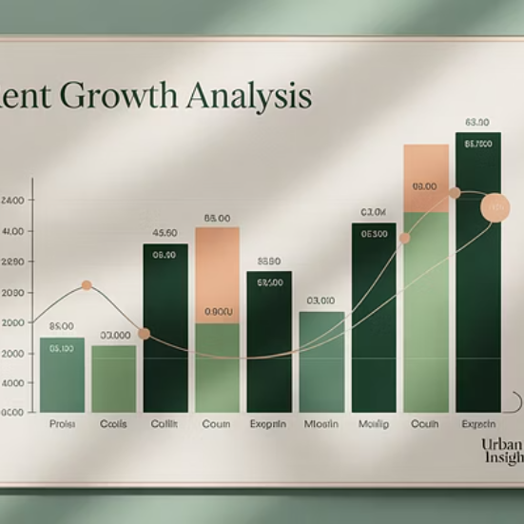
The Second Principle
"If a city grows by increasing area rather than density, property rent growth will be relatively greater closer to the periphery; but if a city grows by increasing density instead of area, property rent growth will be relatively greater the closer to the center of the city."

Slide 12
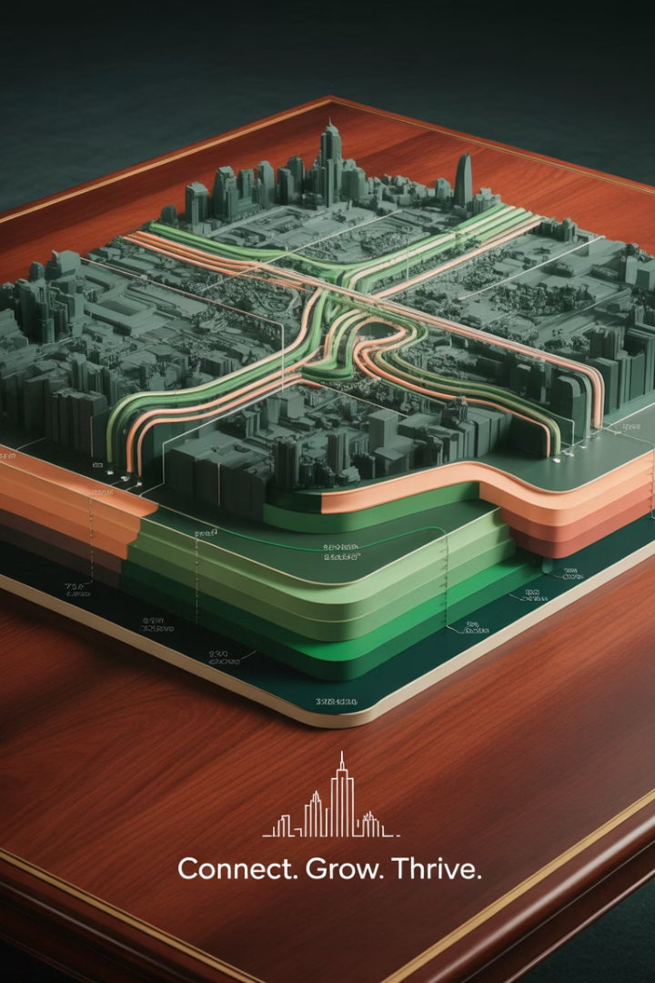




Transportation Cost Effects
Reduced Transport Costs
Improvements in technology and infrastructure reduce per-mile costs and increase value of periphery land.
Flattened Rent Gradients
Lower transport costs reduce the premium for central locations.
City Expansion
People may use savings to purchase more land, expanding the city outward.
Central Value Decline
Central location rents may decline in absolute terms.

Slide 13
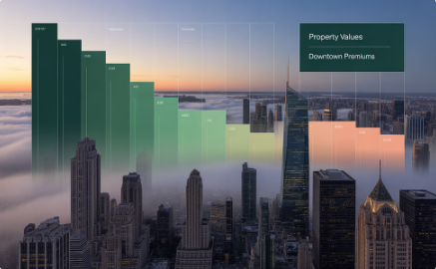

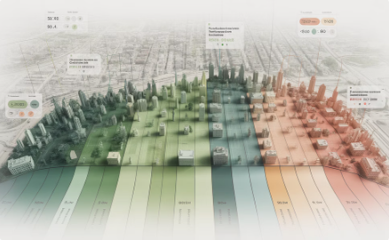
The Third Principle
Central Value Decline
Declining transport costs always reduce the value of location rent in the center of the city.
Peripheral Ambiguity
Effects on peripheral location rents depend on density changes.
Flattened Gradients
The overall result is a flattening of rent gradients throughout the city.

Slide 14





Income Growth Effects
More Land Consumption
City Expansion
Higher Time Value
This spreads the city out spatially, reducing density.
Higher incomes increase the value of time, potentially offsetting other effects.
People typically spend additional income on larger lots and more open space.
Constrained Cities
If expansion is limited, transport cost effects dominate, steepening rent gradients.

Slide 15
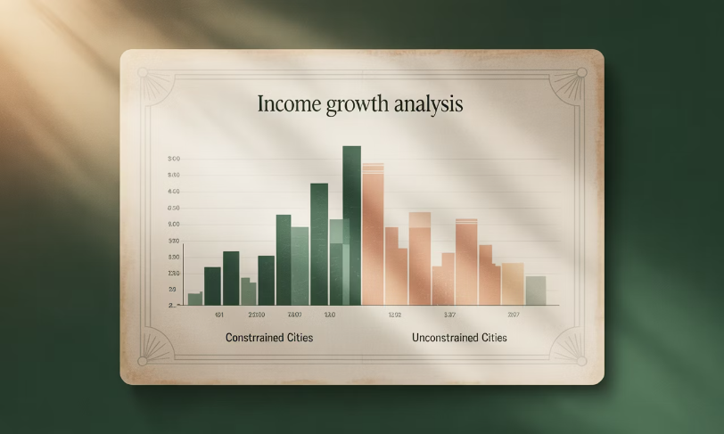
The Fourth Principle
Income Effect
"Increasing real income per capita will tend to decrease rent gradients, with a possible result of absolute reductions in land rent at the center of the city."
However, secondary effects may mitigate or reverse this result, especially in spatially constrained cities.
The balance between spatial expansion and increased value of time determines the final outcome.

Slide 16

Practical Applications
Analyze Growth Patterns
Identify Relevant Centers
Determine if the area is growing through density increases or spatial expansion.
The "center" may not be downtown but could be a university campus, highway node, or other focal point.
Forecast Property-Specific Impacts
Consider Supply Constraints
Apply principles to predict how different property types in various locations will perform.
Physical and regulatory constraints affect long-run rent growth potential.

Slide 17








Markets in Equilibrium
Space Market
Asset Market
Where supply and demand for physical space determine rents.
Where property values are determined based on income streams.
Dynamic Linkages
Development Industry
Changes in one market affect the others in a continuous cycle.
Converts financial capital to new physical supply.

Slide 18
The Quadrant Model
Space Market (NE)
Asset Market (NW)
Stock Adjustment (SE)
Development Industry (SW)
DiPasquale and Wheaton's quadrant model illustrates how four key relationships connect the space market, asset market, and development industry. The model shows how rent, property prices, construction rates, and space stock interact in long-run equilibrium.

Slide 19
Using the 4QM to help understand “boom & bust” cycles…

Slide 20
4-Quadrant Diagram…
Rent $
Asset Market:
Valuation
Space Market:
Rent Determination
R*
D
Price $
P*
Q*
Stock (SF)
C*
Asset Market:
Construction
Space Market:
Stock Adjustment
Construction (SF)

Slide 21
Effect of Demand Growth in Space Market:
Rent $
Asset Market:
Valuation
Space Market:
Rent Determination
D₀
D₁
R*
Price $
P*
Q*
Stock (SF)
C*
Asset Market:
Construction
Space Market:
Stock Adjustment
Construction (SF)

Slide 22
Effect of Demand Growth in Space Market: First phase…
Rent $
Can this be a long-run equilibrium result?…
Asset Market:
Valuation
Space Market:
Rent Determination
D₀
D₁
R₁
Doesn’t form a rectangle.
R*
Price $
P₁
P*
Q*
Stock (SF)
C*
Asset Market:
Construction
Space Market:
Stock Adjustment
Construction (SF)

Slide 23
Effect of Demand Growth in Space Market: LR Equilibrium…
Rent $
Asset Market:
Valuation
Space Market:
Rent Determination
D₀
D₁
R₁
R**
R*
P**
Price $
P₁
P*
Q*
Q**
Stock (SF)
C*
Asset Market:
Construction
C**
Space Market:
Stock Adjustment
Construction (SF)

Slide 24
Effect of More Relative Demand for Real Estate in the Asset Market…
Rent $
Asset Market:
Valuation
Space Market:
Rent Determination
D₀
11% OAR
D₁
8% OAR
R*
R**
SR
P₁
LR
Q**
Price $
P**
P*
Q*
Stock (SF)
C*
Asset Market:
Construction
C**
Space Market:
Stock Adjustment
Construction (SF)

Slide 25




Boom and Bust Cycles
Demand Increase
Higher space demand temporarily pushes rents above long-run equilibrium.
Price Response
Higher rents increase property values, attracting investment capital.
Supply Expansion
New construction increases space supply over time.
Market Correction
Additional supply brings rents back toward long-run equilibrium levels.

Slide 26





Key Takeaways
Location Determines Value
Land value is primarily determined by location and its ability to minimize transportation costs.
Market Equilibrium
Competitive markets allocate land to its highest and best use, maximizing productivity.
Urban Growth Patterns
Population, income, and transportation cost changes affect city size and rent distribution.
Interconnected Markets
Space, asset, and development markets form a dynamic system that shapes the built environment.

