Slide 1
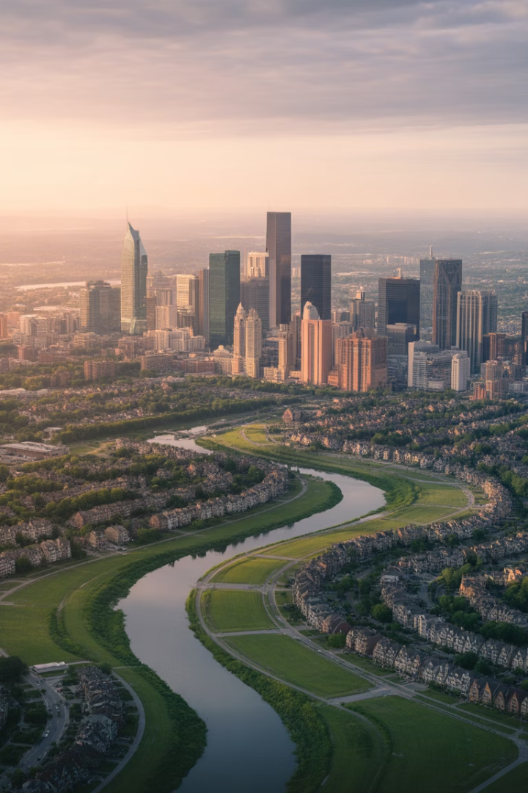
Determinants of Rent II: Property Level
This chapter extends the monocentric city model by exploring dynamic, real-world factors influencing urban land values and property investments. It distinguishes land rent from land value and highlights how rent growth expectations and market uncertainty shape investment decisions.
Viewing land as a call option, we'll see how uncertainty can raise land values and delay development, resulting in denser cities. We'll explore polycentric city structures, varied land uses, and examine how neighborhood and property life cycles impact long-term property value.
NM

Slide 2
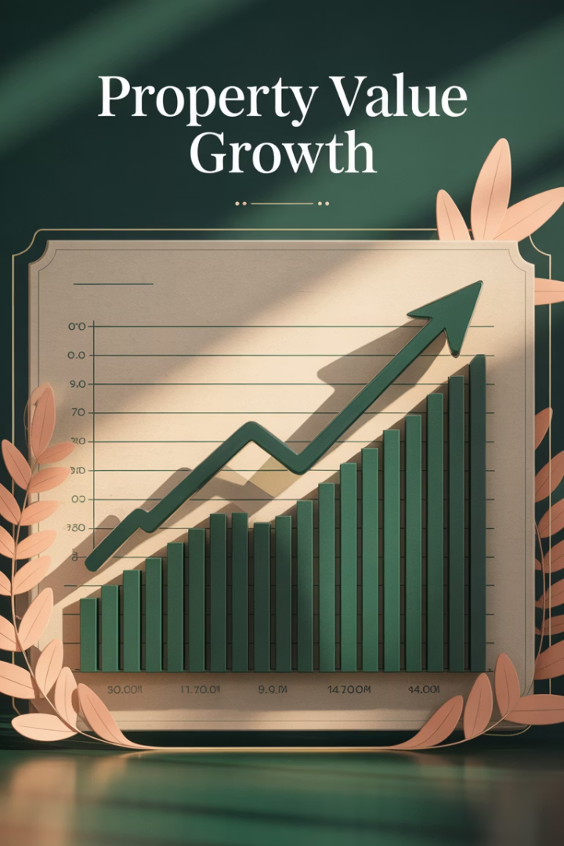
From Property Rent to Property Value
1
Property Value vs. Property Rent
Property value is the present value of expected future rents. Higher growth rates in future rents increase present value.
2
Growth Premium
Properties sell at higher multiples of current rent in cities expecting greater future rent growth.
3
Highest and Best Use (HBU)
Optimal delay in development occurs when future HBU evolution is expected to yield higher returns.

Slide 3





Effect of Uncertainty on Land Value
Land as a Call Option
Landowners have the right but not obligation to develop at any time.
Profiting from Uncertainty
Owners can take advantage of market upswings while avoiding downside exposure.
Irreversibility Premium
Uncertainty creates a premium in rent required before development occurs.
Urban Impact
Results in smaller, denser cities with higher rents than would exist without uncertainty.

Slide 4








Speculative Land Value Components
Irreversibility Premium
Value of option to wait for better development timing
Growth Premium
Present value of expected future rent increases
Construction Cost Rent
Compensation for building expenses
Agricultural Rent
Opportunity cost of undeveloped land

Slide 5

Historical Urban Rent Growth
0.4%
100%
7
Annual Growth
Industrial Revolution
Cities Studied
Average real rent growth in European cities over 500 years
Long-term data from major Western European urban centers
Real rents doubled between 1850-1900 during rapid urbanization

Slide 6
Density Variations in Real Cities
Central Density Logic
Economic Principle
Denser, more intensive land uses locate closer to central points where transportation costs are minimized.
Scarce input factors (like central locations) should be used more sparingly and productively.
This maximizes profits by minimizing aggregate transportation costs for society.
Higher-density land uses tend to be more productive per acre and have steeper rent gradients.

Slide 7








Concentric Ring Model
CBD
Transition Zone
Central business district with highest density commercial uses
Warehouses and industrial plants requiring good transportation access
Middle/Upper Income
Working Class Housing
Lower-density, newer housing for higher-income residents
Higher-density, older housing for factory workers

Slide 8



Sector Model of Urban Form
Directional Growth
Similar land uses cluster along rays or wedges from center
Outward Expansion
Established land uses continue in same direction as city grows
Environmental Factors
High-income areas often located upwind from industrial zones

Slide 9

Effect of Land Use Boundaries
Compatibility Effects
Negative Externalities
Similar land uses tend to "clump together" in cities, forming districts. Compatible uses bring synergy and increase value for each other.
Incompatible uses detract from each other's value. Location rents often depress near boundaries for unfavorably affected uses.
Zoning Impact
Both free markets and zoning regulations tend to separate incompatible uses and draw compatible uses together over the long run.

Slide 10

Polycentric Cities
1
Traditional CBD
Single dominant center known as downtown
2
Major Activity Centers
Airports, medical centers, sports complexes serving metropolitan needs
3
Neighborhood Centers
Business districts serving local community needs
4
Edge Cities
Large suburban centers at highway nodes, almost as large as traditional CBDs

Slide 11

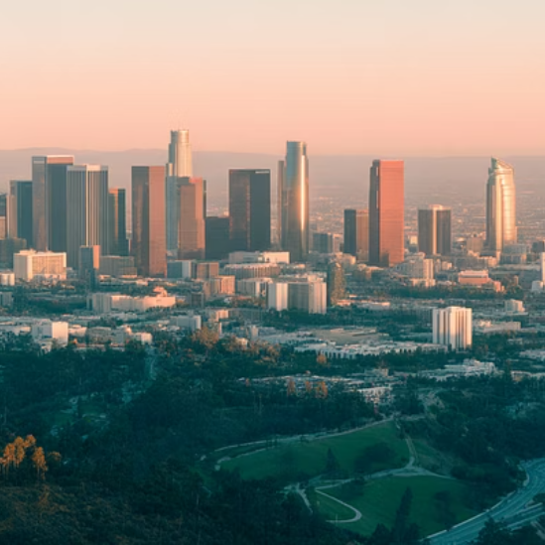

Polynuclear Cities
Some metropolises have never had a single dominant CBD. These range from "twins" like Minneapolis-St. Paul to multicentered conglomerates like Los Angeles to urban clusters like China's Pearl River delta.

Slide 12








Neighborhood Life Cycle
Initial Growth
Maturity
Rapid rise in usage and land values as area becomes ripe for urban development
Fully built neighborhood with stable values and gradual structure replacement
Renewal
Decline
Redevelopment becomes profitable as property values bottom out
Aging structures, lower-income residents, disinvestment and deterioration

Slide 13
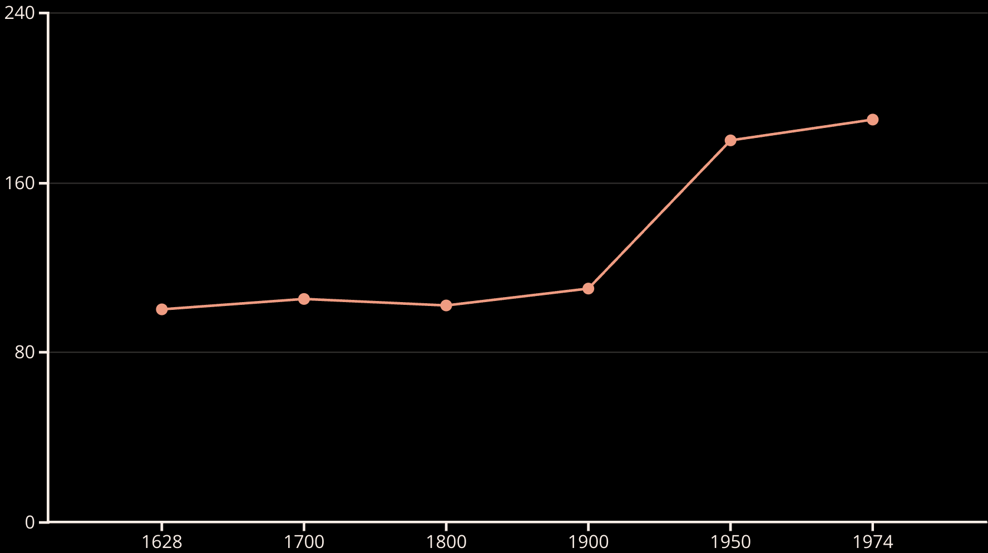
The Herengracht Case Study (Real price change over a long period of time)
Amsterdam's Herengracht canal shows property values cycling around a flat trend for almost three centuries. The only substantial increase came in the early 20th century when metropolitan expansion increased the location's centrality and altered its highest and best use.

Slide 14
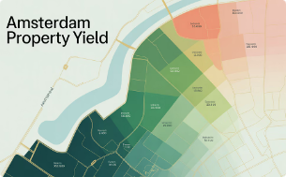
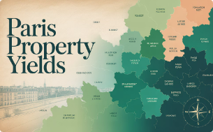
Neighborhood Investment Returns
Amsterdam Yields
Paris Yields
High variation within blocks. Canal belt shows lower yields while neighboring Jordaan offers higher yields due to lower property prices relative to rental income.
More uniform distribution across the city, indicating a more homogeneous property investment landscape in space.

Slide 15
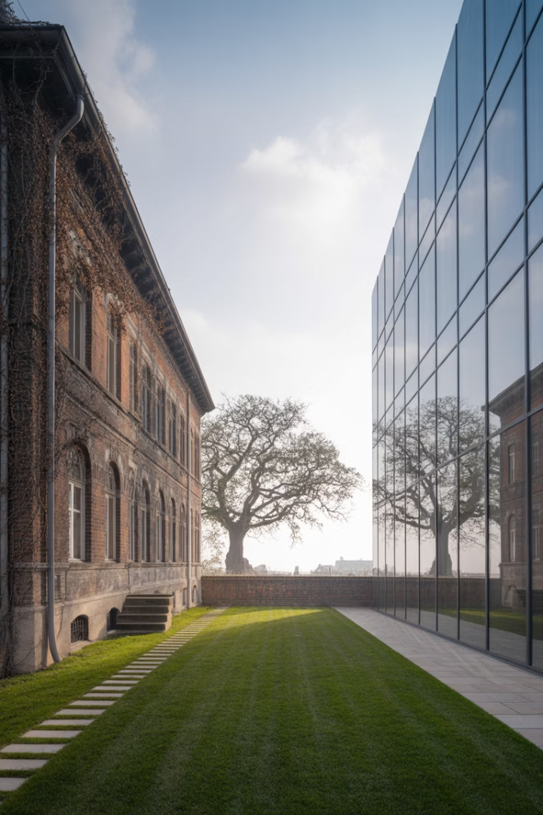




Property Life Cycle
Initial Development
Structure built to serve highest and best use, structure value dominates property value
Aging Structure
Building depreciates due to physical, functional, and economic obsolescence
Changing Land Value
Redevelopment option value grows as structure depreciates and HBU evolves
Redevelopment
Occurs when structure becomes worthless relative to redevelopment potential

Slide 16
Components of Property Value
Land Value Perspectives
Structure Value
Traditional appraisal view: value of vacant land similar to subject property
Difference between property value and land value
Declines over time due to various forms of obsolescence
Economic view: value derives from development/redevelopment option
Initially dominates property value after construction

Slide 17
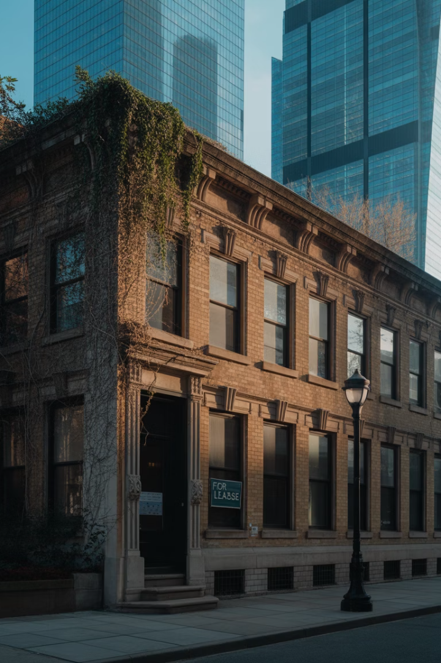



Types of Obsolescence
Physical Obsolescence
Functional Obsolescence
Economic Obsolescence
Structure physically wearing out as components deteriorate over time
Changing technology and user requirements make design outdated
Structure becomes unsuited to evolving highest and best use of site

Slide 18

The Depreciation Principle
Key Insight
Numerical Example
Rental Implications
Over the long run, change in location value provides a theoretical ceiling to the investment capital gain of the unlevered investor in stabilized property.
If redevelopment occurs every 50 years and land value is 20% of redeveloped property value, built property value grows 3.2% less annually than location value.
Rents must also grow at a rate less than that of the location value as property competes with newer, less obsolete buildings.

Slide 19
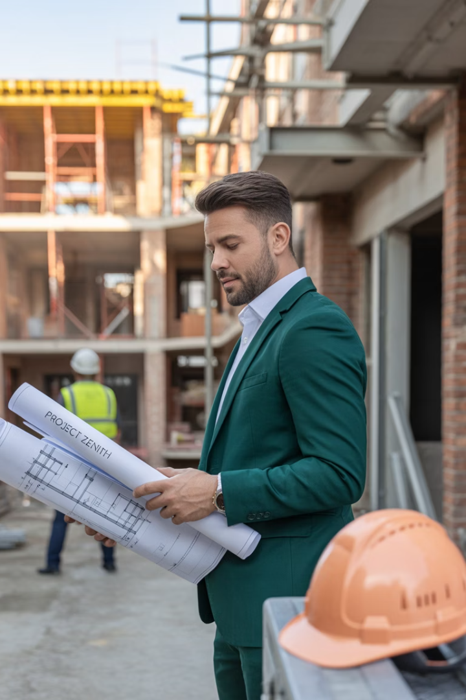
Optimal Redevelopment Timing
Monitor Structure Value
Track depreciation of existing building relative to potential new development
Evaluate Redevelopment Option
Calculate value of potential new development minus demolition and construction costs
Identify Optimal Timing
Redevelop when existing structure becomes worthless relative to redevelopment potential

Slide 20





Key Takeaways
Land Value vs. Rent
Property value reflects present value of expected future rents, with growth expectations and uncertainty affecting current values.
Urban Form Models
Both concentric ring and sector models explain aspects of real cities, with polycentric structures increasingly common.
Life Cycles
Neighborhoods and properties follow predictable cycles of development, maturity, decline, and renewal.
Investment Implications
Structure depreciation means property value growth is capped by location value growth, a fundamental principle for investors.

