Slide 1

Forecasting the Space Market: Real Estate Market Analysis
This presentation explores how to forecast rental trends in real estate markets. We'll examine the economic forces governing urban land values and how to predict rental growth - arguably the most crucial and difficult exercise for real estate investors.
NM

Slide 2

Understanding Market Analysis
Purpose
Quantitative or qualitative characterization of supply and demand in a specific space usage market.
Primary Goal
Forecast rent and price trends for investment decisions.
Property Types
Multi-family, office, retail, industrial, and specialty properties.
Scope
Typically conducted at metro level with 5-10 year horizon.

Slide 3
Micro vs. General Market Analysis
Micro-Level Analysis
General Market Analysis
Focuses on specific sites or users
Broader characterization of markets
Feasibility analysis
Quantifies supply and demand
Site analysis
Forecasts rents and vacancies
Individual building assessment
Examines market-wide trends

Slide 4








Defining Market Segments
Geographic Scope
Property Type
Metropolitan level or narrower (quadrant, neighborhood)
Office, retail, multi-family, industrial
Temporal Range
Quality Class
Historical analysis and future forecasts (5-10 years)
Class A, B, or C properties at different price points

Slide 5



Structural Approach to Rent Forecasting
Rent = f(Vacancy)
Vacancy and sublet space drives rent levels
Occupied Space = f(Rent, Demand)
Space usage relates to demand and rent
Construction = f(Rent, Vacancy)
Development responds to profitability signals where
Value exceeds cost to create new space or upgrade space.

Slide 6

Key Physical Variables
Construction
Absorption
Addition of new supply to the stock of space available in the market.
Amount of additional space occupied per year, indicating demand activity.
Vacancy Rate
Market Rent
Percentage of stock not currently occupied, reflecting supply-demand balance.
Rent level charged on typical new leases, the key economic indicator.

Slide 7
Understanding Absorption
Gross Absorption
Net Absorption
Total amount of space for which leases were signed during a period.
Net change in the amount of occupied space in the market.
Measures transaction volume
Better measure of true demand growth
Includes internal market moves
Comparable to net construction
Relevant for brokerage services
Indicates market direction

Slide 8



Natural Vacancy Rate
Search Time
Landlords and tenants need time to find optimal matches
Market Balance
Point at which no rent pressure exists in either direction
Market Indicator
Varies by market and changes over time
Zero vacancy indicates suboptimal behavior. Natural vacancy tends to be higher in faster-growing, more volatile markets with fewer constraints on development. It also varies by market and property type. I.e. Office is lumpy and has a higher vacancy rate while multifamily has a lower natural vacancy rate.

Slide 9
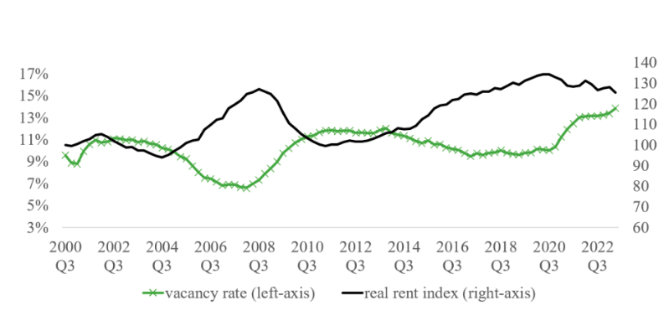
Rent-Vacancy Relationship for Los Angeles Office Market
When vacancy is below the natural rate, rents rise. When vacancy is above the natural rate, rents fall.
The rent cycle typically lags behind the vacancy cycle.

Slide 10
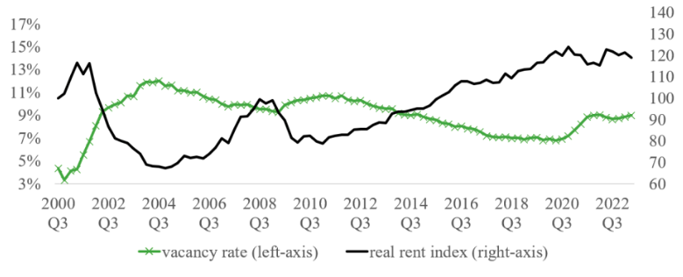
Rent-Vacancy Relationship for Boston Office Market

Slide 11
Market Dynamics: Boston vs. Los Angeles
Boston
Los Angeles
CBD rents 60% higher than non-CBD
Minimal CBD/non-CBD rent difference
Average vacancy: 9%
Average vacancy: 11%
Strong regulatory constraints
Moderate regulatory constraints
High physical constraints (34% undevelopable)
High physical constraints (53% undevelopable)

Slide 12

Months Supply Indicator
Interpretation
Months needed to absorb all vacant space at current absorption rate.
Decision Rule
Compare to typical construction time to assess market capacity.
Market Signal
If months supply exceeds construction time, market may be oversupplied.

Slide 13





Office Space Demand Drivers
Office Employment
Space Per Employee
Work From Home
FIRE industry jobs (Finance, Insurance, Real Estate)
Trending down pre-COVID, spiked after pandemic
Reduced office demand in many markets
Industry Base
Different industries have varying WFH potential

Slide 14





COVID-19 Impact on Office Markets
Initial Shutdown
Forced remote work, negative absorption
Technology Adoption
Zoom and remote work technologies accelerated
Vacancy Increase
Rates jumped from 7% to 12% in Boston
Hybrid Models
Partial return with reduced space per employee

Slide 15








Multi-Family Housing Demand
Population Growth
Overall driver of housing demand
Young Households
64% of people under 35 rent
Income Levels
61% of lower income quartile rent
Employment Growth
Especially blue-collar jobs
Note there is interaction with the homeowner market in that the less affordable is housing the greater the demand for MF rentals.

Slide 16



Warehouse Space Demand
Warehouse demand follows inventory needs, driven by e-commerce growth. Key indicators include employment in NAICS codes 48-49, truck tonnage, port volumes, and e-commerce sales.

Slide 17

Retail Space Challenges
1%
4%
16%
2000
2010
2024
E-commerce as percentage of total sales
E-commerce as percentage of total sales
E-commerce as percentage of total sales
Retail space demand is driven by retail sales and consumption, but e-commerce growth has reduced traditional space needs. Sales data must be adjusted for online shopping trends.

Slide 18

Demand Drivers by Property Type
Property Type
Primary Drivers
Secondary Drivers
Office
FIRE Employment
Public Administration
Multi-Family
Population Growth
Young Population, Blue-collar Jobs
Retail
Retail Sales
Disposable Income, Employment
Warehouse
Inventory Needs
Transportation Employment
Single-Family
Population
Interest Rates, Employment

Slide 19








Real Estate Market Cycles
Rising Demand
Rising Rents
Absorption exceeds construction, vacancy falls
Low vacancy triggers rent increases
Oversupply
New Construction
Construction exceeds absorption, vacancy rises
High rents stimulate development

Slide 20



Cyclical Market Characteristics
Construction Volatility
Leading Indicators
Independent Cycles
Cycles are more exaggerated in construction than in rents or vacancy.
Vacancy cycle leads rent cycle slightly; vacancy peaks before rent bottoms.
Real estate cycles may differ from underlying business cycles.

Slide 21

Key Takeaways
Track Key Indicators
Define Your Market
Monitor construction, absorption, vacancy, and rent to understand market dynamics.
Specify geographic scope, property type, and temporal range for analysis.
Anticipate Cycles
Identify Demand Drivers
Understand that real estate markets are inherently cyclical with predictable patterns.
Focus on property-specific drivers like employment, population, or sales.

