Slide 1

Forecasting the Space Market: Estimating Cash Flow Growth
This presentation explores the essential techniques for forecasting real estate market fundamentals and cash flows. We'll examine how to develop accurate numerical forecasts, understand market dynamics, and account for depreciation in property valuations.

Slide 2
Forecasting Fundamentals
Market Analysis
Use localized data for space market forecasting to capture specific market conditions.
Statistical Approaches
Apply regression analysis and other statistical tools for more accurate rent forecasts.
Risk Assessment
Employ simulation and sensitivity analysis to understand potential outcomes and risks.
Depreciation Impact
Account for real economic depreciation in DCF proformas to reflect realistic returns.

Slide 3

Simple Structural Analysis
Inventory Existing Supply
Collect data on current space inventory from brokerage firms, planning agencies, and commercial data providers.
Identify Demand Sources
Determine fundamental drivers of space demand, such as office employment for office space.
Relate Demand to Space Usage
Calculate space requirements per demand unit (e.g., square footage per employee).
Forecast Future Supply and Demand
Project demand growth and inventory construction pipeline to predict market balance.

Slide 4

Boston Office Market Example
Formula
Now
In 5 years
Difference
Net Current Inventory
223,954,598
230,766,696
6,812,099
Employees
844,000
874,000
30,000
Net Absorption
26,574,343
26,186,442
(387,902)
Vacancy rate
11.87%
11.35%
-0.52%

Slide 5





Regression-Based Forecasting
Collect Historical Data
Gather time series data on rents, construction, vacancy, and demand drivers.
Build Statistical Model
Use Vector Autoregressive Model (VAR) to relate variables and capture market dynamics.
Estimate Parameters
Apply Ordinary Least Squares (OLS) to find optimal parameters that minimize errors.
Generate Forecasts
Project future values with confidence intervals to quantify uncertainty.

Slide 6
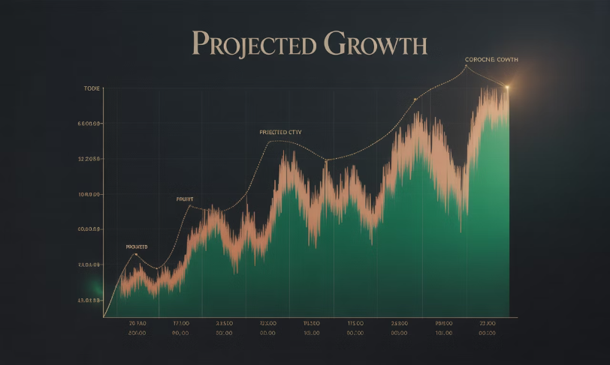
Forecast Uncertainty
The Reality of Forecasting
Every forecast contains uncertainty. The probability of exact accuracy is nearly zero.
Confidence intervals widen over time as errors compound. A 5-year forecast might range from -1.2% to +8.2% annual growth.
Understanding this uncertainty helps investors quantify risk and make better decisions.

Slide 7

Sensitivity and Simulation Analysis
Sensitivity Analysis
Simulation Analysis
Tests how changes in key variables affect outcomes. Example: How would a 1% lower rent growth impact IRR?
Runs multiple scenarios with probability distributions to generate outcome probabilities.
Value at Risk (VaR)
Quantifies the probability that value falls below a specified threshold, useful for lenders.

Slide 8



The Value of Flexibility
Property Purchase
Initial investment based on expected value
Market Changes
New information reveals positive or negative scenarios
Timing Decision
Option to sell early or hold based on market conditions
Flexibility in real estate investment timing creates option value. The ability to adapt to new information by choosing when to sell can significantly enhance returns.

Slide 9






Understanding Depreciation
Functional Obsolescence
Outdated features as technology and preferences change. Requires capital expenditures to address.
Physical Deterioration
External Obsolescence
Wear and tear on building components. Impacts maintenance costs and operating expenses.
Changes in surrounding area affecting property value. Often impossible to "cure" without redevelopment.

Slide 10
Vintage and Survivor Bias
Vintage Effect
Survivor Bias
Some architectural styles from specific eras command premium values. Examples include Art Nouveau buildings in New York and canal houses in Amsterdam.
Only the best-built properties from earlier eras remain standing today. This creates a false impression that older buildings don't depreciate.
Original, authentic examples have cachet that imparts extra value and can resist some depreciation effects.
Data shows only about 20% of commercial buildings developed 200 years ago still exist in their original form.

Slide 11
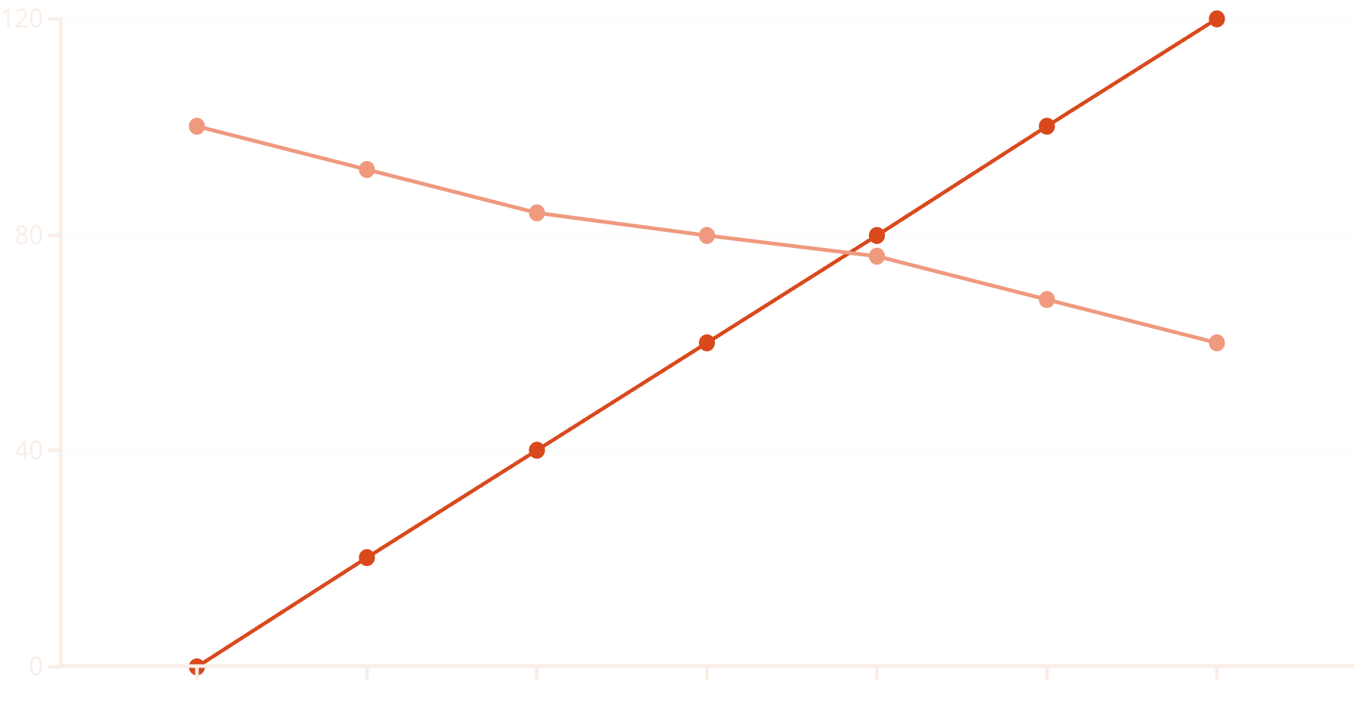
Rent Depreciation Over Time
Building Age (Years)
Real Rent Index
Rent depreciation follows distinct life cycles. Initial 30-40 years show steady decline as buildings lose "A" status. Middle age (30-90 years) shows plateau at "B" class level. After 90 years, buildings either undergo major renovation or enter terminal depreciation.

Slide 12

Impact on Operating Expenses
5%
35%
11%
OpEx Increase
Peak CapEx
Vacancy Rate
Higher operating expenses as percentage of EGI after 60 years
Capital expenditures as percentage of NOI around age 60
Average vacancy for 80-year-old buildings vs. 5% for new buildings

Slide 13
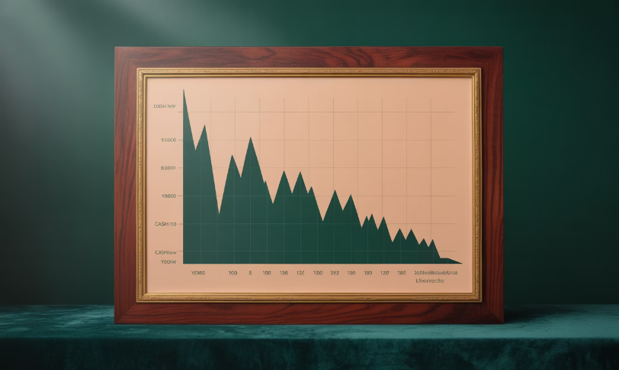
Cash Flow Depreciation
Beyond Rent Depreciation
Cash flow depreciation exceeds rent depreciation due to rising expenses and capital needs.
In first 40 years, rents typically decrease by 16% while PBTCF decreases by 37%.
After 50 years, PBTCF often flattens as capital expenditures decrease and property value shifts toward land value.

Slide 14
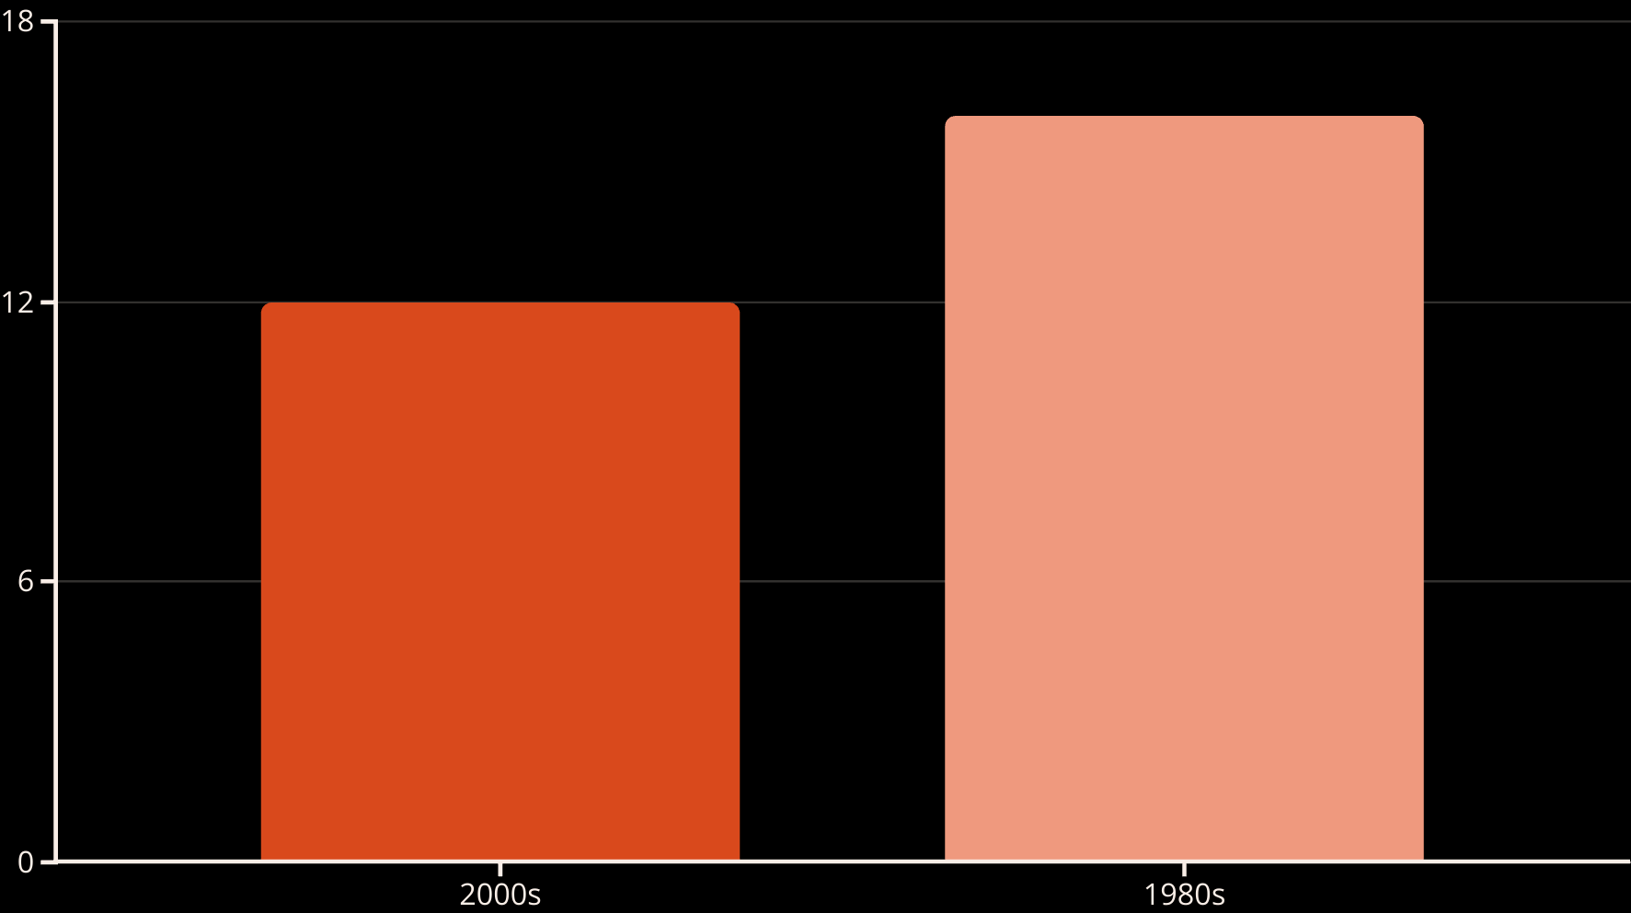
Vacancy Rates by Building Age
Older buildings consistently experience higher vacancy rates than newer properties. The difference averages about four percentage points between buildings from the 1980s and those from the 2000s.

Slide 15

Rising Insurance Costs
100%
400%
National Increase
Florida Increase
Average insurance cost increase since 2018
Insurance cost increase in climate-vulnerable regions
Climate-related events are driving unprecedented increases in property insurance costs. Some locations face difficulty obtaining insurance at all, affecting mortgage availability and overall property economics.

Slide 16




Adjusting Market Forecasts for Individual Properties
Market Forecast
Average market rent growth projection (e.g., 4% annually)
Depreciation Rate
Property-specific depreciation (e.g., 0.4% annually)
Property Forecast
Adjusted growth rate for specific property (e.g., 3.6% annually)
Market-level forecasts must be adjusted for individual property depreciation. A property's rent growth will typically be lower than market averages due to aging effects.

Slide 17



Determining Potential Gross Income
Current Leases
Analyze existing leases, including rates, terms, and expiration dates
to project near-term income.
Vacancy Projections
Estimate probability of lease renewal and expected downtime between tenants.
Market Rent Projections
Forecast market rents for when spaces "roll over" to new leases.

Slide 18

Lease Roll Analysis Example
Space
Current Status
Lease Expiration
Current Rent
Market Rent
Space 1
Leased
Year 3
$10.50/SF
$10.00/SF
Space 2
Leased
Year 5
$10.00/SF
$10.00/SF
Space 3
Vacant
N/A
N/A
$10.00/SF
When forecasting property income, analyze each space individually. Account for above/below market rents, lease expirations, and expected vacancy periods.

Slide 19

Tenant Analysis
Credit Quality and Resilience
Renewal Probability
Consider space customization, tenant improvements, and industry type. Legal and architectural firms tend to be more static than insurance agencies.
Assess tenant financial strength and ability to fulfill lease obligations. Government tenants like the Department of Commerce offer high reliability.
Sublease Activity
Monitor sublease space as a leading indicator of future vacancy and potential rent movements in the market.

Slide 20





Key Takeaways
Market-Based Forecasting
Use localized data and statistical methods to develop robust market forecasts.
Property-Specific Adjustments
Adjust market forecasts for individual property characteristics, especially depreciation.
Comprehensive Analysis
Consider all aspects: market trends, property condition, tenant quality, and lease structures.
Uncertainty Management
Use sensitivity analysis and understand the value of flexibility in timing decisions.

