Slide 1
Cash Flows After Tax
And some investment metrics
Alex Van de Minne

Slide 2
1 Introduction
Today, we are going to show the implications of income tax on cash flows and investment valuation.
Note that we are taking some basic American tax laws and apply them.
  It is going to be different in other countries.
  Tax laws change all the time.

Slide 3
2 General Effects of Tax and Debt
The question on how tax affects cash flows seem easy enough, right?
All profit is taxed at a certain rate and that is it?
No! It is important to understand that in the US, the owner’s income tax obligation on CRE is based on accrual accounting, and income taxes are themselves, a cash flow item.
The starting point is Net-Operating-Income. After that, cash flow and accrual statements change. Most importantly;
  Depreciation
  Capital Expenditures
  Debt Amortization

Slide 4
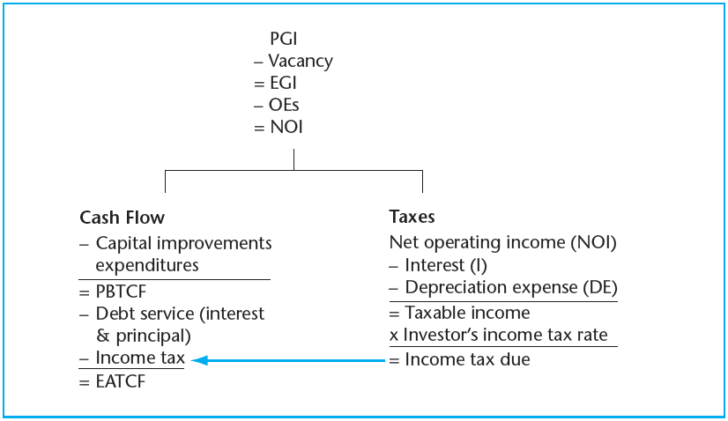
2 Overview of Income tax
You pay federal, state and local taxes, or about 30 -- 40%.

Slide 5
2 Capital Expenditures
CapEx is a cash expense, and is thus a cash flow item.
The IRS ignores CapEx, other than determining the “gross book value” see later slides.
As a result, CapEx hardly affects the tax obligation.
This is important, because it means you might have to pay considerable income tax in a year, even though you did a large CapEx.
  This means you could have a large negative after-tax cash flow in a year of CapEx.
  Thus you need to time your CapEx and safe some money in the years before your CapEx.

Slide 6
2 Debt Amortization
Typically, an owner uses debt to finance a property, by taking a mortgage.
The cash flow for the investor is therefore affected.
  You must subtract the debt service payments from the cash flow. Debt service is the repayment and principle payments together.
  During resale, you obviously must repay the outstanding balance to the lender.
So how is debt amortization treated in the IRS tax code?
  You can only subtract the interest portion against the taxable income!
  Reduction of debt service is not seen as an expense.

Slide 7
3 Depreciation Expense
Depreciation is not a cash flow item.
With depreciation we mean that the property loses value as it ages, starting at the purchase value (i.e. book value). How realistic is this?
Depreciation is important to determine tax obligation by (I);
  You can expense a straight-line depreciation on (taxable) income of;
    1/27.5 per annum for apartment.
    1/39 per annum for office/retail/industrial properties.
    This only counts for the structure value of the property.
    The idea is that land does not depreciate!
    You can take about 80% for this.

Slide 8
3 Depreciation Expense
You purchased the property in 2007.

Slide 9
3 Depreciation Expense
Actual value over time (RCA CPPI).
Value according to the IRS.

Slide 10
3 Depreciation Expense
Depreciation is not a cash flow item.
With depreciation we mean that the property loses value as it ages, starting at the purchase value (i.e. book value). How realistic is this?
Depreciation is important to determine tax obligation by (2);
  During the property resale you are taxed twice (capital gains tax, CGT);
    Difference between resale price and gross book value (= book value + all CapEx). Tax = 15%.
    There is a “recapture tax” of 25%, on any accrued depreciation (of NOI, see previous slide) that is recovered by the resale price.

Slide 11
3 Depreciation Expense
This portion (with CapEx) is taxed 15%.
Gross Book value
This portion (unless resale price is below depreciation) is taxed 25%.
Capex

Slide 12
3 Depreciation Expense
However, it is important to know that investors hardly pay Capital Gains Tax!
See section 1031 of the IRS code.
If you purchase a “like kind” investment (i.e. another property) using gains from a resale, you can carry forward the tax obligation.
Which everyone does… (Exceptions are usually inheritances.)
You have 6 months to do the reinvestment, but you need to notify it to the IRS within 45 days.

Slide 13
6 Example
Only first-year cash flow analysis (we will complete a 10-year pro forma later in class)
Purchase an apartment property for $1M.
Depreciable cost basis (i.e., structure value) = $0.8M.
NOI is $60K in this first year.
We take out a $750,000 loan (LTV is 75%) with a 5.5% interest rate, and we pay $2,000 per annum to pay back the principal balance.
  Note that as you pay off the principal (the $750,000), the interest payments go down.
We do not have any CapEx in this first year!
Again, only first-year cash flow, no resale or IRR yet.
What is the free cash flow after tax?

Slide 14
6 Example (Accounting)
Comments
Year 1 analysis
Ouch… Why would we invest in this property?
We make a loss of over $8K.
Perhaps the resale value will recuperate some of the loses?
Note that you do not literately get tax back.
Rather, the loss ($10K) can be deducted from other taxable income.
This is also called a tax shield.
You can also carry losses forward.
However, this is not your actual cash flow!
Item | Year 1
NOI | $ 60,000
Depreciation Expense | $ (29,091)
Interest Expense | $ (41,250)
Net Income (before tax) | $ (10,341)
Income tax | $ (2,068)
Net Income (after tax) | $ (8,273)

Slide 15
6 Example (Accounting)
Comments
Year 1 analysis
Ouch… Why would we invest in this property?
We make a loss of over $8K.
Perhaps the resale value will recuperate some of the loses?
Note that you do not literately get tax back.
Rather, the loss ($10K) can be deducted from other taxable income.
This is also called a tax shield.
You can also carry losses forward.
However, this is not your actual cash flow!
Item | Year 1
NOI | $ 60,000
Depreciation Expense | $ (29,091)
Interest Expense | $ (41,250)
Net Income (before tax) | $ (10,341)
Income tax | $ (2,068)
Net Income (after tax) | $ (8,273)

Slide 16
6 Example (Cash flow)
Comments
Year 1 analysis
Starting with NOI we;
  Subtract CAPEX (is zero in this case)
  Subtract debt service (interest + principle).
  Subtract our tax bill.
This looks a lot better.
Our Equity After Tax Cash Flow (EATCF) is positive now and almost $19K.
Item | Year 1
NOI | $ 60,000
Capital Expense | $ -
Interest Payment | $ (29,091)
Principle Payment | $ (2,000)
Income Tax | $ (2,068)
EATCF | $ 18,818

