Slide 1
Income Definitions
Before Tax and Debt
Alex Van de Minne

Slide 2
1. Introduction
What are we going to do during this class:
The DCF valuation problem can be thought of in two analytical steps;
  Forecast the future expected net cash flows from the property.
  Determining the appropriate discount rate.

Slide 3
1. Introduction
What are we going to do during this class:
The DCF valuation problem can be thought of in two analytical steps;
  Forecast the future expected net cash flows from the property.
  Determining the appropriate discount rate.
In this module we are going to discuss the before tax level cash flow projection.

Slide 4
2 The Proforma
Forecasting property cash flows is so basic, that we refer to it as a proforma.
However, forecasting cash flows is very difficult, meaning we should take it very seriously!
A typical proforma, projects 10 years of cash flows, after which the property is “sold.”
A Proforma should represent two categories;
  Operating cash flows; cash flow from normal operation of the property.
  Reversion cash flows; this only occurs at the time of, and due to, the sale of the asset.
A typical split in NPV is 70/30 for the two components.

Slide 5
3 Line Items of Proforma
Operating: | Potential gross income = (Rent/SF) x (Rentable SF) = |  | PGI
(all years) | - Vacancy allowance = - (Vacancy rate) x (PGI) = | - | v
 | + Other Income = | + | OI
 | - Operating expenses = | - | OPEX
 | Net Operating Income |  | NOI
 | - Capital improvement expenditures = | - | CAPEX
 | Property-before-tax cash flow = |  | PBTCF
Reversal: | Property value at time of sale = |  | V
(only final year) | - Selling expenses = | - | SE
 | Property-before-tax cash flow = |  | PBTCF
Next, we will discuss these line items one-by-one
Notes:
We want to fill in all these values, for a period of 10 years.

Slide 6
3 Line Items of Proforma
Operating: | Potential gross income = (Rent/SF) x (Rentable SF) = |  | PGI
(all years) | - Vacancy allowance = - (Vacancy rate) x (PGI) = | - | v
 | + Other Income = | + | OI
 | - Operating expenses = | - | OPEX
 | Net Operating Income |  | NOI
 | - Capital improvement expenditures = | - | CAPEX
 | Property-before-tax cash flow = |  | PBTCF
Reversal: | Property value at time of sale = |  | V
(only final year) | - Selling expenses = | - | SE
 | Property-before-tax cash flow = |  | PBTCF
Next, we will discuss these line items one-by-one
Notes:
We want to fill in all these values, for a period of 10 years.

Slide 7
4 Potential Gross Income (PGI)
In practice this is often referred to the rent roll.
The PGI is determined by multiplying the rentable space (square foot, or units) by the rent per space (like rent per square foot, or rent per apartment).
With rent, we mean the effective rent, as opposed to the asking rent.

Slide 8
Line Items of Proforma
Operating: | Potential gross income = (Rent/SF) x (Rentable SF) = |  | PGI
(all years) | - Vacancy allowance = - (Vacancy rate) x (PGI) = | - | v
 | + Other Income = | + | OI
 | - Operating expenses = | - | OPEX
 | Net Operating Income |  | NOI
 | - Capital improvement expenditures = | - | CAPEX
 | Property-before-tax cash flow = |  | PBTCF
Reversal: | Property value at time of sale = |  | V
(only final year) | - Selling expenses = | - | SE
 | Property-before-tax cash flow = |  | PBTCF
Notes:
We want to fill in all these values, for a period of 10 years.

Slide 9
4 Vacancy Allowance
A property is almost never completely occupied over its lifecycle. We therefore allow for a vacancy allowance in the second line. There is two ways to quantify this;
  As a % of PGI: Typical for properties with many short-term leases. Some units will be vacant, and others are not.
  Vacant period as % of total holding period: Typical for properties with long-term leases. Its takes time to find a new tenant for the vacant space.
    Say the total cycle of a unit is 63 months. Of this, it takes 3 months to find a tenant. Then the vacancy is 3/(63 + 3) = 5%.

Slide 10
4 Vacancy Allowance
Both parties on the demand and supply side of the market, will maximize their profit by searching for better deals. This search time results in space being held vacant, waiting for better deals to shop up. Thus zero vacancy, is actually not optimal!
Natural vacancy rate. This is the sort of long run vacancy rate that prevails on average in an analyzed market, that is optimal.
  When vacancy is below its natural rate, we call it tight.
  When vacancy is above its natural rate, we call it a buyers’ market. (Or tenants’ market, or an overbuilt market.)
Natural vacancy is expected to be higher in faster-growing more volatile markets, and in markets with less constraints on new development, because supply is added in a “lumpy” matter, and takes time.

Slide 11
4 Long-run US vacancy

Slide 12
4 Long-run US vacancy
Buyers` market
Natural vacancy rate has been historically around 9%.
Tight

Slide 13
Line Items of Proforma
Operating: | Potential gross income = (Rent/SF) x (Rentable SF) = |  | PGI
(all years) | - Vacancy allowance = - (Vacancy rate) x (PGI) = | - | v
 | + Other Income = | + | OI
 | - Operating expenses = | - | OPEX
 | Net Operating Income |  | NOI
 | - Capital improvement expenditures = | - | CAPEX
 | Property-before-tax cash flow = |  | PBTCF
Reversal: | Property value at time of sale = |  | V
(only final year) | - Selling expenses = | - | SE
 | Property-before-tax cash flow = |  | PBTCF
Notes:
We want to fill in all these values, for a period of 10 years.

Slide 14
5 Other Income
After subtracting the vacancy from the PGI, we get the effective gross income (EGI).
However, many properties also have different sources of income, these include;
  Vending machines
  Laundry machines
  Parking
  Billboard or antenna rental
  (Small) retail within the property
These are generally referred to as other income, which is added in the third line.

Slide 15
Line Items of Proforma
Operating: | Potential gross income = (Rent/SF) x (Rentable SF) = |  | PGI
(all years) | - Vacancy allowance = - (Vacancy rate) x (PGI) = | - | v
 | + Other Income = | + | OI
 | - Operating expenses = | - | OPEX
 | Net Operating Income |  | NOI
 | - Capital improvement expenditures = | - | CAPEX
 | Property-before-tax cash flow = |  | PBTCF
Reversion: | Property value at time of sale = |  | V
(only final year) | - Selling expenses = | - | SE
 | Property-before-tax cash flow = |  | PBTCF
Notes:
We want to fill in all these values, for a period of 10 years.

Slide 16
6 Operating Expenses
The next line item on the Proforma are the operating expenses (OpEx). We identify fixed OpEx and variable OpEx.
Fixed (variable) meaning it doesn’t (does) change with occupancy levels.
  Fixed OpEx;
    Property Management. (Even if property is managed by the investor.)
    Property Security.
    (Hazard) Insurance.
    Property Taxes.
  Variable OpEx;
    Utilities.
    Regular Maintenance and Repairs.

Slide 17
6 Operating Expenses
OpEx is usually paid for from the properties’ (own) cash flow.
The cost of OpEx van vary substantially.
The of property management fees can be;
  For small properties it is between 5 to 10% of EGI.
  For large properties it is between 2 to 3% of EGI.
It is not uncommon for the tenant to pay the OpEx. This happens regularly in A-class properties for example. These are called net leases.
There can also be expense stops in place. Here the tenants start paying the OpEx if a certain threshold is reached.

Slide 18
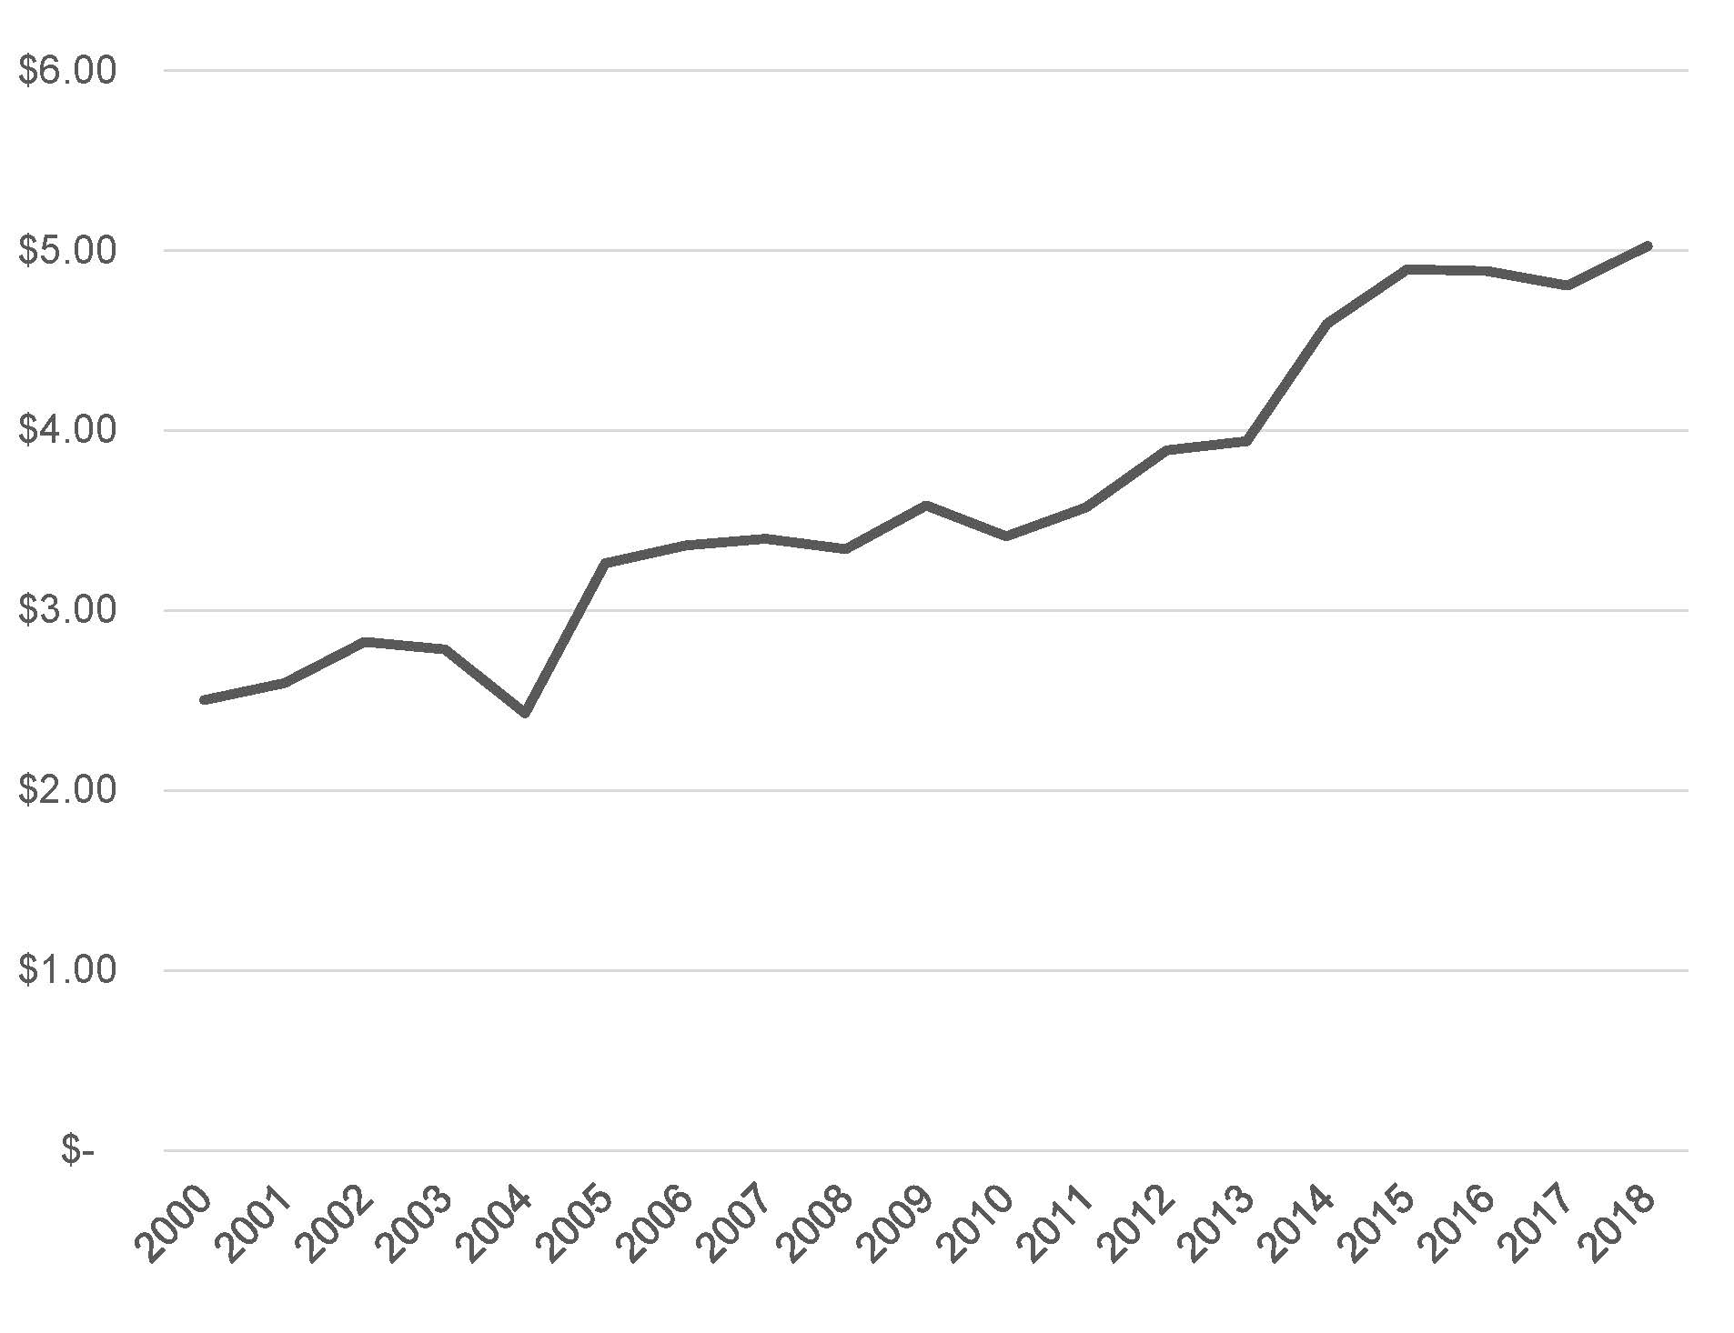
6 Operating Expenses

Slide 19
7 Net Operating Income (NOI)
The Net Operating Income (NOI) is the most widely used indicator of the net cash flow or operating profit generation ability of the property.
Strange, right? Don’t we have capital expenditures left?
Operating: | Potential gross income = (Rent/SF) x (Rentable SF) = |  | PGI
(all years) | - Vacancy allowance = - (Vacancy rate) x (PGI) = | - | v
 | + Other Income = | + | OI
 | - Operating expenses = | - | OPEX
 | Net Operating Income |  | NOI
 | - Capital improvement expenditures = | - | CAPEX
 | Property-before-tax cash flow = |  | PBTCF
Reversal: | Property value at time of sale = |  | V
(only final year) | - Selling expenses = | - | SE
 | Property-before-tax cash flow = |  | PBTCF
???

Slide 20
7 Net Operating Income (NOI)

Slide 21
7 Net Operating Income (NOI)
The Net Operating Income (NOI) is the most widely used indicator of the net cash flow or operating profit generation ability of the property.
Strange, right? Don’t we have capital expenditures left?
The problem is that CapEx is irregular and discretionary in its timing. NOI is more stable (especially on a year-to-year basis) and more easily quantified than the actual net cash flow after CapEx.
Note that the earlier mentioned cap rates are also based on NOI, not on the free cash flow. (There the relevant measure is total return, or cost of capital. See next class.)

Slide 22
Line Items of Proforma
Operating: | Potential gross income = (Rent/SF) x (Rentable SF) = |  | PGI
(all years) | - Vacancy allowance = - (Vacancy rate) x (PGI) = | - | v
 | + Other Income = | + | OI
 | - Operating expenses = | - | OPEX
 | Net Operating Income |  | NOI
 | - Capital improvement expenditures = | - | CAPEX
 | Property-before-tax cash flow = |  | PBTCF
Reversion: | Property value at time of sale = |  | V
(only final year) | - Selling expenses = | - | SE
 | Property-before-tax cash flow = |  | PBTCF
Notes:
We want to fill in all these values, for a period of 10 years.

Slide 23
8 Capital Improvements (CapEx)
Capital Improvement Expenditures (CapEx) refer to major expenditures providing long-term improvements to the physical quality of the property. These include;
  New HVAC system;
  Replacing a roof;
  Adding a parking lot;
  New landscaping;
  Etc.
CapEx can be paid for by taking up a loan, because it adds value to the property. This is very different from OpEx.

Slide 24
8 Capital Improvements (CapEx)
There is also CapEx associated with the signing of long-term leases. These leasing costs include tenant improvements (TIs) and leasing commissions.
TIs are a major category of CapEx in many buildings with long-term leases. These refer to customized physical improvements, like;
  Finishing's, partitioning's and decorations provided at the time of lease signing.
Sometimes the tenant gets an TI allowance from the landlord.
It should be noted that the line between OpEx and CapEx can be subject to accounting procedures (like GAAP), so pay close attention!
  Small warning in place here: Appraisers typically put CapEx under NOI. Which is wrong!

Slide 25
8 CapEx breakdown $ per square foot

Slide 26
8 CapEx as % of NOI and property values

Slide 27
8 Total Income Breakdown

Slide 28
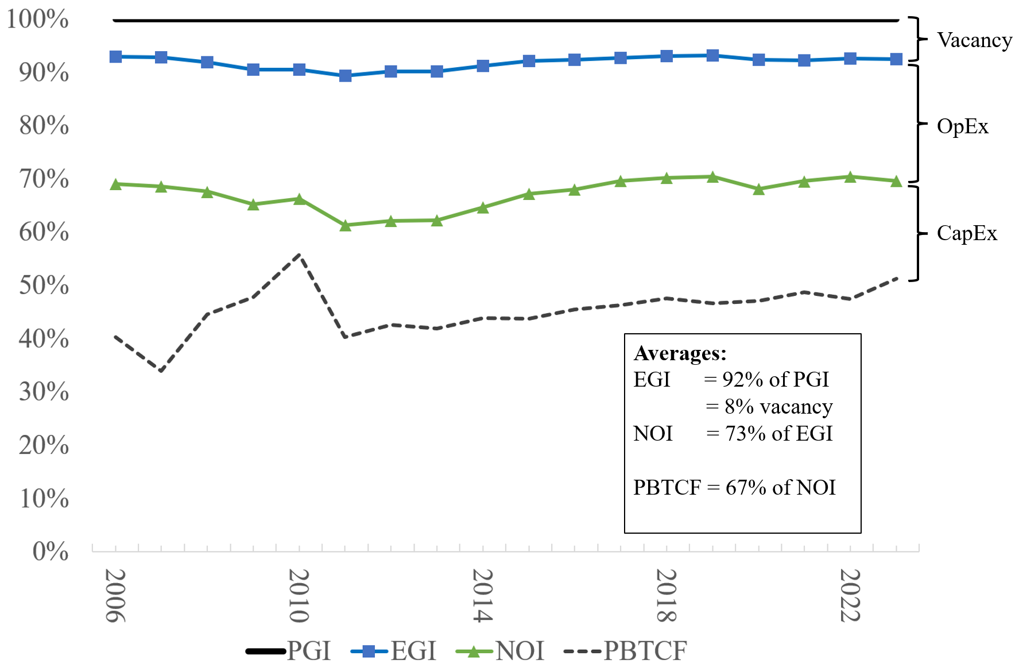
8 Total Income Breakdown

Slide 29
Line Items of Proforma
Operating: | Potential gross income = (Rent/SF) x (Rentable SF) = |  | PGI
(all years) | - Vacancy allowance = - (Vacancy rate) x (PGI) = | - | v
 | + Other Income = | + | OI
 | - Operating expenses = | - | OPEX
 | Net Operating Income |  | NOI
 | - Capital improvement expenditures = | - | CAPEX
 | Property-before-tax cash flow = |  | PBTCF
Reversal: | Property value at time of sale = |  | V
(only final year) | - Selling expenses = | - | SE
 | Property-before-tax cash flow = |  | PBTCF
Notes:
We want to fill in all these values, for a period of 10 years.

Slide 30
9 Reversal Cash Flow
Subtracting CapEx from NOI gives us the free and clear cash flow available to the owners of the property (before debt service and income taxes), called the property-before-tax cash flow (PBTCF).
However, we need to add back in the sales price of the property at the end of the investment (again, typically 10 years).
This past is often met with a lot of scrutiny as it seems unlikely we will know what properties would sell for in 10 years.
However, this only means that real estate is risky, and is thus part of the denominator of the DCF procedure.
Note that using the GGM for the exit value becomes “iffy.” How do we solve this?

