Slide 1
Price Indexing
Data Issues and Liquidity
Alex Van de Minne

Slide 2
1 Introduction
What are we going to do during this class:
Price indexes
Data issues
Liquidity

Slide 3
1 Introduction
We need price return data for multiple reasons;
  Comparing investment performance of different asset classes (risk & return)
  Determining the cost of capital of our investment (total returns)
  Mark-to-Market portfolios
  It is necessary for portfolio allocation
  It is fundamental to measure investment management performance (benchmarking)
Long story short… we need good return indexes!

Slide 4
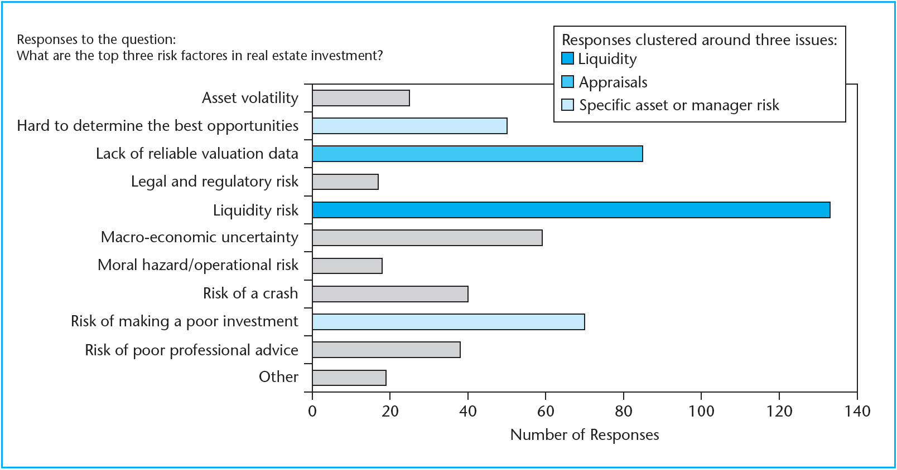
1 Introduction

Slide 5
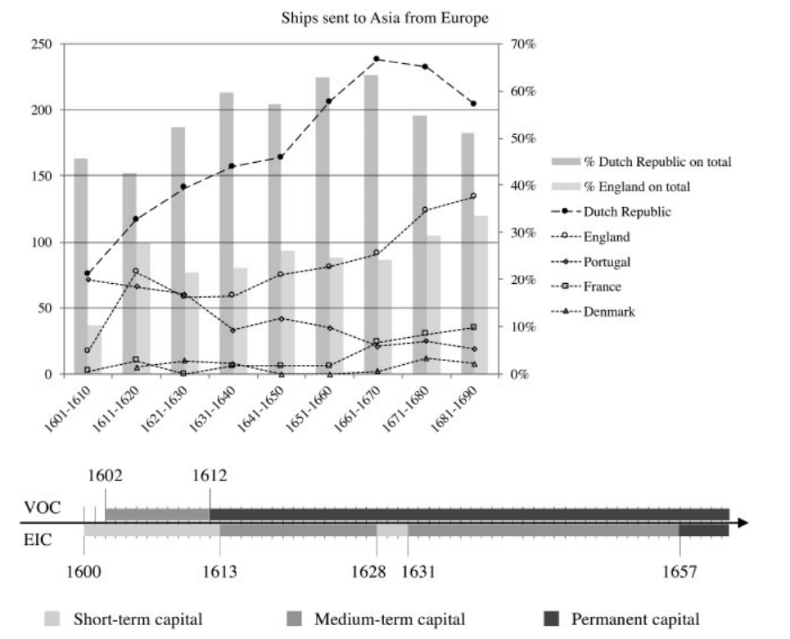
1 Introduction

Slide 6


1 Introduction

Slide 7
2 Types of Return Data
There are three major types of return data:
  Appraisal-based
  Transaction-based
  Stock market-based
We will go through the strengths and weaknesses of these types of data, but first, we will discuss some specific issues with real estate return data.
Most notably;
  Lag bias
  Random error

Slide 8
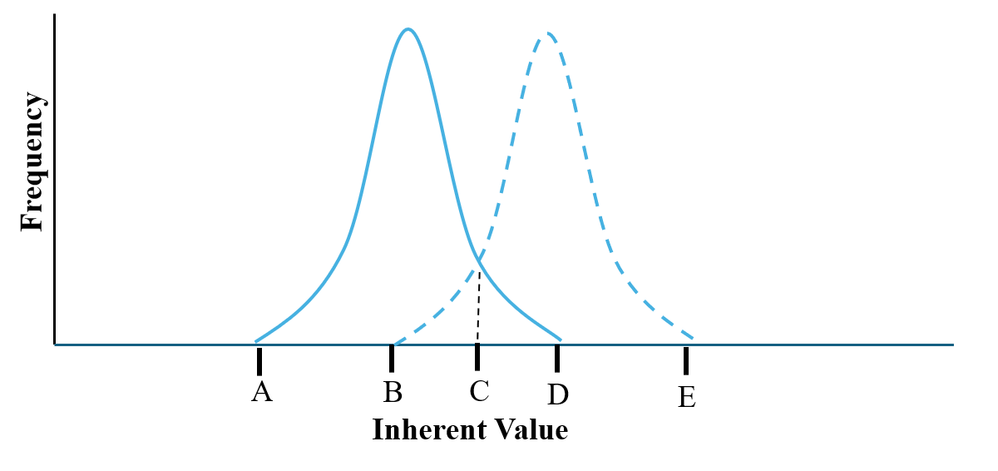
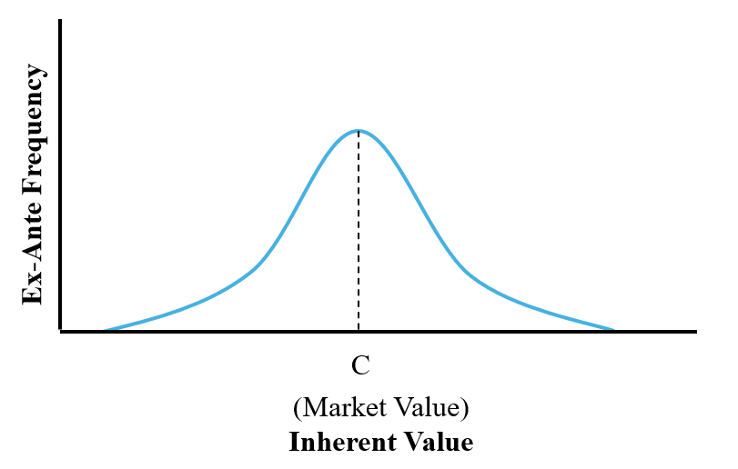
2 Noise

Slide 9
2 Noise
Values are unbiased as long as there are many participants in the market and the error is purely random.
However, with temporal lag, values will be biased.
The problem is that a less random price estimate typically also tends to be more biased.
  The more price information you are looking for, the further back in time you must look.
  Think of the famous Square Root of n Rule. If you use six comps instead of two comps, you will have 1/√3 (or about 58 percent) less error (because 6/2 = 3)
This tradeoff is different when you think of individual property appraisal or macro-level return statistics. (Like indexes.)

Slide 10
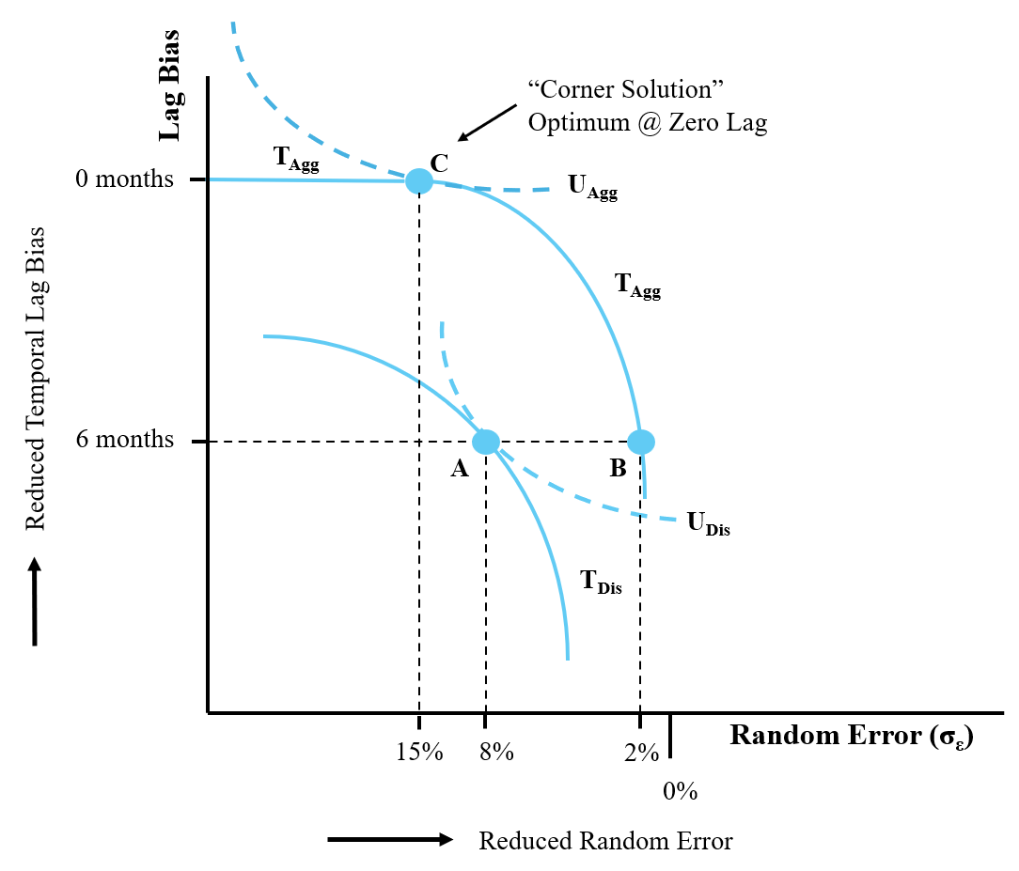
2 Noise

Slide 11
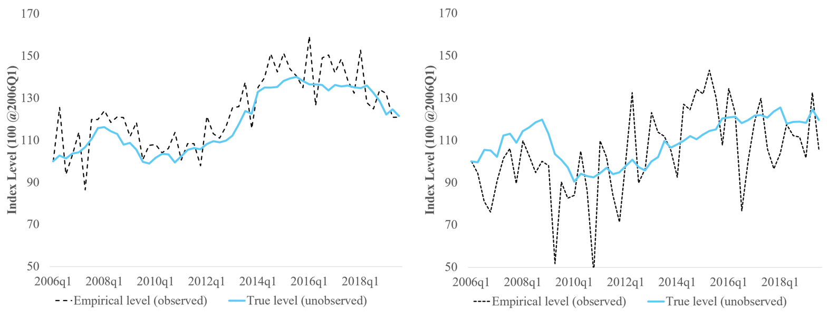
2 Noise and Index Levels
500 observations
200 observations

Slide 12
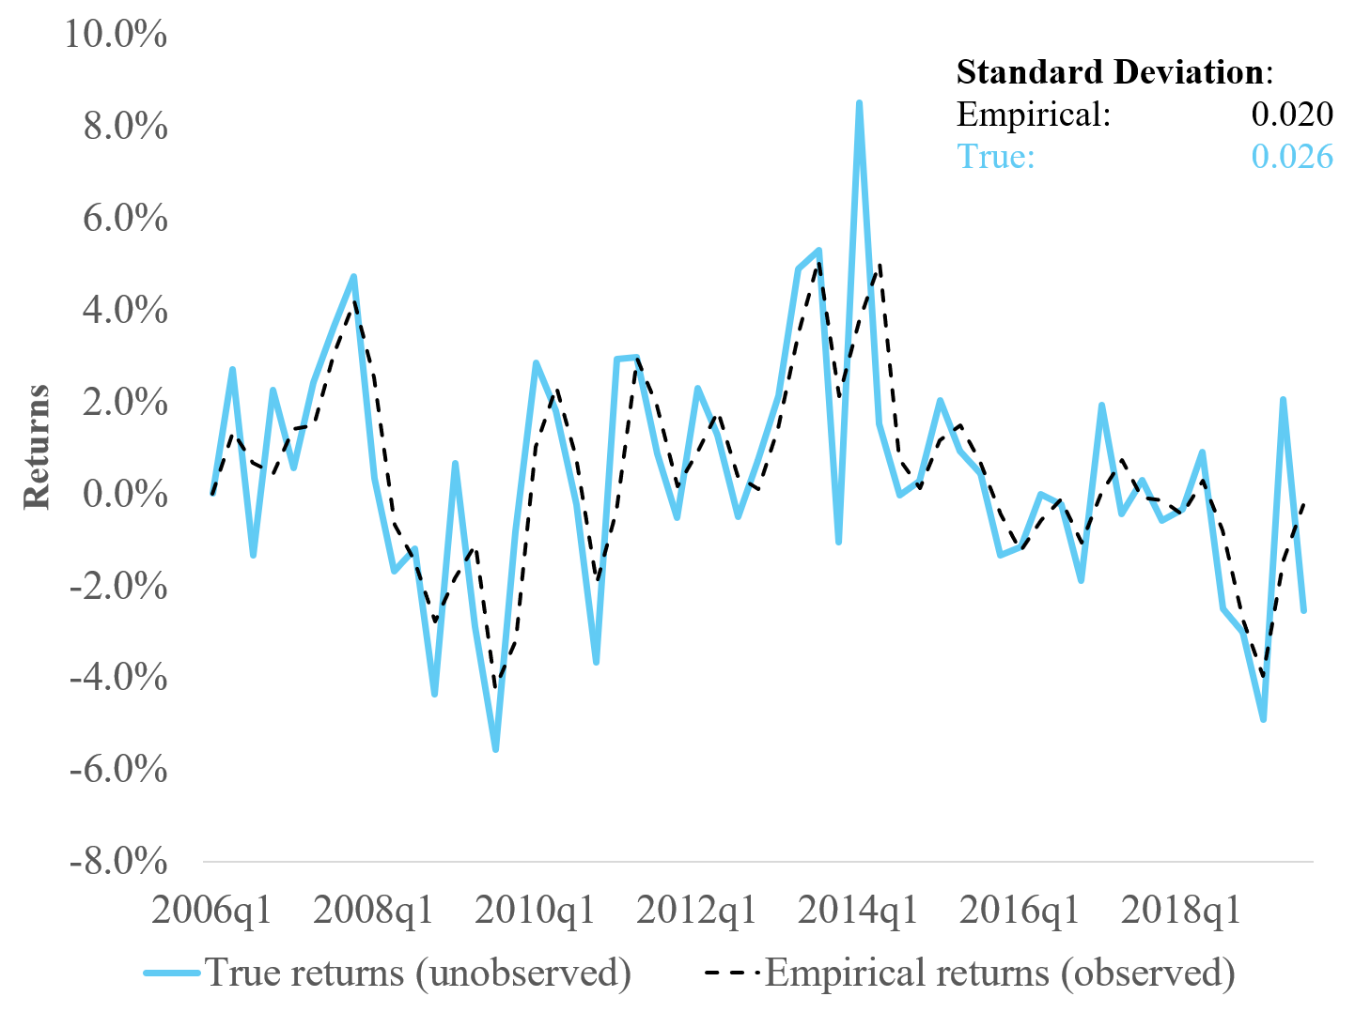
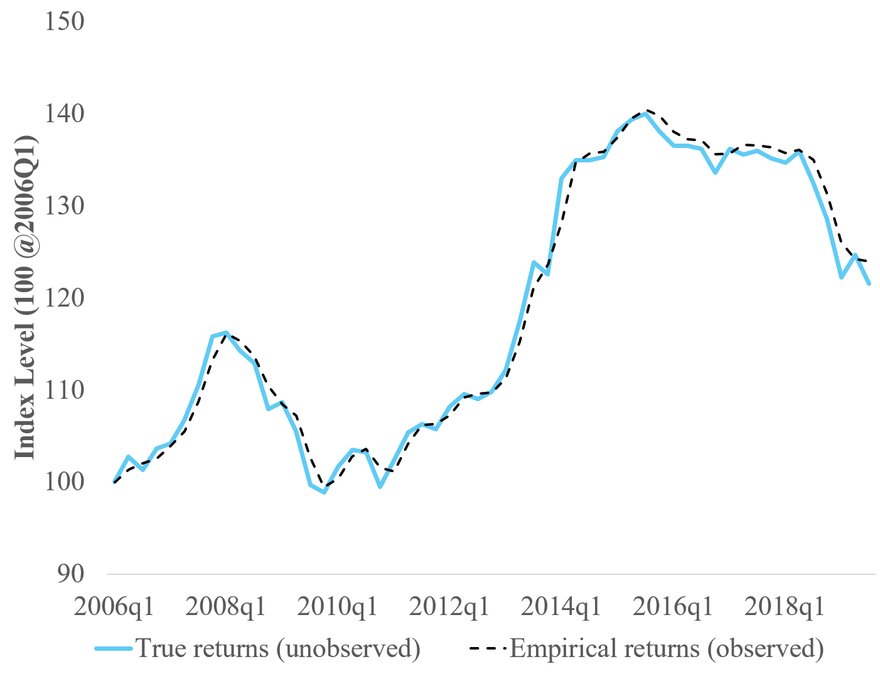
2 Lag and Indexes
returns
index

Slide 13
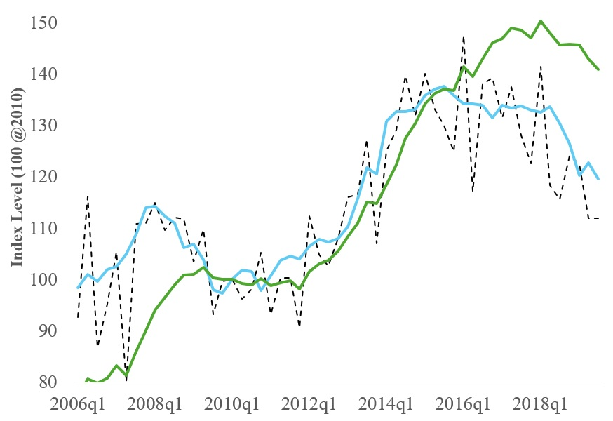
2 Putting them Together

Slide 14
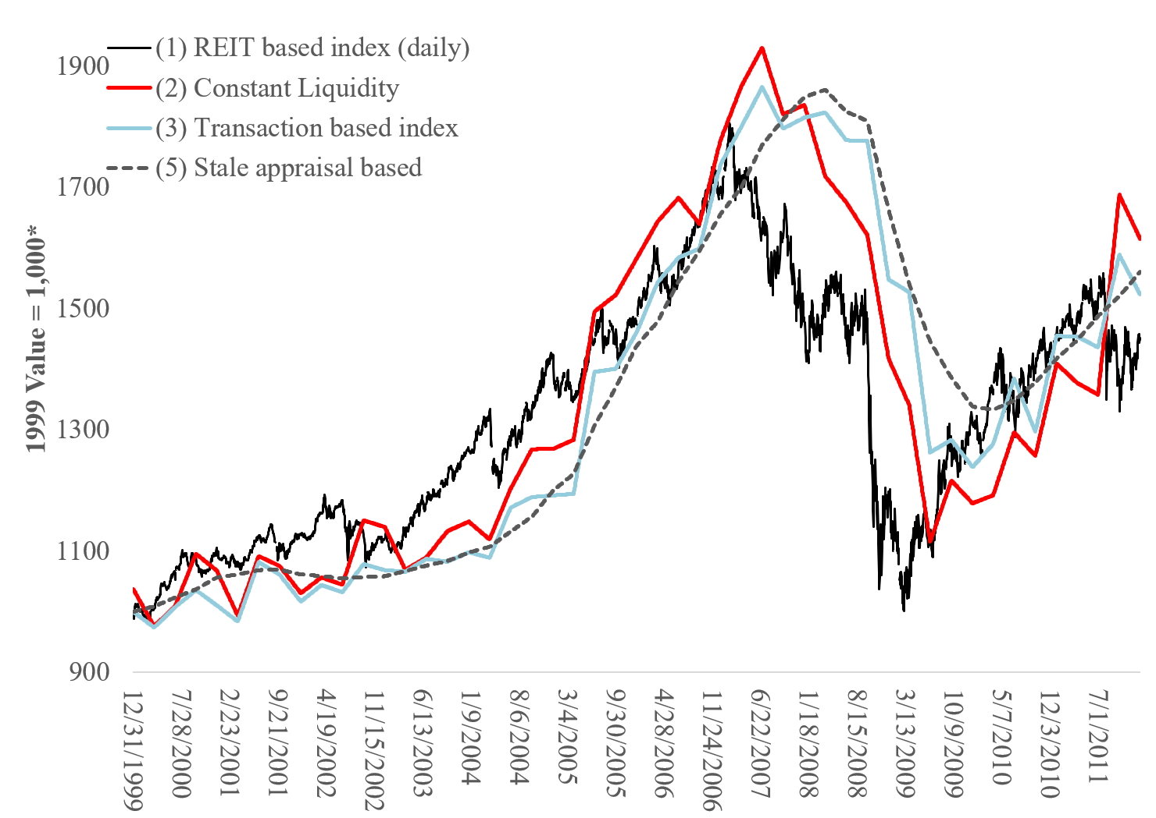
3 Circling Back, the Indexes

Slide 15
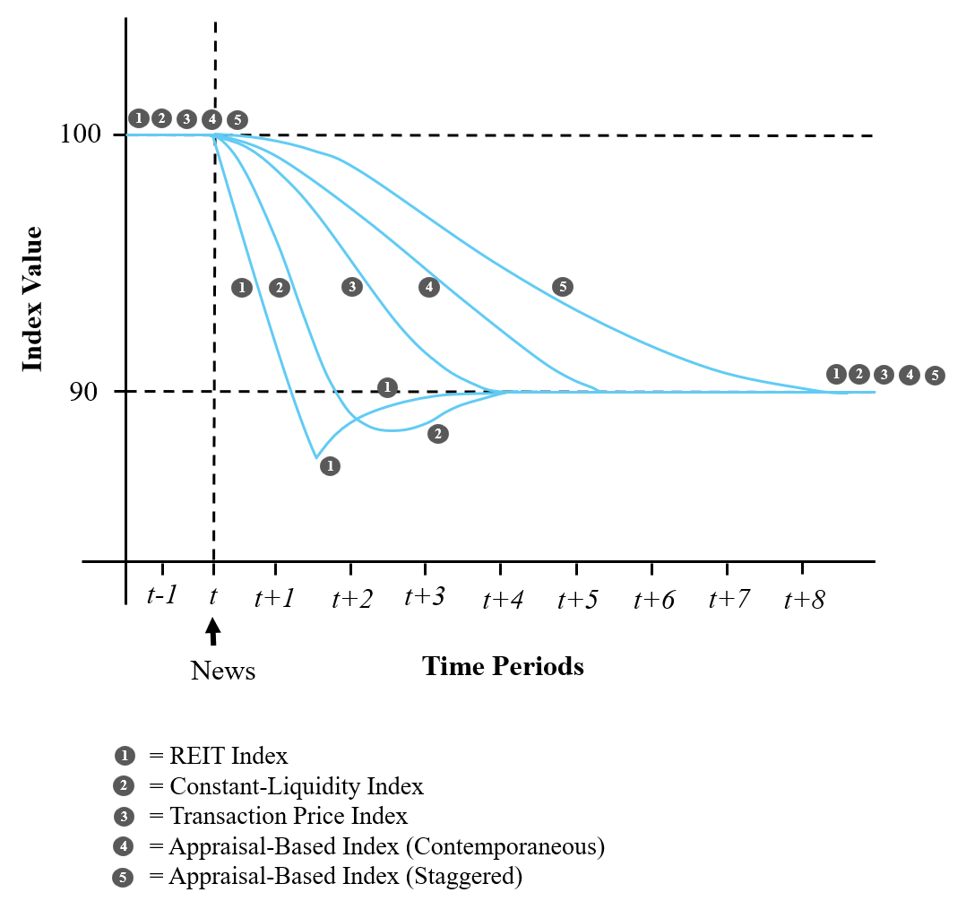
3 Circling Back, the Indexes

Slide 16
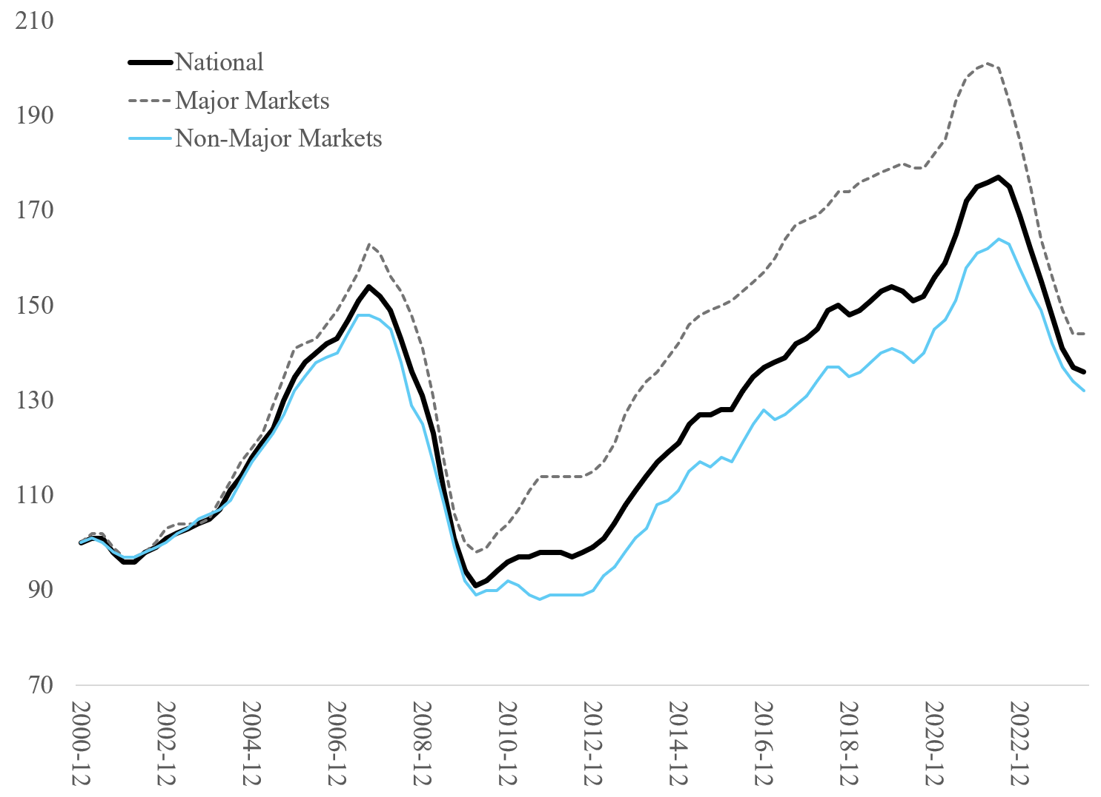
3 MSCI RCA CPPIs

Slide 17
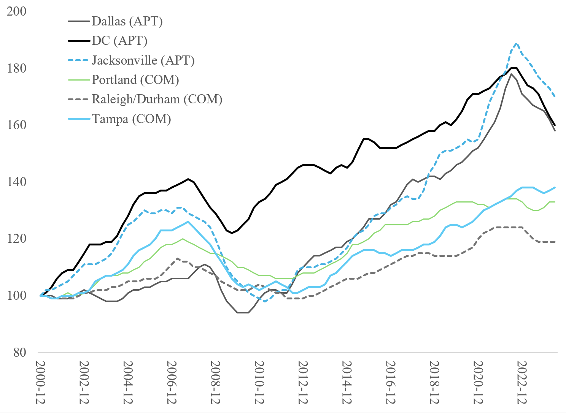
3 MSCI RCA CPPIs

Slide 18
4 Liquidity
One definition of liquidity for real estate could be;
The ease in which you can buy and sell in each market, under normal conditions, without being forced to buy or sell.
“Normal conditions” include that you can sell (or buy) the real estate for a “normal” (or market) price.
One immediate issue is the question on how do we measure liquidity?
  There is no direct index of liquidity, as it is not something you can directly measure, as say prices.
  However, we can look at the consequence of good versus bad liquidity; Transaction volume.
  With transaction volume we mean the total amount of (dollar) purchases in a given period.

Slide 19
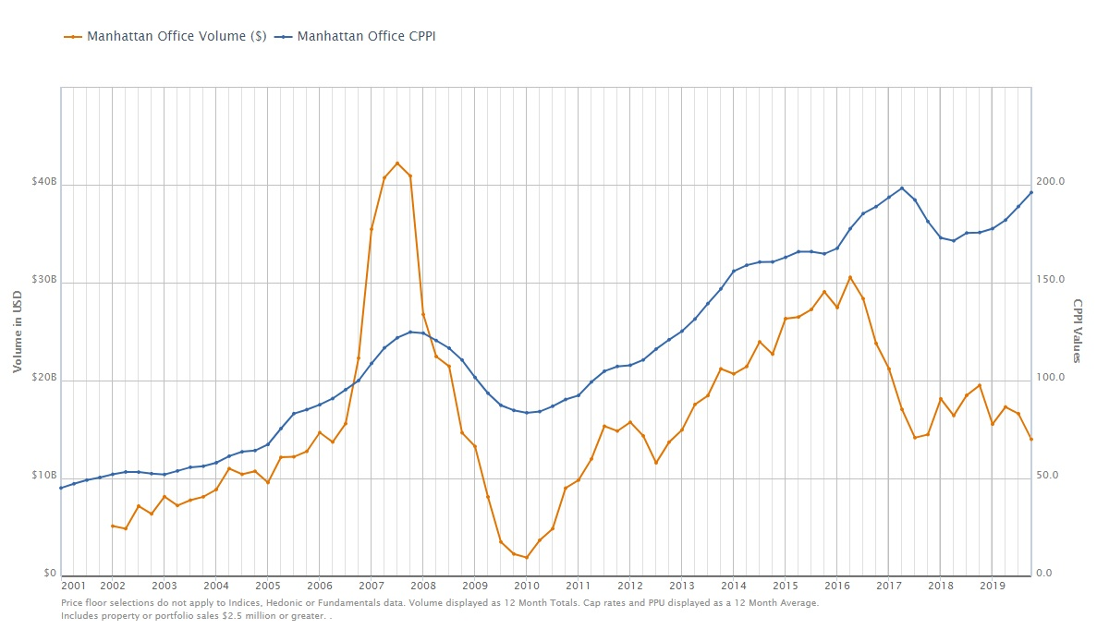
4 Transaction Volume

Slide 20
4 Transaction Volume
The trends are for offices in Manhattan.
There are a few interesting things to note;
  First, see that transaction volume drops considerably during the GFC? Prices dropped as well, but not nearly as much as transaction volume.
  Volume in general seems more volatile.
  However, there is a correlation between prices and volume. This so-called positive price-volume correlation is specific for real estate.
  Note that volume seems to lead prices?!
Whew… that seems like a lot! What is going on?
In reality it is even worse, as volume is smoothed and therefore lagged.

Slide 21
5 Supply and Demand for Real Estate
To explain some of the above phenomena, it might help to take a step back and think more thoroughly about liquidity.
Another way to look at liquidity is to think about reservation prices and how the reservation prices of (potential) buyers overlap with (potential) sellers.
  Seller: The reservation price is the minimum price for which you would sell your property in case you own the real estate.
  Buyer: The reservation price is the maximum price you are willing to pay for a property if you are a potential buyer.
  Only if the reservation price of the (potential) buyer is higher than the reservation price of the seller would we get a transaction. The average price (on a market level) is the average between the average reservation prices of buyers and sellers.
Note that reservation prices are private! However, we have statistical techniques to tease them out.

Slide 22
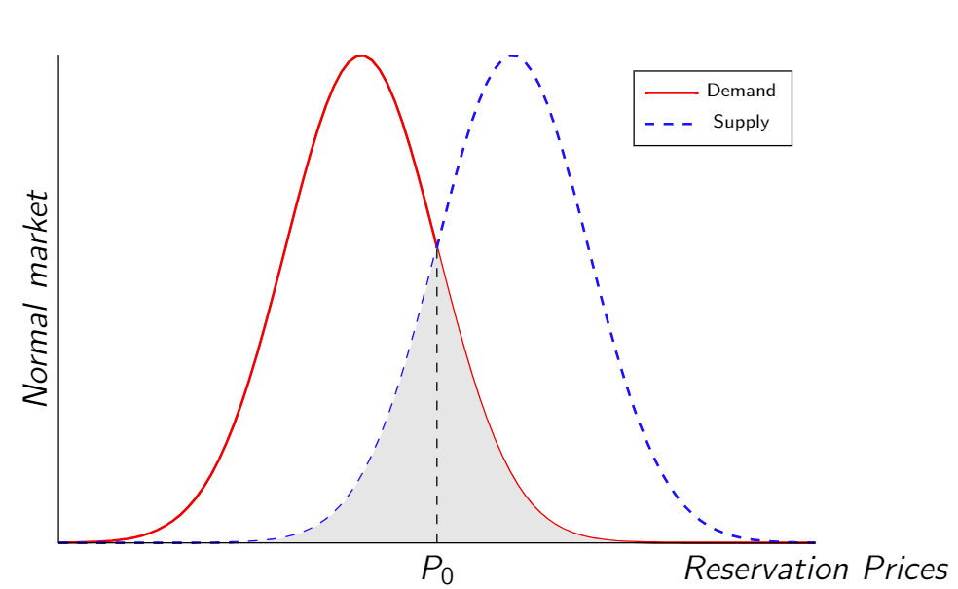
5 Supply and Demand for Real Estate

Slide 23
5 Supply and Demand for Real Estate
These buyers’ reservation price is so low, that they cannot match a buyer!

Slide 24
5 Supply and Demand for Real Estate
These sellers’ reservation price are so high, that they cannot match a seller!

Slide 25
5 Supply and Demand for Real Estate
At the point where the reservation prices overlap, do we see transactions!

Slide 26
5 Supply and Demand for Real Estate
The average transaction price is the average of both distributions.

Slide 27
5 Supply and Demand for Real Estate
The more the reservation prices overlap, the more liquid the market is, meaning there are more transactions!
Next, let’s have a look at the lead/lag relationship. Why does “liquidity” generally move first in real estate?
To understand this, we must first go back 150 years back in time and revisit Walras. More specifically, the process called “tatonnement.”
This principle is applied to many other fields, most famously unemployment and wages;
  Employers cannot “observe” the “correct” wage.
  If employees ask a raise, what should the employer do?
  If she refuses the raise (while wages have gone up) the employees will leave the company.
  The employer notices this mistake, and quickly increases wages until a new equilibrium is reached.
  Hence, the employers always “lag” the wages.

Slide 28
5 Supply and Demand for Real Estate
It is relatively straightforward to project this line of thinking to real estate.
  A real estate owner puts the property on the market, using historic information. It thinks the “correct” price should be $10M.
  Now, say that demand for real estate has gone up. This means that the sell very quickly… A bit too fast!
  The previous owner sells the property almost instantaneously and realized she could have asked $12M.
  By the time the current owners increased its reservation prices a new equilibrium is reached.
Although it should be noted, that because of the slowness in the response perhaps the market will never reach equilibrium.
Note that this means that demand for real estate is the thing that leads everything.

Slide 29
5 Supply and Demand for Real Estate – normal liquidity

Slide 30
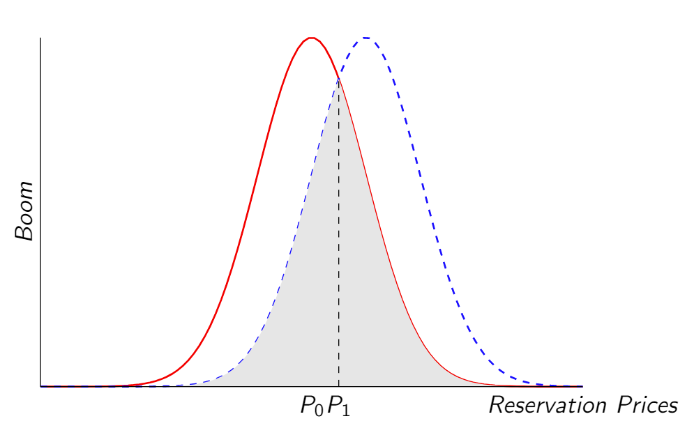
5 Supply and Demand for Real Estate – high liquidity

Slide 31
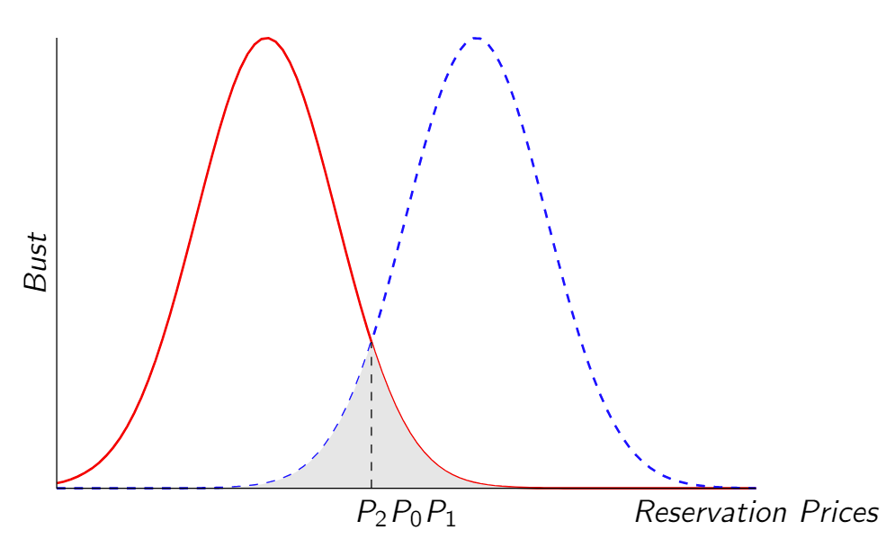
5 Supply and Demand for Real Estate – low liquidity

Slide 32
5 Supply and Demand for Real Estate
This is very fundamental stuff guys!
Note that we have all the puzzle pieces.
  Demand moves, and supply doesn’t respond immediately.
  As a result, demand moves first and drives the market.
  Properties will sell more often, and for higher prices.
  This is essentially why we observe positive price-volume correlation in real estate.
Liquidity is measured by how far the reservation prices (on average) of buyers and sellers are apart.
Let’s look back in history and see how all these elements moved together. (Prices, reservation prices for buyers and sellers and liquidity.)

Slide 33
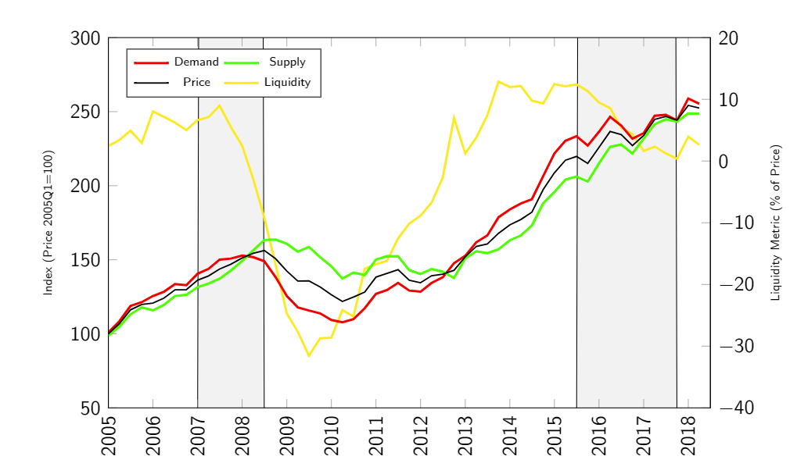
5 New York

Slide 34
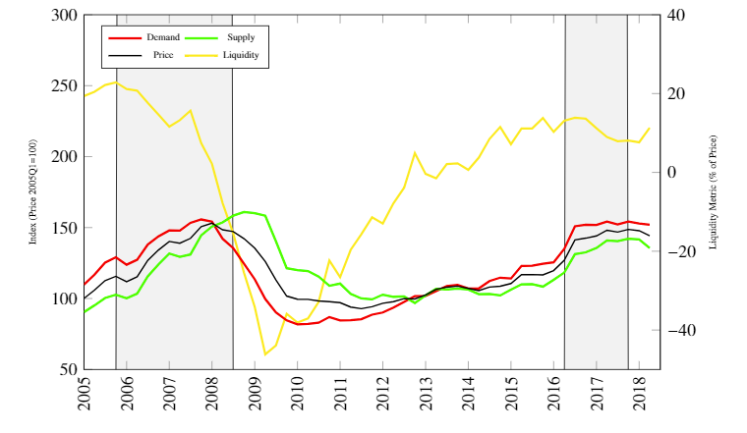
5 Phoenix

Slide 35
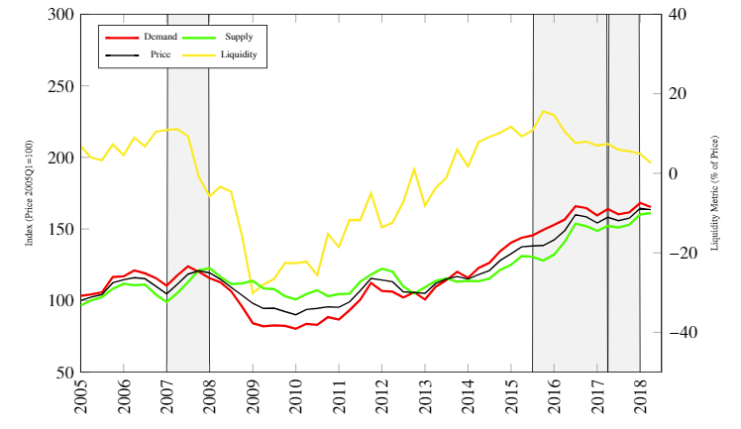
5 Boston

Slide 36
5 Supply and Demand
Note that the red line (representing demand) indeed almost always leads the other lines.
Another point that is very interesting is the correlation between the liquidity of the markets. (The yellow line.)
  To make sure it is not some statistical fluke, we looked at multiple cities in the US.
  We find that this correlation persists.
  What could drive these correlations?
  Liquidity for real estate is mostly driven by the asset market. Remember that the asset market is a cointegrated market and co-moves to a large extent? This is another manifestation.
  New researched showed that it mostly goes through interest rates. Lower interests spurs demand, etc.

Slide 37
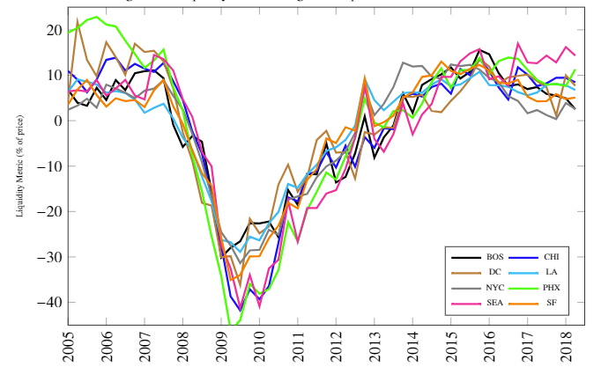
5 Supply and Demand

Slide 38
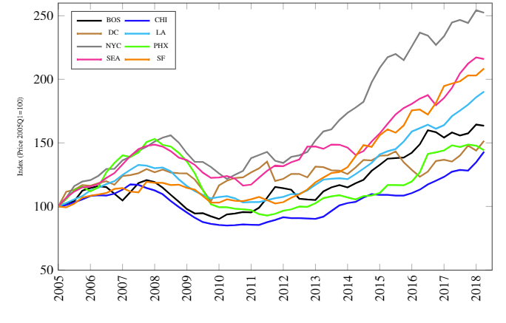
5 Supply and Demand

