Slide 1
Discounting Cash Flow with (Re)Development
The Economics of Construction
Alex Van de Minne

Slide 2
1 Introduction
What are we going to do during this class:
When is a development desirable.
The problem with not using NPV analysis for developments are;
  Difficult to communicate an investment analysis with mainstream investment and corporate finance world. (Both debt, and equity.)
  The decision-making lacks the kind deep understanding that can facilitate greater creativity and innovation in project conceptualization and deal formation.
Again, real estate investment analysis – and especially developments – are like capital budgeting.
Today we are going to apply all the DCF/NPV rules we know to developments.

Slide 3
2 Features of Developments
Investment in developments is different from investing in stabilized assets. Right? Hence a separate module.
Summarized, we can identify three main differences;
  Time-to-build. In development projects the investment cash outflow is spread out in time, instead of occurring all at once up front. This is essentially where the operational leverage comes from discussed last week.
  Construction loan. Use of (100% of construction cost) debt financing is used universally.
  Phased risk regimes. Mostly because of the aforementioned “operational leverage”, development typically has different levels of investment risk between the construction phase, the absorption phase (or lease-up) and the stabilized asset phase.

Slide 4
2 The Basic Idea
The Net Present Value for the investor point of view is equal to the difference of the value of the property being obtained and the cost of obtaining it, or;
NPV = V – P
Where V is the value of the property, and P is the price of obtaining it.
Net Present Value means we “bring back” the values to one point in time (so-called year 0).
Note that year 0 in development is when you exercise your irreversible option to develop the property!
It is assumed that you exactly pay for the value for something, or NPV = 0.

Slide 5
2 The Basic Idea
We already did this for stabilized asset.
Let’s take a simple example, of a property (let’s call it property A) which has an PBTCF of $900,000 per year (or $75,000 per month) in perpetuity with a return requirement of 9%. The property is perfectly HBU.
No growth expectation.
Hence the value (and thus price) is simply;
    $900,000/0.09 = $10,000,000
Say that this property is an office in the Harford area and consists of two separate towers, each valued at $5M (as they are similar).
Now – say – that there is a piece of vacant land on the other side of the road of property A. Let’s call it property B.
The HBU of property B is exactly (same FAR / same property type) the same as that of property A.

Slide 6
2 The Basic Idea
To built property B (which will exactly the same as property A) will take us 1 year to built. The cost;
  $1.5M in month 3.
  $1.5M in month 6.
  $1.5M in month 9.
  $1.5M in month 12.
Thus totaling of $6M spread out over one year.
At month 6, tower 1 is done and the second tower is finished at month 12.
Note that both towers are similar and are thus expected to be worth $5M each.
Again, year 0 is when we made the irreversible decision to built this property B.

Slide 7
2 The Basic Idea
This type of multibuilding development we call parallel.
The building are completely independent of each other, and can be build separately or simultaneously.
You can value the land by simple-call options on each of the properties.
This is different from sequential development.
In this case you cannot start one phase before finishing the preceding phase.
This more complex to price, and is out of the scope of this lecture series. You would have to model a series of compound options.
However, we are already at year 0, so do not think too much about option values anyways!

Slide 8
2 The Cash flows
Note that every tower generates $450,000 per year, or $37,500 per month per building. Also note that with developments we typically talk in months, as timing becomes very important.
As we now know, the value of the land is the price that you can pay for the land if the project is zero NPV, where the project is HBU.
We are now going to predict the cash flows, both on the benefit and cost side, which will enable us to calculate the land value.
The construction costs are typically denoted K.

Slide 9
2 Benefit Side (V)
Given that property B is the same as property A, we can also use the same discount rate.
This is 9% per year, or 0.75% (0.0075) per month.
We can compute the value now in two different ways – depending on what we want to do with the property – which will render similar results.
We can either;
  Option 1: Sell the towers whenever they are done. So, tower #1 at month 6, and tower #2 at month 12.
  Option 2: Keep tower #1 until month 12 (but enjoy the cash flows in the meantime) and then sell both at once.

Slide 10
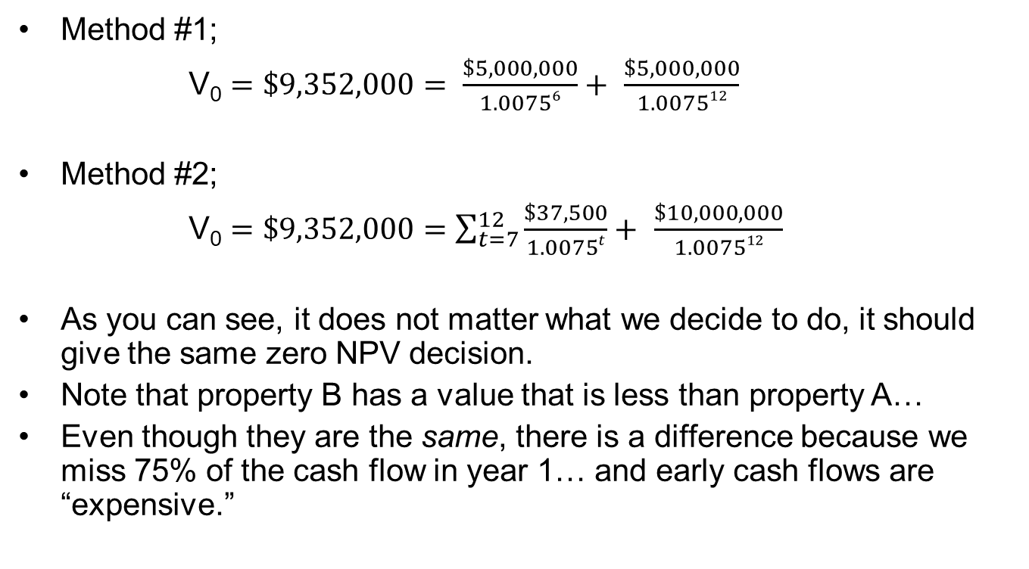
2 Benefit Side (V)
Method #1;
V₀ $=\$9,352,000= \frac{\$5,000,000}{1.00756}+$ $\frac{\$5,000,000}{1.007512}$
Method #2;
V₀ $=\$9,352,000=\sum_{t=7}^{12}{\frac{\$37,500}{1.0075t}}+$ $\frac{\$10,000,000}{1.007512}$
As you can see, it does not matter what we decide to do, it should give the same zero NPV decision.
Note that property B has a value that is less than property A…
Even though they are the same, there is a difference because we miss 75% of the cash flow in year 1… and early cash flows are “expensive.”
Notes:
Note that you would still have to compute the NPV of the building in reality.
You also have to somehow know the income.

Slide 11
3 Cost Side (K)
Next, we look at the costs of development.
At first this seems easy enough!
We have $1.5M of costs in month 3, 6, 9 and 12.
The bigger question is; what return requirement should we use?
Is it going to be higher or lower than the 9% OCC of the stabilized asset?

Slide 12
3 Cost Side (K)
Next, we look at the costs of development.
At first this seems easy enough!
We have $1.5M of costs in month 3, 6, 9 and 12.
The bigger question is; what return requirement should we use?
Is it going to be higher or lower than the 9% OCC of the stabilized asset?
It’s lower, actually close (or equal) to the risk free rate!
Wait, what?!
This obviously need some explanation.
Although note that the risk coming from operational leverage is similar to risk via financial leverage (mortgage).

Slide 13
3 Cost Side (K)
First of all, think of how a developer thinks about risk of construction cost.
She is probably afraid that the cost of development might be higher then budgeted beforehand.
Thus, she would do good to put in enough contingencies as well.
Also, you want to give the construction cost a large (negative) value, which you do by taking a low cost of capital.
There are also financial economic reasons to have a low cost of capital.

Slide 14
3 Cost Side (K)
Lack of systemic risk. Unexpected increases in construction cost do not tend to correlate with financial or capital market factors. Thus, this risk can be diversified away (negative “beta” in CAPM) and should, thus, not be priced in.
Fixed price. Remember that risk comes from not being able to predict the (negative) cash flows. However, in development, the construction costs are fixed or semi-fixed, reducing (or eliminating completely) this “risk.”

Slide 15
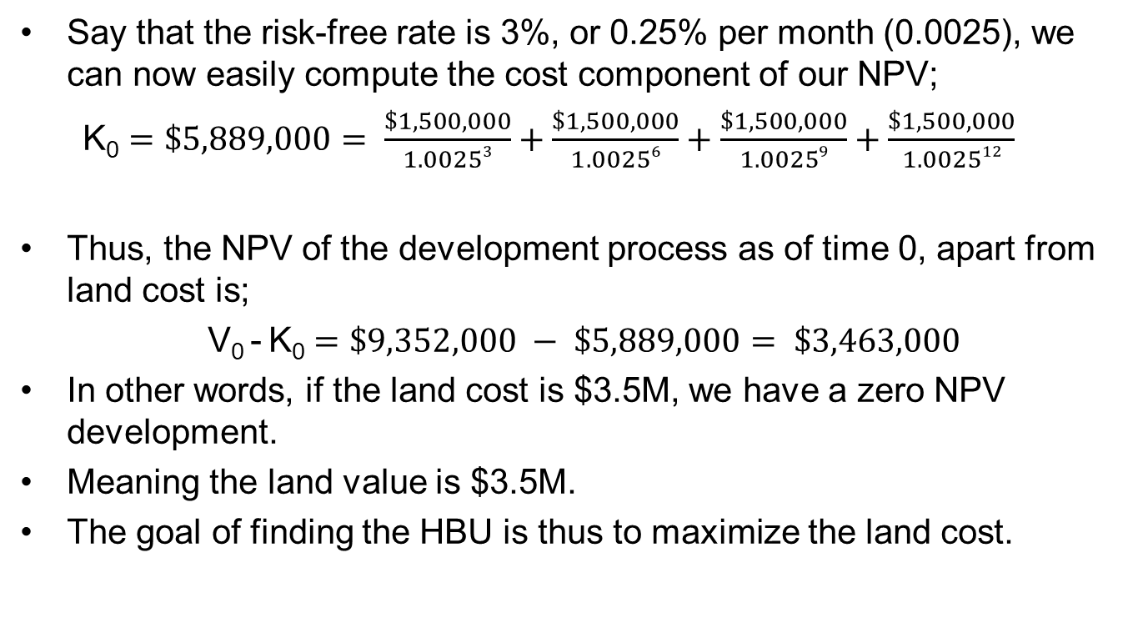
3 Land Cost
Say that the risk-free rate is 3%, or 0.25% per month (0.0025), we can now easily compute the cost component of our NPV;
K₀ $=\$5,889,000= \frac{\$1,500,000}{1.00253}+\frac{\$1,500,000}{1.00256}+\frac{\$1,500,000}{1.00259}+\frac{\$1,500,000}{1.002512}$
Thus, the NPV of the development process as of time 0, apart from land cost is;
V₀ - K₀ $=\$9,352,000 − \$5,889,000= \$3,463,000$
In other words, if the land cost is $3.5M, we have a zero NPV development.
Meaning the land value is $3.5M.
The goal of finding the HBU is thus to maximize the land cost.

Slide 16
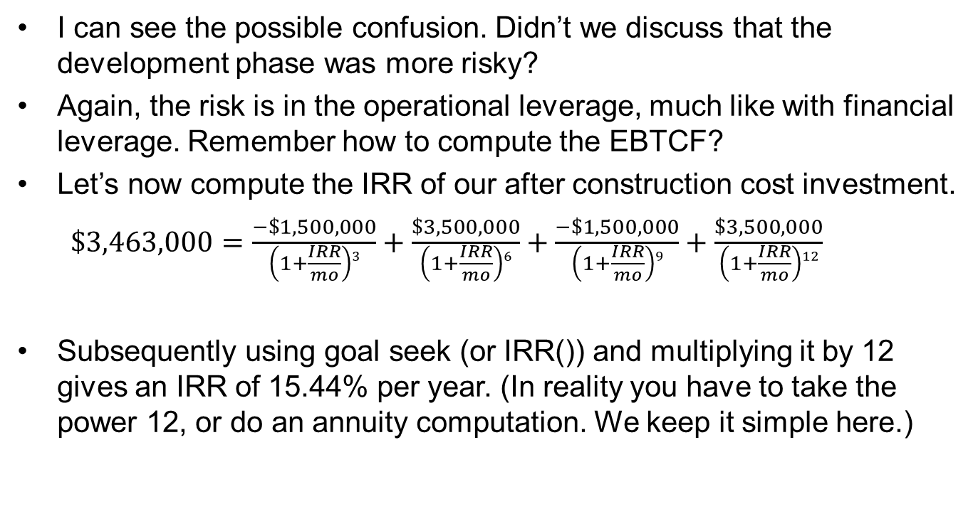
3 Operational Leverage
I can see the possible confusion. Didn’t we discuss that the development phase was more risky?
Again, the risk is in the operational leverage, much like with financial leverage. Remember how to compute the EBTCF?
Let’s now compute the IRR of our after construction cost investment.
$\$3,463,000=\frac{−\$1,500,000}{\left(1+\frac{IRR}{mo}\right)3}+\frac{\$3,500,000}{\left(1+\frac{IRR}{mo}\right)6}+\frac{−\$1,500,000}{\left(1+\frac{IRR}{mo}\right)9}+\frac{\$3,500,000}{\left(1+\frac{IRR}{mo}\right)12}$
Subsequently using goal seek (or IRR()) and multiplying it by 12 gives an IRR of 15.44% per year. (In reality you have to take the power 12, or do an annuity computation. We keep it simple here.)

Slide 17
3 Operational Leverage
If we take out the risk-free rate out of both Property A and Property B’s expected total return we get;
  Property A: 9% - 3.00% = 6.00%.
  Property B: 15.44% - 3.00% = 12.44%.
This means that the risk premium for the development is 12.44/6.00 = 2.07 times that of a stabilized property. We call this the development risk ratio.
Again, there is no arbitrage, so it follows neatly the SML.
This difference is caused by the operational leverage! Again, this increase in expected return is caused by the fact that changes in K and V are not correlated.

Slide 18
3 Operational Leverage
A next obvious question is, what is the correct cost of capital for our development project?
Apparently, we have some control over it.
Or do we not even care?

Slide 19
3 Operational Leverage
A next obvious question is, what is the correct cost of capital for our development project?
Apparently, we have some control over it.
Or do we not even care?
Very generally speaking, there are two ways to increase your operational leverage;
  Having high construction costs (K) as a fraction of the properties’ value (V).
  Earlier realization of V (as compared to when K occurred) also increase operational leverage. Thus, selling of as many assets early as possible increases the expected return.

Slide 20
3 Control over Operational Leverage
Say that we do not sell off the building immediately, but instead hold it from month 7 through 12, and only then sell it, while enjoying the rental income in the meantime.
If we do this in Excel, we find that the IRR is 12.81% per year.
Thus we decreased our expected return by keeping the property.
So much like with financial leverage, the operational leverage gives you some control over the amount of risk you want.
This makes development also interesting from a management point of view where you try to hit a certain risk/return profile.
But what is the correct OCC?
Both!
Notes:
Talk about lease-up risk as well. How that affects occ…

Slide 21
3 Control over Operational Leverage
The “market” can also allow for different values for the operational leverage.
Remember that market with high volatility will have higher land values (because of the option valuation process)? Lower cap rates will also relate to higher land values.
Because the land values are relatively high (as a fraction of total property value), the inverse is also true; the construction costs (i.e. the structure value) is relatively low.
In other words, investing in high land value markets, will also result in low operational leverage, and thus less risk, all things equal.
For example, in an extreme case where the construction cost are only a negligible fraction of the total property value, the development will be as risky as the stabilized asset.

Slide 22
3 Control over Operational Leverage
This can also help you flag whether or not you are constructing according to HBU.
  Suppose you find that your development risk ratio is fairly high, but you are investing in a high volatile / low cap rate market. This indicates that you are not adding enough value to the site, and you should probably spent less on the building (different scale or property type).
  Likewise, if you find a low development risk ratio for you project, that is located in a low volatile / high cap rate market, you might want to increase the FAR (or quality per square foot) of the property.

