Slide 1
Investing in (Re)Development
Development Process
Alex Van de Minne
April, 2025

Slide 2
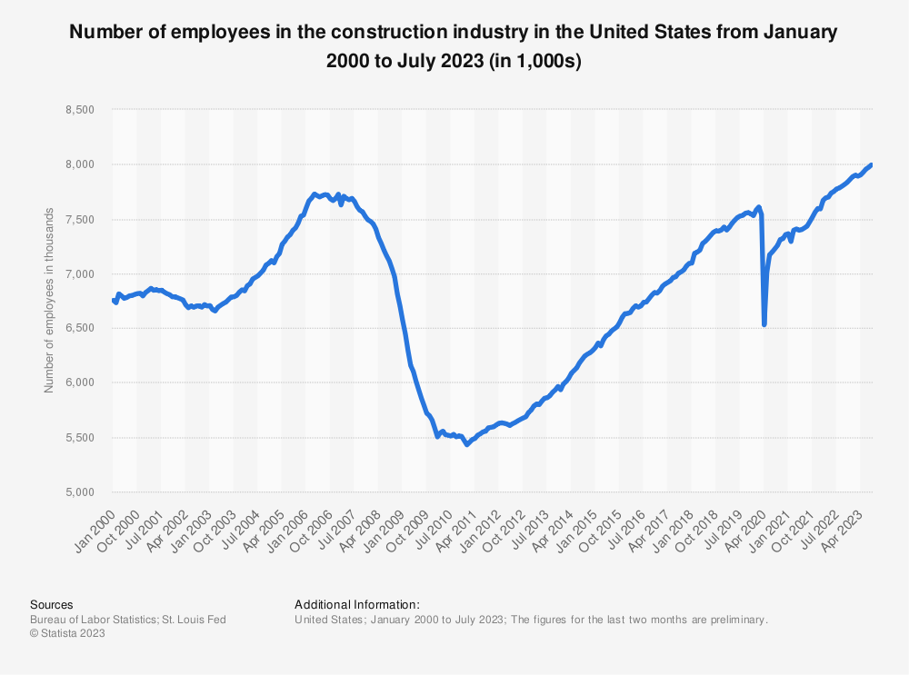
1 Introduction

Slide 3
1 Introduction
What are we going to do during this class:
Development is very important for many reasons.
  Housing alone contribute 17% tot total GDP, mostly via renovations and developments.
  You can actually add value with developments!
Today we will look at the development process in overview.

Slide 4
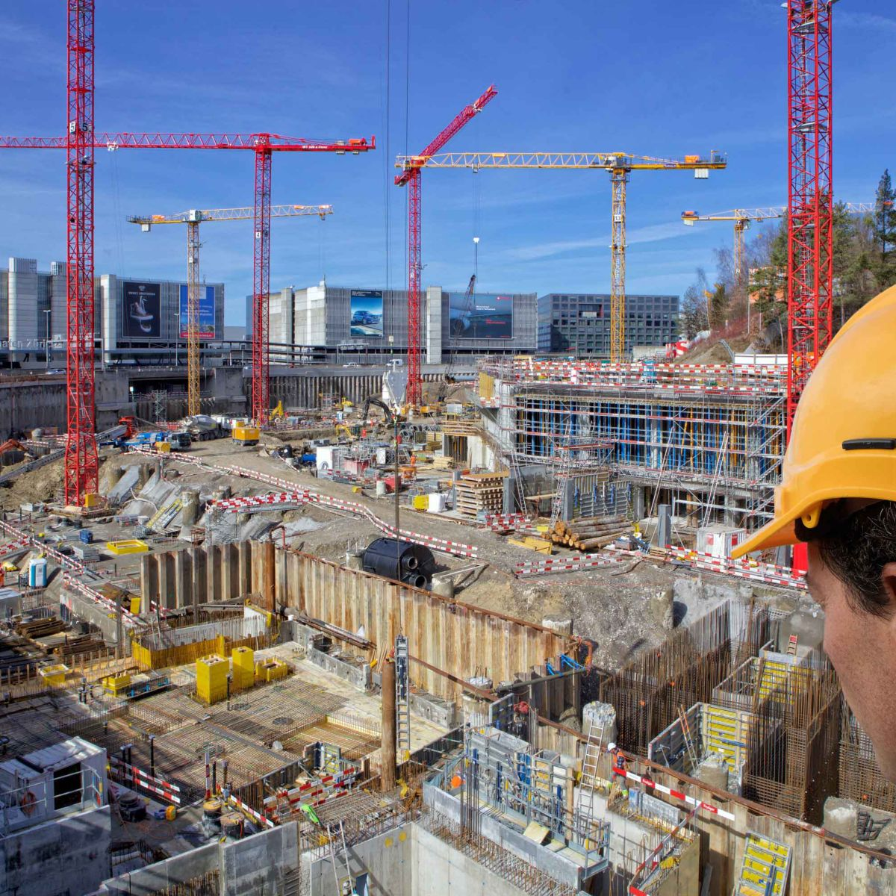

Slide 5
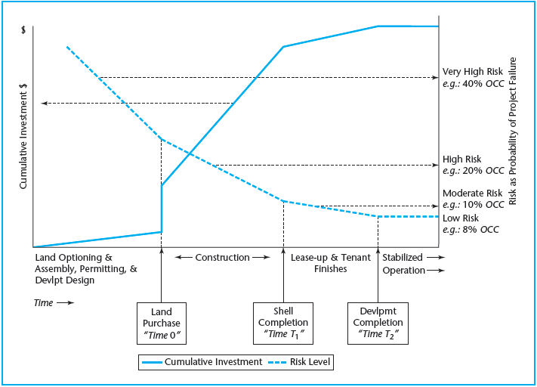
The four stages of development

Slide 6
The four stages of development
Notes:
IMPORTANT NOTE: you could have purchased the land earlier, however, you also can sell it in the mean time, meaning the investment is zero up to that point. Only when you start construction, is the land irreversibly conjoined with the development project. Land optioning means you bargain a option to buy the land at a certain date for a specific price, so you have the time to finish the permits, testing the soil etc.

Slide 7
Highest and Best Use
Graaskamp famously that development can be described by two scenarios;
  There is a site looking for a use.
  There is a use looking for a site.
With the first, you already own a piece of land, and you are looking for the HBU of that site. Thus, the main focus of such an exercise is the find HBU, etc.
The second mostly occurs when a developer has a special expertize, like biotech space or senior-oriented housing. We find a lot of retail specialization in the real world. In this case you have to find to perfect location (demand-wise and competition-wise) for your new property.

Slide 8
Highest and Best Use
Graaskamp famously that development can be described by two scenarios;
  There is a site looking for a use.
  There is a use looking for a site.
With the first, you already own a piece of land, and you are looking for the HBU of that site. Thus, the main focus of such an exercise is the find HBU, etc.
The second mostly occurs when a developer has a special expertize, like biotech space or senior-oriented housing. We find a lot of retail specialization in the real world. In this case you have to find to perfect location (demand-wise and competition-wise) for your new property.
Notes:
This going to be our main focus. The second is very different for every developer, and thus difficult to generalize. Also, the first is just more interesting and fun…

Slide 9
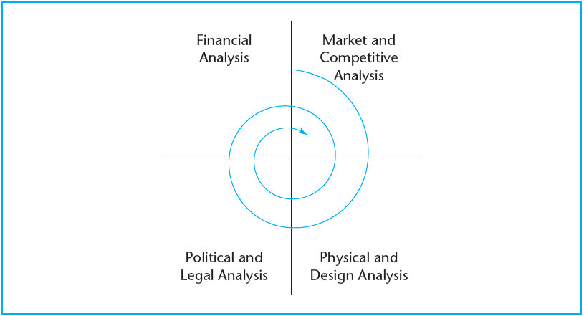
Site looking for a use

Slide 10
Site looking for a use
Development will cycle through analysis from at least four different disciplinary perspectives;
  Urban economics. Knowing the real estate space market.
  Architectural/engineering. Physical analysis.
  Legal/political. Think of zoning restrictions, etc.
  Financial economics. Knowing the real estate asset market, and the borrowing market.
Obviously, our focus is on the feasibility of developments. However, development is very tricky and needs input from multiple disciplines, and one good entrepreneur to put it all together!
Notes:
This going to be our main focus. The second is very different for every developer, and thus difficult to generalize. Also, the first is just more interesting and fun…

Slide 11
Site looking for a use
General flow:
Find the Highest and Best Use of a plot of land.
Make a design and get all necessary permits.
We are going to discuss;
  The cost-side. Known as the construction and absorption budget.
  The benefit-side. Also known as the operating budget.
In order to know how much the property will sell for, you will need to do a DCF of the finished property!
  However, it will only be finished in a year or two. What to do?
Purchase (or option) the land (assemble) and find a limited / money partner.
Find as many tenants as possible.

Slide 12
Cost of Construction
We typically divide construction costs into two subgroups;
  Hard costs. Direct cost of the physical components of the project, like building materials and labor.
  Soft costs. Basically, everything else, like design, legal and interest rate on the construction loan. (I.e. financing costs.)
Where the land acquisition cost or opportunity cost of land is placed depends on who you ask.
  It is also sometimes a completely separate item to make it even more confusing…

Slide 13
Cost of Construction
Hard costs
Land cost*
Site preparation costs
Permits
Contractor fees
Management and overhead
Materials
Labor
Equipment rental
Tenant finish
Developer fee
Soft costs
Loan fees
Construction interest
Legal fees
Soil testing
Environmental studies
Land planner fees
Architectural fees
Engineering fees
Marketing cost
Leasing commissions

Slide 14
Cost of Construction
Other than costs associated with constructing the physical asset, there are also so-called absorption or lease-up cost for income producing properties.
  This absorption budget is necessary when a project is built at partially on spec. In other words, the property was not pre-leased at the time of the development decision.
You need an absorption budget until at least;
  Property-level; current building is break even on a current cash flow basis.
  Financial-level; until the building is at or near its expected long-term occupancy level. Only at this point is the property “stabilized” (meaning it has the expected risk/return profile). This is also the moment you can get a permanent loan.

Slide 15
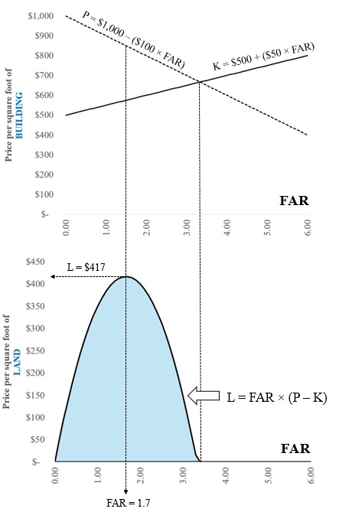
Finding FAR

Slide 16
Stage 1: Preliminary state
Most creative and entrepreneurial time of the project!
This phase of development can include;
  Optioning and assembly of separate land parcels or infrastructure requirements.
  The design of the project.
  Doing a Highest and Best Use analysis of the project.
This phase is characterized by the highest degrees of iterations between the disciplines described before.
This phase is where the most value is created! It is also the stage where you have the most risk (it is basically land speculation), even though the invested amount is relatively small.
At the end of this stage, you have the right to start construction.
This phase can take decades!

Slide 17
Intermezzo: What happens here?

Slide 18
Intermezzo: What happens here?
The land is bought here!

Slide 19
Partnership structure
General partner (the entrepreneur) needs a limited partner for two reasons;
  The GP simply does not have the money.
  The bank (for construction loan) requires collateral, something a GP typically doesn’t have.
The deal is usually structured as a waterfall. This works;
  Less risk for the LP. It gets a preferred return.
  The GP supervises the development process and get compensated for this.
  The GP can get huge returns and is therefore incentivized.

Slide 20
The four stages of development

Slide 21
Stage 2: Construction
This is the moment were the bulk of the capital expenditures take place.
Here you pay for the entire construction cost of developing the site.
This phase is risky for two reasons;
  In many/most cases, the building is leased-up before construction starts. Thus, it is not known for certain what the occupancy will be. (A space market risk.)
  Development investments inherently contain “operational leverage”, even if there is no loan, because you have to pay the construction costs, no matter how much the property is worth at completion.
    Suppose construction costs are $70M, and you bought the land for $20M, and the present value of the constructed property is $100M. What happens if this present value happens to be 10% less?

Slide 22
Cost of Construction Loan
As we noted earlier developments are financed by a temporary construction loan.
You typically do not pay interest while the development is underway.
In contrast, you pay back the principle and the full accrued interest after the loan is refinanced to a permanent loan.
A construction loan is typically not a lump sum amount, but rather a maximum is negotiated, and as the construction moves forward, funds are drawn out.
The construction loan provider, typically will check the development status during the process.

Slide 23
Cost of Construction Loan
Say you have a loan with 8% annual interest.
  Thus monthly interest is 8%/12.
The new loan balance increases because the principle is not paid.
At the end, the new loan balance is $2.78M, whereas the withdrawn amount is $2.75M. The difference is the accrued interest.
Month | New Draw | Current Interest | New Loan Balance
1 | $ 500,000 | $ 3,333 | $ 503,333
2 | $ 750,000 | $ 8,356 | $ 1,261,689
3 | $ 1,500,000 | $ 18,411 | $ 2,780,100
4 | and so on

Slide 24
Cost of Construction Loan
The lender typically checks whether or not all previous work has been done.
  For smaller project just showing the receipts of all subcontractors is enough.
  For bigger projects, the lender might send inspectors.
There is always a contingency budget of around 5-10%.
The construction lender, also typically requires that the developer already obtains a commitment in advance from a permanent lender.
  This is also why the permanent loan is sometimes referred to as a take-out loan.

Slide 25
The four stages of development
© OnCourse Learning

Slide 26
Stage 3: Leasing up & Tenant Finishes
This stage starts when the outer shell is done.
The inside can be finished.
However, it is quite common that (in case of long-term leases) the future tenants are involved in finishing up the inside.
  Both tenant and developer can pay for such finishes, it really depends.
Less capital needed, and also less risky by now.
Together with the construction phase, both phases represent the development project.
The development can take several years.
Sometimes, with multiple buildings for example, this phase itself might be subdivided into multiple stages. Flexibility!

Slide 27
The four stages of development
© OnCourse Learning

Slide 28
Stage 4: Stabilized
At the end of the development, we have a stabilized property.
It now operates at its long-run steady-state level of profitability.
Usually, this means recapitalization;
  Different investors are in the market for such low-risk property.
  The construction loan will be retired, by replacing it with a “permanent” commercial mortgage on the property.
Starting from now, we can use the tools we developed earlier to do our investment analysis on the existing property.

Slide 29
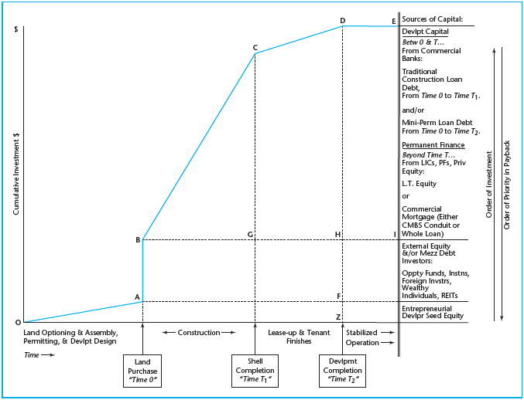
Sources of Debt

Slide 30
Sources of Debt
Entrepreneur’s money

Slide 31
Sources of Debt
Money partner’s money

Slide 32
Sources of Debt
Construction loan

Slide 33
Sources of Debt
Sold to end user.

Slide 34
Sources of Capital
Even though this course is not about debt financing, it is important from the development workflow point of view to understand where the capital comes from. We identify three stages;
  First, we have the seed equity from the entrepreneur starting the project in the preliminary phase. It is a relatively small amount, but with a high return requirement.
  Next, we find that “money partners” / Join Venture partners jump in, like opportunity funds, financial institutions (like pension funds) or public real estate firms, in order to buy the land. The entrepreneur can also completely fund this part itself. Sometimes even “mezzanine debt” is used.
  During the construction, you take up a construction loan.

