Slide 1
Capital Stack
More Complete Look at Financing a Real Estate Investment
Alex Van de Minne

Slide 2
1 Introduction
What are we going to do during this class:
We are discussing;
  What is capital stack?
  Why do we need to do this?
  How does it work?
  Example in Excel.

Slide 3
1 What is Capital Stack?
In general capital structure means how much debt you are using.
Thus, a simple capital structure for an existing / stabilized property could be:
  M4$ equity
  M6$ debt (mortgage)
However, we find that in many real estate investments the capital stack looks a bit more complex.

Slide 4
1 Why do we need a Capital Stack
In other asset classes, it is quite easy to raise money to pursue positive / zero NPV deals.
  You can issue new stocks.
  You can issue new bonds.
  And perhaps get a loan.
In real estate (development) we do not have this luxury (mostly).
Real estate is expensive, and many entrepreneurs do not have the cash to finance an investment all by themselves.
The banks also want to see collateral when financing real estate investments, something most entrepreneurs do not have.
Thus, they need a partner.

Slide 5
2 How does it Work (1/2)
Together, they are in a Joint Venture (JV):
  The entrepreneur finds something we call a money partner, or limited partner (LP).
  In this framework, we also call the entrepreneurial partner the general partner (GP).
The LP will fund most of the project. The LP will also be the one that has the collateral needed for the banks to be happy.
The GP is generally also the asset manager. For this, the GP gets a fee, which they typically need to pay the operating budget of their own company.
  This is also usually the only source of stable income for them.

Slide 6
2 How does it Work (2/2)
The LP will get a preferred return.
Return will trickle down to the GP via a waterfall.
  This comes in the form of a promote (sometimes called a catch-up).
Thus;
  The LP will get less risk, but also less return compared to just owning a stabilized asset directly.
  The GP can get tremendous returns, while also running most risk, meaning the GP has the correct incentive.

Slide 7

3 Waterfalls explained
1 Gallon (Total)
+Inf Gallon (Total)

Slide 8
3 Waterfalls explained
2 Gallons
1 Gallon
1 Gallon

Slide 9
3 Waterfalls explained
3 Gallons
Note that by increasing the amount of water by 50% (2 to 3 gallons), the water in the lower bucket doubled (1 to 2 gallons).
1 Gallon
2 Gallon

Slide 10
3 Waterfalls explained
1 Gallons
But when less water is poured, the lower bucket receives nothing.
1 Gallon
0 Gallon

Slide 11
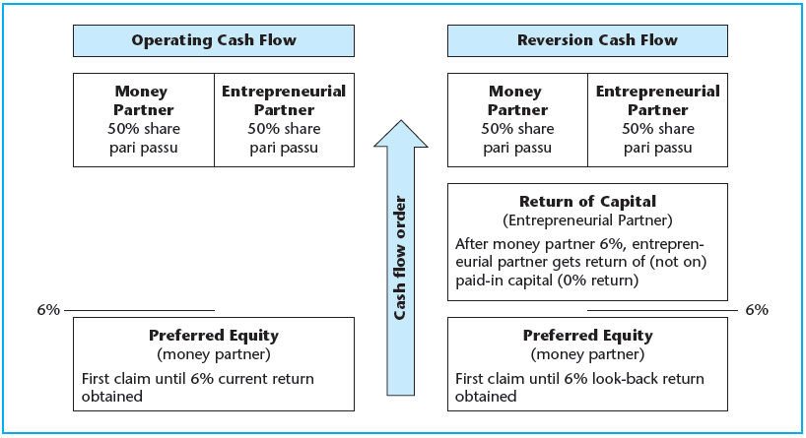
3 Waterfalls explained

Slide 12
4 Mezzanine Debt
A quick note on mezzanine debt.
It is rather loosely defined, but my take on it is that this is company level debt, used to finance a property.
This typically will go hand-in-hand with a normal (nonrecourse) mortgage from the same debt provider.
Thus, mezzanine debt is recourse!
“Mezz” debt became popular after the Dodd-Frank act.

