Slide 1
Leasing Strategies
Effective rent and Term of the lease
Alex Van de Minne

Slide 2
1 Introduction
In today’s class we are going to discuss;
How to compute effective rents.
We are also going to discuss other considerations when leasing up a property, showing increasing effective rents is not the only thing we should be worrying about.

Slide 3
2 Some Terminology
A lease is a contract between a holder of property rights, and a consumer or user of some of those rights, for a specified period.
  The property owner / landlord is called the lessor.
  The tenant is referred to as the lessee.
  The lease gives some possession rights, and mostly using rights. However, the lessor keeps the disposition / redevelopment right.
  The price of the lease is called the rent.
Leases are very difficult legal documents! Just try and read one!

Slide 4
2 Why Does Leasing Exist?
So why do leases exist? Wouldn’t it be more obvious if everyone owns their own real estate?
Around the Second World War, owner-occupancy was still the norm!
We identify the following reasons;
  There are some tax considerations.
  Specialization played a key role. Landlords know how to lease very well, whereas one-off owner-occupiers do not.
  It is more efficient to centralize certain common functions. Think of security of the building.
  Most firms do not want to be exposed to real estate risk, as it is not their core business.

Slide 5
2 What are the Lease Components?
Next, we will discuss all the components in a typical lease.

Slide 6
2 Basic Lease Typology
Who pays for the operating expenses is a big part of the lease. We broadly distinguish three separate types of leases;
  Gross Lease. The landlord pays all the operating expenses.
  Net Lease. The tenant is responsible for paying the expenses. The purest form is called a triple net (NNN) lease. The tenant will even pay the property taxes. Property management, and leasing costs are still for the property owner though. With multiple tenants, the expenses are shared on a pro-rata basis.
  Hybrid Lease. This is obviously a mix. Landlords typically pay for the fixed costs, like property taxes, but also costs that are more difficult to charge per tenant (water, security, common area costs).
Remember that we also have expense stops?

Slide 7
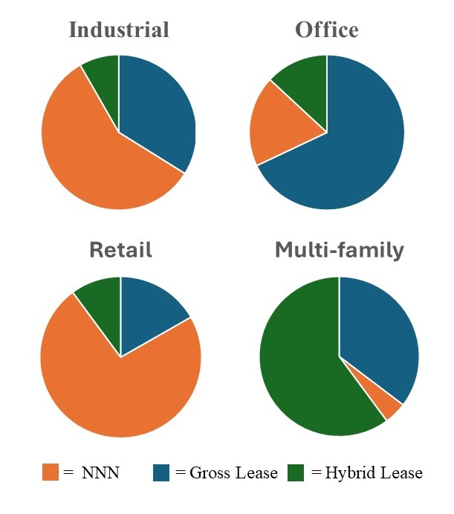
2 Basic Lease Typology

Slide 8
2 Rent Changes
How are leases re-evaluated over time?
  Flat Rent. No rent change! This is more common for short term leases.
  Graduated Rent. Such a lease has pre-specified step-ups, like $2 every two year per square foot.
  Revaluated Rent. A professional appraiser will revaluate the new rent level at pre-determined times. This is big in Europe, but not really in the US.
  Indexed Rent. The rent is adjusted using a predetermined – and publically available – time series index. Like the CPI or PPI. Most common is a % of the CPI per annum. (Like 50%)
  Percentage Rent. Will get back at this later. But basically, the landlord shares in the revenues of the tenant.

Slide 9
2 What Affects the Value of a Lease?
What are the determinants of the value of a lease?
  The rent, obviously!!!
  The space. The location is important, but also the shape, design, the floor it is on, etc. The size is also important, as the most “normal” sized areas will also be supplied the most.
  Tenant. Some tenants are more valuable then others, because of prestige, or synergy it can bring.
  Lease Term. All things equal, a land lord prefers longer-term leases, and they shouldn’t expire at the same time!
  Concessions. Rent abatements, moving allowance, and TIs.
  Lease Covenants. Think of the right to sublet.
  Lease Options. Renewal, cancellation, and expansion options can be part of the lease.

Slide 10
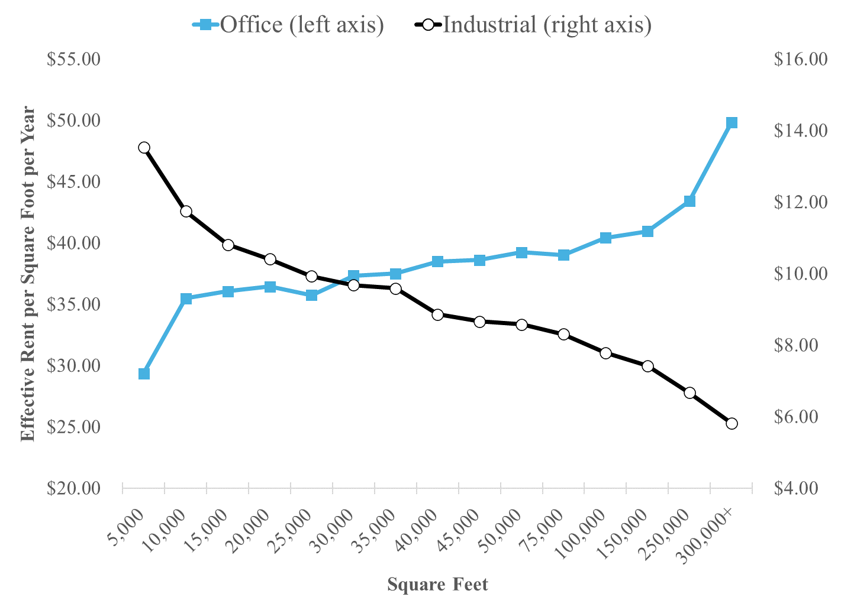
2 What Affects the Value of a Lease?

Slide 11
2 Effective Rent
How do we compute the effective rent that is signed in a space?
The most obvious method is the annuitized lease value (ALV).
The ALV method consists of two steps;
  First compute the Lease Present Value (LPV).
  Determine the annualized value.
Let’s see Excel…

Slide 12
3 Broader Perspective
It seems that as an investor you should maximize the ALV, right?
However, there are other moving parts here, that we should discuss.
  Interlease Risk. Expected cash flows are not contractually fixed between leases. Thus, landlords prefer longer leases over shorter ones. However, in reality this effect is going to be small.
  Releasing Costs. Landlords have vacancies and search costs, whereas tenants have moving costs. (The latter includes disruptions in operation.) These can be especially severe for tenants who need highly specialized space.
  Rent Growth Expectations. Note that g is not part of the ALV per se. However, if you expect the rents to go up, you might want to reduce the lease term. The tenant might not agree however!

Slide 13
3 Broader Perspective
It seems that as an investor you should maximize the ALV, right?
However, there are other moving parts here, that we should discuss.
  Uncertainty and Flexibility. If the tenants’ operations are slowly growing its operations, it might want to have shorter leases. Allowing for subleasing might also help here. If the landlord is thinking about redevelopment, it might also want to reduce the lease term.
  Staggering Leases. As noted earlier, you do not want all the leases to expire at the same time. Thus, you might want a different lease term than what the ALV would tell you.

Slide 14
3 Broader Perspective
Because of all these issues, we find certain equilibria for different uses.
  Longer leases have lower rents, ceteris paribus. Although;
  Optimal lease length is a trade-off between releasing costs and the value of flexibility, and therefore;
  Certain property uses will have different lease lengths.
    Hotel: 1 day / 1 week.
    Apartment: 1 year.
    Small retail: 2 – 5 years.
    Office: 3 – 10 years.
    Anchor retail: 5 – 15 years.
    Industrial: 5 – 20 years.
    Unique corporate space: 20+ years, or owner-occupied.

Slide 15
4 Other Issues
Space size. Having many smaller spaces (instead of fewer larger spaces) typically results in higher management costs.
Tenant mix. Especially in retail, having an anchor tenant might increase the revenues of everyone in the mall. You can share this with the anchor tenant by reducing its rent, and want to reduce the lease term. A large corporate tenant in an office tower might increase your prestige.
Why do percentage rents exist? With percentage rent, the tenant pays a base rent, and subsequently shares a % of its revenue. This incentives the landlord to find the best mix. It also reduces the overall risk, however it does decrease the incentive from the tenants’ perspective.
Why do concessions? It can help smaller / newer businesses who would otherwise not move / start. It can help you time your cash flows better, and it might fool other investors as the quoted rents do not include concessions.

