Slide 1
Leverage
Effect on investment performance
Alex Van de Minne

Slide 2
1 Introduction
What are we going to do during this class:
There are trillions in mortgage debt in the US alone.
We will focus on leverage, and its effect on investment performance of the equity. (There might also be other considerations, like tax treatment, which we will skip for now.)
Note that in normal corporate finance, this section would most likely be skipped.
  Stockholders can lever up or down on their own account.
  Borrow money, or by investing in bonds. (Or anything that is highly collinear with interest rates.)
This is obviously not the case for direct real estate investment.

Slide 3
2 What is leverage
You can use debt to “lever” up your property.
Say you purchase a $10M property, and you take up a $6M loan. (I.e. you use $4M of your own money.)
We have two ways to measure leverage;
  Leverage ratio (LR): V/E = (L + E)/E. Which is $10M/$4M = 2.5.
  Loan to Value (LTV): L/V = L/(L + E). Which is $6M/$10M = 0.6.
    V = value of property.
    L = loan amount.
    E = equity, i.e. own money in the property.

Slide 4
2 What is leverage
Equity is your ownership share. However, it gives you (normally) full control over the property. (As long as you meet the requirements of the debt obligations.)
Debt, on the other hand, receives a senior claim on the cash flows and value. In other words, the debtor is always paid first.
However, equity gets the residual claim on cash flow and value. Meaning that whatever is left after the debtor is paid, is for the equity holders.
  The residual claim ensures that property managers are sufficiently incentivized to maximize profit.

Slide 5
3 Effect of leverage on risk and return on equity
Note that as an investor, you only really care about the return (and risk) of your own money, aka equity.
Previously, we have only focused on risk/return of properties, treating them as if there is no leverage on them.
This is extra interesting, as this means that heterogeneous investors, have yet another way to match their risk/return preference on a property.
Next, we will discuss what the effect of leverage is on return, followed by the effect of leverage on risk.

Slide 6
3 Effect of leverage on return on equity
Take the following numbers:
  Value in t: $10,000,000.
  Value in t+1: $10,200,000, or a 2% capital gain / appreciation.
  8% income return at t, or $800,000.
  Thus, total return was (8% + 2% =) 10% on the property, free and clear of debt. (PBTCF)
However, now assume that the investor takes a $6M loan to fund this property (thus equity is $4M), and the interest rate is 8%.
  LR = 2.5 ($10M / $4M), LTV = 0.6 ($6M / $10M).
  What is the return on equity in this case?
  Note that the return on the property remains 10%.
Small (but important!) technical note, the loan is assumed to be interest rate only and risk free.

Slide 7
3 Effect of leverage on return on equity
There are multiple ways on calculating the return on equity. One way;
  Lender gets the first claim on the cash flow. Interest rate is 8%, and the loan amount is $6M, thus total interest paid is $480,000.
  Subtract that amount from the free cash flow of the property of $800,000, and you – as an investor – can keep ($800,000 - $480,000 =) $320,000.
    Expressed as a yield, this gives us $320,000/$4,000,000 = 8%. This remains the same, because the interest rate is a similar % as the income yield.
  You can keep the entire capital gain of $200,000.
    Expressed as a yield, this is $200,000/$4,000,000 = 5%.
Thus the total return on equity is (8% + 5% =) 13%.

Slide 8
3 Effect of leverage on return on equity
 | Property | Levered equity | Debt
Initial value | $ 10,000,000 | $ 4,000,000 | $ 6,000,000
Cash flow | $ 800,000 | $ 560,000 | $ 240,000
Ending value | $ 10,200,000 | $ 4,200,000 | $ 6,000,000
Income return | 8% | 14% | 8%
Appreciation return | 2% | 5% | 0%
Total return | 10% | 19% | 4%

Slide 9
3 Effect of leverage on return on equity
 | Property | Levered equity | Debt
Initial value | $ 10,000,000 | $ 4,000,000 | $ 6,000,000
Cash flow | $ 800,000 | $ 560,000 | $ 240,000
Ending value | $ 10,200,000 | $ 4,200,000 | $ 6,000,000
Income return | 8% | 14% | 4%
Appreciation return | 2% | 5% | 0%
Total return | 10% | 19% | 4%
Now we lowered the interest rate to 4%.

Slide 10
3 Effect of leverage on return on equity
 | Property | Levered equity | Debt
Initial value | $ 10,000,000 | $ 4,000,000 | $ 6,000,000
Cash flow | $ 800,000 | $ 560,000 | $ 240,000
Ending value | $ 10,200,000 | $ 4,200,000 | $ 6,000,000
Income return | 8% | 14% | 4%
Appreciation return | 2% | 5% | 0%
Total return | 10% | 19% | 4%
Note that the total return even increases more.
But now let’s go back to the original example of 8%.

Slide 11
3 Effect of leverage on return on equity
Great! We increased our return by 30%! (Difference between the 10% and 13%.)
What the market really cares about is the return over the risk-free rate.
  In that case the difference is even larger. Note that we called the loan risk-free? This means we can assume the risk-free rate is 8% in the previous example.
  Thus, the comparison should be between (10% - 8% =) 2% and (13% - 8% =) 5%.
  Which is 2.5 times as much!
Unfortunately, as we know, there is no such thing as a free lunch. And this increase in expected return, comes with an increase in expected risk.
  Note again that it is very important to distinguish between realized risk/return and expectations.

Slide 12
4 Effect of leverage on risk of equity
Risk in investment is related to uncertainty and unpredictability. We do not know the cash flow growth. We do not know the price / rent appreciation for sure.
  With our NPV investment reports, this is reflected in the return requirement (r).
  In this case we are talking about the same property, with the same return requirement, but an “extra” layer of risk for the investor.

Slide 13
4 Effect of leverage on risk of equity
We have two scenarios;
  Optimistic;
    Value at t + 1: $11,200,000, or 12% increase.
    9% net income yield, or $900,000.
  Pessimistic;
    Value at t + 1: $9,200,000, or -8% appreciation.
    7% net income yield, or $700,000.
The loan amount and interest rate stays the same ($6M at 8%), and does not care about whether or not an optimistic or pessimistic scenario unfolds.
We quantify risk, as the range in total return between the good and bad scenario. So what is the risk?

Slide 14
4 Unlevered (LR = 1, LTV = 0)
 | Optimistic | Pessimistic
Initial value | $ 10,000,000 | $ 10,000,000
Cash flow | $ 900,000 | $ 700,000
Ending value | $ 11,200,000 | $ 9,200,000
Income return | 9% | 7%
Appreciation return | 12% | -8%
Total return | 21% | -1%
The risk is essentially the difference in total return (obviously minus the risk-free rate), which has a range of 11% around the mean (the 10% total return of the unlevered property).

Slide 15
4 Effect of leverage on risk of equity
We have two scenarios;
  Optimistic;
    Exit value on Equity is $11.2M - $6M = $5.2M.
    Cash on Equity is $900,000 – $480,000 = $420,000.
  Pessimistic;
    Exit value on Equity is $9.2M - $6M = $3.2M.
    Cash on Equity is $700,000 – $480,000 = $220,000.
The in initial investment of Equity was $4M.
What are the returns in both scenarios?

Slide 16
4 Levered (LR = 2.5, LTV = 0.6)
 | Optimistic | Pessimistic
Initial value | $ 4,000,000 | $ 4,000,000
Cash flow | $ 420,000 | $ 220,000
Ending value | $ 5,200,000 | $ 3,200,000
Income return | 10.5% | 5.5%
Appreciation return | 30.0% | -20.0%
Total return | 40.5% | -14.5%
Unlevered the “risk” was 11%. When the same property is being levered, the “risk” increases to (40.5 – 13 =) 27.5%. Note we use the mean total return of the levered property. If we divide the 27.5% / 11% = 2.5. Where did we hear that number before? Even real estate abides by the security market line!

Slide 17
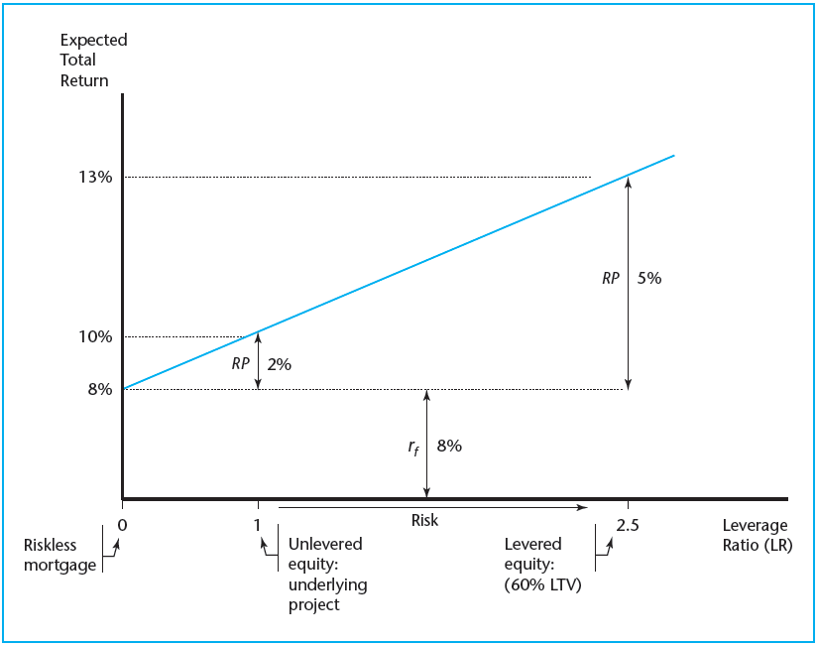
4 Security Market Line

Slide 18
4 Security Market Line
Note that only the return over the risk-free rate increases by 2.5.

Slide 19
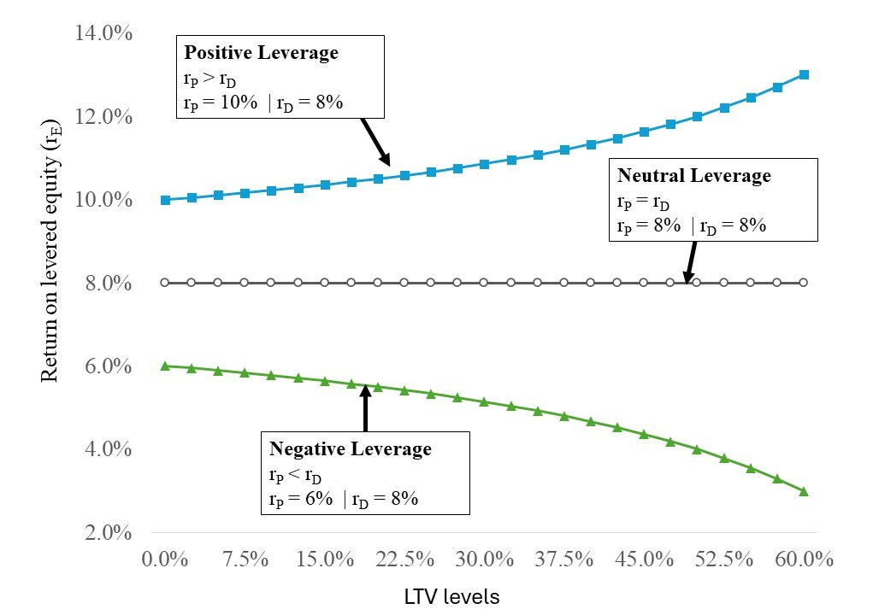
4 Positive Leverage

Slide 20
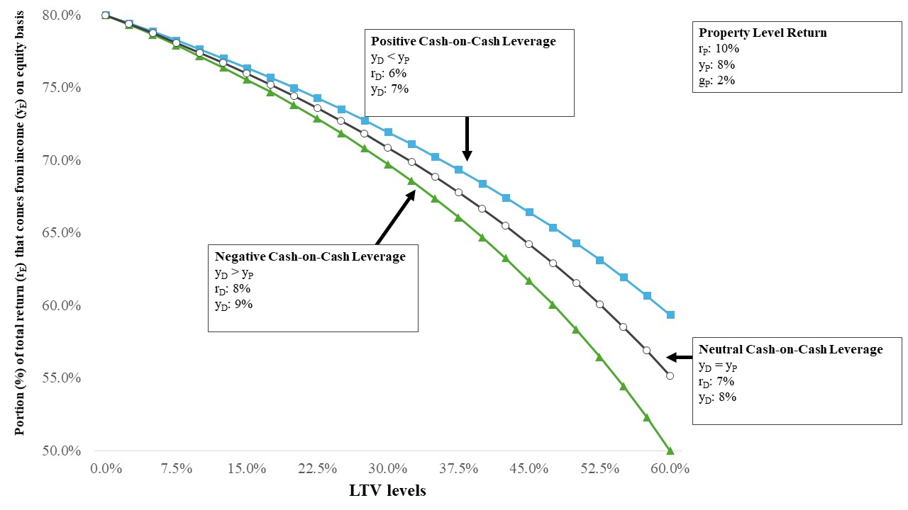
4 Income Component

Slide 21
5 Short note on debt
In reality, debt is not riskless.
There are two/three main sources of risk when in the market for mortgage lending.
  Default risk. Meaning the lender may repossess the property to run it or sell it.
  Interest rate risk. Mortgages are fixed for a long time, whereas deposits are short-run.
    Refinance risk. Investors refinance when interest rates go down, but not vice verse.
To get a sense of these risks and how to mitigate them, think of the following extreme mortgage products;
  ARM. Adjustable Rate Mortgage. The interest rate floats every year to reflect current market prices.
  FRM. Fixed Rate Mortgage. The interest rate stays fixed for the entire time of maturity. (Which in an extreme would be 30 years.)

Slide 22
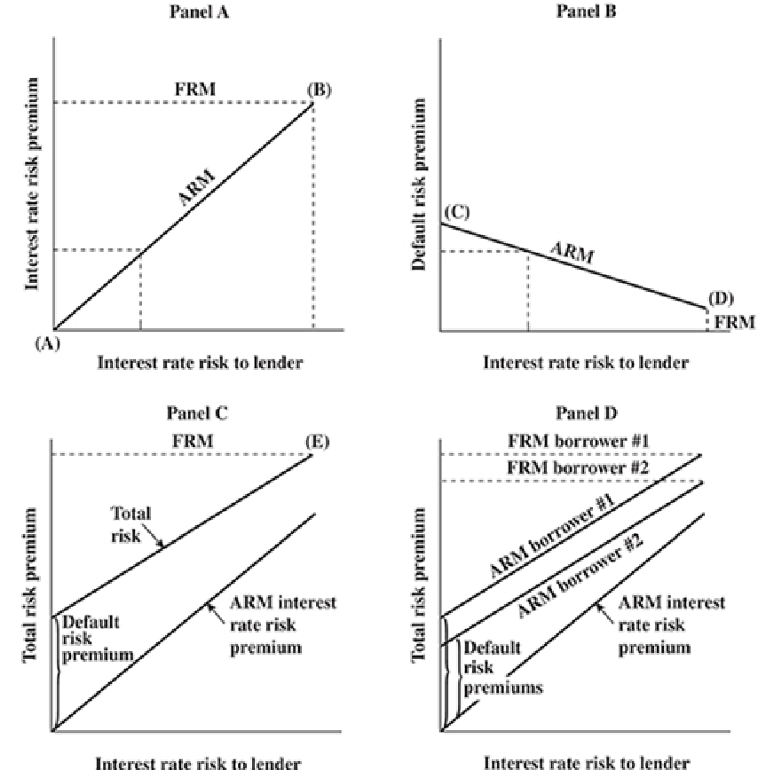
5 Short note on debt

Slide 23
5 Housing Market
In housing markets, mortgages are securitized. Meaning the mortgages are pooled in a SPV (essentially a separate LLC), and bonds are sold (backed by the SPV) to ultimate investors.
The government guarantees the bond payments.
This way, the banks do not run the interest rate risk anymore, but also, it is safer for homeowners as they can get 30-year FRM.
This does not work for CRE for several reasons;
  No political incentive
  CRE is way more heterogeneous, meaning we cannot accurately price what is in the SPV.

Slide 24
5 CRE debt in Reality
How is the mortgage market organized in CRE?
  Properties are put in an SPV (SPV) or something similar (like a private REIT) or LLC.
    As a result, when the mortgage cannot be paid anymore, only the property is affected, not the firm.
    Unless you want to talk about mezzanine debt…
  Unlike the residential market, CRE is a mix of ARM and FRM, with a maturity of less than (or equal to) 10 years.
    Typically, it amortizes in 20/25 years, with a balloon payment at 10/7/5 years.
    A 2/10 structure means a mortgage with a FRM for 2 years, after which it becomes ARM for the remaining 8 years.
    A 3/7 structure and 1/5 structure are also popular.
  Typical LTV levels are 20% (low risk), 40% (medium risk), and 60% (high risk).
    Higher LTV levels also mean higher interest rates!

Slide 25
5 CRE debt in Reality
Mortgages (nowadays) are always Constant Payment Mortgages (CPM) for the FRM part of the contract.
Note that the debt payment (or debt service) consists of two components;
  Interest payment: the contract rate you often see advertised. This is to compensate the lender for the risk she is running.
  Principal payment: This is the amount you use every month to pay off the debt. It is based on the amortization table.
With CPM you ensure that the total payments remain the same every month. Which makes it easier to predict.

Slide 26
5 CRE debt in reality
Assuming the CPM, we can calculate the total payments (PMT) as such;
Where:
  L = total initial loan amount
  r = monthly interest rate (so i/12)
  N = is the total amount of months to amortization

Slide 27
5 CRE debt in reality
Once you know your payments, you can subdivide payments into interest and principal payments, by calculating the interest payments first.
The interest payment is simply r times the outstanding balance (not the original amount!).
The principal payment is subsequently the total debt service minus the interest payment.
But what do we do after the mortgage becomes an ARM?
Well… we can’t predict interest rates well, and we can purchase a hedge/insurance against interest rate hikes.

