Slide 1
Rent Forecasting I
Market Analysis
Alex Van de Minne
February, 2025

Slide 2
1 Introduction
“Prediction is very difficult, especially about the future”
What are we going to do during this class:
Today we will start explaining what drives rent over time.
In the previous class, we discussed how the space market is segmented.
As a result, we would like to make rental predictions per segment.
However, which segments do we choose?

Slide 3
1 Introduction
“Prediction is very difficult, especially about the future”
What are we going to do during this class:
We noted that price levels can vary considerably due to the segmentation.
However (!);
  Within a market and property type, rent changes tend to be similar over time. (Even though rent levels are not.)
  The reason is that, in the end, tenants will move out to the suburbs if CBD prices are too high.
  The same goes for A to B-class buildings, etc.

Slide 4
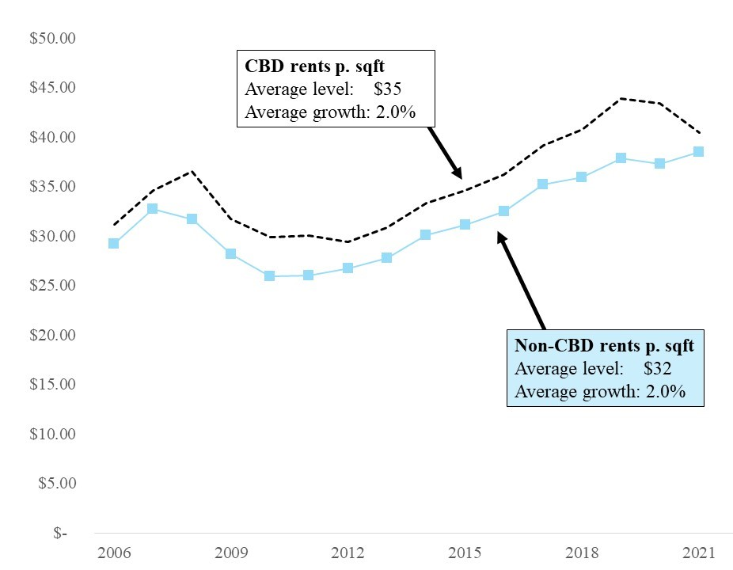
1 Los Angels Office

Slide 5
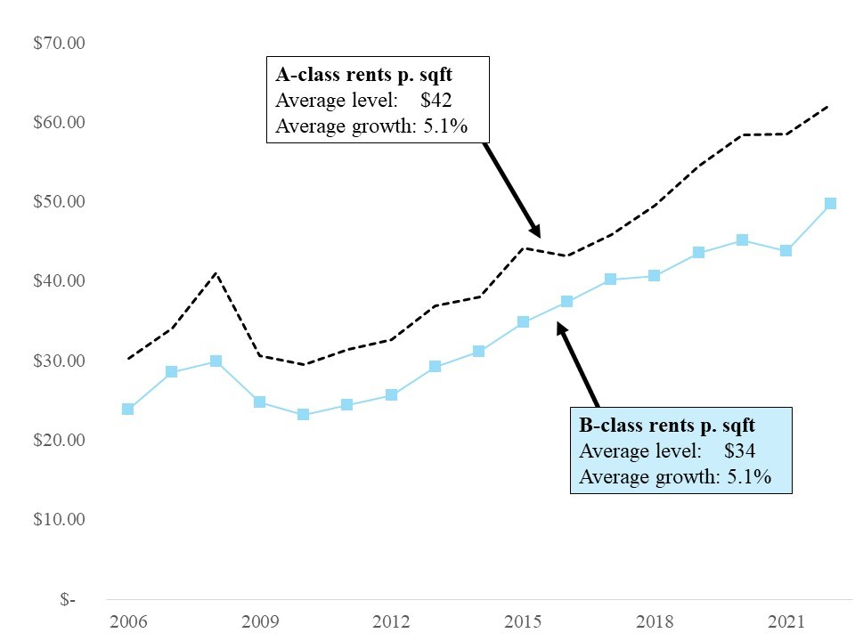
1 Boston Office

Slide 6
2 Structural Approach
Think of these following equations;
  Rent = f(Vacancy)
  Occupied Space = f(Rent, Demand)
  Construction = f(Rent, Vacancy)
Note that they are linked via the following identities
  OS_{t} = (1 - V_{t})S_{t}
  S_{t} = S_{t-1} + C_{t}
Where OS is occupied space (sqf), V is vacancy (%), S is existing stock (sqf), and C is the total amount of net construction (C).

Slide 7
2 Structural Approach
These structural relationships are not complete. It is a simplification of the real world. However, companies such as CBRE and Moody’s have successfully applied this simplification.
We have the following endogenous variables;
  Rent
  Vacancy
  Construction
We have the following exogenous variable;
  Demand for space
Successfully, the relationships between all these variables allow us to forecast.

Slide 8
2 Supply and Demand Variables
Market rent. Arguably the most important market indicator. This refers to the level of rents being charged on typical new leases signed in the market.
Unfortunately, finding this measure is more difficult than you might think. Taking a plain average of newly signed rents will not work, because;
  A specific site and space might have a specific rent.
  The terms of the lease have a big impact.
Some different rents metrics include;
  Real rent. It is typical to subtract the inflation rate from rent increases. Real rents reflect the actual (in)balance between supply and demand.
  Asking rent. This is typically reported online, but can be (very) different from;
  Effective rent. This includes the monetary effect of concessions and rent abatement that landlords sometimes offer to tenants to persuade them to sign a lease.

Slide 9
2 Supply and Demand Variables
Construction starts and/or completions. Construction takes time, from a few months for single family housing to many years for large institutional real estate. In older markets is also important to consider redevelopments. New construction will increase the supply of real estate square footage.
Space absorption. This refers to the amount of additional space that is occupied per year. This is a good measure of activity of the demand side of the market. We distinguish;
  Gross absorption. Total amount of leasing activity. This measures rental transaction activity. However, some tenants might move from within the same market.
  Net absorption. This is more relevant for market analysis, as it only looks at the change in leased space within an analyzed market.

Slide 10
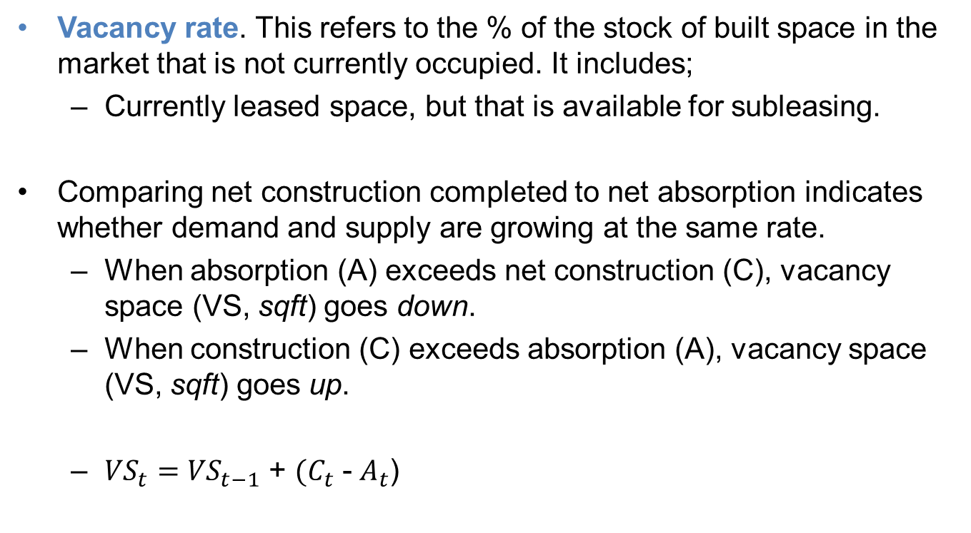
2 Supply and Demand Variables
Vacancy rate. This refers to the % of the stock of built space in the market that is not currently occupied. It includes;
  Currently leased space, but that is available for subleasing.
Comparing net construction completed to net absorption indicates whether demand and supply are growing at the same rate.
  When absorption (A) exceeds net construction (C), vacancy space (VS, sqft) goes down.
  When construction (C) exceeds absorption (A), vacancy space (VS, sqft) goes up.
  ${VS}_{t}=$ ${VS}_{t−1}$ + $(C_{t}$ - $A_{t}$)

Slide 11
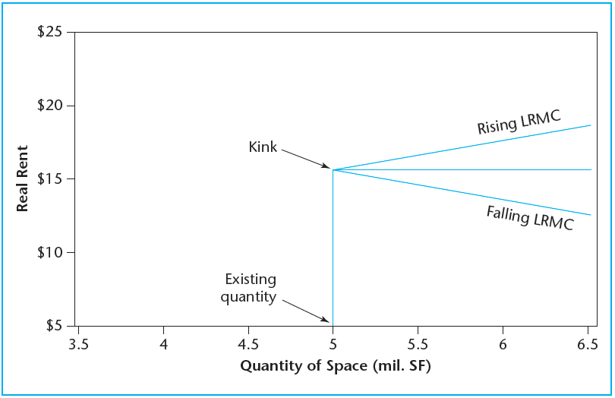
2 Space Market

Slide 12
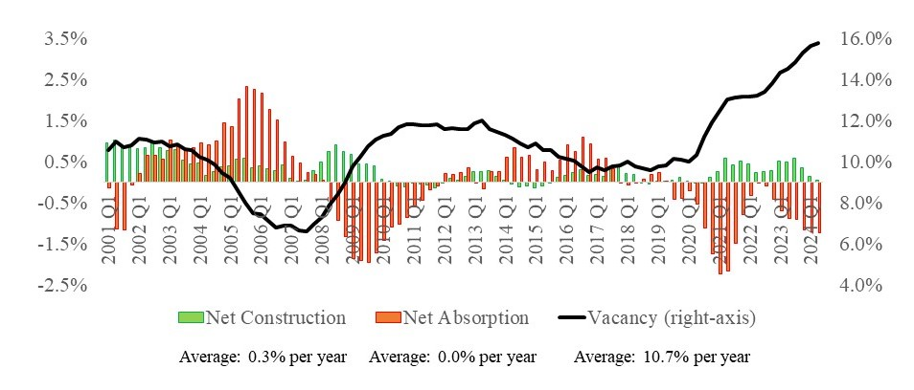
2 Los Angeles Office

Slide 13
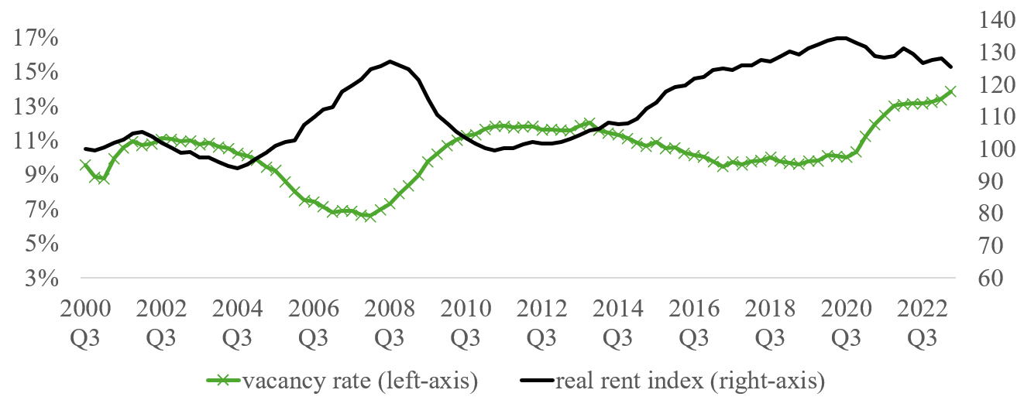
2 Los Angeles Office

Slide 14
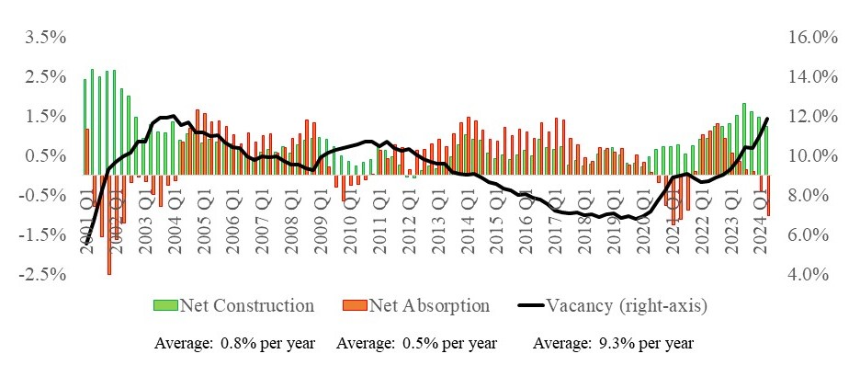
2 Boston Office

Slide 15
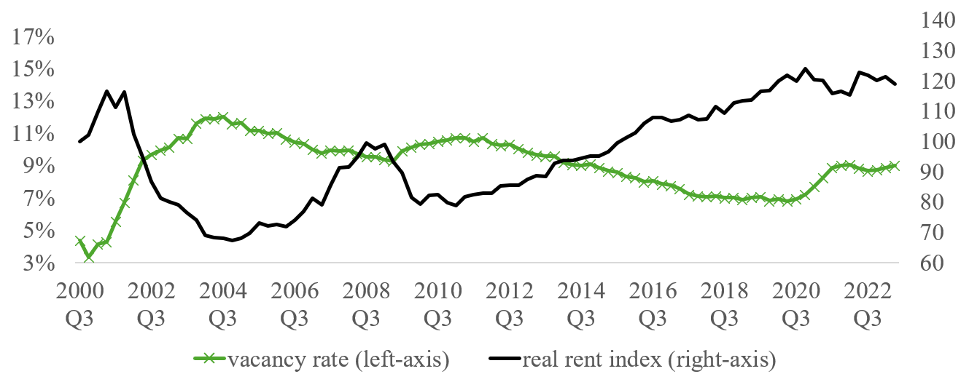
2 Boston Office

Slide 16
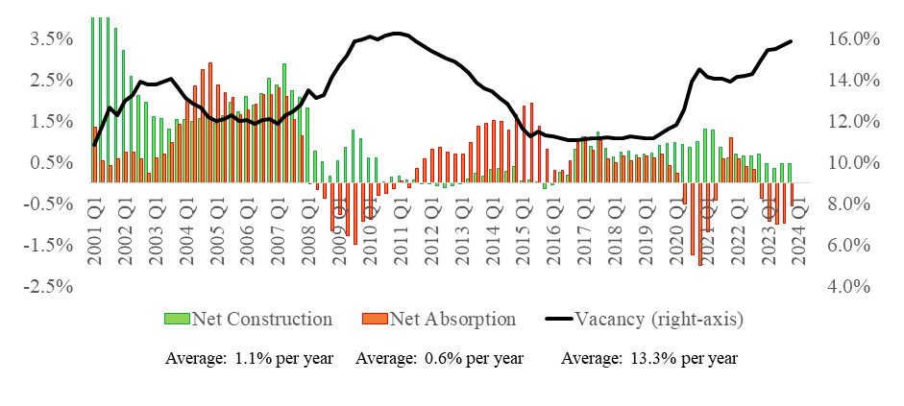
2 Atlanta Office

Slide 17
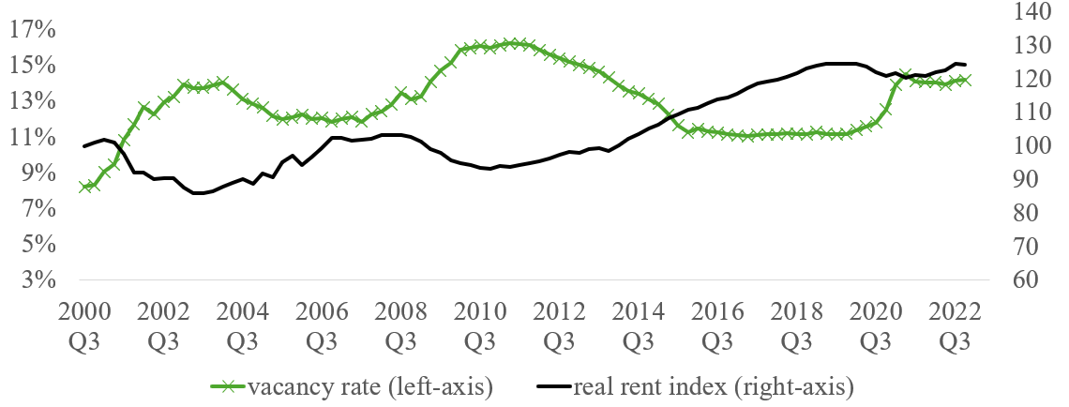
2 Atlanta Office

Slide 18
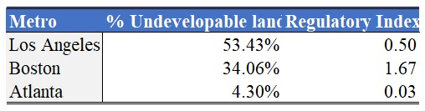
2 Supply and Demand Variables
Average rent (2022):
  $36/SF in Los Angeles,
  $49/SF in Boston, and
  $25/SF in Atlanta)

Slide 19
3 Demand for Space
What we need to find is a demand driver that “shocks” the system.
This shock should (but is not necessary) be exogenous. (I.e., coming from outside the “real estate” system.)
This demand shock will – in principle – change the occupied space in the short run.
For office, the driver of demand is “simply” office employment.
  The BLS has NAICS codes on a disaggregated level that allows you to find office workers per market.
  The BLS typically also provides long-run forecasts of office employment.
The only thing you need to know now is how many square feet every employee takes up. (Typically about 200 sqf / empl)

Slide 20
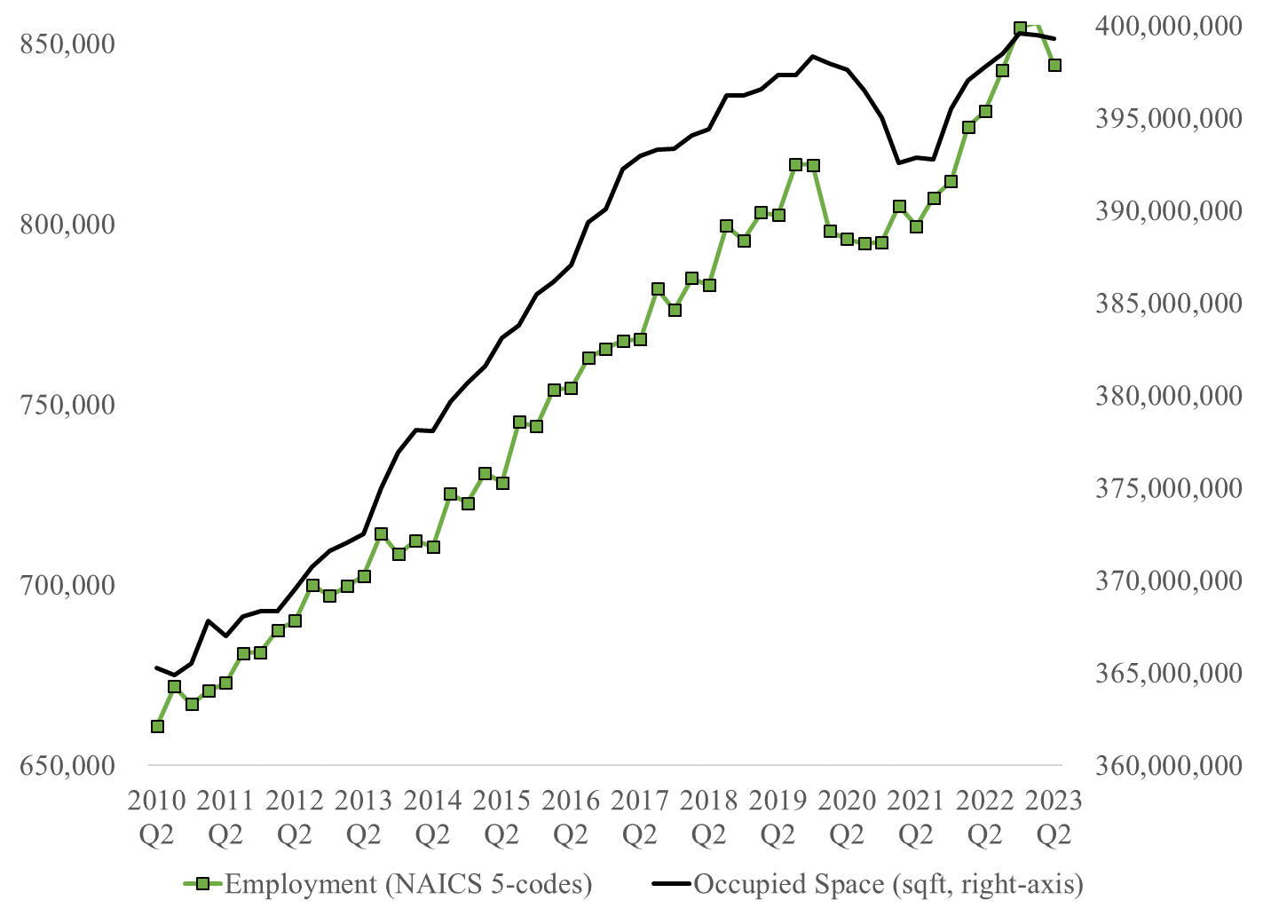
3 Demand for Space

Slide 21
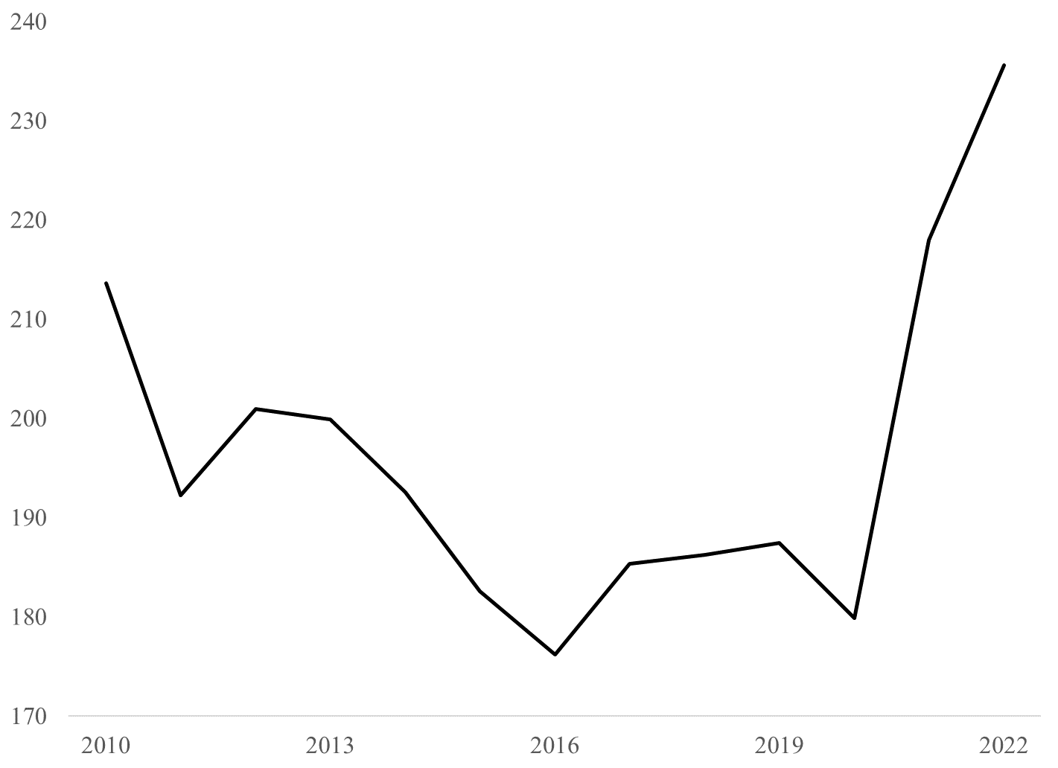
3 Demand for Space

Slide 22
3 Demand for Space
For housing, the driver of demand is “simply” households.
The link is also simpler, one household, one house.
  There are many (local) forecast providers of population increases. Including the US Census Bureau.
However, there are some segments here that you might want to think about.
  Senior housing
  Student housing
  There is some segmentation over income and age towards renting and owning.
All of this means you might have to include some subgroup forecast.

Slide 23
3 Demand for Space
The demand for warehouse space is fundamentally driven by the need to store inventory and (re)distribute.
Thus, warehouse employees are not the primary driver of warehouse space.
Indeed, you need workers, but the companies could also invest in technology to replace the workers.
There are no forecasts (as far as I know) that predict the need to store and distribute goods. (On a local level.)
Luckily, technological innovation has been limited in this field, and thus, warehouse employees are a good proxy for the occupied space.

Slide 24
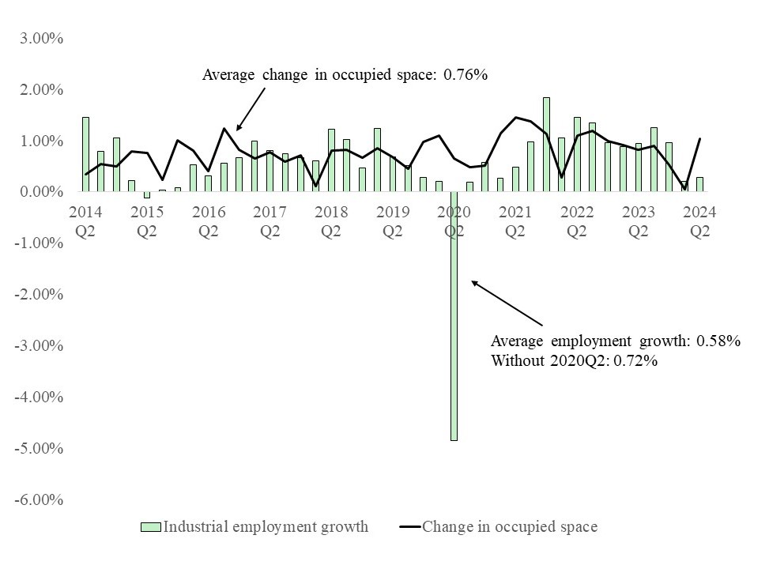
3 Dallas Warehouse Space

Slide 25
3 Demand for Space
The demand for retail space is driven by retail sales and/or consumption of goods. (Not to store workers, as was the case with office.)
Forecasts of retail sales are widely available. (Including US Census Bureau.)
The main challenge is understanding how e-commerce will impact retail sales.
E-commerce does benefit the warehouse space discussed previously.
E-commerce accounts for about 20% of all sales in 2020.
What’s more confusing is that some firms do both in-store and e-commerce.

Slide 26
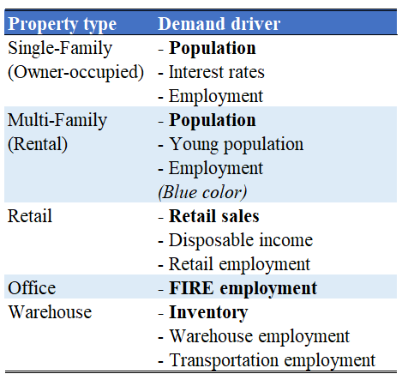
3 Demand for Space

