Slide 1
Rent Forecasting II
Rental Growth and Uncertainty
Alex Van de Minne
February, 2025

Slide 2
1 Introduction
What are we going to do during this class:
In the previous class we showed how to do forecasts using time series data of ret.
Today, we are going to talk more about a structural approach. We are going to forecast rent (the g) parameter, based on other variables that directly impact rent. This is also called the structural approach based on market analysis.
We will directly model demand and supply for real estate in a short-run model.

Slide 3
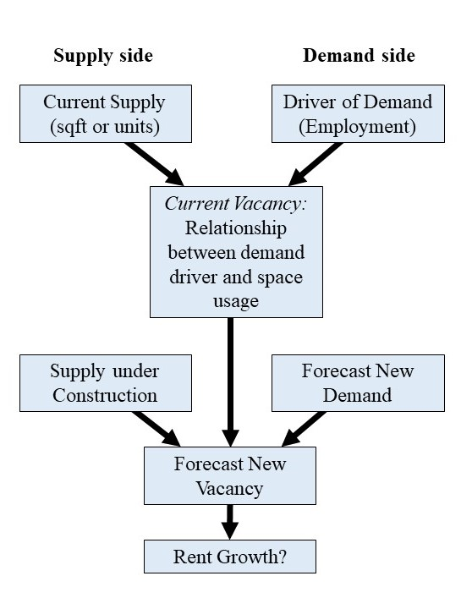
2 Simple Structural Approach

Slide 4
2 Simple Structural Approach

Slide 5
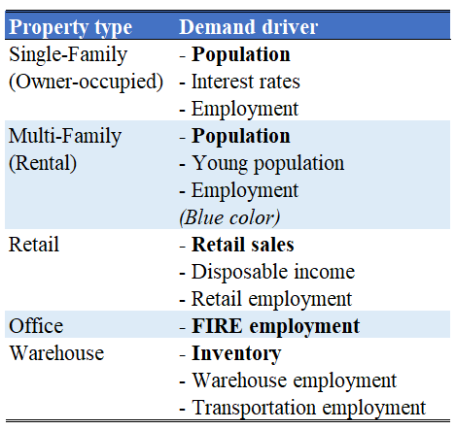
2 Simple Structural Approach

Slide 6
2 Simple Structural Approach

Slide 7
2 Simple Structural Analysis
Next, we relate the underlying demand sources to the amount of real estate space usage demand.
This can be easy;
  The number of households, should roughly equal the amount of housing units.
Or hard;
  How much square feet does an employee for a given occupation need?
  What type of retail would fit for what income levels? And how much retail per person would you need?

Slide 8
2 Simple Structural Approach

Slide 9
2 Simple Structural Analysis
Next, we forecast future demand and supply of space in our market.
  Demand side. Make projections by extrapolating previous trends on the relevant demand drivers. This will tell you how much more (or less of course) square feet / units will be needed at any given point in time in the future.
  Supply side. Construction permits are typically publicly available. However, note that not all projects are finished, and that redevelopment can also be important. This will give us the amount of square feet / units that will be added in the future.
Note that it is now relatively straightforward to subtract the two, to find the future shortage (or not) of supply.

Slide 10
2 Simple Structural Analysis
Example (Boston Office, 5-year projection)
  BLS expects office jobs to grow at 70 basis points (0.7%) annually in the coming 10 years.
  This equates to approximately 6,000 office jobs per year.
  In 2024, there were 844 thousand office jobs in the Boston metro area.
  6.8 million (net) square feet is under development.
  Assume 240 square feet per employee.

Slide 11
2 Simple Structural Analysis
Example (Boston Office, 5-year projection)
  BLS expects office jobs to grow at 70 basis points (0.7%) annually in the coming 10 years.
  This equates to approximately 6,000 office jobs per year.
  In 2024, there were 844 thousand office jobs in the Boston metro area.
  6.8 million (net) square feet is under development.
  Assume 240 square feet per employee.
Vacancy roughly stays the same

Slide 12
2 Simple Structural Analysis
The pro of this approach is that it is… well, simple.
  When looking over a short horizon (3 years or less), the approach can give valuable insights.
A few issues with this approach.
  We still cannot ascertain an exact rental growth forecast (g)
  It assumes that all the development in the pipeline will be developed.
  It ignores the dynamics over a longer period of time.

Slide 13
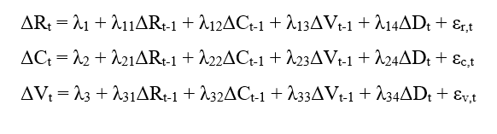
4 Regression based VAR
The Vector Autoregressive (VAR) Model is a popular model for forecasting.
With
  R = rent, C = net construction, V = vacancy, D = demand driver

Slide 14
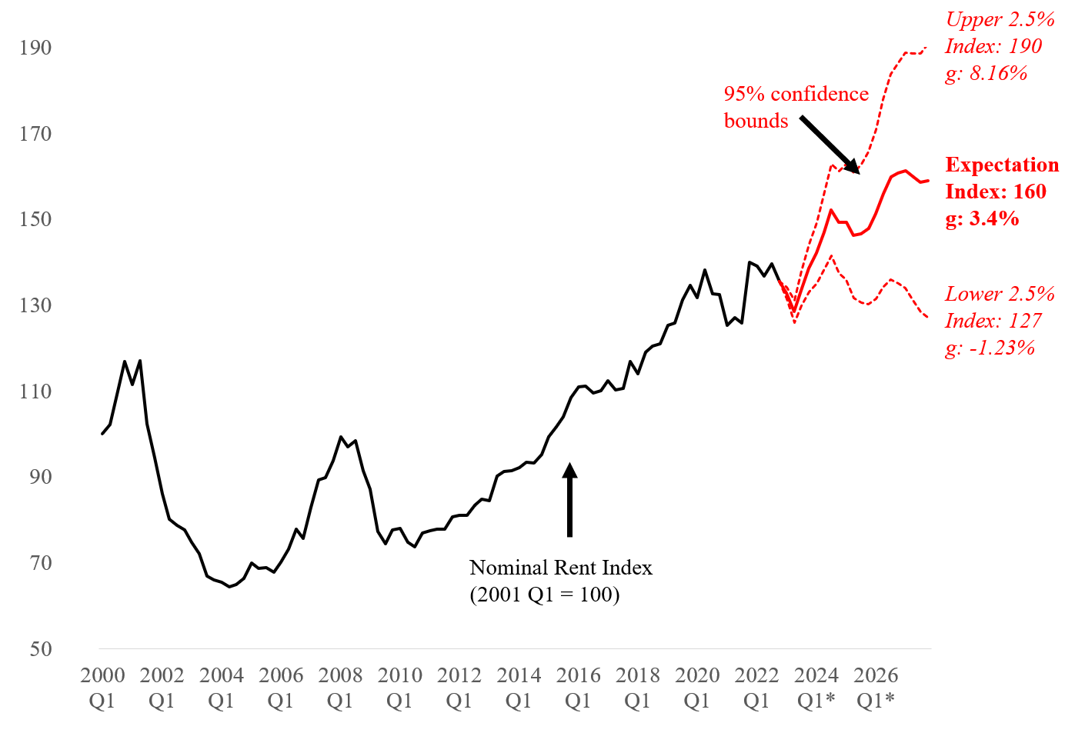
4 Regression based VAR

Slide 15
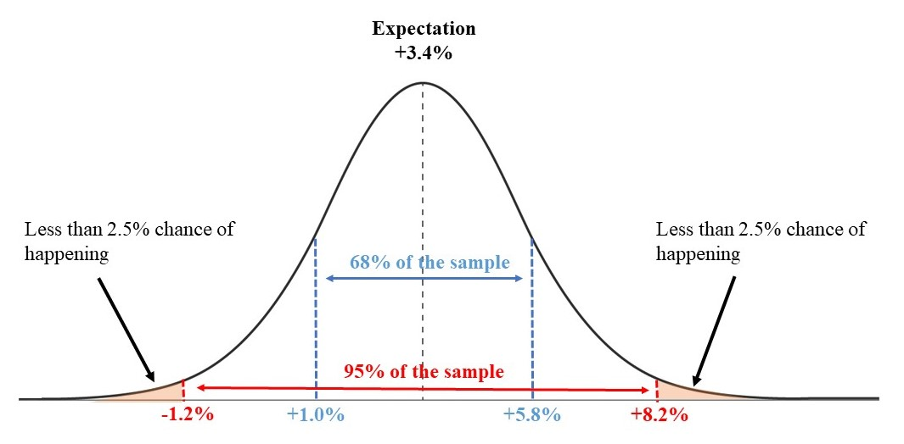
4 Regression based VAR

Slide 16
5 Depreciation of Cash Flows
Depreciation consists of three components;
  Physical Deterioration. Physical wear-and-tear of using the building.
  Functional Obsolescence. Caused by changes in technology and tastes over time.
  External Obsolescence. Changes in HBU can drive prices down (but also up… although never compared to its HBU).
Related, but not depreciation;
  Vintage. Certain styles that correspond with certain eras can be valued more.
  Survival bias. Only the best of the best survive.

Slide 17
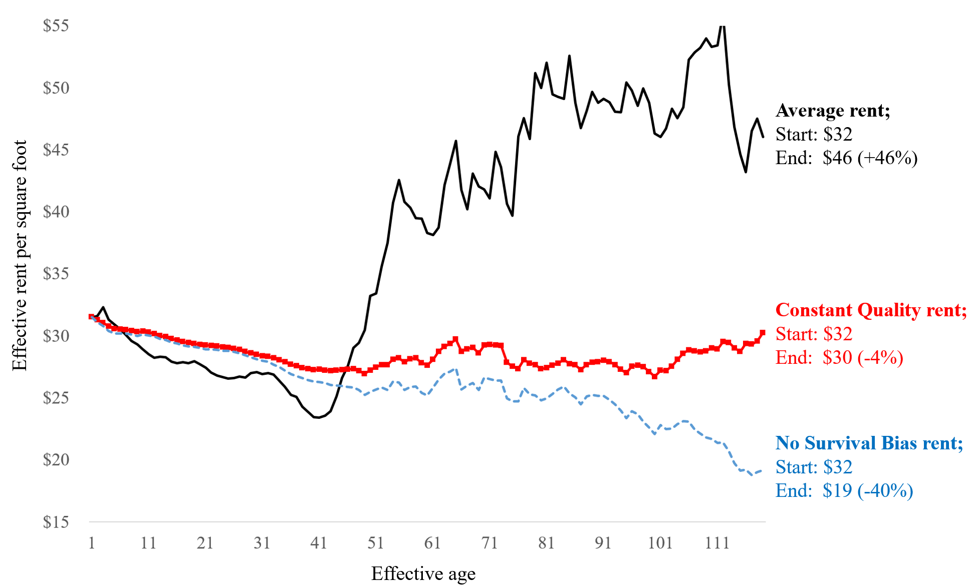
5 Depreciation of Cash Flows

Slide 18
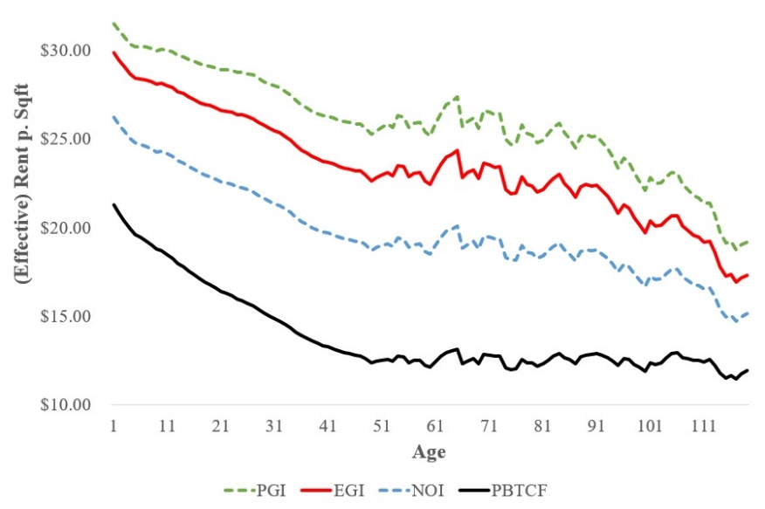
5 Depreciation of Cash Flows

Slide 19
5 Depreciation of Cash Flows
Interesting stuff, but what does any of this have to do with rental growth?
Everything!
  Market forecasts of rent are based on the entire market as a whole.
  Younger properties’ cash flow depreciates faster compared to the market, whereas very old properties’ cash flow does not depreciate as much.
Thus, you need to make a micro adjustment to your forecast.
To get a sense of the depreciation, you can always do a rent-comparable analysis of properties that are 10 years older.

Slide 20
6 PGI and Vacancy
Say our building has three spaces of 10,000 sqft each.
Rental growth is predicted to be 1% annually.
Market rent in year 1 is $10 per square foot.
Thus, in normal circumstances, the PGI is $300,000 in year 1.
However, say that space 1 has a rent of $10.50. Then, the PGI in year 1 is $305,000.
Vacancy at time of renewal is calculated by;
(1 - Probability of Renewal) x Market Rent x Expected Length of Vacancy if Nonrenewal
Typically, we multiply the market rent by 0.50 or 0.75.

Slide 21
6 PGI and Vacancy

Slide 22
6 PGI and Vacancy
Space 1: rented for “too much”

Slide 23
6 PGI and Vacancy
Space 1: End Year 3 lease ends
Lease reverts back to market level
However, we might lose 50% of the income in that year,
due to vacancy

Slide 24
6 PGI and Vacancy
Space 1: We expect it to be rented out for another 5 years, at market rent (year 4)

Slide 25
6 PGI and Vacancy
Space 2: rented for market rent
Space 2: runs through end of year 5

Slide 26
6 PGI and Vacancy
Space 3 is expected to be vacant in year 1

Slide 27
6 PGI and Vacancy
Space 3 is subsequently leased for 5 years

Slide 28
6 PGI and Vacancy
Remember EGI = PGI – vacancy allowance
Typically, ARGUS® will do this for you

