Slide 1
Investment Performance
Measuring Returns
Alex Van de Minne
January, 2025

Slide 2
1 Introduction
What are we going to do during this class:
Remember that investors have either a savings or an income objective.
They also have some constraints, most notably risk.
Thus, today;
  How do you measure a return.
  How do you measure risk. (Theoretically)

Slide 3
2 Measuring Returns
With returns, we can look forward or backward.
  Backward in time, and ex-post are used to measure past performance. Which we do because;
    Can help us make predictions.
    Measure the performance of investment managers.
    Understand the current mood.
  Forward in time, ex-ante, are used as future expectations. These are important when making investment decisions.

Slide 4
2 Measuring Returns
There are two ways to split returns;
  Period-by-period (or periodic). This is usually quantified as a simple holding period return (HPR). It’s a measure that assumes that all cash flows occur at the beginning and end of a period.
  Multiperiod return. This gives 1 number for a longer period. (Similar to TWR.) You can average period-by-period returns by simply taking an average, giving the time-weighted return (TWR). If cash flows can go in and out of the investment in the meantime; The most famous of such measure is the Internal Rate of Return (IRR). The IRR is typically expressed as a yearly number (like TWR) but note that it is money-weighted return (not like TWR).

Slide 5
2 Advantages Periodic Return
Period-by-period returns are still used in real estate on a macro-level (i.e. portfolio-level or market-level research).
Advantages of using periodic returns;
  It allows to compare your performance with the main components of most institutional portfolios; stocks and bonds.
  Allows to calculate co-movement in asset returns.
  It allow to measure risk (more on that later).
  It is more appropriate for evaluating or comparing the performance of managers who have no control over the timing of the cash flows in and out of the investments they manage.

Slide 6
2 Advantages IRR
As mentioned in the previous class, the IRR is the most used measure in real estate, why?
  It does not require knowledge of market values of investment assets at intermediate points in time.
    We do know when we sell the asset.
    We do know when we get a thorough appraisal report.
  It is more appropriate for evaluating or comparing the performance of managers who do have control over the timing of the cash flows in and out of the investments they manage.
This contrast (of control vs no control) is important, as who controls the capital flows is different per industry.
Next, we’ll have a more detailed look in both types of returns.

Slide 7
4 Multiperiod Returns
If one has returns over multiple periods, and one want to summarize it in 1 annualized number, there are numerous options;
  Time Weighted Return;
    Arithmetic mean. Like; (10% + 15% + 20%) / 3 = 15%.
    Geometric mean. Like; (1.10 x 1.15 x 1.20)^1/3 = 14.9%.
  And obviously the Internal Rate of Return.

Slide 8
4 Arithmetic vs Geometric Mean
The Arithmetic mean;
  Is always at least as great as the geometric mean.
  Has superior statistical properties and is therefore used for forecasting purposes.
  Income + growth = total return.
Geometric mean;
  It reflects the compounding effect; Thus, it better represents the amount of $$$ you end up with after your investment.
Geometric mean is mostly used to evaluate investment managers, and historic performance in general, whereas arithmetic mean is better in formulating future expectations.
When are they similar or different?

Slide 9
4 Internal Rate of Return
As noted earlier, capital flow timings matter for IRR!
How much you invest is part of the IRR, hence it is money-weighted.
It gives 1 number (annualized total return).
You will find that in some cases the IRR and geometric return (sometimes even the arithmetic return) are equivalent. This can happen if income and capital grow with the same amount every period.
See Excel.

Slide 10
5 Risk

Slide 11
5 Total Return Volatilty in Reality

Slide 12
6 Some Final Thoughts
Difference between nominal and real returns.
  Real Return ≈ Nominal Return – CPI
  (See Chapter on Husky to see how to do it officially if interested.)
Where does the volatility come from? Income or price appreciation?
  Typically, from price appreciation.
  Large drop in income, translates into small drop in total return.
  If income goes from $100,000 to $80,000 on a $2,000,000 property, that is a 20% drop in income, but only a 1%-point drop in total return. (Income return goes from 5% to 4%.)

Slide 13
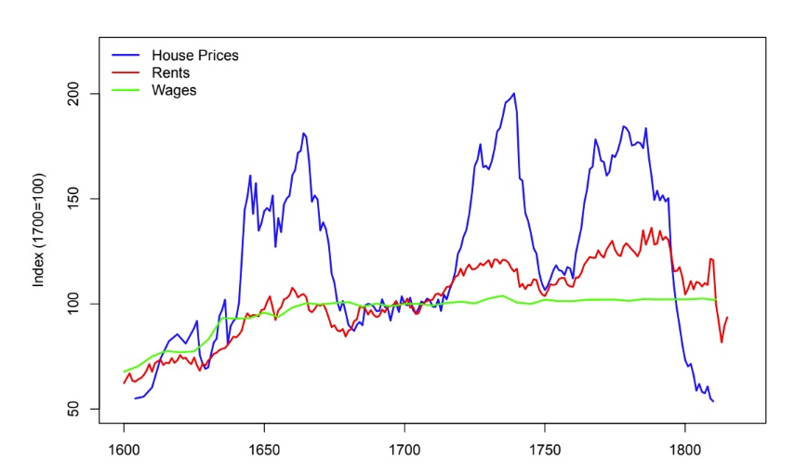
6 Amsterdam Home Prices

