Slide 1
Real Estate as an Asset Class
Introduction to real estate investment
Alex Van de Minne
January, 2025 (CH 7. of Geltner et al., 2013)

Slide 2
1 Introduction
What are we going to do during this class:
In the first section we are going to discuss the investment industry (not just real estate investors!);
  Objective and constraints.
  Who are they?
In the second section we will specifically discuss real estate as one real estate investment asset among other assets.
  How did it perform compared to other asset classes?
If we have the time, we will also quickly go over the history of real estate investment.
Note CRE = Commercial Real Estate

Slide 3
2 Investor Objectives
Why do people invest?
Investment is the act of putting money aside that would otherwise be used for current consumption expenditure.
Why would anyone do that?
  They have more money that they currently need.
  They have a future objective, for which they willingly sacrifice current consumption.
Consider the following examples;
  Dual-income couple in their 20s. They need to save up for a down payment on their house. (3 – 5 years.)
  Dual-income couple in their 30s. They want to save up for their children's college tuition. (10 – 15 years.)
  Retired couple in their 60s. They start to draw out cash from their investments accumulated over the years.

Slide 4
2 Investor Objectives
What are the major investment objectives and the major constraints faced by most investors? At the fundamental level we have the following mutually exclusive types of investor objectives;
  The growth (or savings) objective: This implies a relatively long-time horizon with no immediate or likely intermediate need to use the cash being invested. Any cash that does come out of the investment can be plowed back.
  The income (or current cash flow) objective: This implies that the investor has a short-term and ongoing need to use cash generated from the investment.
What types of investor would have which objective?

Slide 5
2 Investor Constraints (1/2)
In addition to certain objectives, investors also come with a set of constraints/concerns;
  Risk: The possibility that future investment performance may vary over time in a manner that is not entirely predictable at the time when the investment is made. Obviously, investors dislike risk, all things equal.
  Liquidity: The ability to sell and buy investment assets quickly at full value and without much affecting the price of the assets. Investors will pay more, for more liquid assets. This is possibly a major constraint to invest in real estate.
  Time Horizon: The future time over which the investor’s objectives, constraints/concerns are relevant. This affect’s investors tolerance for illiquidity and their ability to bear risk.

Slide 6
2 Investor Constraints (2/2)
In addition to certain objectives, investors also come with a set of constraints/concerns;
  Investor Expertise and Management Burden: How much knowledge, ability, and desire the investor has, to manage the investment process and the investment assets. This is also a specific concern to real estate, as you need to manage the properties themselves.
  Investor Size: How “big” the investor is in terms of the amount of capital in need of investment. You need economies of scale to purchase real estate, and to hire the management expertize.
  Capital constraint: Whether the investor faces an absolute constraint on the amount of capital he or she has available (e.g. from stockholders or depositors).

Slide 7
2 Investor Heterogeneity
Note that because there are so many combinations or objectives/concerns/constraints we have a lot of investor heterogeneity.
Every investor has their own different constituencies, different liabilities, different levels or types of expertise, and the are subject to different types of regulations and legal constraints.
One implication of investor heterogeneity is that this allows for market segmentation. Different products can be tailored to different objectives and constraints.
Very big picture; Investment industry, matches the heterogeneous investors, with heterogeneous products.
However, even with just one product, we can still cater to different investor demands… (see next slide)

Slide 8
2 Underlying Assets vs Investment Products
The investment industry matches heterogeneous investors (sources of capital) with heterogeneous productive assets (physical capital).
It is useful to distinguish underlying assets from investment products (also known as vehicles);
  Underlying asset. Refers to the directly productive physical capital, such as an office building, or an industrial or service corporation. The latter is a collection of physical, human, and legal assets that produce net cash flow over time through production.
  Investment product. Are typically one or more levels removed from the underlying asset but are based on the underlying asset. They have a direct, or indirect claim on the productive underlying physical asset. They may or may not have a governing authority over the underlying asset.
The secondary layer(s) are typically used to match investors.

Slide 9
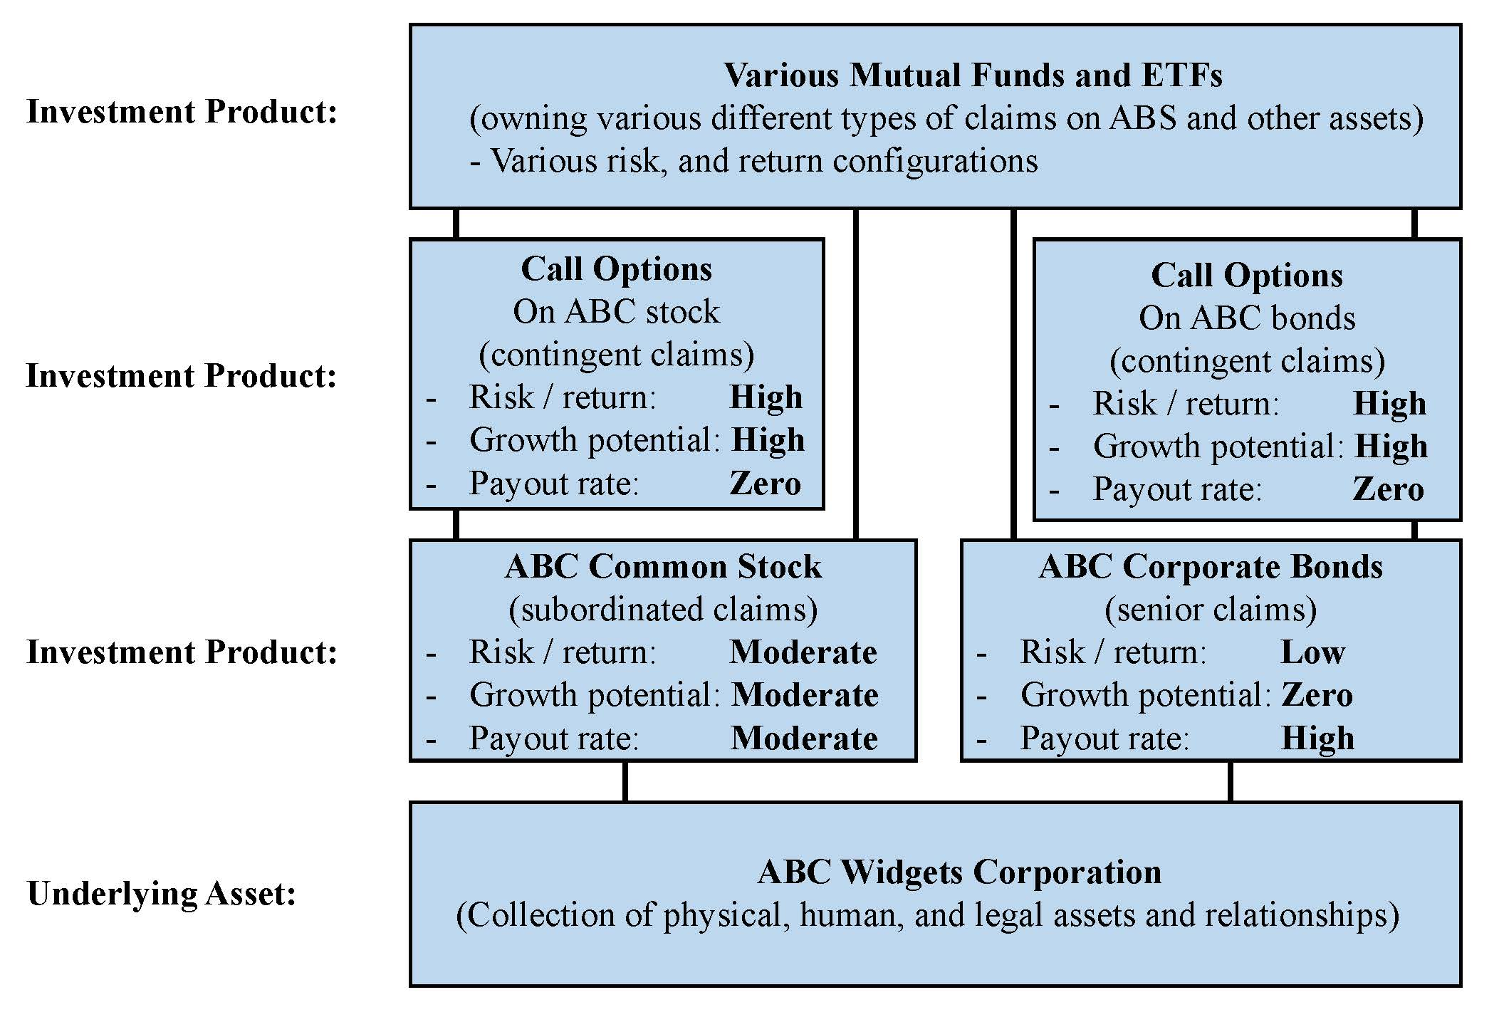
2 Underlying Assets vs Investment Products

Slide 10
3 Enter Real Estate
With commercial real estate we mean rent producing, investable real property.
  Rent producing. The property must produce some sort of cash flow (either now, or in the future) that investors want to enjoy.
  Investable. The property should be able to be bought and sold.
As such, we identity almost 100B of square foot of CRE, worth about $18T.
Notes:
We also have private REITs and CREFs.

Slide 11

3 Enter Real Estate (office)
Notes:
We also have private REITs and CREFs.

Slide 12

3 Enter Real Estate (strip mall)
Notes:
We also have private REITs and CREFs.

Slide 13
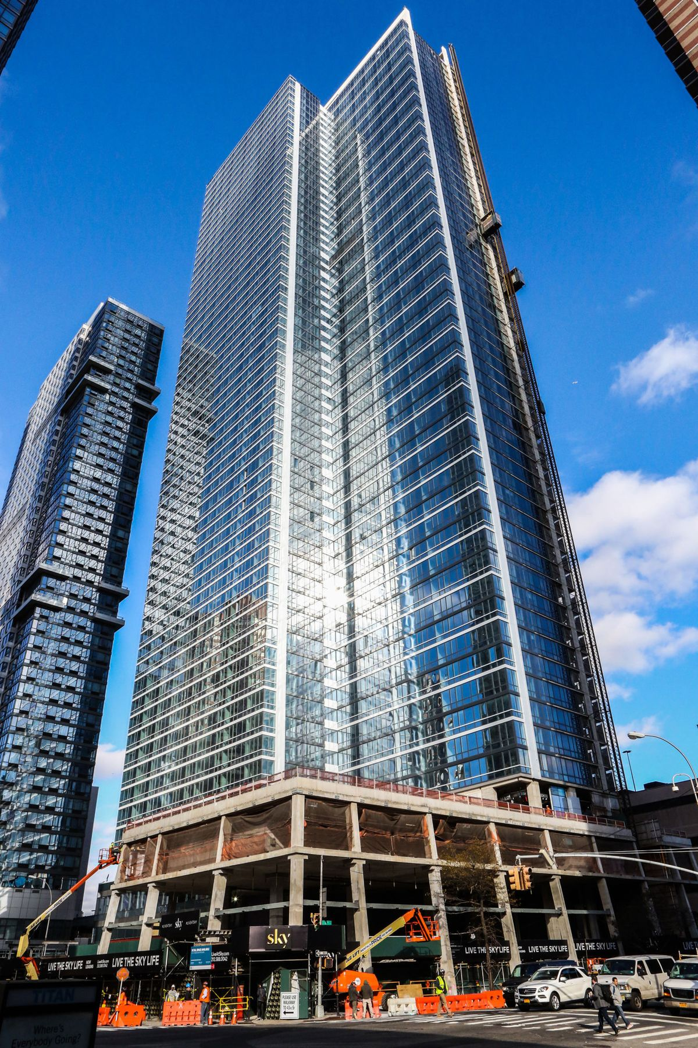
3 Enter Real Estate (apartment)
Notes:
We also have private REITs and CREFs.

Slide 14

3 Enter Real Estate (Boeing)
Notes:
We also have private REITs and CREFs.

Slide 15

3 Enter Real Estate (p. station)
Notes:
We also have private REITs and CREFs.

Slide 16
3 Enter Real Estate
The investment industry pertains to real estate as well.
The underlying assets is the actual “bricks and mortar”, i.e. the real estate itself.
Real Estate Investment Trusts (REITs) own real estate, and are publicly traded, meaning that all the investment products exist for real estate as well.
Commercial mortgages (including CMBS) are like corporate bonds.
Unlike the typical industrial corporation, however, investors can actually own and trade the underlying assets directly!
The ownership is also structured in many cases, including Joint Ventures, private REITs, RELPs, and CREFs. However, in most case,s it is kept private.
Notes:
We also have private REITs and CREFs.

Slide 17
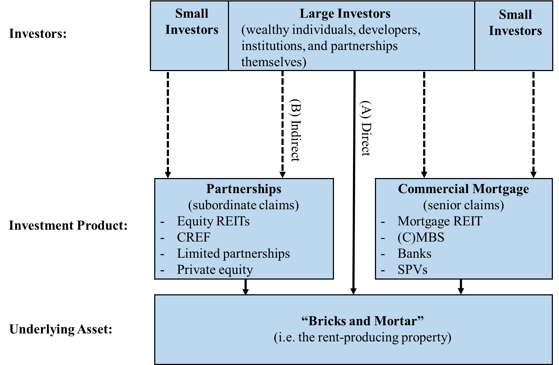
3 Real Estate Investment

Slide 18
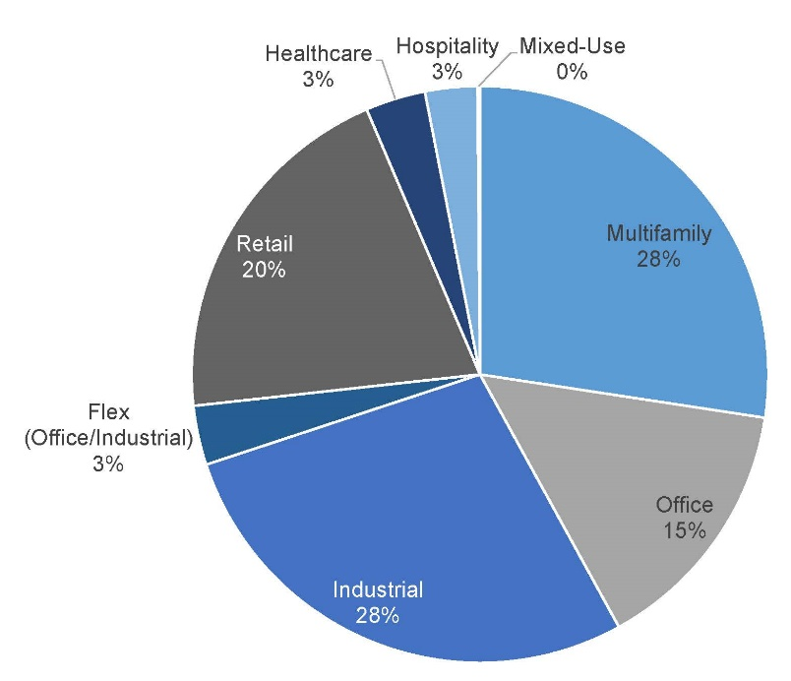
3 Having a look at typical “investable” properties.

Slide 19
3 CRE Investor Heterogeneity

Slide 20
3 CRE Debt Heterogeneity

Slide 21
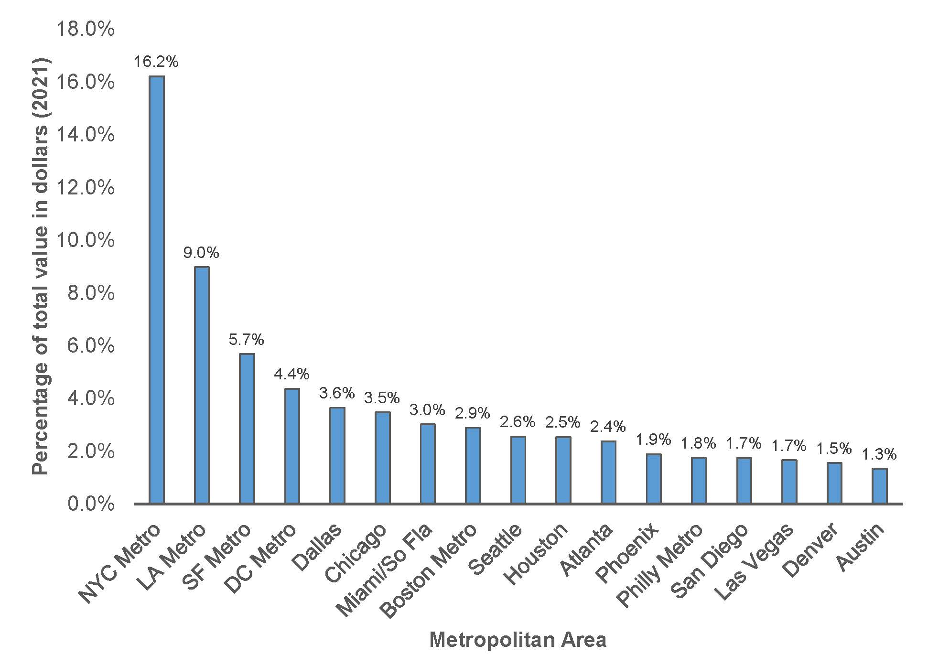
4 Location of typical “investable” properties.

Slide 22
4 Real Estate as an Asset Class
Let’s take a few steps back and put ourselves in the shoes of an investor. Say we have the following 4 options to invest in;
  Cash (T-bills)
  Stocks
  Bonds (Long-run government debt)
  Real Estate (NPI)
With “real estate” in this context we mean direct unlevered investment in large-scale commercial property. Also known as “core”, with AAA tenants.
These investment groups are interesting as they are large, unique and “investable.”

Slide 23
4 Commercial Real Estate
We typically subdivide accordingly;
  Core real estate: returns from current income; target 6-9% (?); low risk (compared to other real estate); low leverage (below 50% LTV); long hold (10 years or more). Trophy properties in CBDs with solid economies; properties fully leased to AAA tenants.
  Core plus real estate: mix of current income and growth (price appreciation), target 9-12% (?), moderate risk, 50-60% LTV, 5-7 year hold. Stabilized building generating steady rents.
  Value-added: some yield, expected significant appreciation; target 18-21% return with accompanying risk; often 60-70% leverage, 5-7 year horizon. Modestly performing property, anticipating that improved asset management can raise rent and value.
  Opportunistic: most expected return from capital gains; target returns of 20% or more, but with substantial risk. Often highly levered albeit at high rates, complex capital stack; short holds (5 years, or less). Undermanaged assets requiring substantial rehabilitation and repositioning.

Slide 24
4 Aggregate Value of Assets (in 2020) in Trillions of $

Slide 25
4 Total return of all asset types, between 1977 – 2019 ($1 inv)

Slide 26
4 Makes sense… right?
Stocks had the highest returns, followed by real estate, gov bonds, T-bills.
All “out-performed” the CPI, which is reassuring…
However, note that returns are highly dependent on the timing of one gets “in the game.”
See next slide for example…
 | Real Estate | T-bill | Stock | Gov. Bonds | CPI
average | 9.28% | 4.44% | 12.45% | 6.17% | 3.57%
standard deviation | 7.50% | 3.58% | 13.47% | 3.29% | 2.84%

Slide 27
4 Total returns between 2000 and 2009.

Slide 28
4 Income versus growth
It is also important to note the source of the return. Again, we have growth and income. A general rule of thumb is;
  For T-bills and bonds all return come from income.
  Real Estate (especially our NCREIF returns) also had relative more income with about 65% of the returns coming from income (rents) and the remainder from growth (price appreciation).
  With stocks it’s the other way around. About 70% is growth and “only” 30% is income (dividend).
Note that there seems to be an inverse relationship with the amount of return coming from income and the risk.

Slide 29
4 Source of return for real estate

Slide 30
4 Comparing the Investments
With real estate we mean a direct “core” investment, without the use of debt.

Slide 31
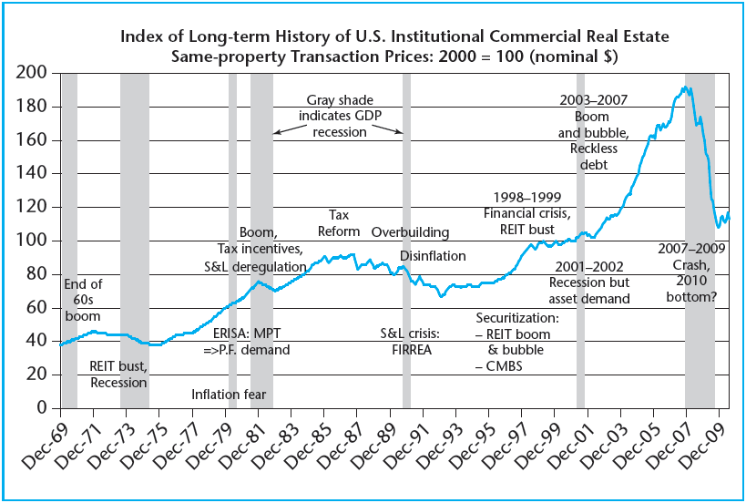
5 History of Commercial Real Estate (in US)

Slide 32
5 History of Commercial Real Estate (in US)

Slide 33
5 Stagflation early 1970s
After the economic growth of the 1960s, the early 1970s were not good for real estate investment.
At this point in time, we had (mostly) mortgage REITs. They borrowed short-term at low interest rates and issued mortgages at higher interest rates to real estate investors, on a long-term fixed basis.
Unfortunately (for them), inflation (and thus interest rates) started to rise at unprecedented levels.
  Government deficit started rising due to Vietnam war.
  Oil crisis (1973 – 1974).
The results were devastating for the REIT industry.
Rents also dropped during this era.

Slide 34
5 History of Commercial Real Estate (in US)

Slide 35
5 Late 1970s
Something interesting started to happen in the late 1970s.
  Investors were getting very afraid of inflation at this point. (It was hitting double digits!) They thought of real estate as a natural hedge against said inflation. (WHY?)
  Congress passed the Employee Retirement Income Security Act (ERISA). This essentially forced pension funds to invest in real estate.
All of the above meant that there were new players and thus new capital on the market, increasing property values. Yey!
Some crises happened during this period, but it did not impact commercial property prices. Double yey!

Slide 36
5 History of Commercial Real Estate (in US)

Slide 37
5 Deregulation in the 80s
The Reagan administration provided investment for real estate investment.
  Very generous depreciation schemes.
  Tax shelter for wealthy individuals.
Banks (saving & loans) were deregulated as well. This opened up a new source of capital, which was inexperienced in commercial real estate.
Combined with the economic recovery in the 80s, we find increasing property prices. Still yeeeeey!

Slide 38
5 History of Commercial Real Estate (in US)

Slide 39
5 Trouble starting mid 1980s
By now, commercial real estate prices have been going up for about 15 years. Investors were riding high!
However, the many tax incentives resulted in development that had nothing to do with catering for any demand.
Also, because the deposits of the S&L banks were guaranteed by government deposit insurance, banks didn’t really do their due diligence. (Ergo, moral hazard!)
With that in mind;
  In 1986, a new tax reform removed virtually all tax benefits.
  Inflation stopped being an issue.
This resulted in capital drying up, and prices dropping.

Slide 40
5 History of Commercial Real Estate (in US)

Slide 41
4 Capitalizing gains / socializing losses
The many issues pressed the US congress to take action;
  On the mortgage side: Government took over the bad loans from all the banks that went bankrupt. They also forced financial institutes to securitize loans.
  On the equity side: REITs got greater management flexibility (before REITs could not manage their own real estate) and did not have to pay transfer taxes anymore after changing from a private party into a (public) REIT.
With the 90s Clinton boom, the oversupply was filled with tenants.
The 1998 Russian / Asian crisis did have an impact, but not large enough to (completely) reverse the positive trend.
Pension funds and commercial bank started returning to the commercial real estate market in full force.

Slide 42
5 History of Commercial Real Estate (in US)

Slide 43
5 The Big Boom of the 2000s
With the burst of the “dot-com” crisis, history repeated itself;
  Investors got spooked by the start-up firms that did not make a single dollar, and ran to the dividend rich, tangible asset called real estate.
  For the first time, even Wall Street started to notice, and recognized real estate as a legitimate investment. FINALLY!
  Money from India and China started flowing in the US as well.
With lower and lower interest rates, and more demand (investors) property prices surged.
You did notice there was a bit of a “bubble-mentality.” Investors started flipping properties like crazy.
Still, it was not as bad as the housing market… Right?

Slide 44
5 History of Commercial Real Estate (in US)

Slide 45
5 The GFC for Commercial Real Estate
It is really true that commercial real estate investors did not believe that would be hit so hard. CRE was in better shape than the single-family housing market. For example, there was less overbuilding in the commercial property market.
However, there was excessive lending in CRE as well.
  The total amount of loans issued in the first half of 2007 was as high as all loans issued in the 1992 – 1998 period.
  The complex CMBS market did not price risks well, resulting in too low interest rates, and way to lax underwriting criteria.
  The life insurance companies did see it coming though! However, because they were realistic when underwriting, no-one wanted to do business with them anymore… They bounced back after the GFC though.
Real estate was not safe enough, and investors fled to T bills, resulting in high price drops in CRE as well.

