Slide 1
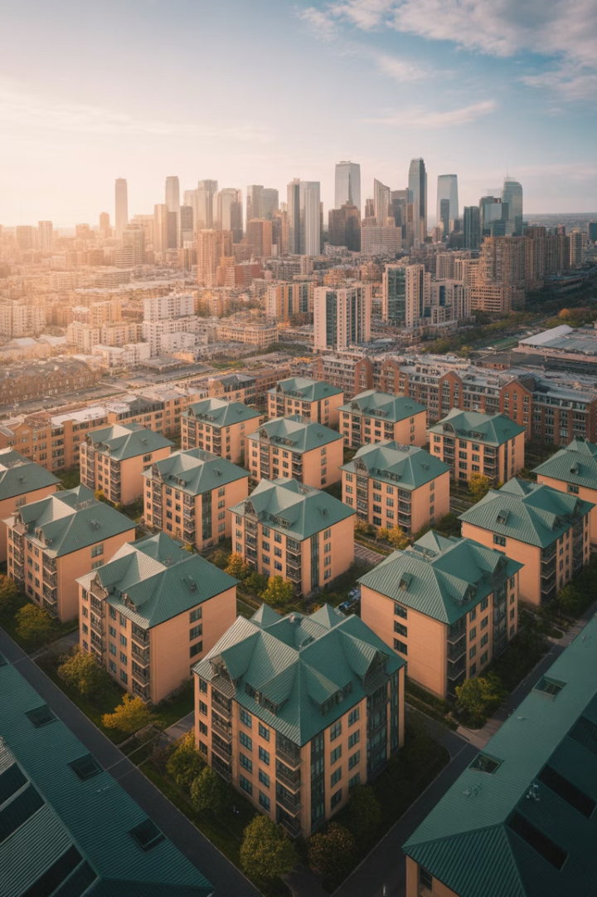
Market Analysis by Property Type
Understanding market dynamics is essential for real estate professionals. This presentation explores how to analyze different property types, from traditional sectors to emerging niches.
NM
by Norm Miller

Slide 2

What Do We Want to Know?
Expected Rents
Vacancy Rates
Rents drive value. They pay expenses and service debt.
Current and projected vacancy affects income stability.
Market Trends
Value Creation
Short-term dynamics and long-term fundamentals shape investment decisions.
Creative marketing, tenant mix, and efficient management enhance returns.

Slide 3




When Do We Want to Know It?
Short Term
Property managers need quarterly forecasts for rent setting and lease negotiations.
Medium Term
Mortgage lenders focus on rent trends over the course of the loan term.
Long Term
Investors want projections over the expected holding period.

Slide 4
Space Market vs. Asset Market
Space Market
Asset Market
Determines rents based on supply and demand for physical space.
Sets property values based on investment criteria.
Yield requirements
Local economic factors
Cost of capital
Demographic trends
Broader geography
Physical constraints

Slide 5








Geographic Market Size
Housing
Office
Neighborhood within same school district
Central business district or suburban cluster
Industrial
Retail
Transportation nodes and access points
Varies by type: neighborhood to regional

Slide 6

Everything Matters
Global/Macro Trends
Regional Trends
Local/Micro Trends
Global economic growth
Tax incentives and credits
Demographic shifts
Exchange rates
Regional economic drivers
Employment trends
Trade policies
Transportation systems
Education and skills
Technology breakthroughs
Land supply and availability
Local transit systems

Slide 7




Market Dynamics Timeline
Demand Increases
Vacancy reduces, rents rise, returns improve
Supply Responds
New construction begins, value-add development occurs
Market Balances
Returns normalize, vacancy returns to equilibrium

Slide 8

Housing Market Analysis
Estimate Population Growth
Consider births, deaths, and net migration patterns.
Calculate Household Formation
Divide by household size, accounting for demographic trends.
Determine Rental Demand
Subtract owner-occupied portion based on homeownership rates.
Adjust for Vacancy
Add units needed for normal market operation.

Slide 9
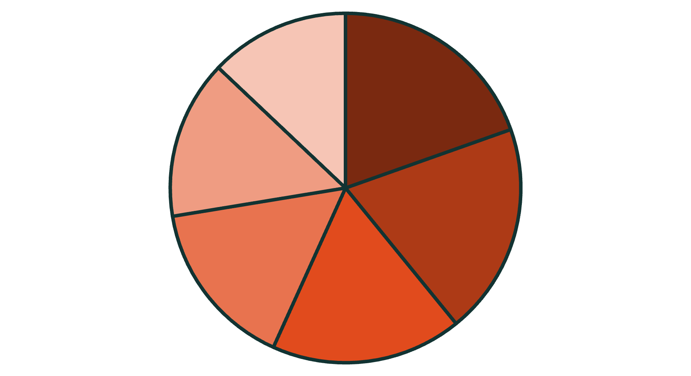
Office Space Demand
Office demand is driven by
professional employment
growth and work patterns.
About 50-65% of total
employment in industrialized
countries consists of
office-based jobs.
Information
Finance/Insurance
Professional Services
Healthcare
Wholesale Trade
Admin Services

Slide 10

Office Space Calculation Example
2,500
55%
210
New Employees
Office Workers
Square Feet
Total projected employment growth
Percentage requiring office space
Average space per office worker
288,750
Total Demand
Square feet of new office space needed

Slide 11
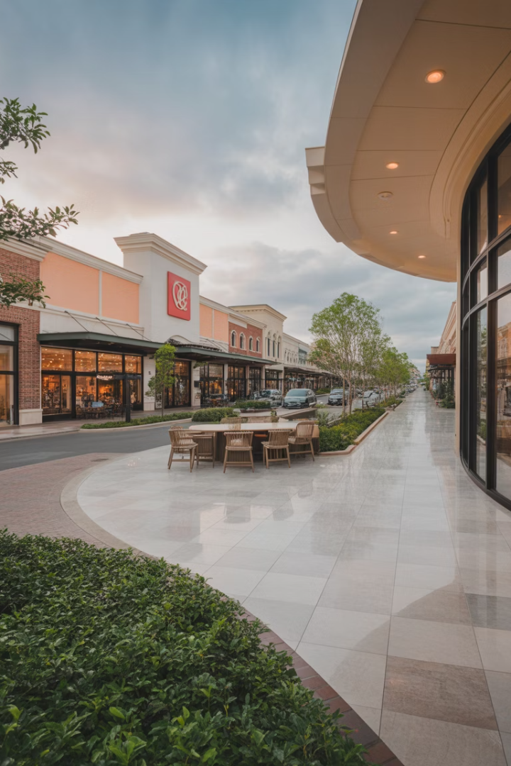
Retail Property Types
Neighborhood Centers
30k-120k sq ft with grocer and drugstore anchors. Drawing distance: 2-5 miles. Most stable retail format.
Lifestyle Centers
80k-250k sq ft featuring restaurants and clothing stores. Drawing distance: up to 10 miles.
Regional Malls
0.5-1M sq ft with 1-2 department stores. Drawing distance: up to 10 miles. Evolving to add grocers and restaurants.
Power Centers
3-6 big box stores at 20k-80k sq ft each. Drawing distance: up to 15 miles. Most vulnerable to e-commerce.

Slide 12






Retail Rent Potential
Rent Calculation
Annual Rent = Sales × Profit Margin × (10-15%)
High Margin Example
Coffee shop: $2,000/sq ft × 50% × 10% = $100/sq ft
Low Margin Example
Grocer: $2,000/sq ft × 12% × 10% = $24/sq ft

Slide 13
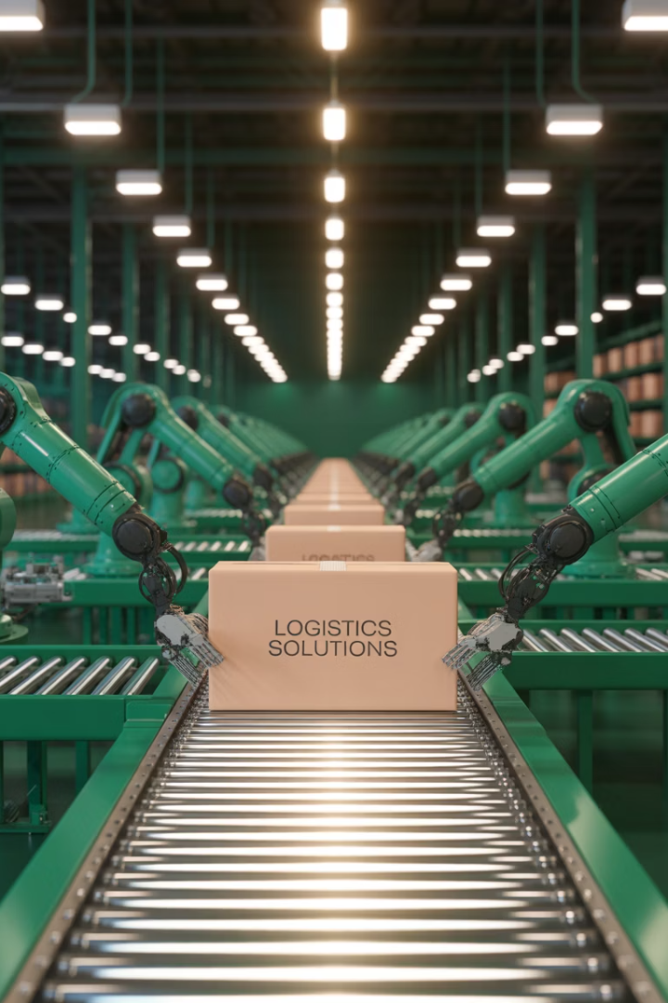




Industrial Warehouse Demand
Supply Chain
E-Commerce
Path of Goods
Located near transportation nodes and central highways
Growing at 16% annually, driving warehouse demand
Distribution markets along flow from manufacturers to consumers
Space Per Capita
US average: 85 sq ft, ranging from 50-150 sq ft but this may change over time.

Slide 14

Lodging Market Analysis
60-85%
90%+
80%
Occupancy
Supply-Constrained
Break-Even
Normal range for hotels
Typical occupancy needed for budget hotels
Occupancy in markets like Hawaii
Key metrics include average occupancy levels, average daily room rate ("rack rate"), and revenue per available room ("RevPar"). Travel demand is split between vacation, personal/family, and business/convention segments.

Slide 15

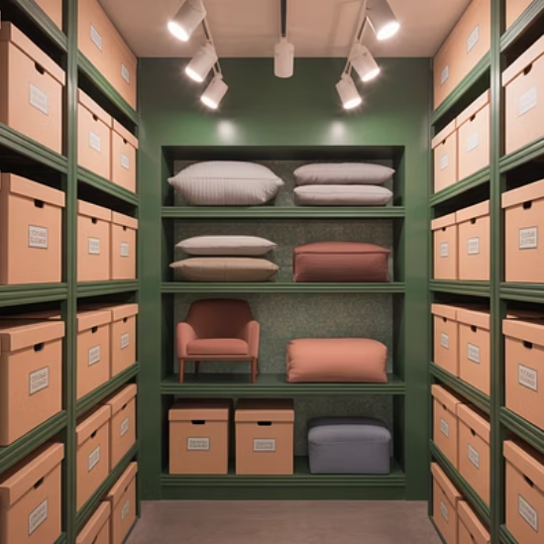
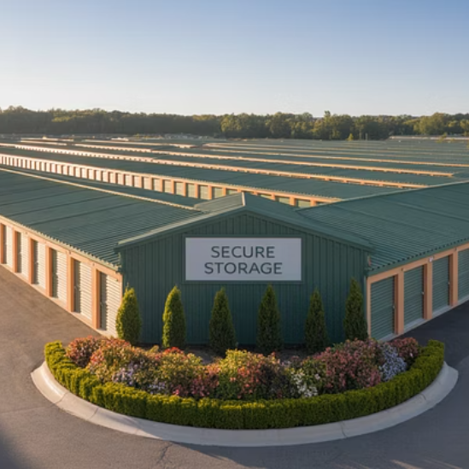
Self-Storage Centers
The US has over 1.65 billion square feet of self-storage space across 50,000 facilities. One in three Americans use self-storage, paying an average of $135 monthly for a 10×10 space.

Slide 16








Self-Storage Market Drivers
Downsizing
Relocation
Primary reason for renting storage units
Temporary storage during moves
Business Needs
Space Constraints
Document and inventory storage
Insufficient home storage

Slide 17



Life Science Facilities
Specialized Features
High ceilings (14-18ft), flexible ceiling structures, and ultra-clean air filtration systems.
Growth Potential
Industry projected to reach $2.4 trillion by 2028, growing at 14% annually.
Robotics Integration
Increasing use of robots for research and manufacturing to maintain clean environments.

Slide 18
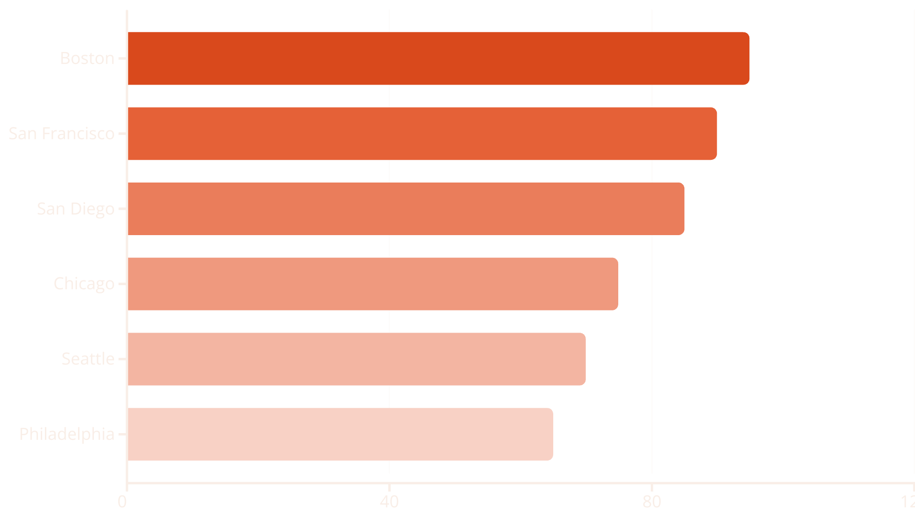
Top Biotech US Locations
Biotech growth is catalyzed by access to major university research facilities that provide innovation and skilled labor. Harvard, MIT, Stanford, and Johns Hopkins are among the top universities driving biotech development.

Slide 19



Data Centers or Data Storage Facilities
Facility Requirements
Power redundancy, temperature control, and security
Location Factors
Cheap electricity and cool climates preferred
Market Growth
Expected to exceed $800 billion by 2026

Slide 20

Surface Parking Lots
Market Segments
Workers seeking regular parking
Short-term business and shopping visitors
Event attendees
Surface lots are "options that pay dividends" - holding sites while earning cash flow until market conditions warrant development.
Parking lots often sell for low cap rates due to their high option value for future development. Most successful investors focus on sites with high option values.

