Slide 1
What Determines Rent?
Residual Land Value and HBU
Alex Van de Minne

Slide 2
1 Introduction
What are we going to do during this class:
We are going to discuss why rent might be higher in one place versus the other.
It will be very theoretically, and we will (mostly) ignore the time dimension.

Slide 3
1 Introduction
What are we going to do during this class:
We are going to discuss why rent might be higher in one place versus the other.
It will be very theoretically, and we will (mostly) ignore the time dimension.
We will be talking about the following topics;
  Basics of rental/space markets
  Disentangling rent into three components
  Monocentric cities

Slide 4
2 Space Market
The space market is the market for the usage of (or the right to use) real property (land or built space).
  Also called the rental market.
The players in this field are;
  On the demand side: individuals, households, and firms or institutions that need space for consumption or production.
  On the supply side: real estate owners who rent space to the tenants.
The price of the right to process and use the space is called rent.
  Typically quoted annually for commercial real estate, and monthly for apartments.

Slide 5
2 Space Market
Demand for built space can be very specific.
  If your law firm needs an office in Hartford, a perfectly adequate building in Orlando will not do.
  Neither will an apartment tower in Hartford itself.
On the supply-side there is also little room for change.
  You cannot move a building.
  Conversions do happen, but are rare and very expensive.
Therefore, the space market is highly segmented.
This means that space markets are local rather than national and is a form of specialization.

Slide 6
2 Space Market
Segmentation is an important concept to understand.
The “Law of One Price” dictates that prices in the same market should be equivalent.
  If you price the product too high, consumers will go to a competitor.
  If you price the product too low, you go out of business.
However, in case of the space market, because of the “barriers of entry” we actually have multiple markets for space usage.
In other words, the “Law of One Price” still holds, within each and every (separate/segmented) market!

Slide 7
2 Space Market
Segmentation thus goes over multiple dimensions, including;
  Spatial. Think of Metropolitan areas (MSAs). However, even within an MSA there can be large differences between downtown (or central business district, CBD) and the suburbs. (As we will find out later…)
  Property usage type. The major types of space markets include office, retail, industrial, and multifamily residential. More specialized markets also exists, think of: hotels, health, and self-storage.
Other forms segmentations can go over property characteristics, like: age of the property (for example new developments), “greenness / ESG”, and size of the property.

Slide 8
2 Space Market (Office NOI)

Slide 9
2 Space Market (Manhattan NOI)

Slide 10
3 Residual Value of Land
Land has value because it is a necessary input, or factor of production.
  In other words; You need land in order for your factory of office to work. (Production does not mean any goods per se, also lawyer firms etc.)
However, land values are not the same across the country, or even within a city.
To get a sense of why this is happening, we are shortly going to introduce what is know as the Residual theory of land.
It might be easier to explain giving a few examples.
  Cloth factory
  Grocery store

Slide 11



3 Cloth factory
The factory needs machines, labor, energy and land to produce the cloths.
Machine: Produce the actual cloths.
Labor and Energy: Needed to operate the machines.
Land: Is needed to house the machines, labor and energy.
The location is important because it determines the cost of transportation.
Costs to bring the raw materials to the factory.
Cost bring the finished product to the end users.
Do you note one big difference between the production factors machine, labor and energy on one hand, and land on the other?

Slide 12
3 Cloth factory
Labor, capital (i.e. machines in the previous example) and the raw materials are mobile.
  In contrast, land is fixed, even in the long run!
  You can never move the land to where the rents are higher.
  This is important, because the “mobile factors” can run away, but land cannot!
  If the mobile factors do not get paid, they simply will look elsewhere. Land does not have that luxury.
  This means, that all the revenue of the cloth factory, will first go to paying off the mobile factors. Land comes last.
This is the residual theory of land.

Slide 13
3 Cloth factory
Raw Materials
Need raw materials to produce the cloth. Costs are $4M.
Pay roll
Next, we pay the workers. Otherwise, our workforce will work somewhere else. Costs are $5M.
Rent on Machines
We also need to pay the rent (or interest rate) used to process the cloth. Costs $900,000 per annum.
The factory earns $10M per year.
Thus, we have $10M - $4M - $5M - $0.9M per annum is;
This would leave $100,000 (the “residual”) to pay the rent of the land (and the space, which we ignored for now) itself.

Slide 14
3 Implications of residual theory of land
So unfortunately, it seems that land is last in line because it is “`trapped”; it cannot go elsewhere. Poor land…
However, there is a flip side as well!!!
Land may only get the residual, but it also gets all of it!
Why would you sell/lease the land to someone if you can get more for it?
Future tenants will bid up the land rent to level at which the tenants makes sufficient profit.
This happens to all “fixed” assets, like paintings, or fine wines. (Note that “fixed” means something slightly different as is the case with land.)
What if our cloth factory could sell its product for $11M a year?
See the immense jump in the residual value for land?

Slide 15
3 Price of Vacant Land
Notes:
Also think of paintings and such.

Slide 16
3 What Role Does the Structure Play? Highest and Best Use
Next, we introduce a new company, namely a grocery store.
  Gross revenue sales $5M.
Thus, we have competition of use.
Our piece of land can only house one use. Which one should it be?
Also, we have two pieces of land.
  The first, same as previous example, is next to an interstate highway.
  The second one is in a residential neighborhood.

Slide 17
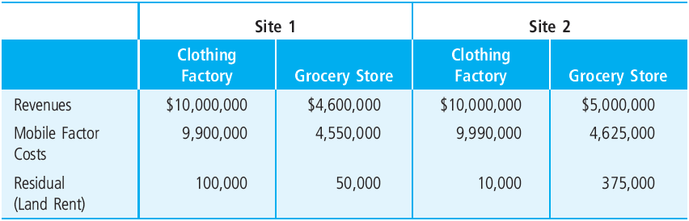
3 Slight Nuance; Highest and Best Use

Slide 18
3 Slight Nuance; Highest and Best Use
Note that the revenues are independent of the location.

Slide 19
3 Slight Nuance; Highest and Best Use
This is not the case for the grocery store. Being closer to the costumers increase revenue.

Slide 20
3 Slight Nuance; Highest and Best Use
In both cases, the transportation costs increase. With 1 – 1.5%.

Slide 21
3 Slight Nuance; Highest and Best Use
Site 1 is better for a clothing factory, for who it is important to have highway access.
Site 2 is for the grocery store. Yes, transportation cost go up, but this is offset by higher earnings.
This is called Highest and Best Use (HBU) and is a very important concept in valuation/investment and in (re)development.

Slide 22
3 What Determines Rent?
Essentially we can disentangle rent into three components;
  Land rent
  Construction rent
  Agricultural rent
Where the total effective rent = land + construction + agricultural rent.

Slide 23
3 What Determines Rent?
Essentially we can disentangle rent into three components;
  Land rent
  Construction rent
  Agricultural rent
Where the total effective rent = land + construction + agricultural rent.

Slide 24
3 Transportation Costs
Note the importance of transportation costs.
  Transportation costs for the cloth factory of both inputs and outputs are lower next to an interstate highway exit.
  The transportation costs of the costumers is lower if the grocery story is close to them.
Note the rather lose terminology of transportation costs here. It includes the costs of moving both inputs and outputs, both directly by the sellers and indirectly the buyers.
Travel time is usually the most important cost.
  This has to do with opportunity cost. And in general HBU will minimize aggregate transportation cost of society.

Slide 25
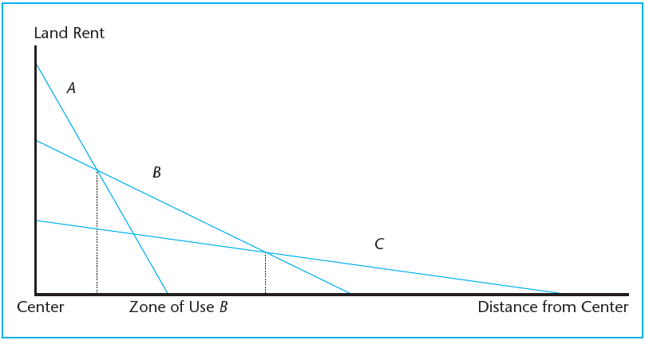
3 Highest and Best Use

Slide 26
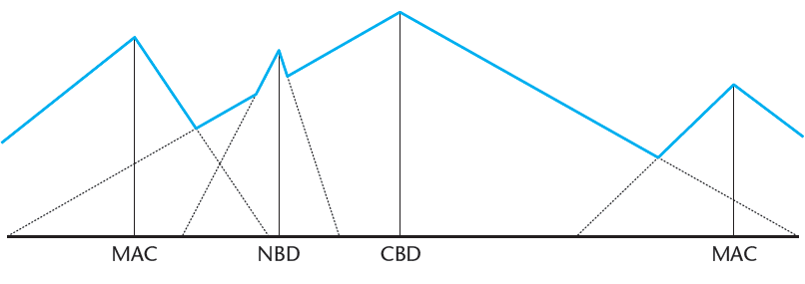
3 Highest and Best Use

Slide 27
3 What Determines Rent?
Essentially we can disentangle rent into three components;
  Land rent
  Construction rent
  Agricultural rent
Where the total effective rent = land + construction + agricultural rent.

Slide 28
4 Other Elements of Rent
Construction rent: is the rent you pay in order to offset the cost of the building (or “structure”) itself. See it as the cost (i.e. periodic interest payments) of financing the construction costs in perpetuity.
  For example, the construction cost for property A were $100,000, and the permanent mortgage has a 10% interest rate. Then, the construction “rent” of property A is $10,000.
Agricultural rent: land has an intrinsic value to it as agricultural land. If all things fail, you can always grow crops on your land, and that will give you a certain profit. Thus, the rent you pay has to be at least higher compared to this profit, otherwise you’ll just grow crops, right?
  For example, the profit of crops is $500 per acre.

Slide 29
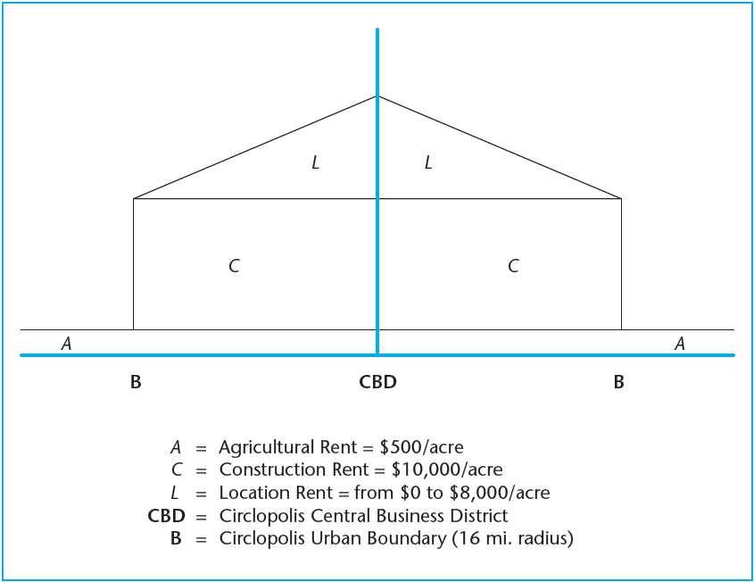
4 The Monocentric City

Slide 30
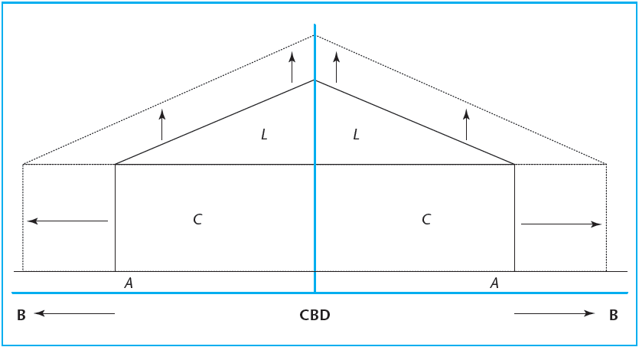
4 Population Increase (A)

Slide 31
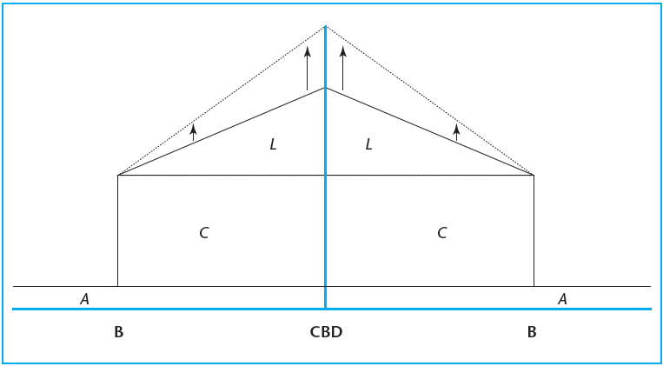
4 Population Increase (B)

Slide 32
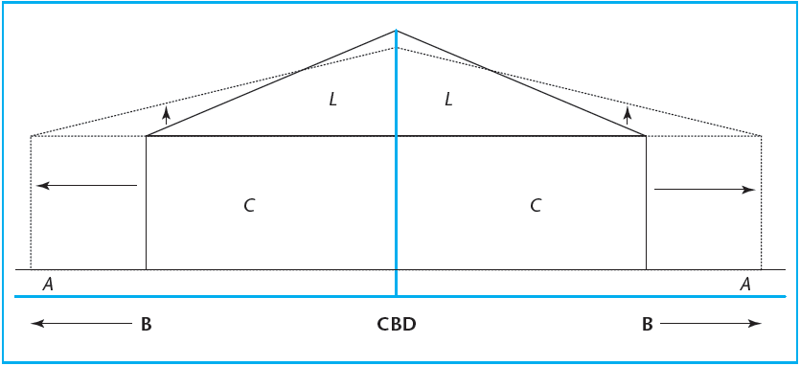
4 Transportation Cost Reduction (A)

Slide 33
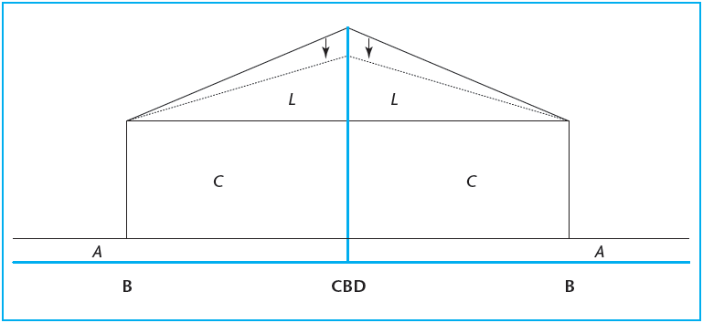
4 Transportation Cost Reduction (B)

