Slide 1
Investment value
And some other specialty topics
Alex Van de Minne

Slide 2
1 Introduction
What we will do in this class:
We will discuss some specific reasons why you would want to adjust your growth (g) term.
We will also discuss noise.

Slide 3
1 Introduction
Before we move on, there are some salient details about CRE investment that you would not find in general finance textbooks;
  There is a market for the underlying assets, namely real estate. (As opposed to say, pharmaceutical labs or microchip plants.)
  The market is not informationally efficient. Real estate trades infrequently and are heterogeneous goods.
  The also exists a large market of publically traded REIT shares. Thus there is a parallel asset market.
Now, let’s look at some of the consequences of this!

Slide 4
2 Market Value
Market value is defined as the expected price at which the asset would sell currently in the private market (without pressure).
  Market value is what we have been talking about so far.
  Such a definition only works when there is a well-functioning market. However;
    You cannot buy and sell quickly.
    Holding periods are long.
    There are large transaction costs associated with trading in the private market.
    Sales price depends on the counter party as well.
Perhaps, real estate is more like corporate capital budgeting?
  Think of building a new manufacturing plant for example.

Slide 5
2 Market Value
Market value is defined as the expected price at which the asset would sell currently in the private market (without pressure).
  Market value is what we have been talking about so far.
  Such a definition only works when there is a well-functioning market. However;
    You cannot buy and sell quickly.
    Holding periods are long.
    There are large transaction costs associated with trading in the private market.
    Sales price depends on the counter party as well.
Perhaps, real estate is more like corporate capital budgeting?
  Think of building a new manufacturing plant for example.
  But is it? Remember, there is no underlying market for m. plants.

Slide 6
2 Investment Value
Investment value is the value of a property to a particular owner, who would be explicitly not plan on selling the asset for long period of time.
In contrast to the market value, which is the price in the market if you sell today, investors have the ability to alter future cash flows and thus (investment) value of the asset.
In principle, IV is private or subjective valuation of a party, whereas MV is an objective value exogenous to any one party.
Note, that – again – investment value is the only way to determine the NPV in capital budgeting, because there is no market for the underlying good.

Slide 7
2 Measuring Investment Value
Actually… the DCF method is more suited for measuring IV, than it is to measure MV.
You can also compute MV by looking up “comps” in a transaction database like RCA or CoStar.
  Find most recent and most comparable transactions in the area. Take an average cap rates and divide it with the target properties’ NOI. Make some discounts/premiums based on differences (like age of property), etc.
Given that IV is about long-term investment, most current prices might not be suitable.
When making a DCF, the differences – in principle – should not be in the opportunity cost of capital.
  All investors face the same price of time and risk for the same property. And everyone has access to the capital markets.
Thus IV has a different g parameter, because you can grow rent more compared to the market. Are you marginal?

Slide 8
2 Examples
What examples of buyers with high IV can you think of?

Slide 9
2 Examples
What examples of buyers with high IV can you think of?
HBU for a vacant site is apartment. However, you own an apartment tower right next to the vacant site. You might want to buy it, and built a retail center. Retail might not be optimal for the site, but it is for your portfolio. (Less competition, and synergy between uses.) In this case rents of your apartment tower will go up more. (But should still be put in the DCF of retail.)
Maybe you are an excellent entrepreneur, that has invented a new property type, like super-senior living.
Perhaps you can create a local monopoly in a supply constraint market. Thus, you can set prices any way you want.
Perhaps you pay less tax because of some loophole somewhere?

Slide 10
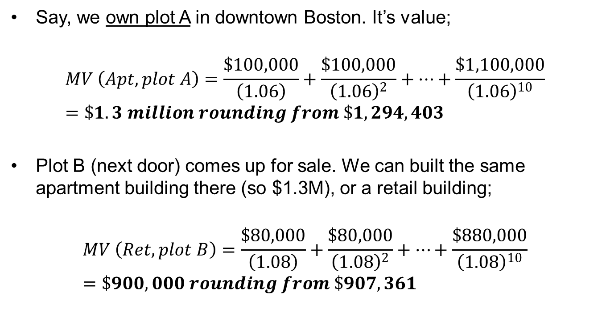
2 Mathematical Example
Say, we own plot A in downtown Boston. It’s value;
$$MV \left(Apt, plot A\right)=\frac{\$100,000}{\left(1.06\right)}+\frac{\$100,000}{{\left(1.06\right)}^{2}}+…+\frac{\$1,100,000}{{\left(1.06\right)}^{10}}=\$1.3 million rounding from \$1,294,403$$
Plot B (next door) comes up for sale. We can built the same apartment building there (so $1.3M), or a retail building;
$$MV \left(Ret, plot B\right)=\frac{\$80,000}{\left(1.08\right)}+\frac{\$80,000}{{\left(1.08\right)}^{2}}+…+\frac{\$880,000}{{\left(1.08\right)}^{10}}=\$900,000 rounding from \$907,361$$

Slide 11
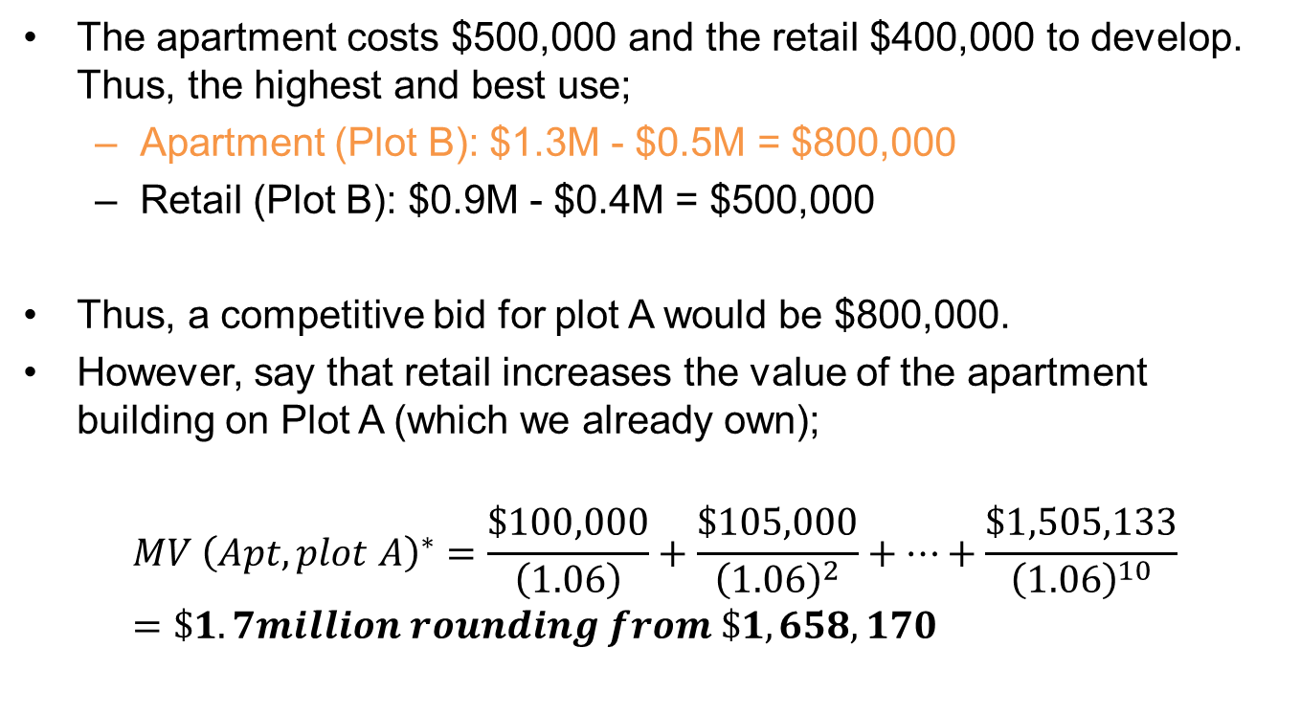
2 Mathematical Example
The apartment costs $500,000 and the retail $400,000 to develop. Thus, the highest and best use;
  Apartment (Plot B): $1.3M - $0.5M = $800,000
  Retail (Plot B): $0.9M - $0.4M = $500,000
Thus, a competitive bid for plot A would be $800,000.
However, say that retail increases the value of the apartment building on Plot A (which we already own);
$$MV {\left(Apt, plot A\right)}^{∗}=\frac{\$100,000}{\left(1.06\right)}+\frac{\$105,000}{{\left(1.06\right)}^{2}}+…+\frac{\$1,505,133}{{\left(1.06\right)}^{10}}=\$1.7million rounding from \$1,658,170$$

Slide 12
2 Mathematical Example
In this case, we gain $400,000 in value in the apartment building on plot A by developing retail on plot B ($1.7M - $1.3M)
Thus, the IV of plot A for us is the MV of the land with retail, plus the increase in value of plot A.
Thus, the IV for plot B is $900,000 ($500,000 + $400,000), compared to $800,000 MV. (Or IV > MV)
Sooooo, should we pay $800,000 or $900,000 for the plot of land?

Slide 13
2 Should we do the deal?
Thus we will focus on expected future cash flow generation, rather than on the denominators.
Now we can have two scenarios;
  NPV_{mv} >> 0 >> NPV_{iv}
  NPV_{mv} << 0 << NPV_{iv}

Slide 14
2 Should we do the deal?
Thus we will focus on expected future cash flow generation, rather than on the denominators.
Now we can have two scenarios;
  NPV_{mv} >> 0 >> NPV_{iv}
  NPV_{mv} << 0 << NPV_{iv}
In the first scenario, the market value is substantially larger than both zero and to the investment value. How can this be?
  You should still make the deal, even though the NPV of the investment value is smaller than zero!
  This, because you can sell it back to the market immediately and make some money.
  The only reason this scenario happens is when it is outside of the area of your expertize.

Slide 15
2 Should we do the deal?
Let’s think about the second scenario.
  The investment has a market value NPV smaller than zero, but positive for the investment value NPV.
Should we purchase the property?

Slide 16
2 Should we do the deal?
Let’s think about the second scenario.
  The investment has a market value NPV smaller than zero, but positive for the investment value NPV.
Should we purchase the property?
  Conservative view: NO! You should never pay more than market value for something. The definition of market value means that the seller is asking for too much for the property. Why give in? Bargain down until NPV_{mv} = 0, or walk away.
  Liberal view: YES! Why walk away from a positive/zero NPV project?
Note that from an IV perspective, both buyer and seller can get a positive NPV for the same deal!

Slide 17
2 Should we do the deal?
Note that it is still important to try and pay the lowest price possible. The amount the you can bargain depends on multiple things;
  Negotiating skills.
  How much you want the asset.
  How costly is it for you to keep searching?
  How sure are you of the MV? You might want to be a bit conservative if you are unsure.
It is also very important to keep your IV information confidential! If the opposing party knows your IV, it might bargain up to that point!
Finally, note that;
  The more homogenous the properties in a market are, and the more transactions there are, they more prices will be closer to MV.
  The more unique properties are, combined with a lack of transactions, will result in prices being closer to IV.

Slide 18
3 Noise
Say you are interested in a certain property. You cannot look up the value of the property on you phone. (Well, maybe you can, but it will not be accurate…)
You have to do research, compute the NPV, etc.
But even then, the negotiation process might result in a different sales prices altogether.
In reality, you can find substantial positive and negative NPV deals in CRE because (even for just marginal buyers / sellers);
  Information asymmetry / mistakes.
  Negotiation skills.
  Pressure.
  Etc.

Slide 19
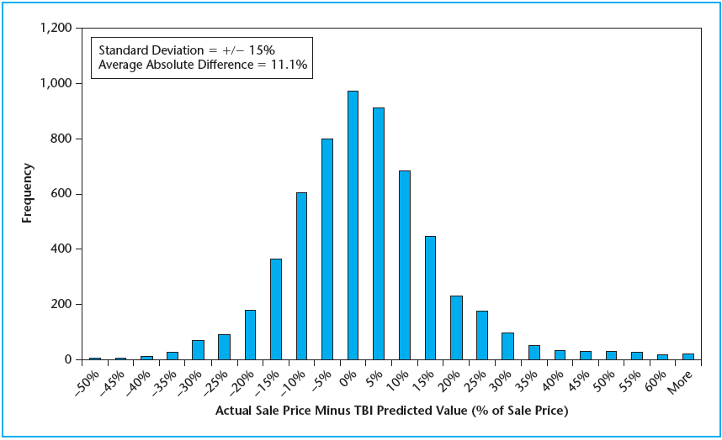
3 Noise

Slide 20
3 Noise
Noise is not typically discussed in general finance textbooks.
There simply is very little transaction noise!
But also, you can diversify noise away.
  Can you truly do this in CRE?
  Not really can you? You would need approximately 15 properties in every market to truly diversify away transaction noise.

