Slide 1

chapter 8:
Writing about theory & Literature

Slide 2

Literature and theory work together (what Ravitch & Riggan, 2012, call the conceptual framework) to undergird your design, results, and writing.

Slide 3

What is theory?
Concept 1
Concept 2
How are they related?

Slide 4

What is theory?
For Anfara & Mertz (2015):
Construct
Proposition
Construct
Concept 1
Concept 1
Concept 2
Concept 2
How are they related?

Slide 5


What is theory?
For Anfara & Mertz (2015):
Construct
Proposition
Construct
Concept 1
Concept 1
Concept 2
Concept 2
How are they related?
Construct
Proposition
Construct
Concept 1
Concept 1
THEORY
Concept 2
Concept 2
How are they related?
Construct
Proposition
Construct
Concept 1
Concept 1
Concept 2
Concept 2
How are they related?

Slide 6
Why use lit & theory?
To “package” our cognition and share it
Literature…
    contextualizes the current study—what we already know
    supports new points
    provides theories to compare or test
    gives methodological and procedural help
Help others learn about the field, including new things they should read.
Shows where the gaps are, and the “entry point” for your study

Slide 7
When to engage Lit & Theory?
Before? During? After?

Slide 8
From where?
Your own experience, intellectual history, political commitments
Look to models in the literature
Advisors or peers
Library catalogs, databases, and search engines

Slide 9
...the conceptual framework for your study is something that is constructed, not found. It incorporates pieces that are borrowed from elsewhere, but the structure, the overall coherence, is something that you build, not something that exists ready-made.
Maxwell (2005), P. 35, emphasis original

Slide 10
where to place it?
Literature and theory can appear in all parts of the manuscript!!
Make sure theories “flow” through the manuscript; come back to theories later to show how your findings relate.

Slide 11
How much?
It depends.
Consider the type of document and the audience: use more for longer documents and scholarly audiences.

Slide 12
How to
Write about Lit & Theory

Slide 13
Planning
Organizing possibilities are plentiful:
    defining terms,
    showing what the field knows and doesn’t,
    describing the chronological development of theories,
    comparing and contrasting two or more understandings,
    discussing major themes in the literature,
    overviewing major figures in a field,
    and exploring previous applications.
Try OUTLINING

Slide 14

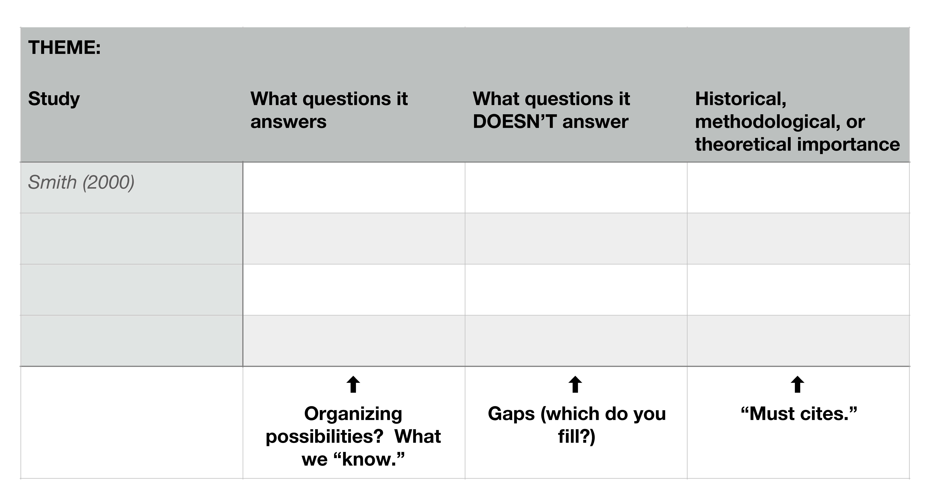
Planning (Cont.)

Slide 15
getting Going
Don’t obsess too much over order. Just start somewhere and you can add in structuring and metacommentary later to clean it up.
There’s rarely nothing to find on your topic. Cast your net wider for corollary literature.
Don’t wait to write until you’ve read everything available.

Slide 16
Techniques & maxims as you write
Pay attention to and include the multiple interpretations of qualitative contexts
Apply, apply, apply. Connect theory to real-world applications and examples.
Be true to the original context. Read the theory, especially the original.
Be appropriately critical. Not too much, not too little.

Slide 17
Techniques & maxims as you write (Cont.)
Focus on themes rather than studies. Focus on individual studies only when they are truly important or relevant.
Pick verbs that shine. Don’t just use argued, found, or said
Quote artfully. Quote for evidence and effect. Not too much or too little.
Use past tense, generally. The studies happened in the past, so talk about them as such.

Slide 18
Crafting your own
Theory
Focus on and articulate the concepts, constructs, and propositions you are working with.
Consider diagramming those building blocks.

Slide 19
Activity: Finding the building Blocks of a theory
Take a theory you like—perhaps even one you made—and break it down into Anfara and Mertz’s (2015) “building blocks”: concepts, constructs, and propositions.
Then, make a diagram that maps out the relationships of the larger theory using different shapes and connectors.

Slide 20
Activity: Getting help with literature
In a writing group or as a class, take turns having individuals present their research question(s) to everyone else.
Then, peers tell the writer what kinds of topics they, as readers, might expect to see in a literature review about the subject. The writer stays silent during this feedback, only taking notes on every idea.
As a group, discuss suggestions that surprised you or that you hadn’t considered.

