Slide 1
MUSIC LICENSING
The Complete Guide to Film & Digital Production:
The Process & The People
Lorene M. Wales, Ph.D.

Slide 2
GETTING MUSIC
Bandcamp, Beatport and Soundcloud (can be frustrating, since artists don’t always respond in a timely fashion).
Commission an original score.
License existing music through ASCAP or BMI.
License through Creative Commons.

Slide 3
Licensing – what is it?
“Renting” a copyrighted material for your use.
Comes with certain terms such as:
Length of use
Amount of use
Distribution of use

Slide 4
Music Licensing
Each license is different, based on:
distribution of the film
length of the piece
number of copies
length of the license itself

Slide 5
Music Licensing Companies
American Society of Composers, Authors & Publishers
www.ASCAP.com
Broadcast Music Inc. or BMI
www.bmi.com
The Harry Fox Agency, Inc.
www.harryfox.com
SESAC (Christian)
www.sesac.com

Slide 6
How it Works
Databases with composition titles.
You can look up a particular song.
You look up a song and they provide contacts for writer/publisher information.

Slide 7
How it Works
Once you find the song, locate that song’s publisher.

Slide 8
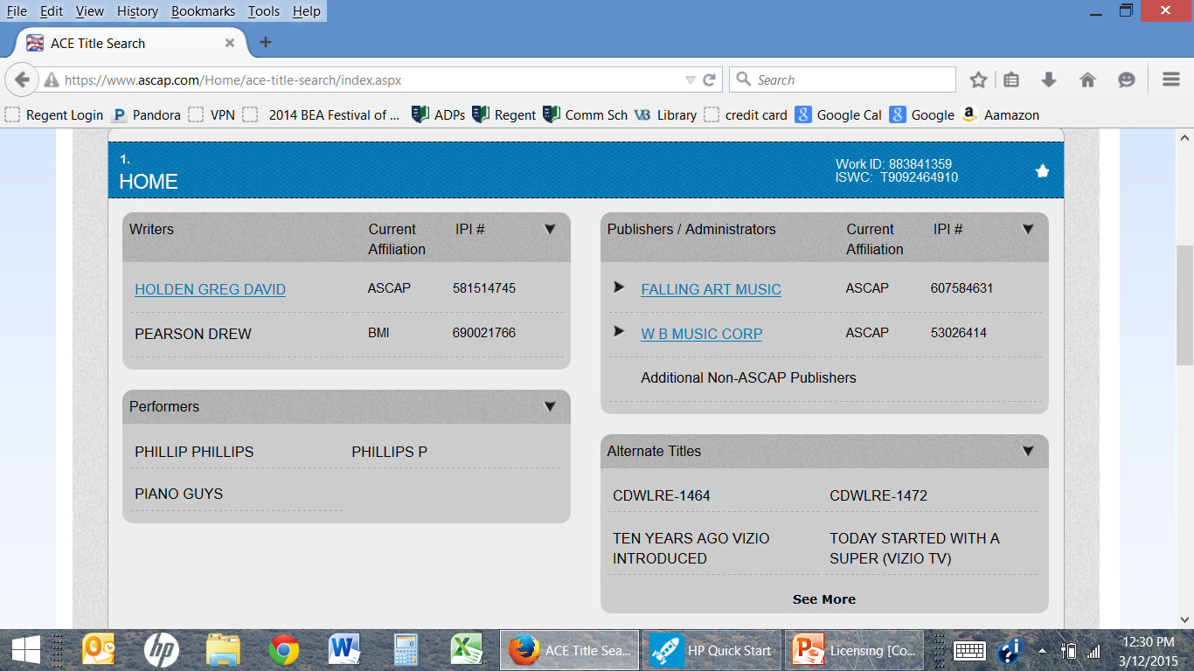
ASCAP
Result when I picked his song “Home”

Slide 9
ASCAP
Choose the publisher.
Click the little down triangle, I get the publisher’s information.
Contact the publisher.

Slide 10
The Music License Agreement
Once you reach an agreement with the music owner/publisher, you sign a music licensing agreement.

Slide 11
How Licensing Companies Work
Companies collect license fees for songs (from you) & distributes a portion of those fees to the writers and publishers.
Then they take a percentage for operating expenses, approximately 15-17%.

Slide 12
Kinds of Licenses
There are different kinds of licenses you can get…
Sometimes you need all of them.
Sometimes you may only need some.

Slide 13
Types of Licenses
Usually yearly, renewable yearly
Public Performance
To play or perform in public.
Mechanical
Written permission to manufacture and distribute a record, CD or digital recording for a specific copyrighted composition.

Slide 14
Types of Music Licenses
Synchronization
Used in combination with visual images.
Grand Rights
Theatrical presentations of operas, complete productions of Broadway musicals.
Adaptation
The right to alter the music in use.

Slide 15
Types of Licenses
At the very least you need a sync and public performance license, in order to put a copyrighted piece of music to your film.

Slide 16
Conclusion
Copyright of the music is an important issue, best handled by a lawyer or music clearance company. If an original score is commissioned, it is written by a composer and performed by musicians in a scoring session.
The scoring session allows the composer to match each piece of music to the picture. After the scoring session, the music is sent to the music editor, to be edited into the sound track.
Finally, if desired, the music for a project may be turned into a sound track, which provides revenue and exposure to the record company and the production.

