Slide 1
Safety on Set
The Complete Guide to Film & Digital Production:
The People & The Process
Lorene M. Wales, Ph.D.
Notes:
Emergency Form
Accident/Injury Report

Slide 2
Safety Manager
May answer directly to a studio.
May answer directly to the producer and director.
Reads the script and marks all actions that may indicate an unsafe or hazardous situation.
Meets with the producer, director, stunt coordinator, or visual effects supervisor to discuss safety issues.
May advise stunt or special-effects department on set.
If needed, shows up on set to supervise the safety of any situation deemed necessary.

Slide 3
A GOOD Safety Manager
Knows the Industry-Wide Labor Management Safety Committee Safety Bulletins.
Is knowledgeable in various safety practices for stunts and special effects.
Can recognize potential safety hazards and has the aggressiveness and integrity to try and prevent accidents.

Slide 4
Paperwork
The Safety Manager will then create a Safety Report with recommendations or requirements for the shoot.
This memo is highly important, should any legal matters arise in case of an accident.

Slide 5
Process
If necessary bulletins from the Industry Wide Labor Safety Committee will be attached to the report.
A link to these bulletins follows:
http://www.csatf.org/bulletintro.shtml

Slide 6
Safety Regulations
The Safety Manager may attend shoots where a safety risk is present.
The Safety Manager in consultation with the EP may recommend to shut down the set if deemed unsafe for crew and/or cast.
In the event of an accident or injury, the Safety Manager must be notified immediately.

Slide 7
If an accident/injury occurs: Procedure
If an injury or accident occurs that causes a person to lose consciousness, or may result in extreme injury to any persons, call emergency services right away.
Next call the shoot’s executive producer.
Next call the safety manager.
Next, submit a safety report to the Safety Manager, as soon as possible.

Slide 8
Procedure
No injured person should attempt to leave set to seek medical attention, alone.
That person must always be accompanied by another person.

Slide 9
Other Safety Considerations
Locations
Never shoot in dangerous neighborhoods.
If a neighborhood is questionable, hire security to assist you in protecting the cast, crew and equipment.

Slide 10
Other Safety Considerations
Power
Never attempt to “tie-in” to any location, or to operate a generator if you have not been properly trained.
Never use electricity near water or when raining, or during a thunderstorm.
All crew operating lights must wear protective gloves.

Slide 11
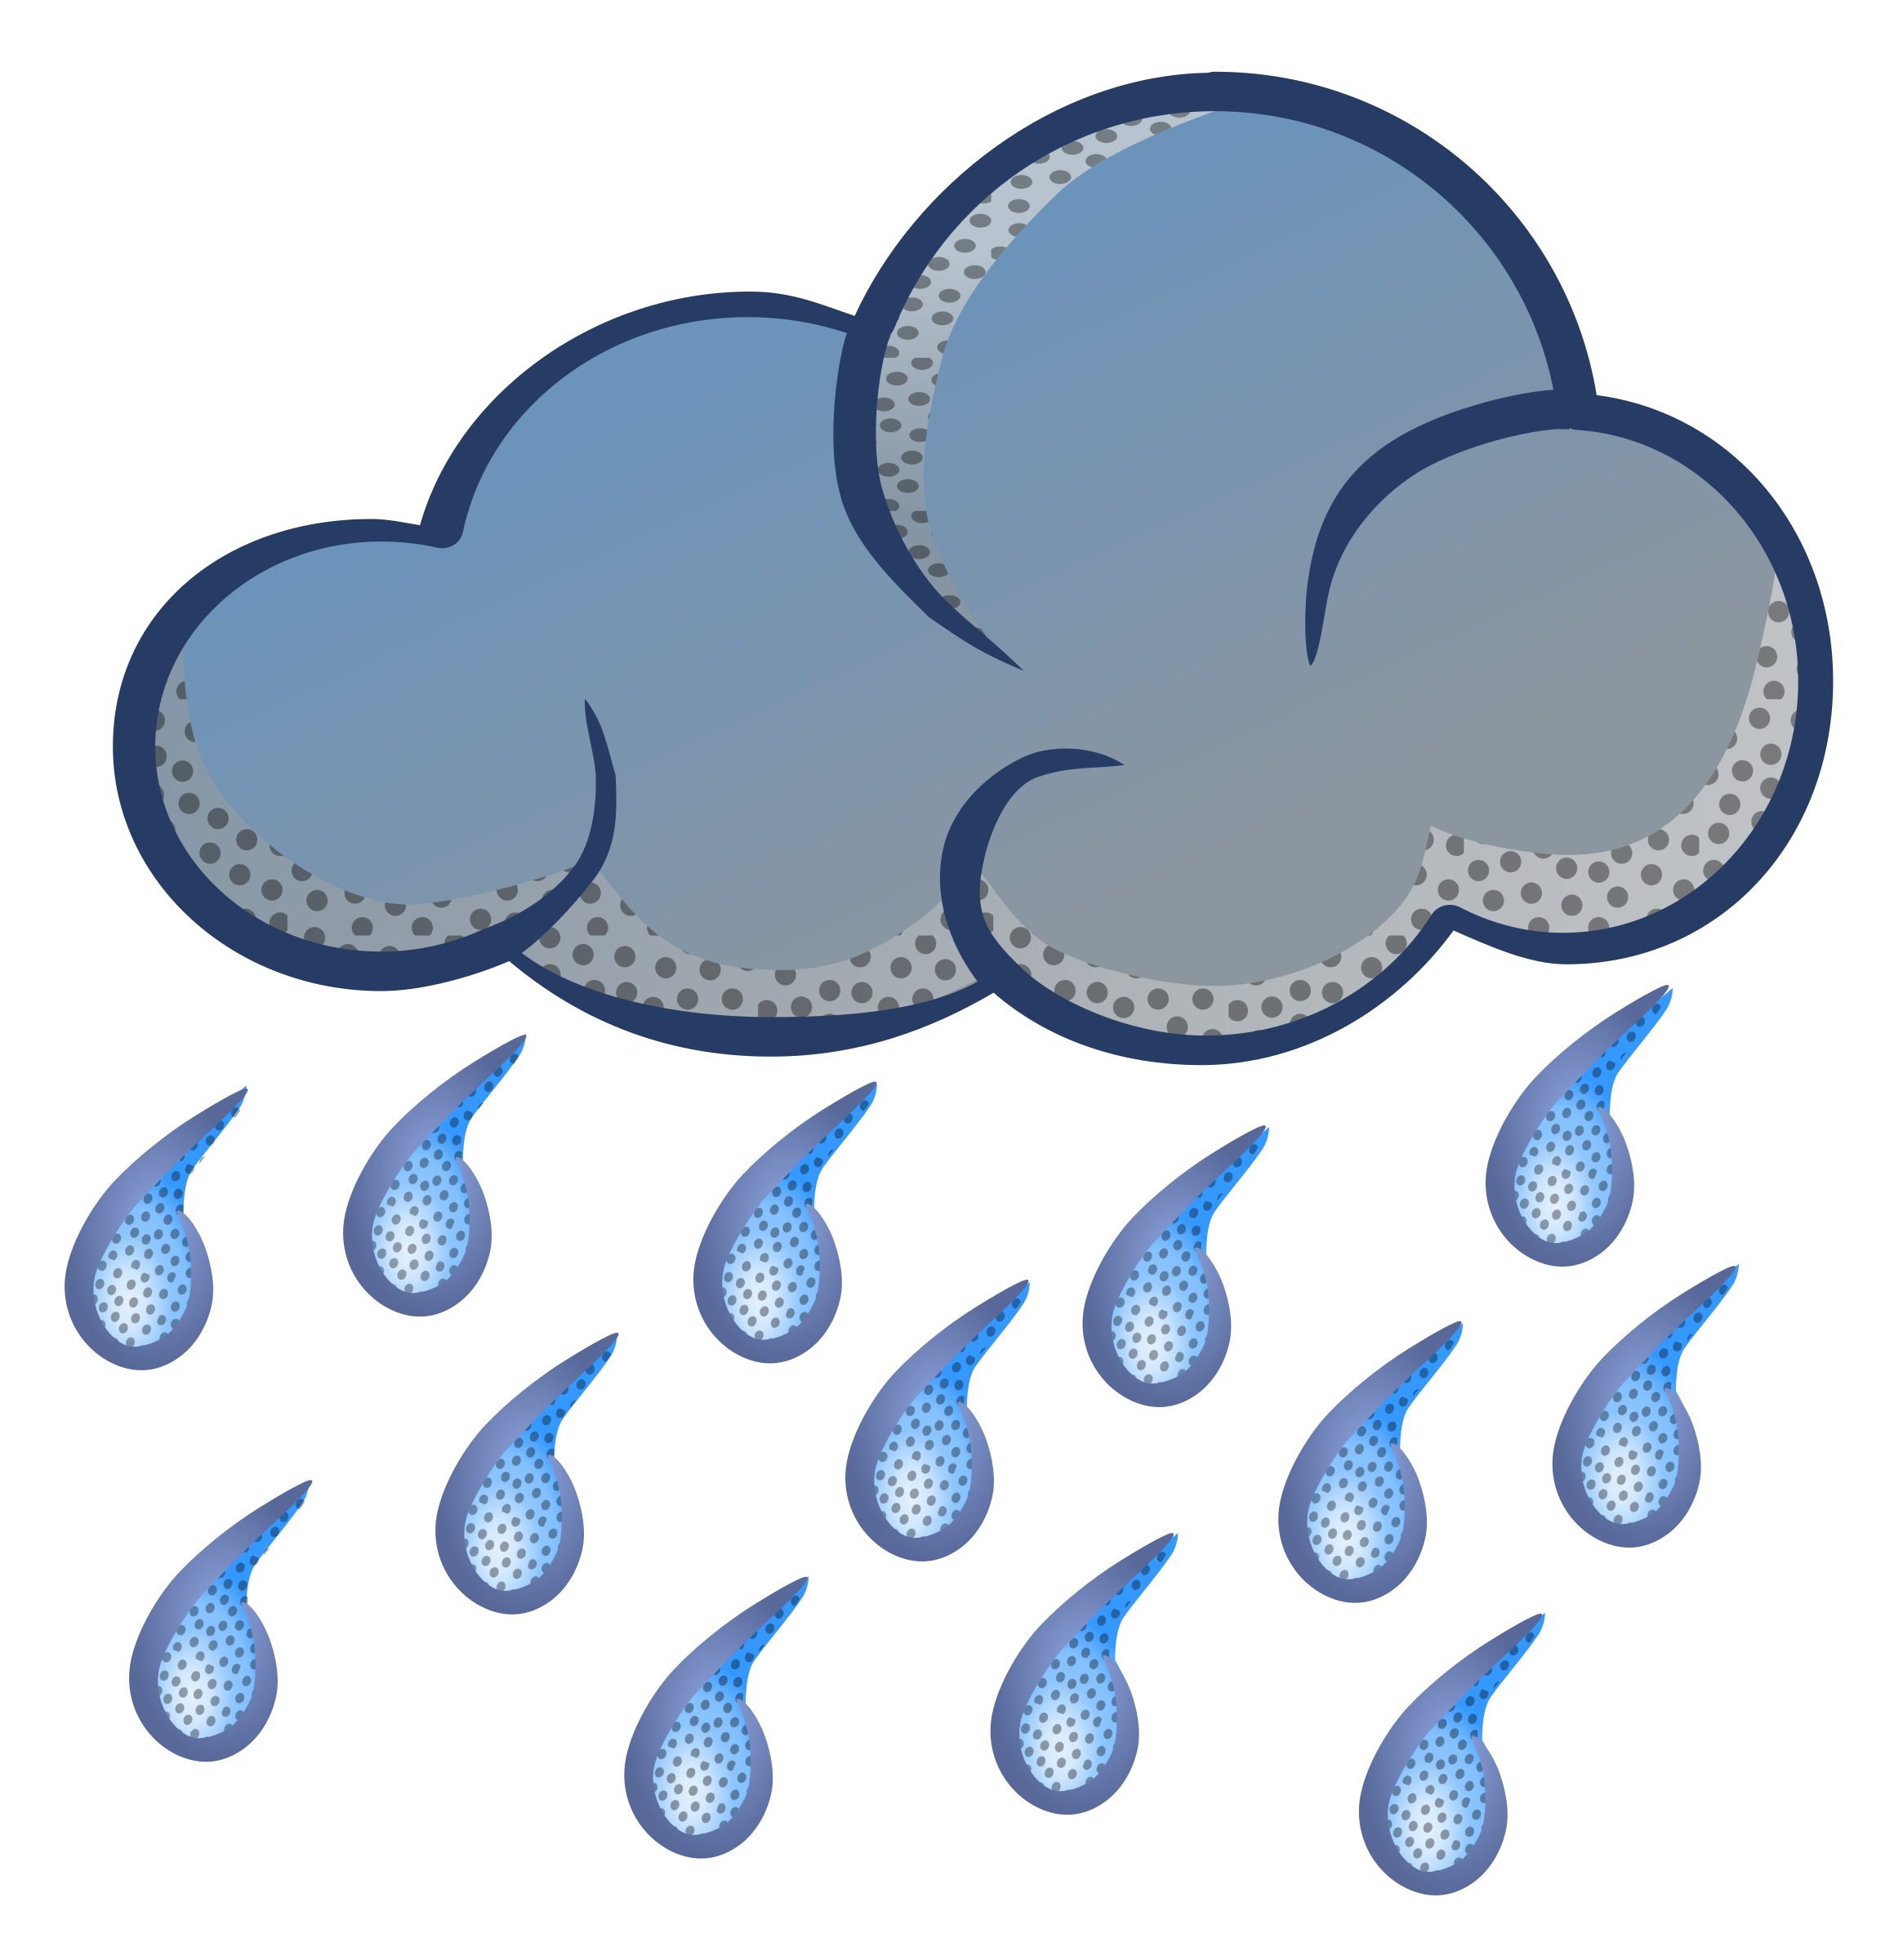
Weather
Keep mindful of extreme temperatures.
In cold weather insure crew and cast are properly protected from the elements.
In hot weather insure crew are given plenty of fluids and watched for heat stroke.
If a shoot needs to be cancelled for weather, the 1st AD will make that determination in consultation with the Producer.

Slide 12
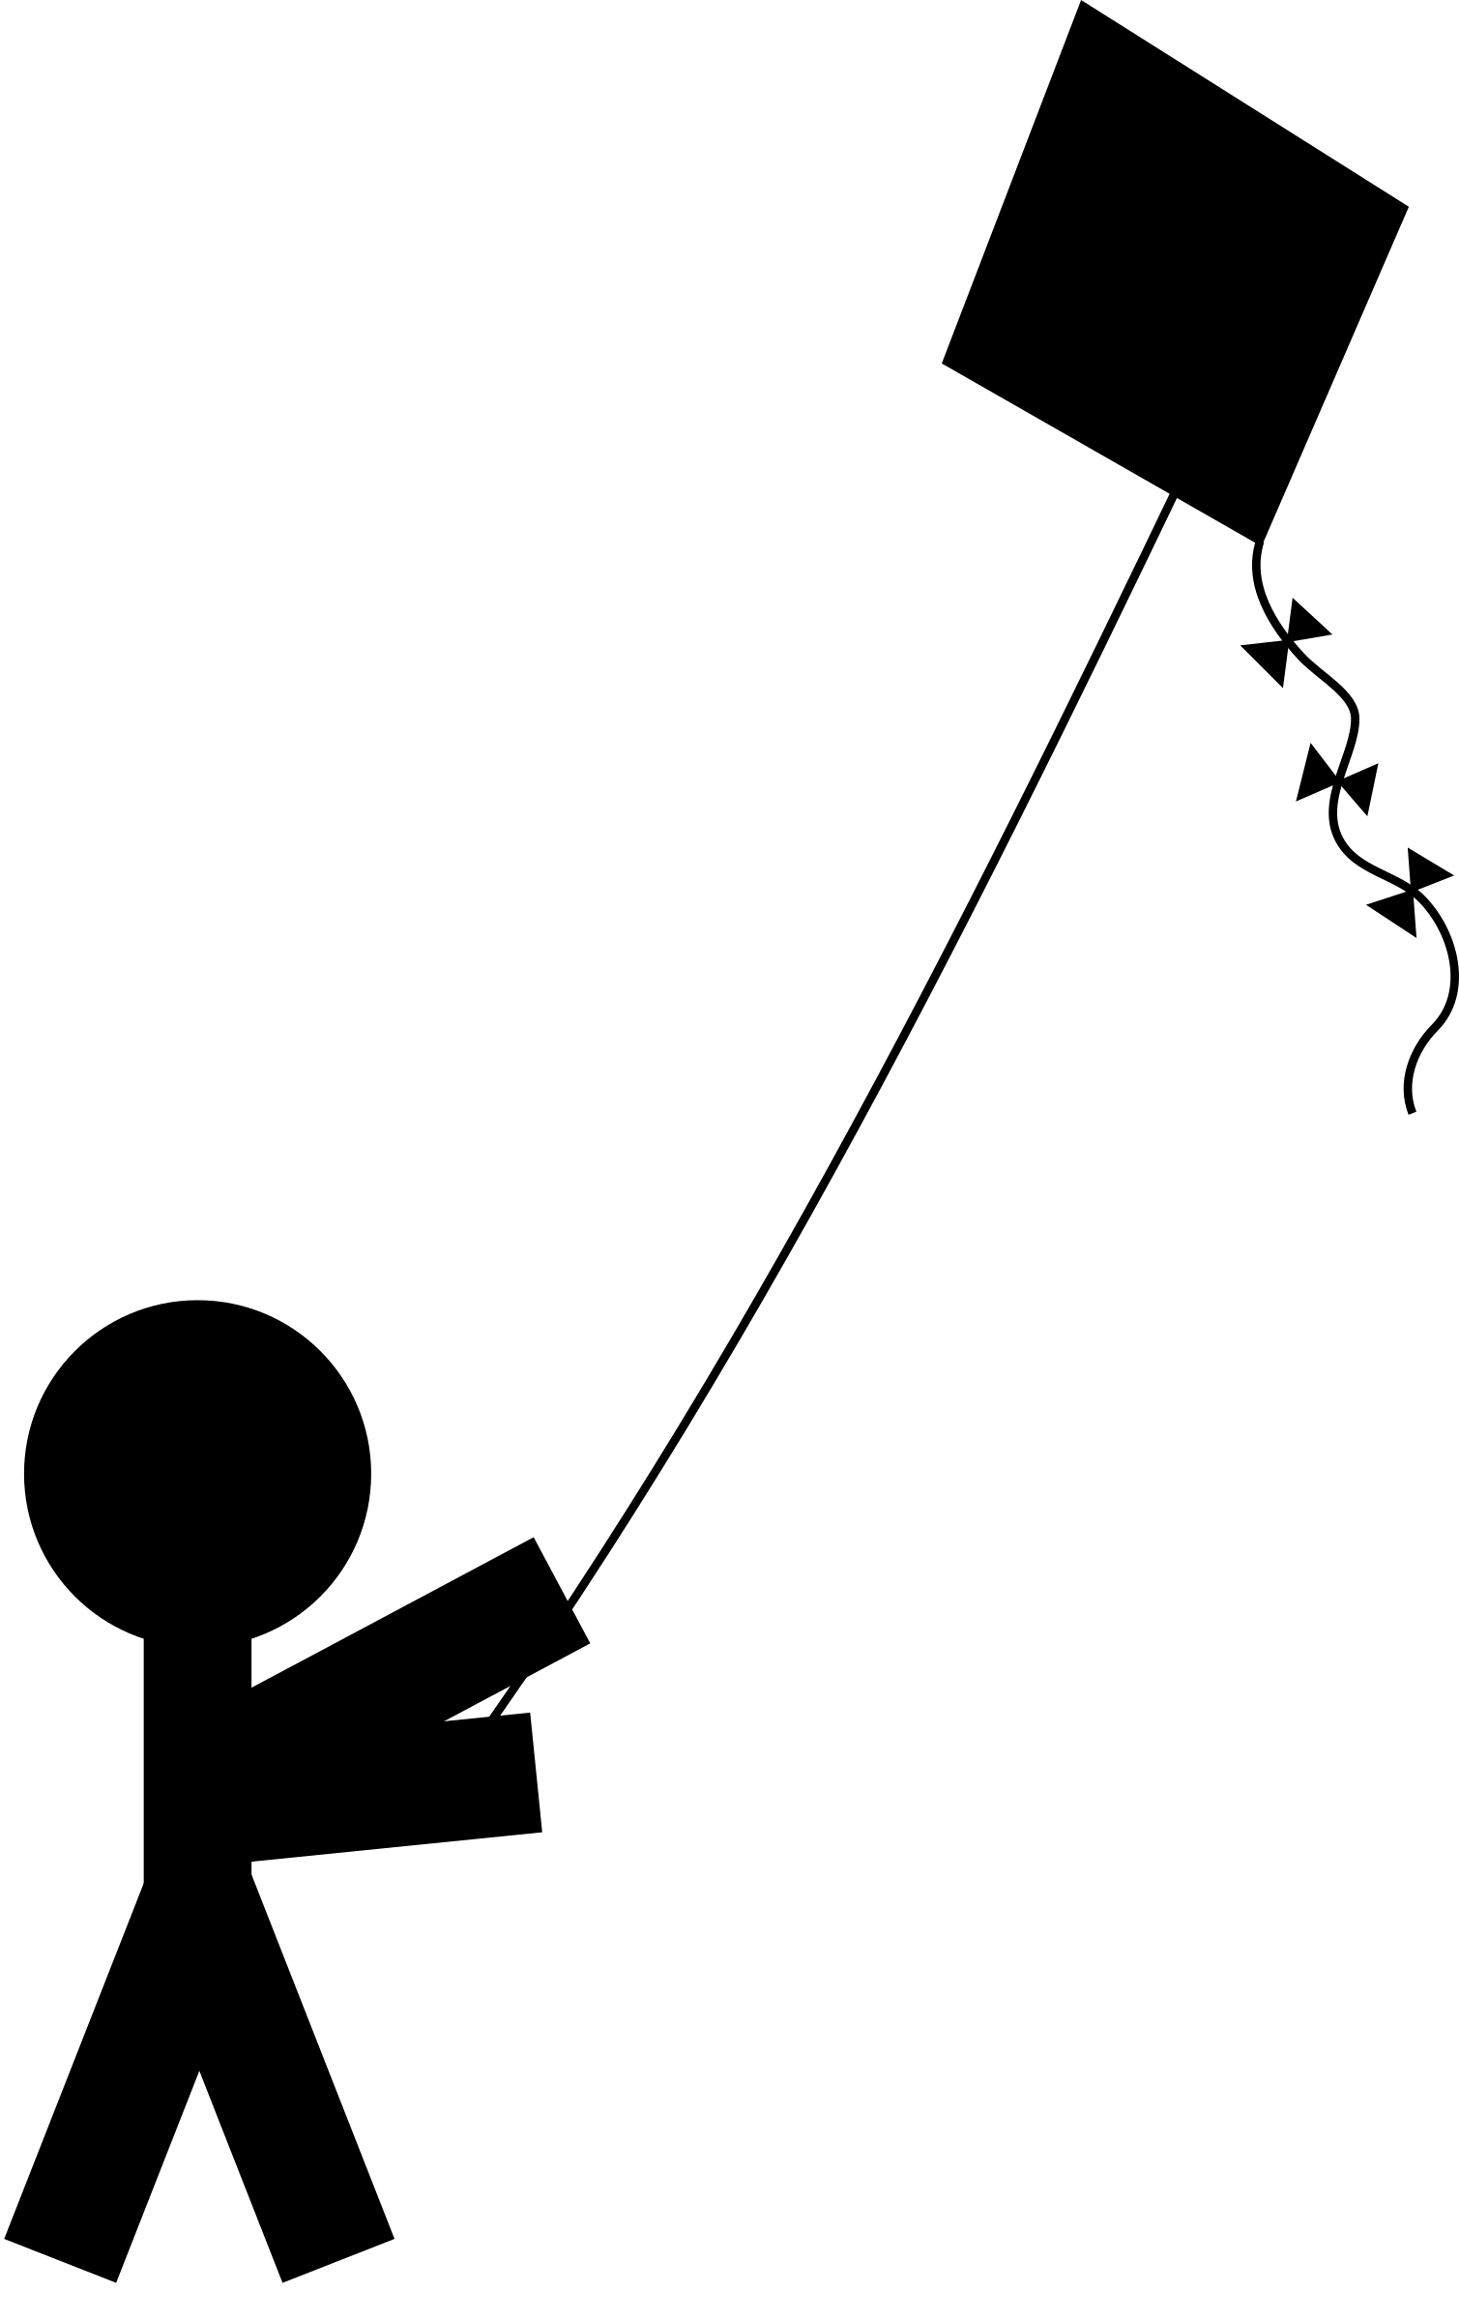
Working With Children
Children should always be accompanied by an adult on set, at all times, and within arm’s length.
Do not try to work a child for long periods of time.
Aside from possibly being outside labor policies, tired children do not perform well on camera.

Slide 13
Working With Animals
There must be someone to wrangle the animal at all times.
In addition, animals need to be fed and have a place to do their business.
One major safety issue with animals is their interactions with humans.
Animals are unpredictable so depending on the kind of animal care needs to be taken as to their proximity and access to crew.

Slide 14
Sleep Deprivation
Many filmmakers get carried away and shoot for 14-18 hour days.
Crew members have been injured or killed by falling asleep while driving after an extremely long day.
In 2003 the 12on12off movement began with two cinematographers, tired of seeing crews abused with long hours.

Slide 15
Sleep Deprivation, Cont.
One of those cinematographers, Haskell Wexler also producing the documentary Who Needs Sleep (2006) which really every filmmaker should see.
Needless to say, no shot is worth someone’s life, so make sure your crew gets adequate turnaround.

Slide 16
Gun Safety
Crew members have been killed on sets in accidents with guns. Brandon Lee lost his life in 1993 on a film set when a projectile was ejected from a gun pointed at his stomach.
Apparently there was no safety check before the gun was given to the actor in the scene.
Follow all appropriate safety checks on set when using guns.

Slide 17
Other Safety Issues to Consider
Underwater filming
Stunts
Working with aircraft
Using fog
Pyrotechnics
Using Polyurethane and polystyrene foam
Fire/flames on set
Working with electrical power tools
Working with moving vehicles
Working with picture vehicles
Working with elevated work platforms
Appropriate clothing
Personal protective equipment
Airbags, boxes or free fall catch systems
Camera boom vehicles
Portable generators
Cranes
Edged and piercing props
Extreme cold and hot weather conditions
Food handling
Working around indigenous critters
Working around water stuff, ponds, etc.
Infancy
Seat belts and helmets
Drones
Using gimbals
Freshly painted surfaces
Dust effects

Slide 18
The Safety Check
Weapons should only be handled by the props or assistant props person.
All weapons should be kept under lock and key when not on set.
If actors are not experienced in handling weapons, give them rehearsal time.
When ready to film, the props brings the weapon to set and filming halts in order to do the check.
The 1st AD, the props person, safety manager (if there is one) and the actor all stand together….

Slide 19
The Safety Check
The props person shows the weapon to all parties. If it is a gun, chamber is opened to show that it is not loaded. If gun uses a clip, the clip should be empty as well.
Props shows all parties the blanks and loads the weapon.
Lastly, props sets the safety on the weapon, showing that he is doing it. At that point the weapon could be turned over to the actor, if you are ready to shoot. If not, the props person should hold onto the weapon until only moments before camera rolls.
As soon as the director calls cut, props immediately retrieves the weapon from the actor and holds onto it for the next take or shot.

Slide 20
Final Words
Above all, BE SAFE.
“Working safely may get old, but so do those who practice it.”
-Author Unknown

Slide 21
Set Medic
Set Medic, or sometimes called the EMT (Emergency Medical Technician).
Specifically trained in emergency medical procedures. If you have a particularly hazardous shoot, you should have an EMT or Set Medic on hand to deal with any injuries.
Can be found through the National Registry of Emergency Medical Technicians (www.nremt.org)

Slide 22
Safety Bulletins
Union shows use a set of established safety guidelines called the Industry-Wide Labor Management Safety Committee Safety Bulletins.
These documents also include an Industry Code of Conduct.
Nonunion and lower budget projects are not bound by these guidelines but would be wise to use them.

Slide 23
Conclusion
Safety is the most important issue on set. Filmmakers must adhere to common sense and utilize industry standard practices to protect the set.
The Industry-Wide Labor Safety Bulletins at everyone’s disposal, contain important guidelines on various safety issues.
Safety issues include, sleep deprivation, working with weapons, weather considerations and more. Safety checks are a requirement on set when using weapons and a general safety awareness should be practiced by all.

