Slide 1
Chapter 3
Minitab: Summarising data

Slide 2
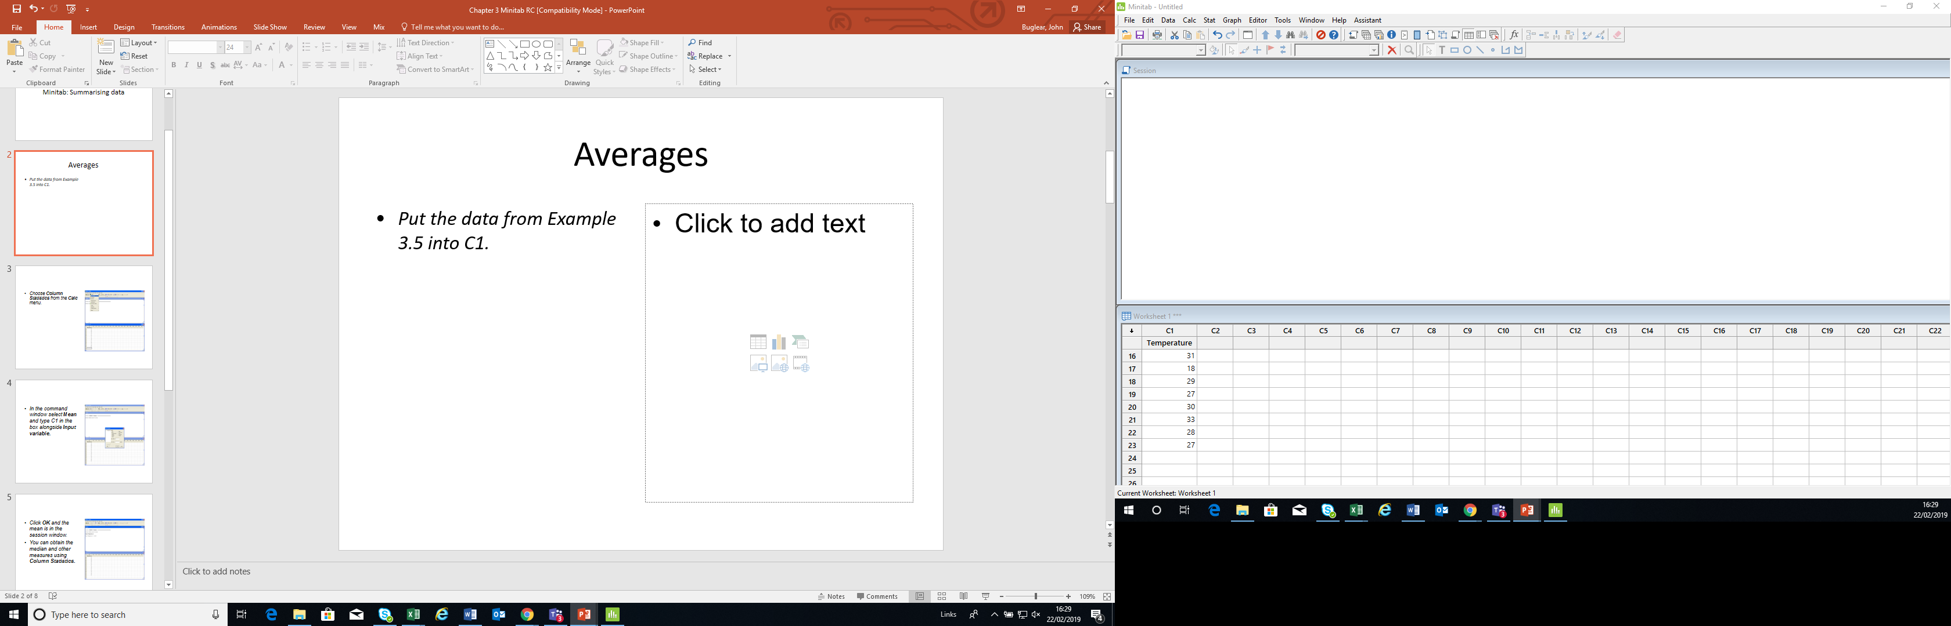
Averages
Put the data from Example 3.5 into C1.

Slide 3
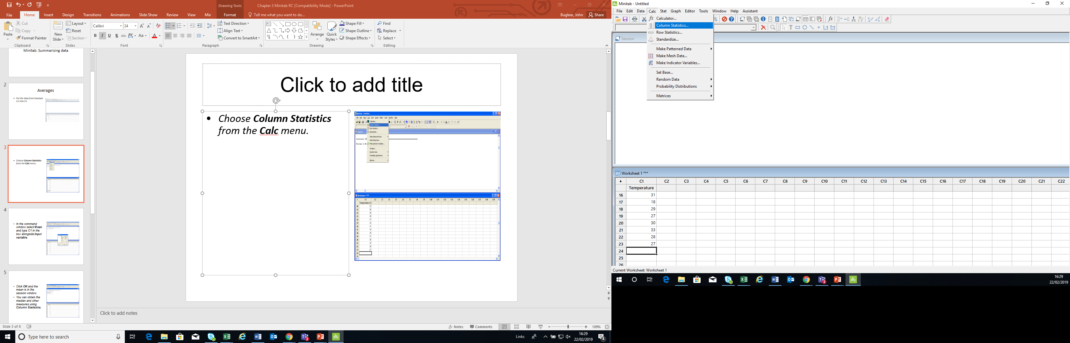
Choose Column Statistics from the Calc menu.

Slide 4
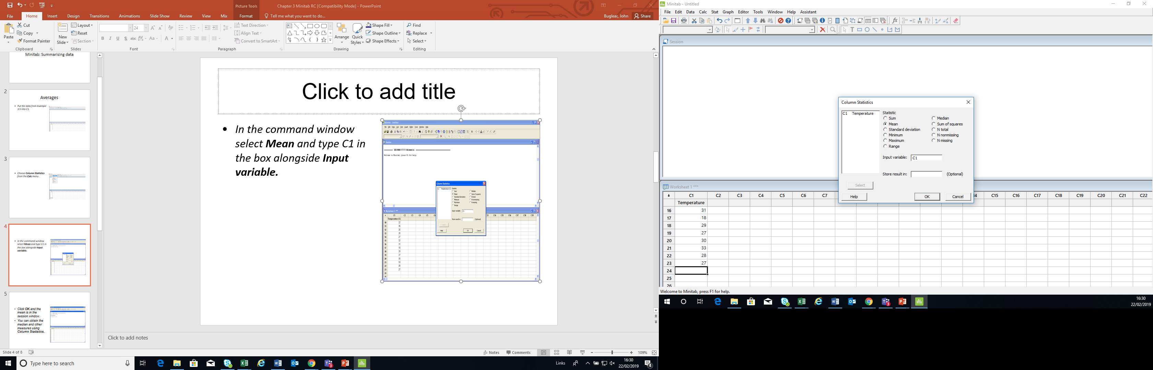
In the command window select Mean and type C1 in the box alongside Input variable.

Slide 5
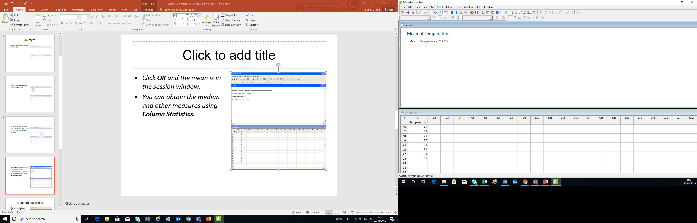
Click OK and the mean is in the session window.
You can obtain the median and other measures using Column Statistics.

Slide 6
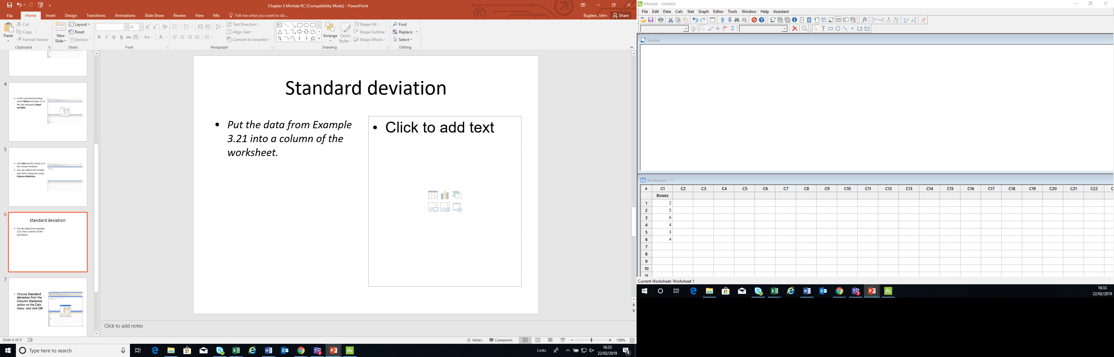
Standard deviation
Put the data from Example 3.21 into a column of the worksheet.

Slide 7
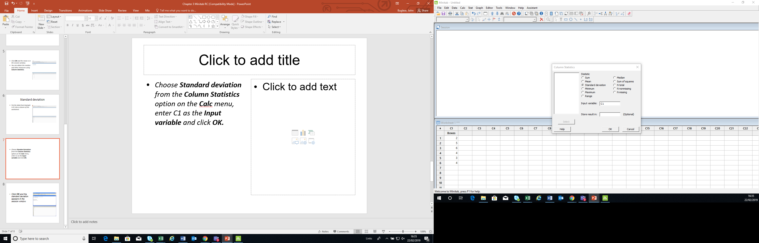
Choose Standard deviation from the Column Statistics option on the Calc menu, enter C1 as the Input variable and click OK.

Slide 8
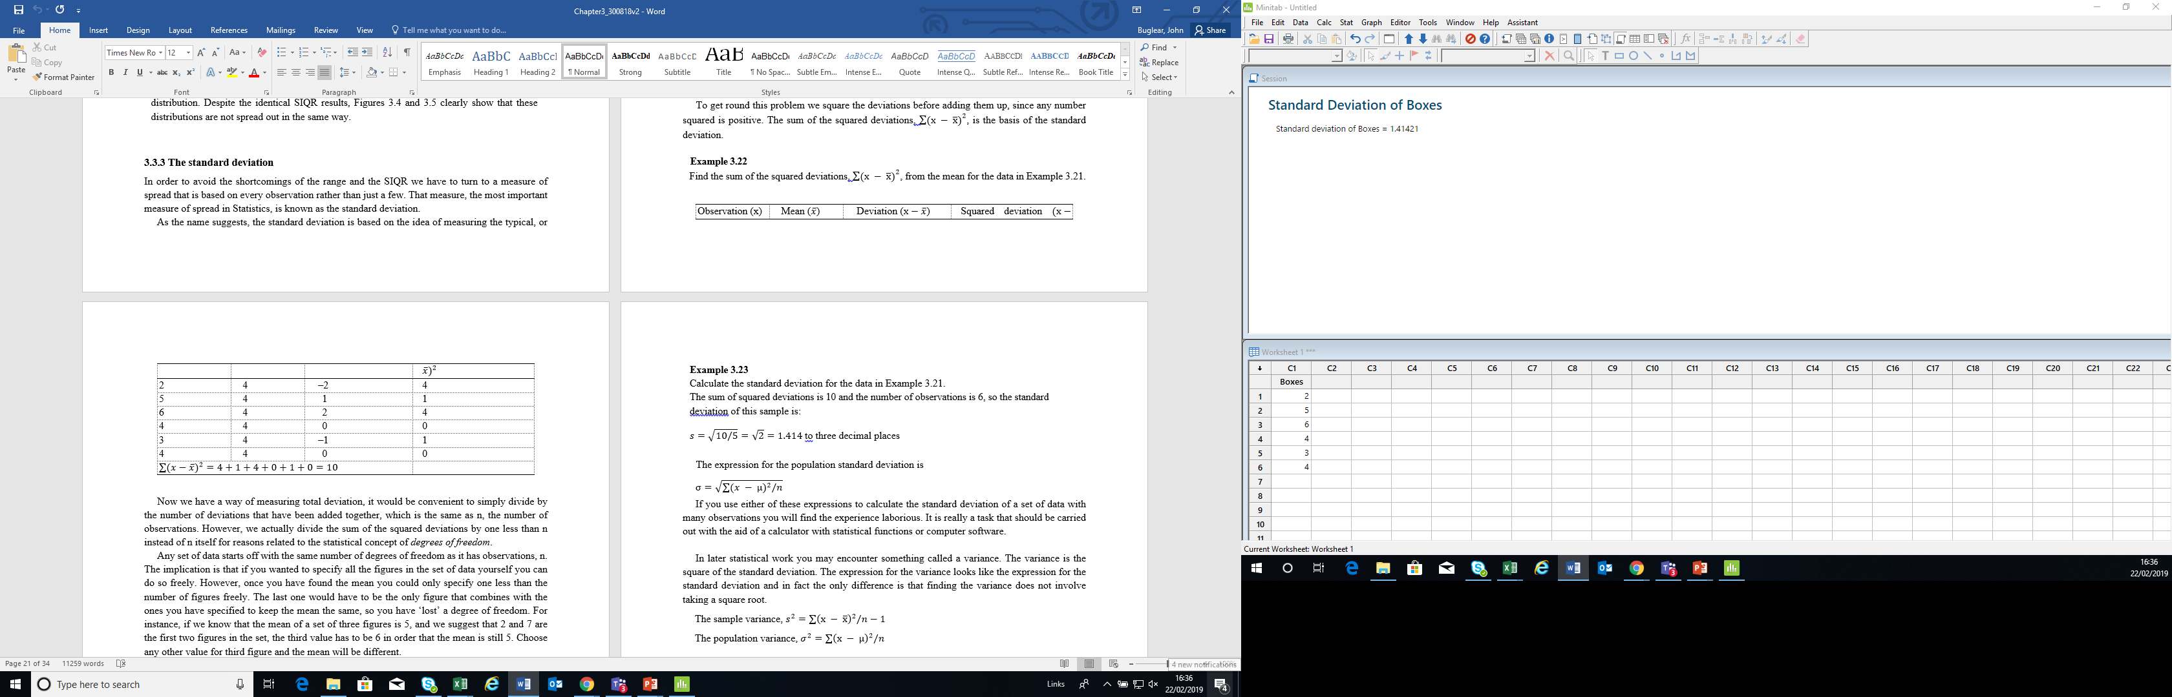
The standard deviation appears in the session window.

