Slide 1
Chapter 7
Minitab: Modelling populations

Slide 2
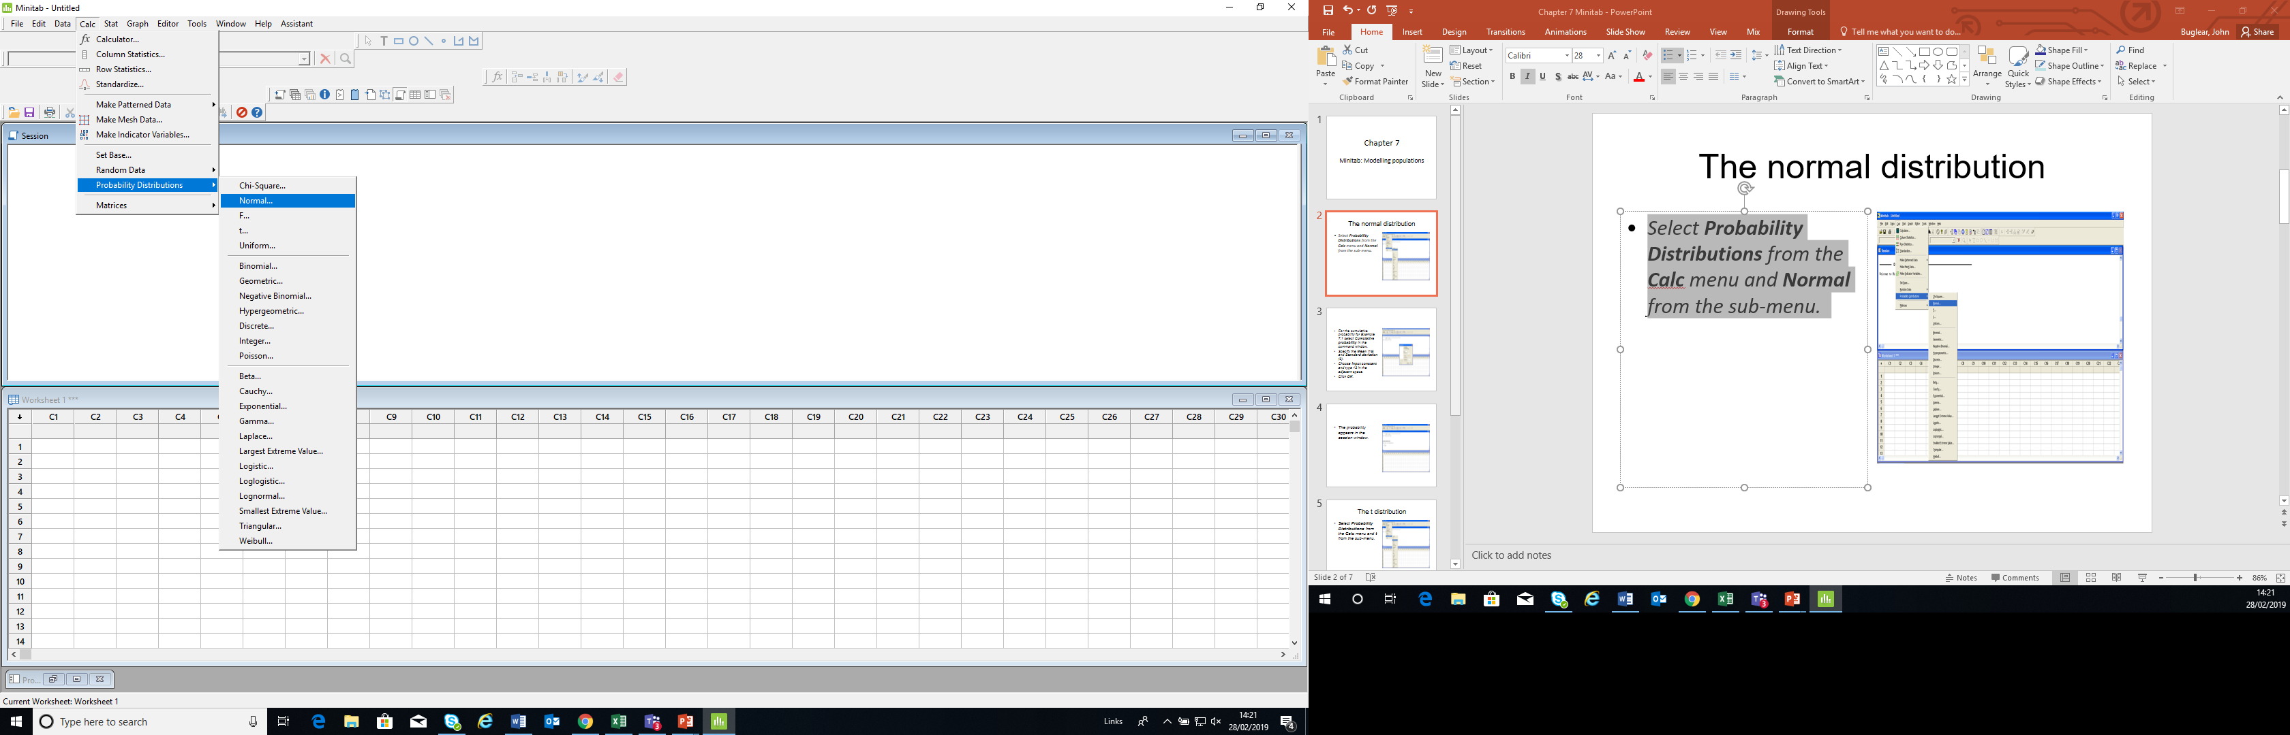
The normal distribution
Select Probability Distributions from the Calc menu and Normal from the sub-menu.

Slide 3
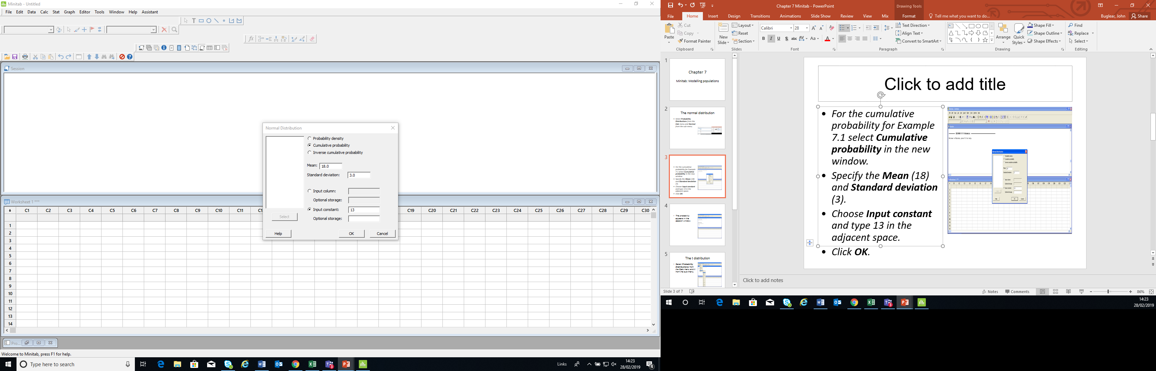
For the cumulative probability for Example 7.1 select Cumulative probability in the new window.
Specify the Mean (18) and Standard deviation (3).
Choose Input constant and type 13 in the adjacent space.
Click OK.

Slide 4
The probability appears in the session window.

Slide 5
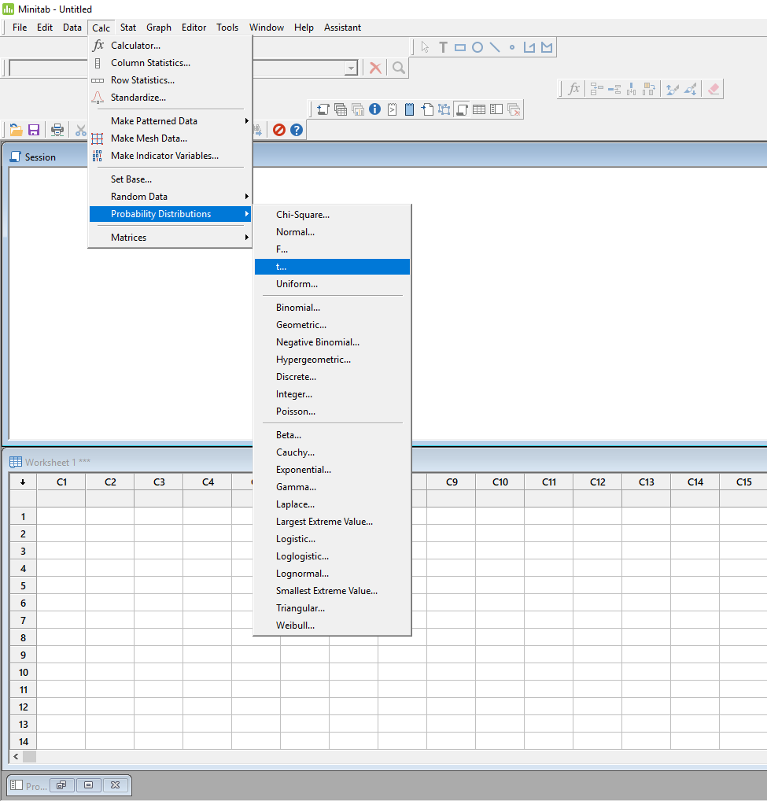
The t distribution
Select Probability Distributions from the Calc menu and t from the sub-menu.

Slide 6
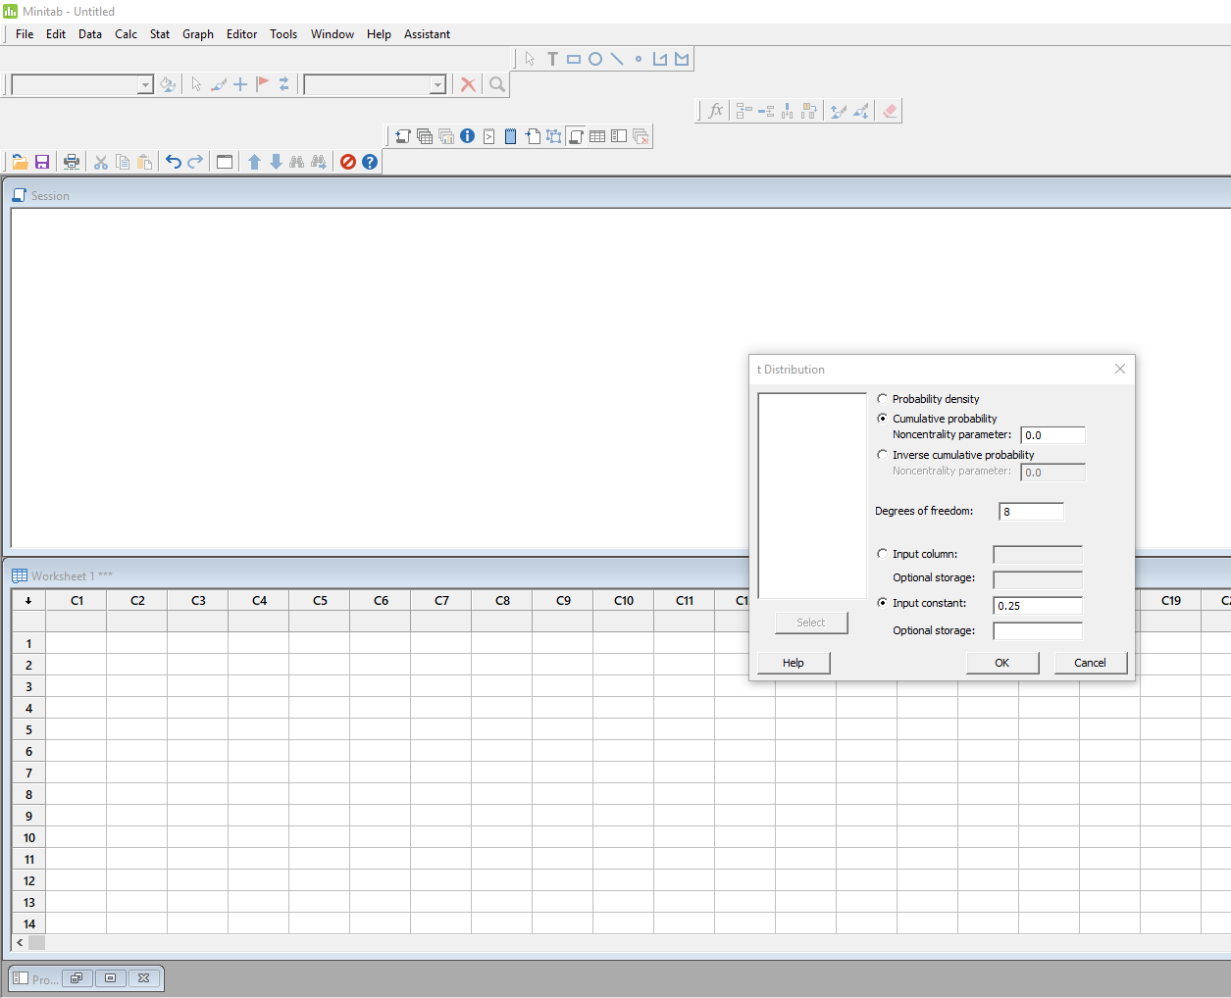
For P (t > 0.25) in Example 7.11 select Cumulative probability in the command window and specify 8 Degrees of freedom.
Choose Input constant and type 0.25 in the adjacent space.
Click OK.

Slide 7
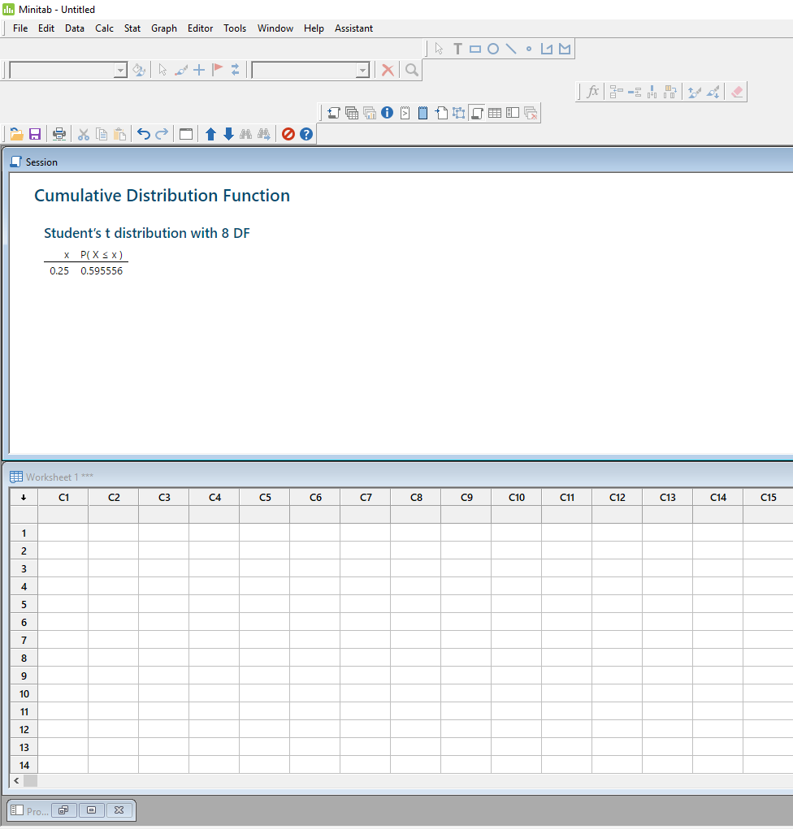
The probability that t is less than or equal to 0.25 appears in the session window.
Subtract this from 1 to give P (t > 0.25).

