Slide 1
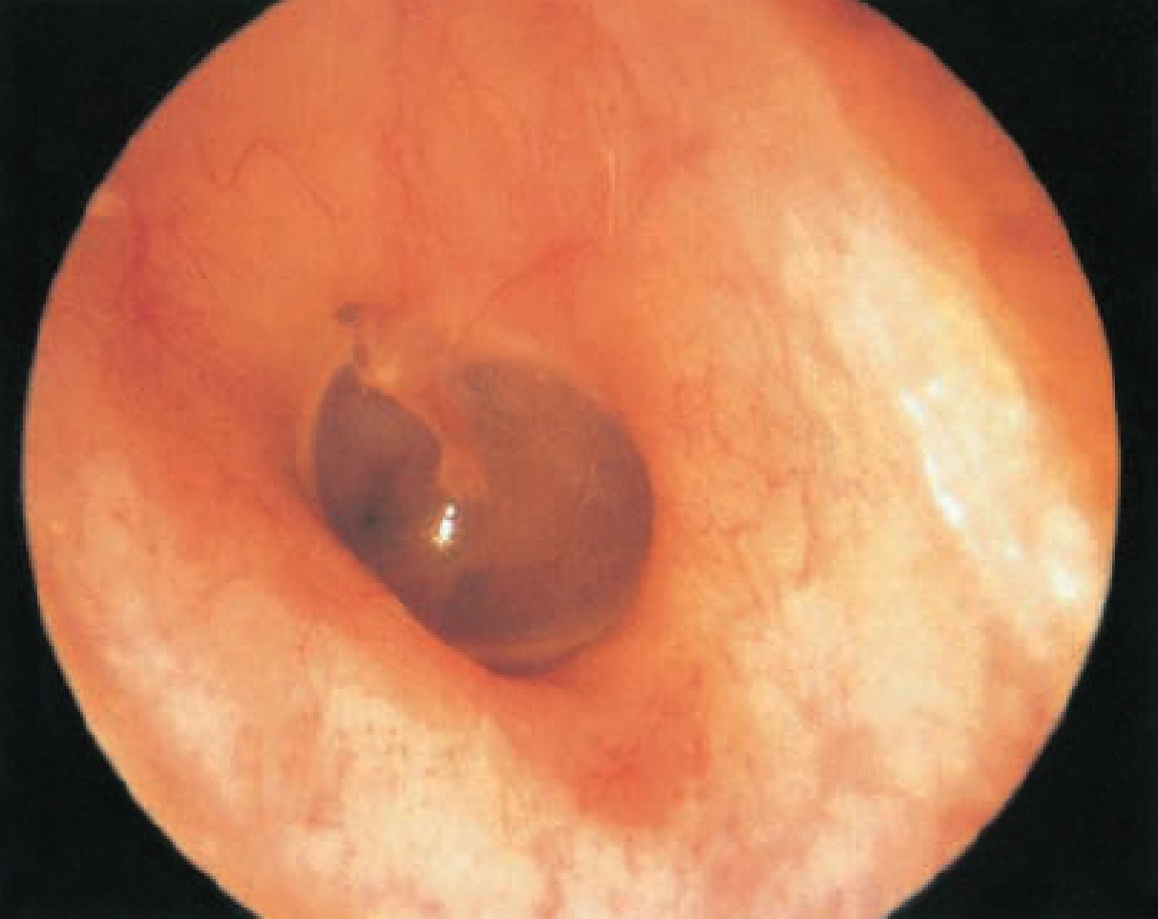
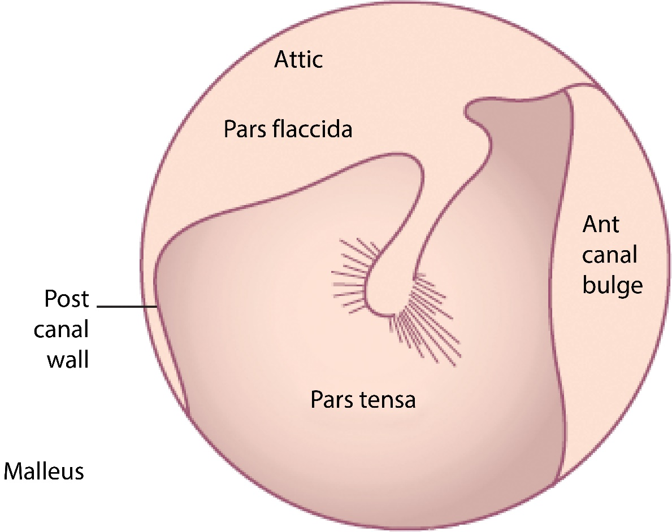
Courtesy of CRC Press/Taylor & Francis Group
Figure 3.1 Endoscopic view of the tympanic membrane (A) with labeled schematic (B). The pars
flaccida is located above the malleolar folds and is deficient of a middle fibrous layer.

Slide 2
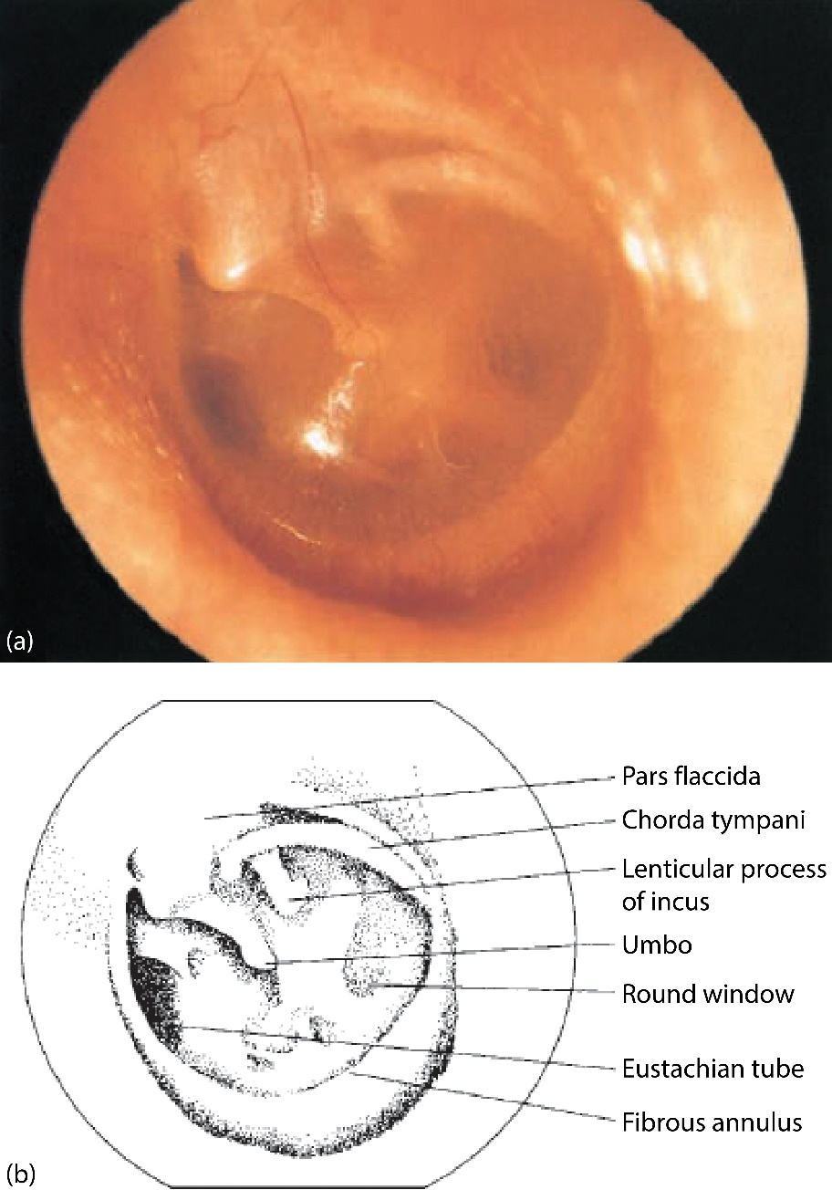
Courtesy of CRC Press/Taylor & Francis Group
Figure 3.2 Normal tympanic membrane with labeled middle ear structures

Slide 3
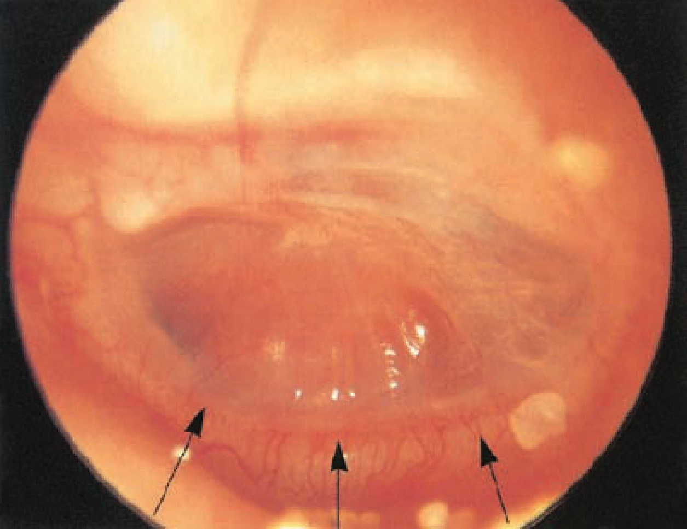
Courtesy of CRC Press/Taylor & Francis Group
Figure 3.2.1 Severely retracted position of the malleus handle in otitis media with effusion (left
ear). As retraction develops, a neoannular fold may form (arrows).

Slide 4
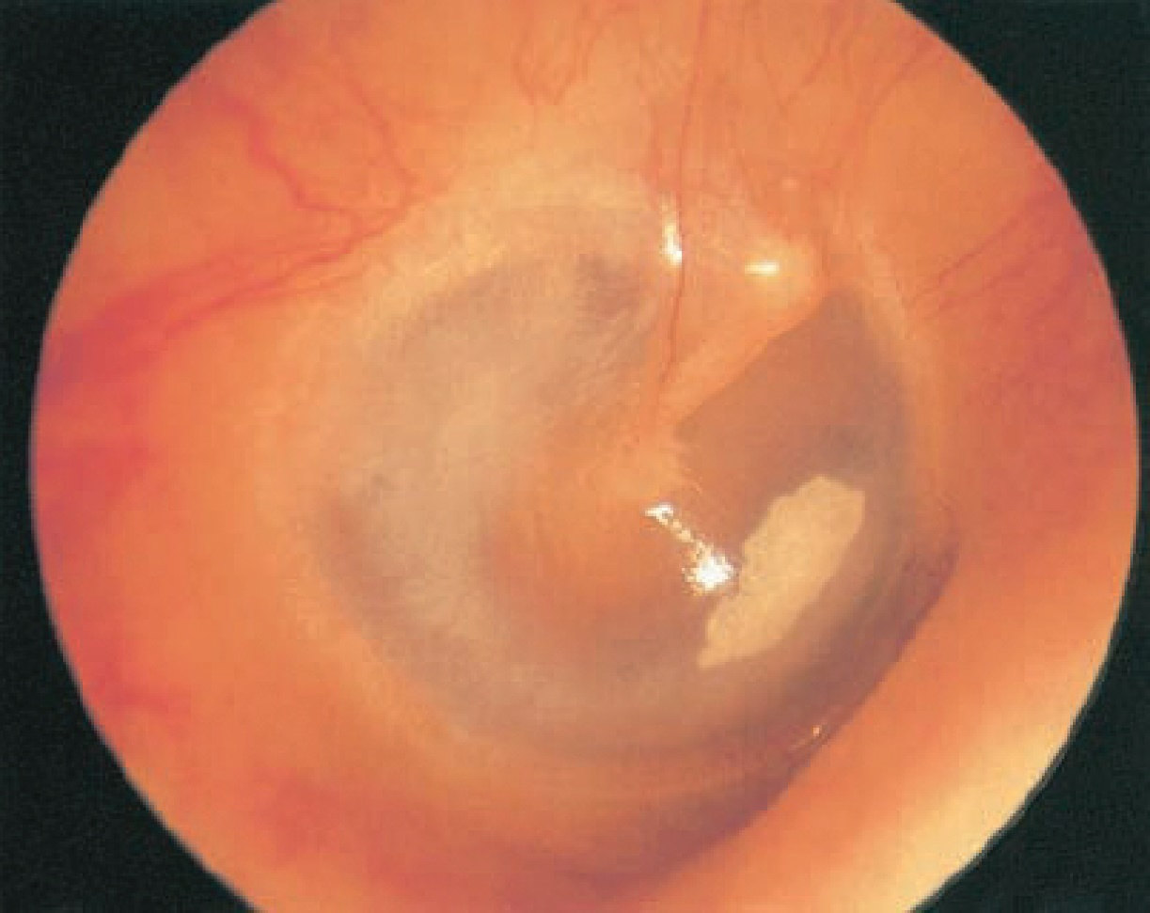
Courtesy of CRC Press/Taylor & Francis Group
Figure 3.2.2 Chalk patch on the anterior pars tensa (right ear).

Slide 5
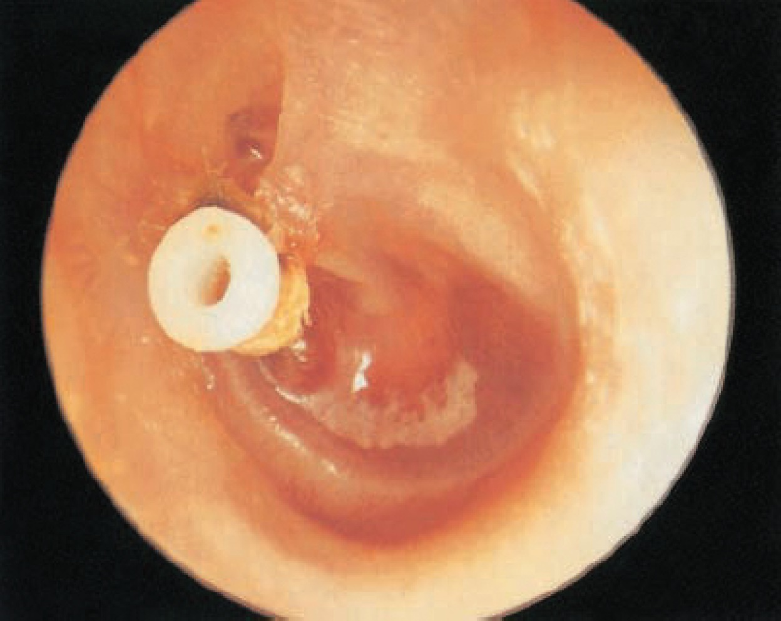
Courtesy of CRC Press/Taylor & Francis Group
Figure 3.2.3 Extruded ventilating tube with otoscopic recurrence of middle ear fluid. Left ear
retracted and yellow.

Slide 6
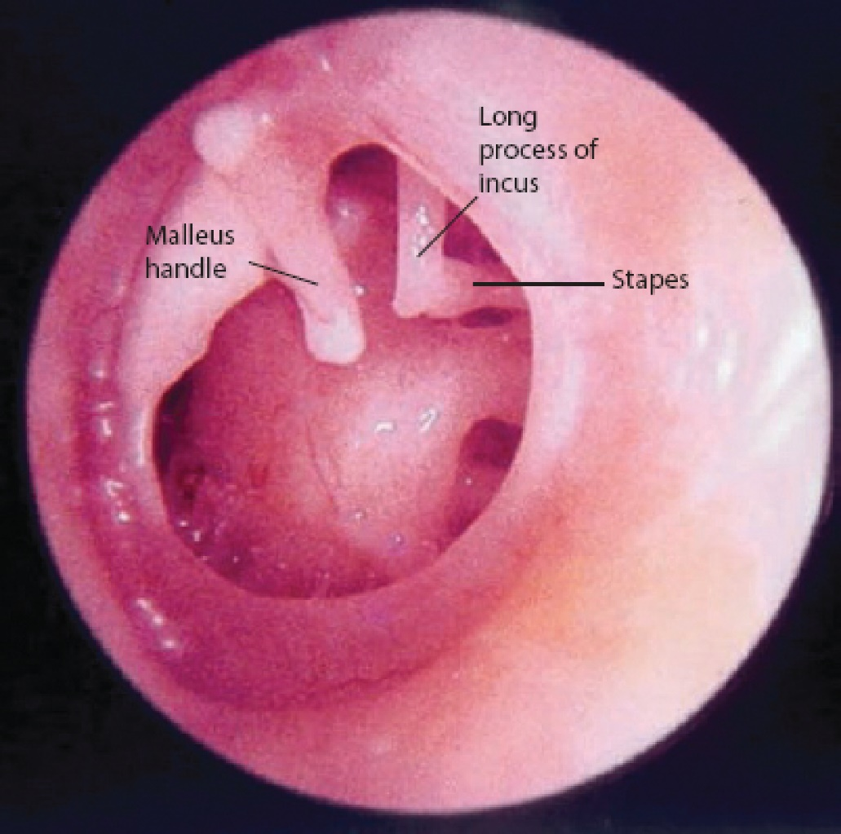
Courtesy of CRC Press/Taylor & Francis Group
Figure 3.3 Subtotal perforation with visible middle ear contents.

Slide 7
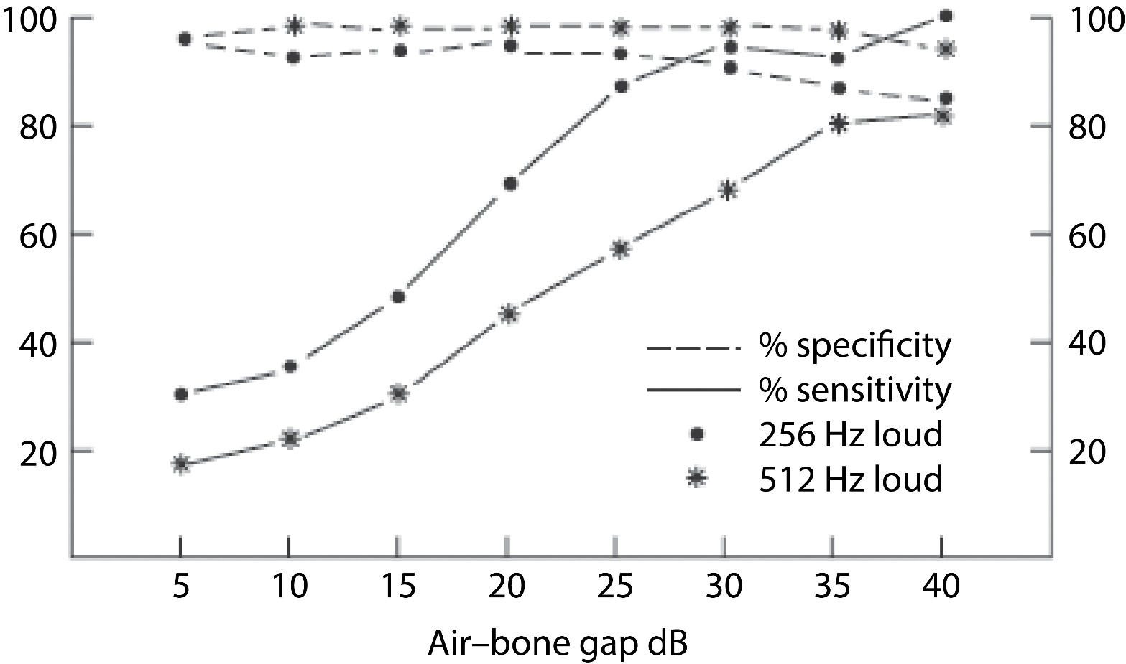
Courtesy of CRC Press/Taylor & Francis Group
Figure 3.3.1 A comparison of the sensitivity and specificity of the 256 Hz fork using a loudness
comparison method against the 512 Hz fork using a threshold method, in detecting air–bone gaps
of various magnitudes. Redrawn with permission from Browning et al. Clinical role of informal
tests of hearing. J Laryngol Otol 1989; 103: 7–11.

Slide 8
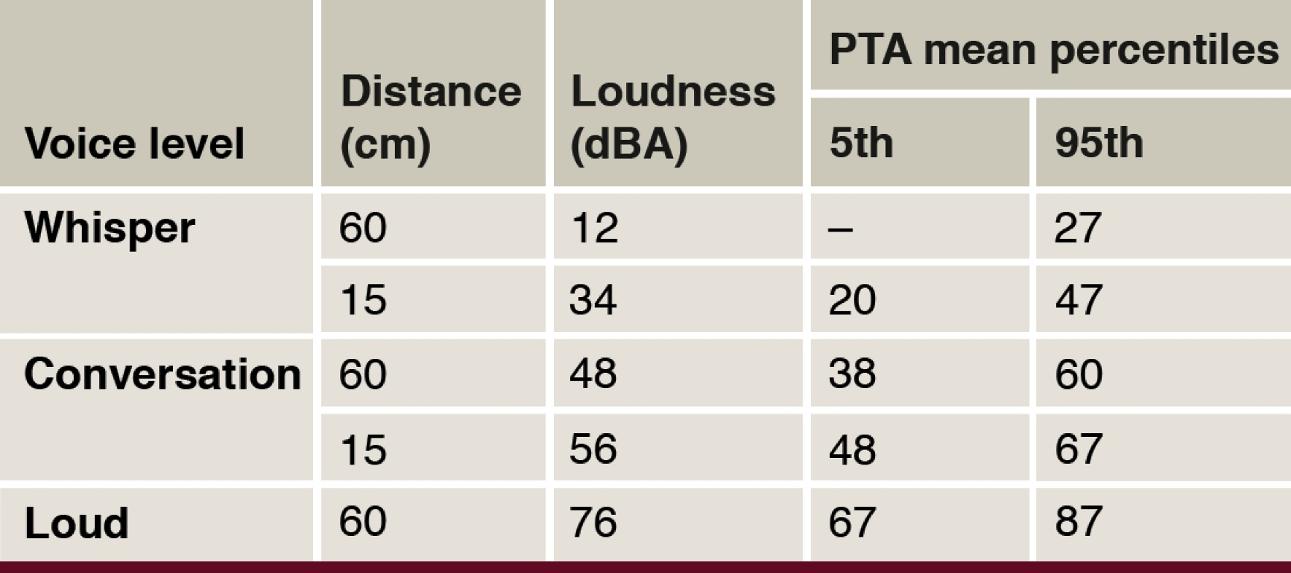
Courtesy of CRC Press/Taylor & Francis Group
Table 3.1 Comparison of free-field voice thresholds and pure-tone average (PTA) over 0.5, 1, 2 and 4kHz
Source: From Swan IRC, Browning GG. The whispered voice as a screening test for hearing loss. J R Coll Gen Pract 1985; 35: 197.

Slide 9
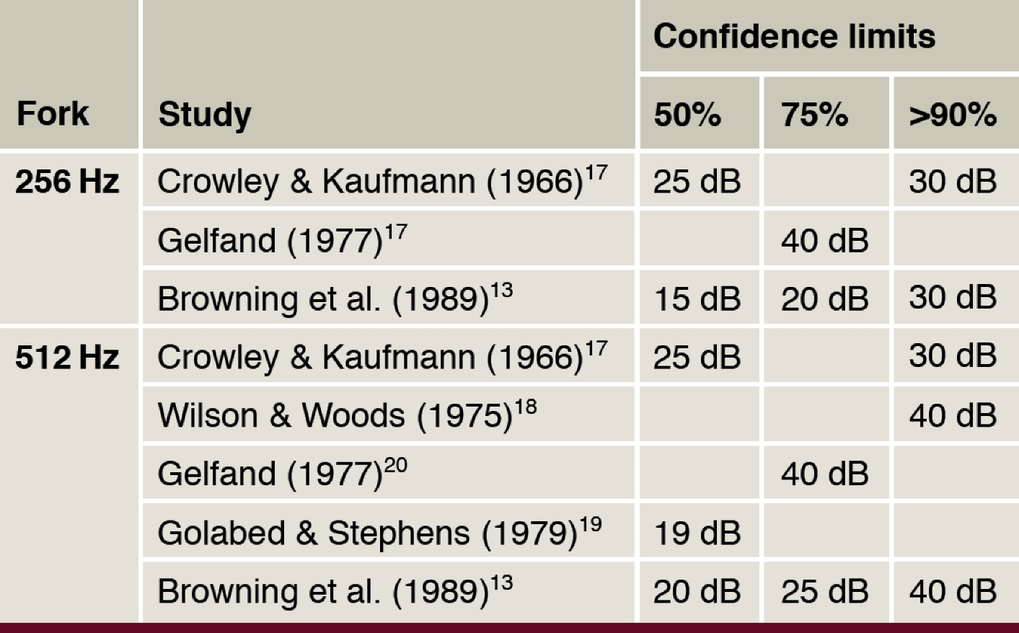
Courtesy of CRC Press/Taylor & Francis Group
Table 3.2 Size of air-bone gap (dB) which would be correctly identified
by Rinne test on various percentages of occasions. (See Scott-Brown’s
Otorhinolaryngology, 8th edition, Chapter 73, for full references)

