Slide 1
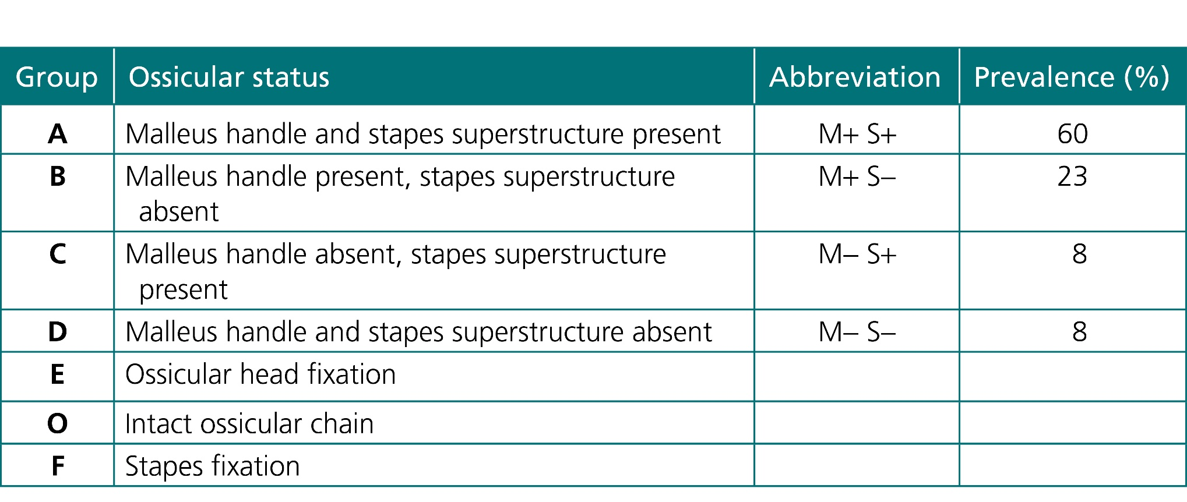
Courtesy of CRC Press/Taylor & Francis Group
Table 11.1 Austin Kartush classification of ossicular status

Slide 2
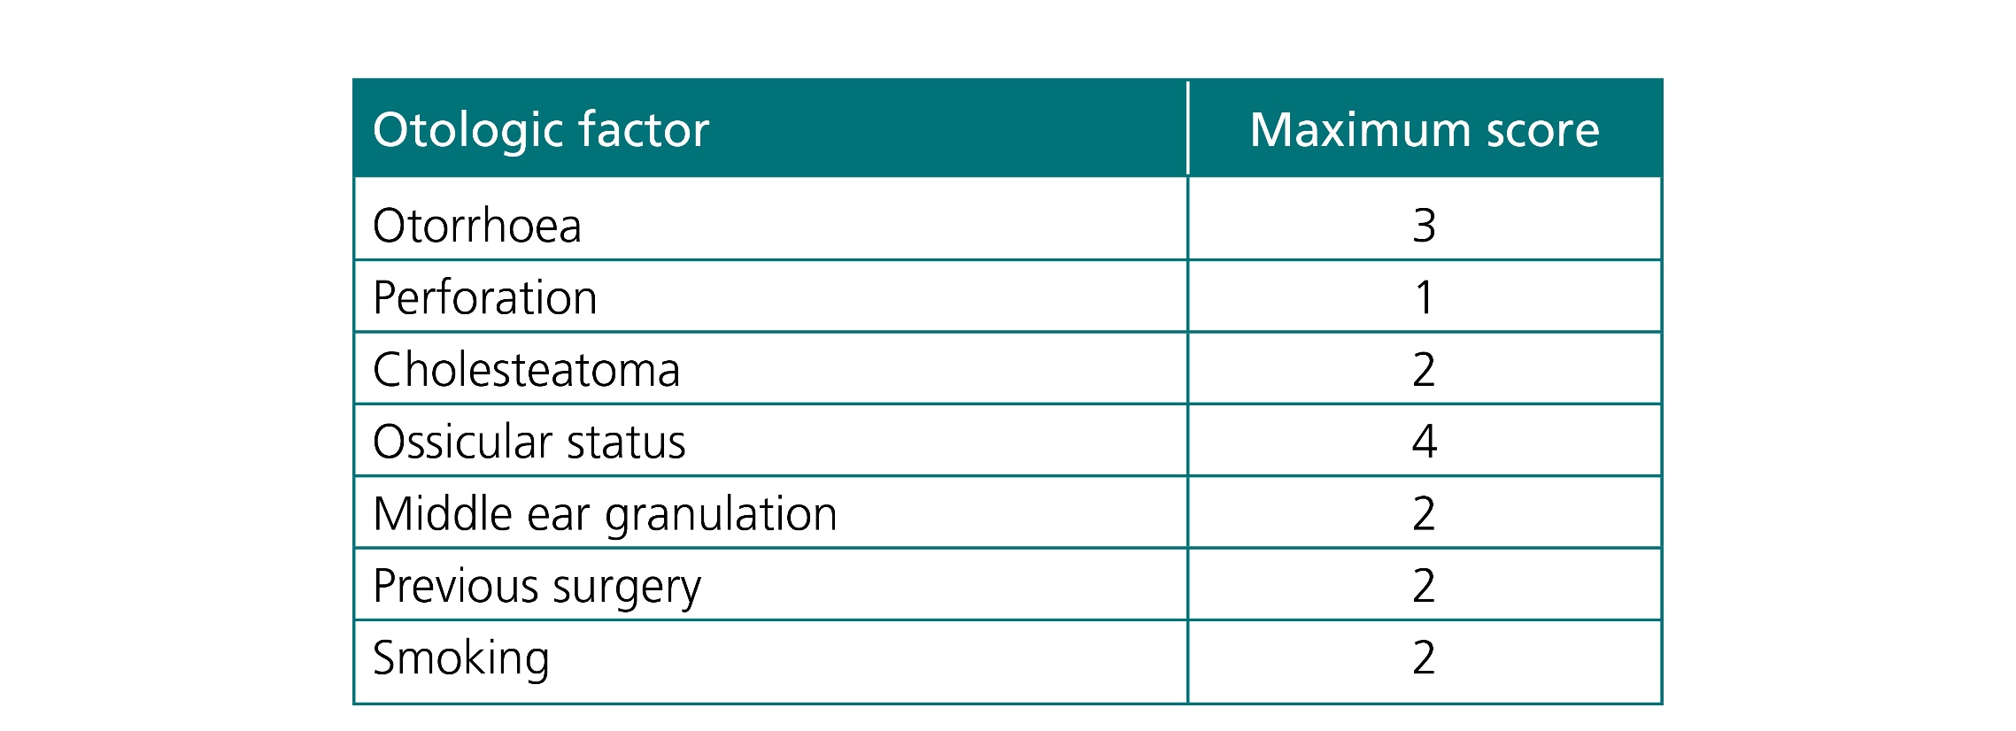
Courtesy of CRC Press/Taylor & Francis Group
Table 11.2 Middle Ear Risk Index 2001

Slide 3
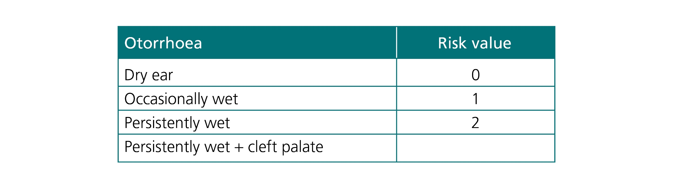
Courtesy of CRC Press/Taylor & Francis Group
Table 11.3 Belluci classification of otorrhoea

