Slide 1
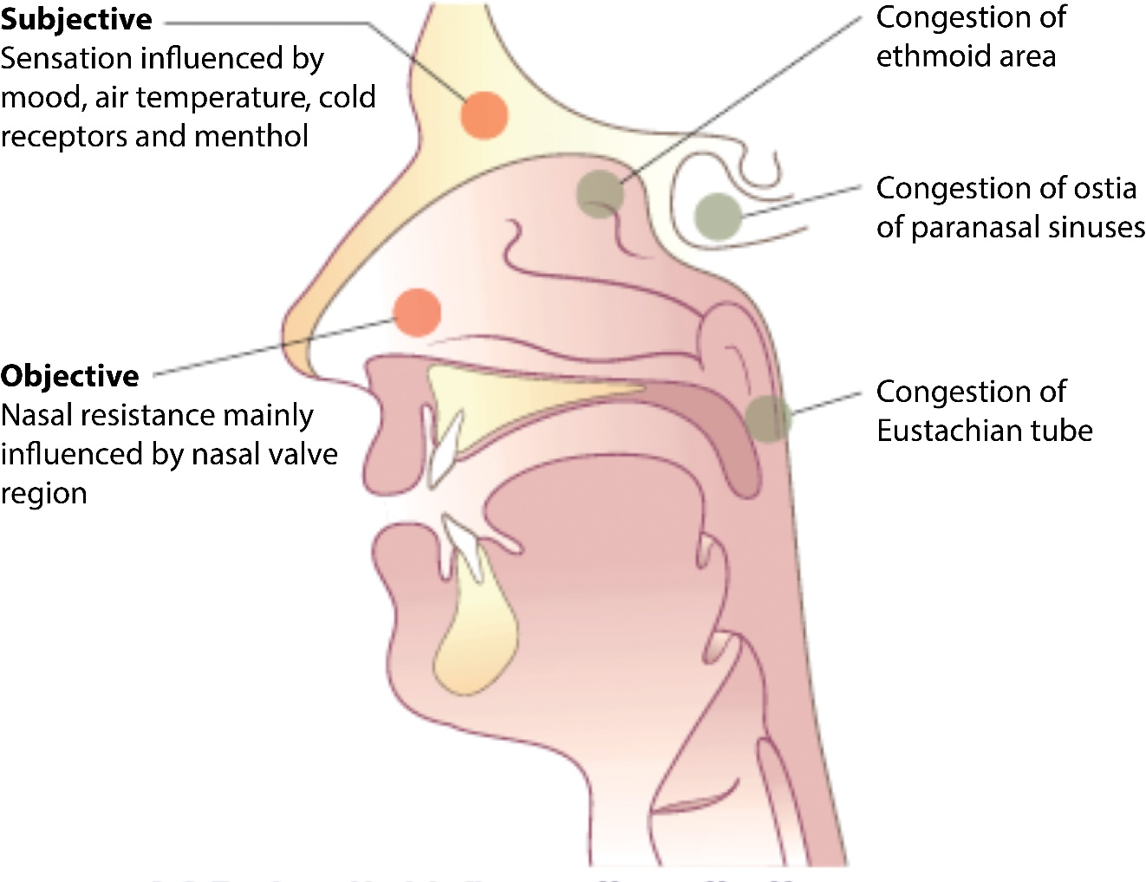
Courtesy of CRC Press/Taylor & Francis Group
Figure 27.2 Factors that influence the patient’s perception of nasal airflow and relationship to objective and subjective measures of nasal obstruction. Objective measurements are mainly determined by the cross-sectional area of the nasal valve region at the tip of the inferior turbinate. Subjective measurements are influenced by the stimulation of cold receptors in the airway. Congestion in the ethmoid area, ostia of paranasal sinuses and Eustachian tube cause a perception of congestion and pressure that is unrelated to any change in nasal airway resistance as these areas are distant from the nasal valve.

