Slide 1
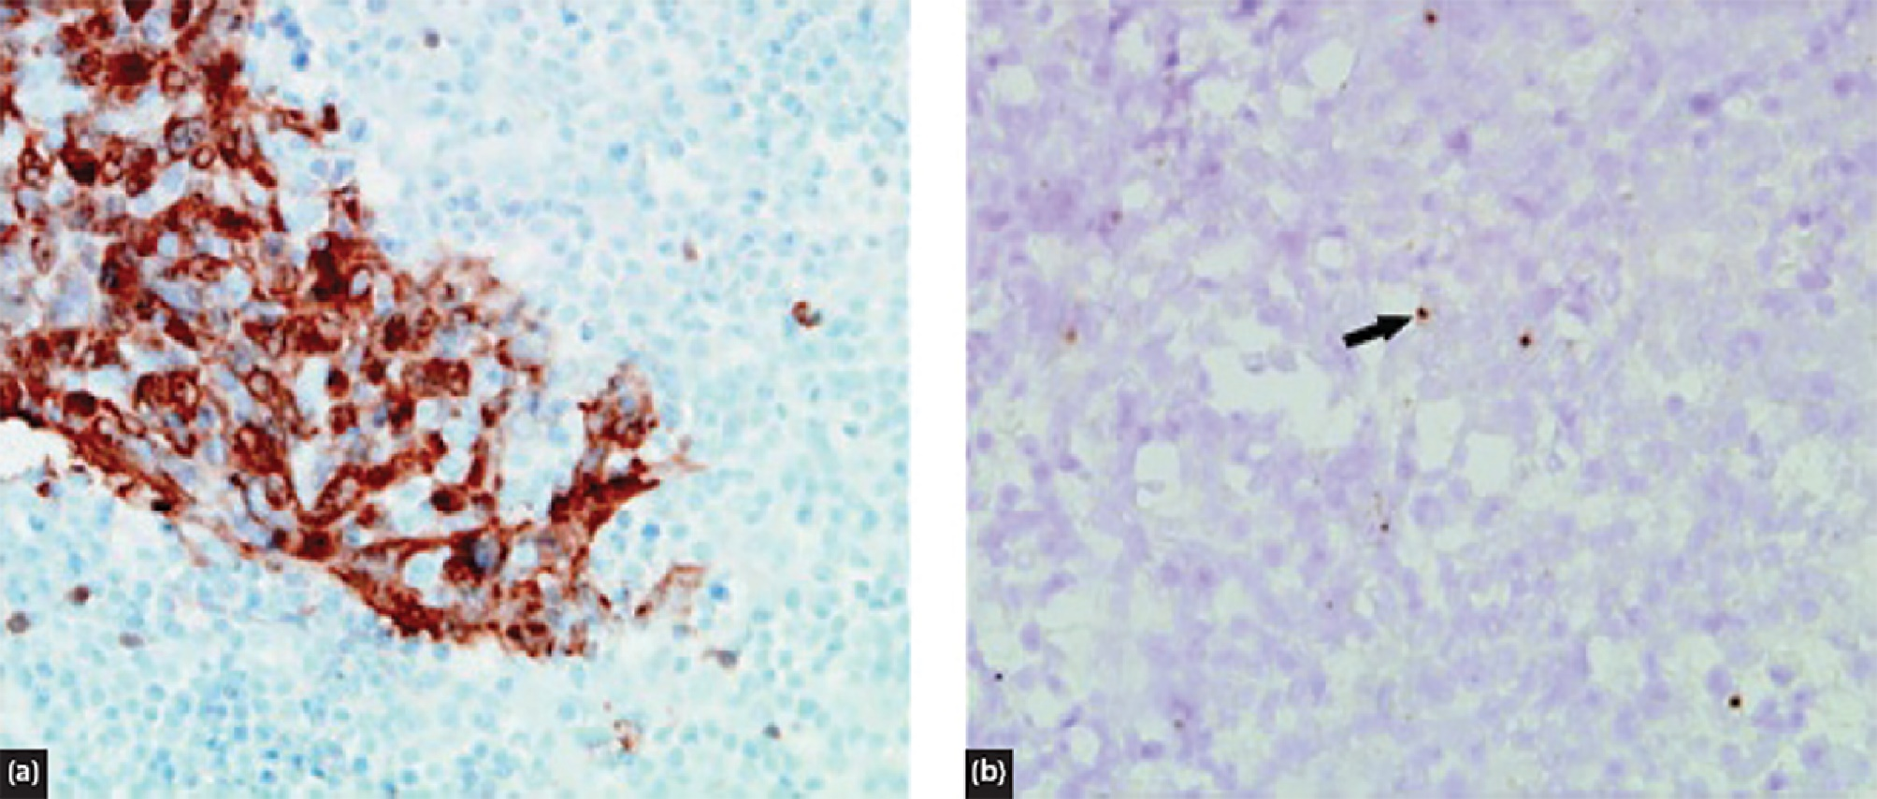
Courtesy of CRC Press/Taylor & Francis Group
Figure 68.1 Photomicrograph showing immunohistochemistry of a lymph node from a patient
with metastatic HNSCC of unknown primary suggesting a tonsil origin. (a) Positivity to p16 in the
tonsil (b) identified malignant cells in the tonsil.

Slide 2
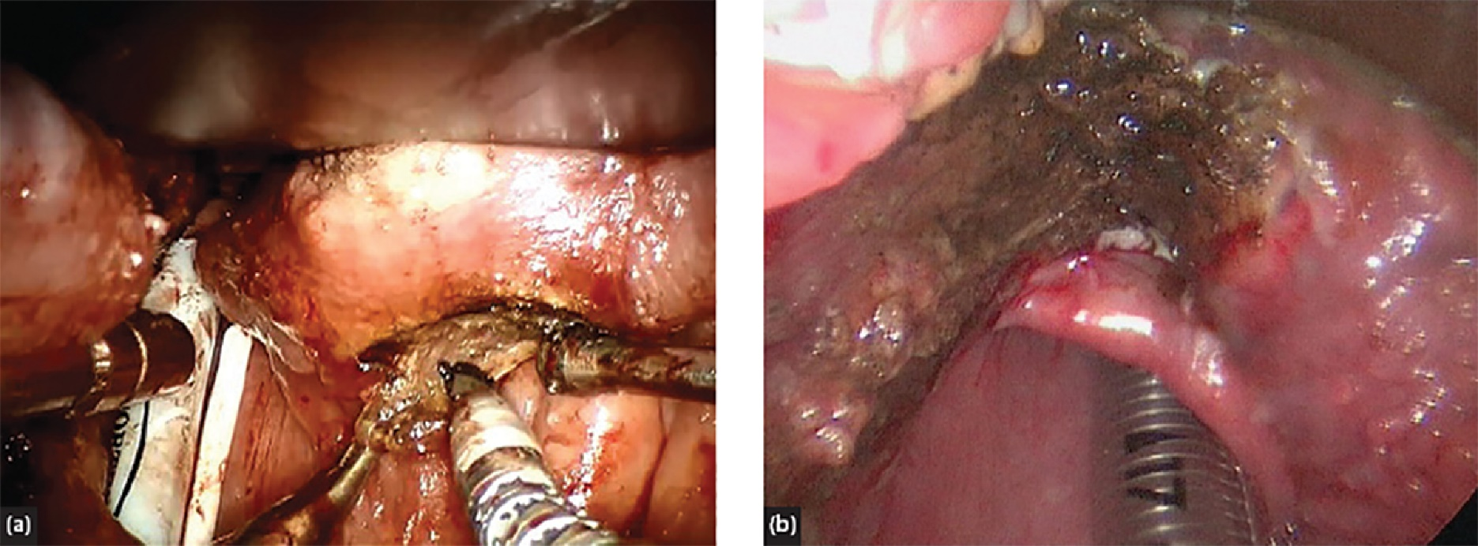
Courtesy of CRC Press/Taylor & Francis Group
Figure 68.2 (a) Robotic tongue base mucosectomy in progress and (b) completed procedure.

Slide 3
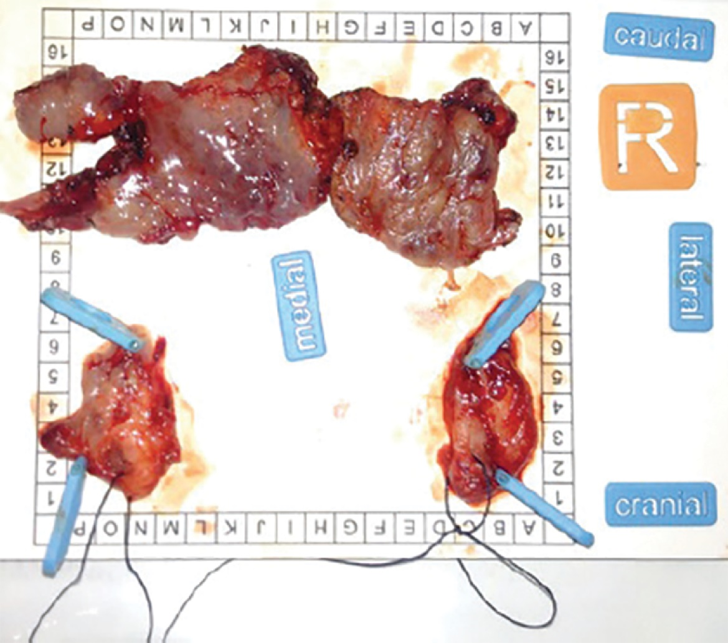
Courtesy of CRC Press/Taylor & Francis Group
Figure 68.3 Bilateral tonsillectomy and robotic tongue base mucosectomy specimen oriented
and mounted for pathological examination.

Slide 4
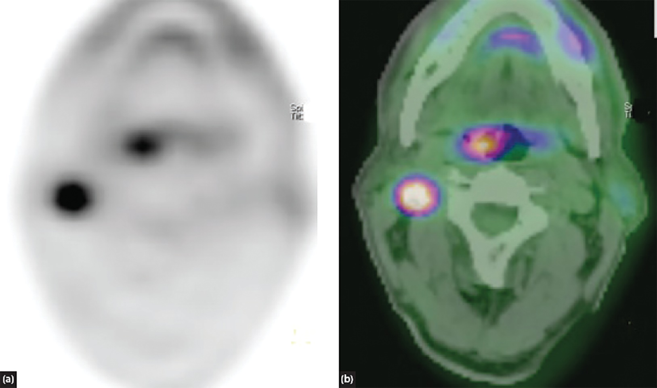
Courtesy of CRC Press/Taylor & Francis Group
Figure 68.4 FDG-PET CT scan demonstrating tracer uptake in the right oropharynx in a patient
presenting with metastatic SCC of the right neck.

Slide 5
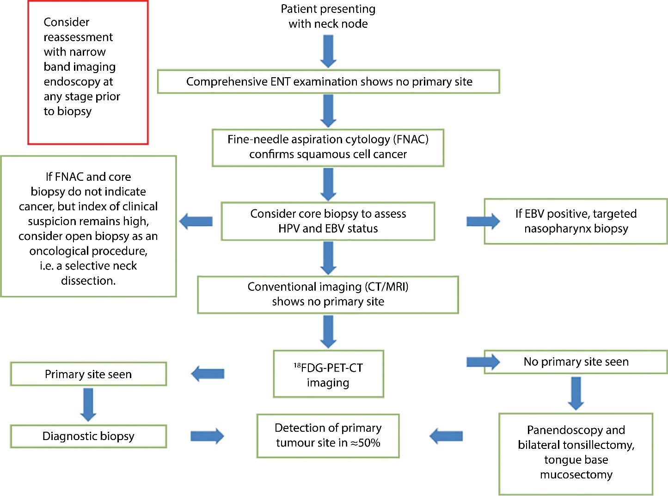
Courtesy of CRC Press/Taylor & Francis Group
Figure 68.5 Suggested algorithm for the management of the unknown primary.

Slide 6
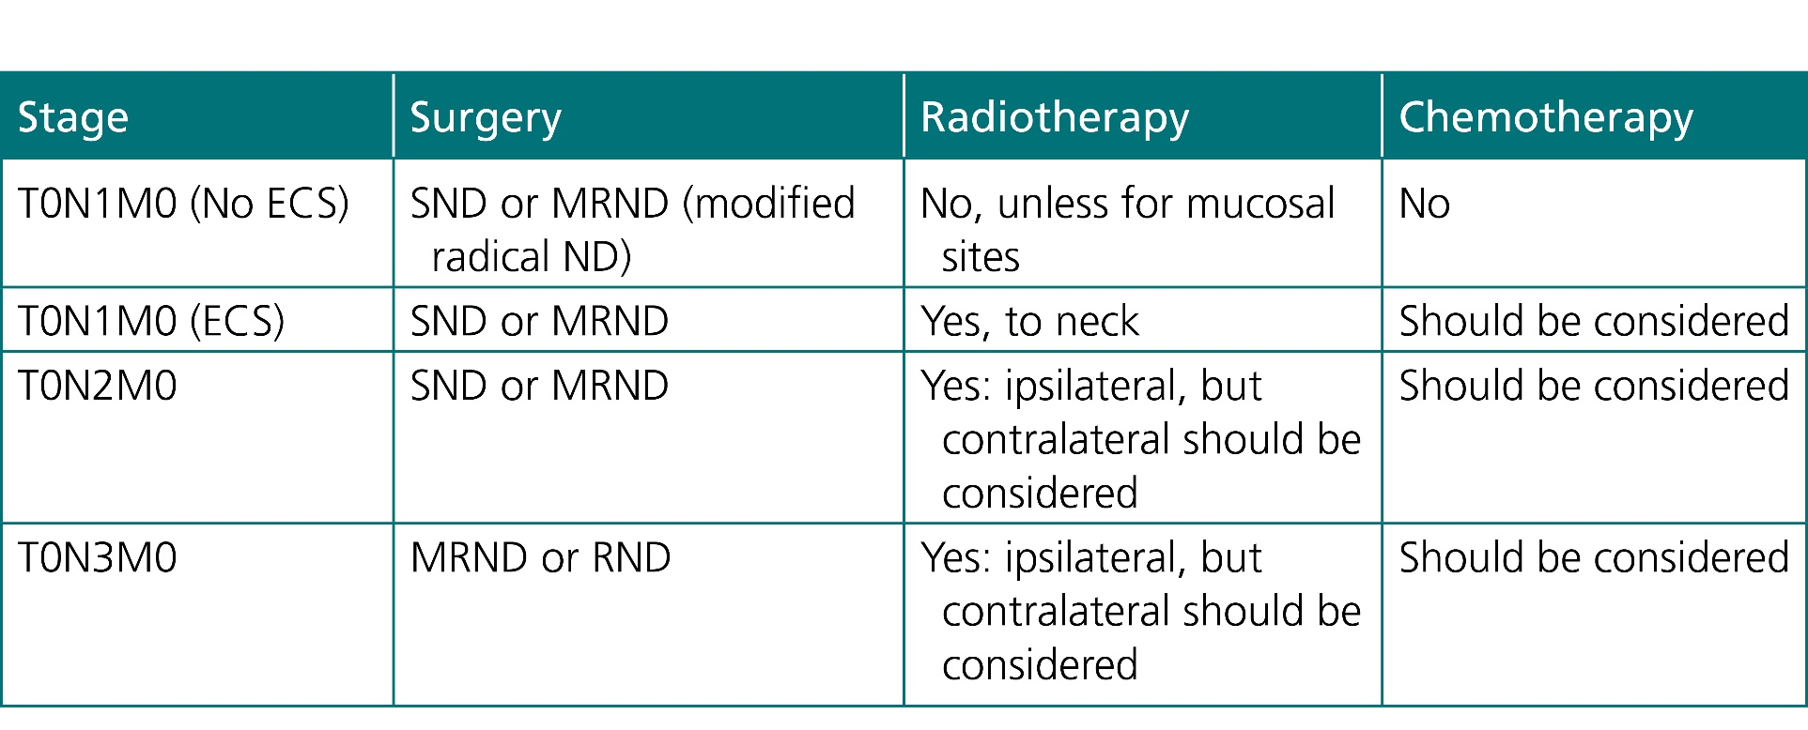
Courtesy of CRC Press/Taylor & Francis Group
Table 68.1 Treatment recommendations from ENT-UK Multidisciplinary Treatment Guidelines (2016)

