Slide 1
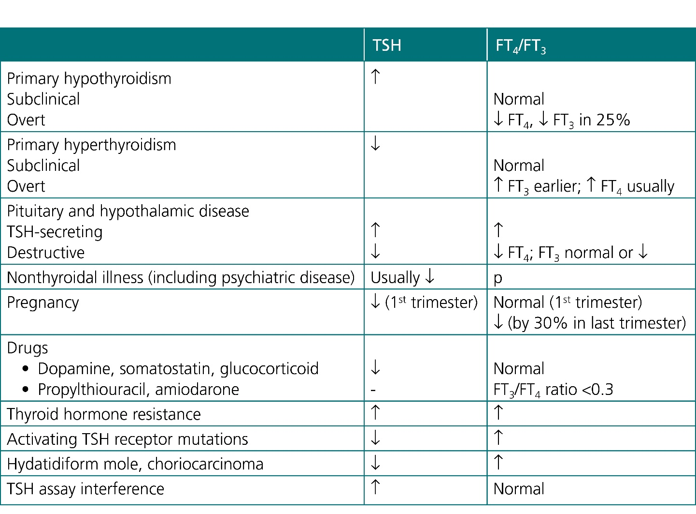
Courtesy of CRC Press/Taylor & Francis Group
Table 80.1 Factors affecting the measurements of serum TSH, FT₃, and FT₄

Slide 2
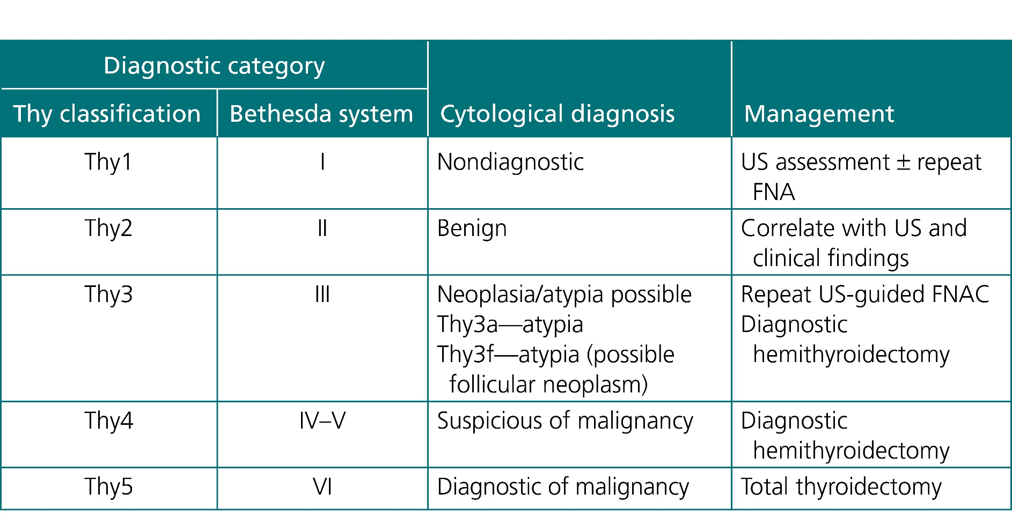
Courtesy of CRC Press/Taylor & Francis Group
Table 80.2 Cytological classifications of fine-needle aspirates and the corresponding management

