Slide 1

The Dynamics of Political Communication
Chapter 13
Political Advertising in Presidential Campaigns
© 2018 Taylor & Francis

Slide 2
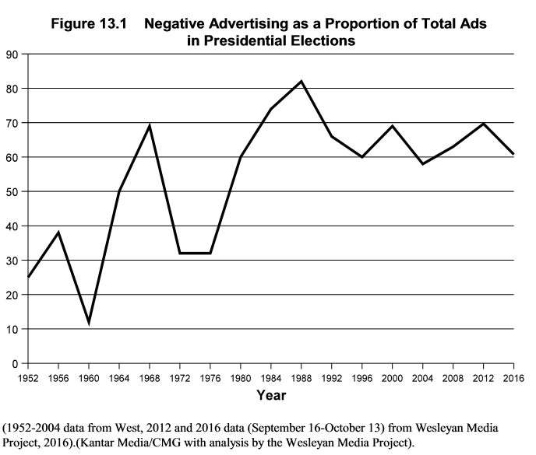
Strategic Features of Political Advertising
Negative ads begin long before the general election
During the general campaign, advertising becomes more strategic
  Some ads target the partisan base
  Others target undecided voters in battleground states
Opposition research is a controversial aspect of negative advertising that involves labor-intensive investigations designed to uncover liabilities in an opponent’s record
© 2018 Taylor & Francis

Slide 3
Political Advertising Content
Campaigns have many strategies for online and television spots
The content of ads depends on:
  Electoral context (e.g., primary vs. general)
  Campaign for state versus federal office
  Incumbent up for reelection versus two challengers for office
Benoit’s (2014) typology of political ads:
Candidates can acclaim, taking a positive approach by highlighting their virtues
Candidates can go negative, attacking the other candidate
Candidates can defend themselves from attacks by refuting or denying the claims
Content of claims, attacks, and defenses can be about policy issues or image
The dichotomy between issue and image is frequently blurred
© 2018 Taylor & Francis

Slide 4
Content of Negative Ads
Negative ad content can:
  Criticize the opponent directly with a frontal attack on character or motives
  Mention both the candidate sponsoring the ad and the opponent; a compare/contrast ad
  Use indirect implications or innuendo about the targeted candidate
Negative ads vary in accuracy and deceptiveness
  Negative messages also communicate tone: civil or uncivil
Negative ads tend to use dramatic production techniques:
  Dark colors
  Compelling camera angles
  Foreboding music
  Grainy, realistic images
  Menacing narrator tone
© 2018 Taylor & Francis

Slide 5
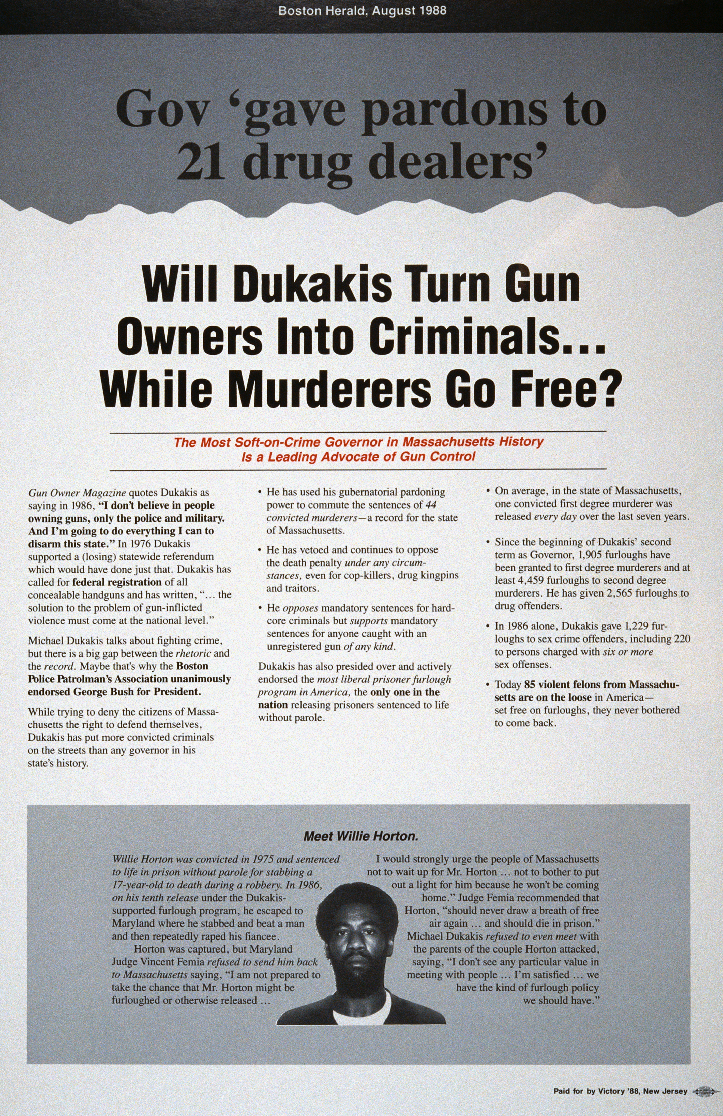
The Infamous “Willie Horton” ad of 1988
The Willie Horton ad is clearly negative, but was it still relevant or appropriate? Why or why not?
© 2018 Taylor & Francis

Slide 6
Limits of Negative Ads
Political ads may not reach their target audience
Negative ads do not change partisans' attitudes
Negative ads won't influence voters if they fail to address salient political concerns
Negative ads will not work if the "hit" is too strong, below the belt, unbelievable, socially inappropriate, or deeply offensive
© 2018 Taylor & Francis

Slide 7
Influences of Negative Ads
Recall: People remember negative ads better than positive spots
Learning and reinforcement: Negative ads can enhance knowledge of candidates’ issue positions and personal qualities, bolster partisan attachments, strengthen attitudes, increase political participation, and mobilize the base
These effects are conditional, depending on:
The competitiveness of the race
Polarization of the information environment
Whether attacks are funded by candidate or by Super-PAC
Emotions aroused by the ad (anger, anxiety, hope)
Level of incivility of the message
© 2018 Taylor & Francis

Slide 8
In Defense of Negative Ads
There is little evidence that negative campaigns depress voter turnout
Negative ads tend to focus more on issues than positive spots
Negative ads get people thinking, arguing, and actively processing politics
Negative campaign messages can encourage activists to work harder for their candidate
Negative advertising provides a check on the system, offering useful correctives to politicians’ puffed-up claims
Negative ads offer a check on incumbents by forcing them to stay accountable to voters
© 2018 Taylor & Francis

Slide 9
Criticisms of Negative Ads
Negative ads frequently provide a superficial rendition of candidate positions on issues
Although negative ads do not depress turnout, they can diminish both trust in government and political efficacy
  Negative ads reward opposition research
  Factual distortions in negative ads are ethically problematic and leave a bigger imprint on memory than those communicated in positive spots
You’ve heard both sides, let’s debate: Would we be better or worse off if there were no negative ads in campaigns?
© 2018 Taylor & Francis

Slide 10
Correcting Misperceptions
An effective counter to untruthful or misleading speech is more speech
Ignoring attacks by opponents increases the credibility of the attacks
Its unclear whether attacks followed by counterattacks clarify voters' cognitions or improve the quality of political information they hold
Fact-checking by specialized organizations can refute inaccurate claims
  Fact-checks that challenge ad accuracy can correct misimpressions
  Effects can be stronger for individuals with low tolerance for negative campaigns
  Fact-checking risks magnifying the effects by further promoting the misleading content
  Viewer selectivity may result in viewers not seeing fact checks that correct false claims made by their candidate
  Campaign consultants delegitimize fact-checking services when both sides repeat false claims
© 2018 Taylor & Francis

Slide 11
Campaign Finance, Or,
Money in Politics
Money plays a major role in politics
  The problem isn’t spending money on political ads; the problem is equality of access to the political elites
  72% of lobbying money comes from organizations representing business interests; no more than 2% comes from organizations representing the vast majority below the very top
The overwhelming majority of large donors during elections are older white men
In the 2012 election, hundreds of millions of dollars of donations were raised by the Koch brothers on the conservative side and George Soros on the Democratic side
What, if anything, about this figure is risky for democracy?
© 2018 Taylor & Francis

Slide 12
A Recent History of
Money in Politics
Watergate
  Burglars sanctioned by Nixon’s attorney general broke into DNC headquarters
  Secret campaign funds financed the burglary and cover-up
International Telephone & Telegraph
  Donated $400k to the 1972 Republican convention in exchange for settling an antitrust case in their favor
Post-Watergate reforms
  1974, Congress implemented new campaign finance laws to:
    Reduce party dependence on wealthy donors
    Discourage secret contributions
    Reduce cost of presidential campaigns
  1976 Buckley v. Valeo Supreme Court decision held that Congress could not limit campaign expenditures, but could limit campaign contributions
© 2018 Taylor & Francis

Slide 13
Even More Recent History of Money in Politics
McCain–Feingold
  The Watergate reforms failed to stop the diffusion of big money into political campaigns
  The 2002 Bipartisan Campaign Reform Act sought to eliminate loopholes
  Barred parties from raising unlimited "soft money" contributions
  Banned corporate or union funding of broadcast or cable media ads mentioning a candidate within 30 days of a primary or 60 days of a general election
Citizens United
Conservatives were angry; could not see why there should be any limits on advertising
Conservative nonprofit called Citizens United produced Hillary: The Movie to undermine Clinton candidacy; McCain– Feingold blocked it from being aired
2010 Supreme Court case ensues; conservatives argue corporations have First Amendment right to spend unlimited money on election ads
Conservatives won the case
© 2018 Taylor & Francis

Slide 14
Aftermath of Citizens United
Conservatives defended the decision, arguing that speech is an essential mechanism of democracy
Liberals argued that the decision would unleash a torrent of corporate money and result in a corporate takeover of American politics
Liberals contested the argument that money is speech, noting that money is not evenly distributed across economic groups
Three unintended and problematic consequences of Citizens United:
  Spending by outside groups has increased astronomically since the decision
  Many donations given to super-PACs are kept secret because super-PACs can use loopholes to hide donation sources
  Candidates can collude with special interest super-PACs, violating the spirit of the decision
© 2018 Taylor & Francis

Slide 15
What to do?
  Citizens United reduces transparency, encourages secretive political activities, and increases the ability of the rich to bankroll political campaigns
Alternate solutions have been proposed:
Public funding of elections by converting tax revenue to "democracy vouchers" that individual voters can allocate to candidates they support
Does not solve the problem of candidate inequality; candidates with fewer resources would still struggle
But … overhauling the system is possible and can be made feasible
What considerations should an alternative campaign finance system take? What should its goals be?
© 2018 Taylor & Francis

Slide 16
Conclusions
Political ads are presumed to have no redeeming democratic features and to be all-powerful
Neither assumption holds up to scrutiny
Political ads play an important strategic role in presidential campaigns
Negative ads can succeed or fail, their effects limited by context and conditions
Ads provide issue information and serve as a check on automatic reelection of incumbents
Political ads are situated in the broader domain of campaign finance
The Citizens United decision has raised concerns about transparency and the influence of money in politics
In the end, presidential elections are about persuasion, and persuasion is not equivalent to truth
© 2018 Taylor & Francis

