Slide 1
Unit III
Professionals and
professional practice

Slide 2
Chapter 14
Careers in the health care profession
By
Jahangir Moini, M.D., M.P.H.
and
Morvarid Moini, D.M.D., M.P.H.

Slide 3
Overview
Careers in health care are subdivided into:
  Therapeutic
  Diagnostic
  Management
  Education
There are many opportunities, and the job outlook is optimistic in health care

Slide 4
Therapeutic divisions of the health care system
Physicians
Physician assistants
Nurses
Medical assistants
Surgical technologists
Dentists
Dental assistants
Dental hygienists
Occupational therapists

Slide 5
Therapeutic divisions of the health care system
Dietitians
Chiropractors
Massage therapists
Psychologists
Medical social workers
Rehabilitation counselors
Respiratory therapists and technicians
Emergency medical technicians and paramedics
Physical therapists and therapist assistants

Slide 6
Physicians
Diagnose illnesses
Prescribe and administer medications and treatments
Examine patients; counsel on choices and behaviors
Obtain medical histories
Interpret diagnostic tests
Two types:
  Medical doctor (MD)
  Doctor of osteopathic medicine (DO) – focuses on musculoskeletal system, preventive medicine, holistic care

Slide 7
Types of physician specialties
Anesthesiologist
Family physician
General internist
General pediatrician
Gynecologist/obstetrician
Psychiatrist
Surgeon

Slide 8
Miscellaneous physician specialties
Allergist
Cardiologist
Dermatologist
Emergency
Endocrinologist
Gastroenterologist
Neurologist
Ophthalmologist
Pathologist
Radiologist

Slide 9
Physicians
Mostly in groups or health care organizations
Up to 80% located in metropolitan areas
About 55% specialists; remainder primary care
About 8 years of education after high school, plus 3–8 years of internship and residency

Slide 10
Physicians
Licensed to practice in all U.S. and its territories
High competition
Acceptance based on:
  School transcripts
  High scores on Medical College Admission Test
  Letters of recommendation
  Personality
  Extracurricular activity participation
  School interviews

Slide 11
Physicians
In final 2 years of schooling, students work with patients, supervised by licensed physicians
Rotated through:
  Family practice
  Pediatrics
  Internal medicine
  Psychiatry
  Gynecology/obstetrics
  Surgery
Most MDs enter a residence after medical school

Slide 12
Physicians
New physicians in significant debt from education costs
Licensure through U.S. Medical Licensing Examination (USMLE)
Reciprocity through various states usually not limited

Slide 13
Physicians
22% growth expected up to 2022
Many colleges are increasing enrollments
Salaries are high:
  Primary care – averages $200,000 per year
  Specialists – average $400,000 per year

Slide 14
Nurses
Treat and educate patients
Give advice and emotional support to families
Record information
Assist with diagnoses
Analyze test results
Operate medical equipment
Administer medications
Assist with follow-up visits and rehabilitation

Slide 15
Nurses
Registered nurses (RNs)
  Establish treatment plans, direct other nurses; may specialize (such as critical care)
  May become advanced practice nurses (APNs), working independently or with physicians
Licensed practical nurses (LPNs)
Nurse practitioners
  Primary care or specialists

Slide 16
Nurses
Largest health care occupation
Most work in hospitals
Usually Bachelor’s, Associate’s degrees, or diploma
National licensing exam then required
Master’s degree required for:
  Clinical nurse specialists
  Nurse anesthetists
  Nurse midwives
  Nurse practitioners

Slide 17
Nurses
Bachelor programs usually 4 years, BSN degree
Associate programs 2–3 years, ASN degree
Diploma programs (less common), 3 years
Other programs:
  RN-to-BSN
  Accelerated Master’s degree

Slide 18
Nurses
Classroom instruction plus supervised clinical experience
National Council Licensure Examination (NCLEX-RN)
Some states have other eligibility requirements
Average $43,410 to $92,240 annually
22% growth expected up to 2022
  More jobs in physician offices anticipated than in hospitals

Slide 19
Nurses
LPNs also known as licensed vocational nurses
  Training about 1 year in length
  Licensure is the NCLEX-PN
  LPNs may receive credentials in special areas
  21% growth expected up to 2022
  Salaries are $28,260 to $53,580 annually

Slide 20
Physician assistants
Directly responsible for own actions
Skills lie between physicians and RNs
  2–4 years of college
  Health care work experience
  Post-graduate program of at least 2 years
  National PANCE exam, then licensure
  After exam, “Physician Assistant – Certified”

Slide 21
Physician assistants
Master’s, Bachelor’s, Associate’s degrees or certificate programs
38% growth up to 2022
Traditional medical practices and telemedicine
Salaries $64,100 to $134,720 annually

Slide 22
Physician assistants
Every 10 years, recertification exam required, or alternative program (CE and at-home examination)
Job duties:
  Examining patients
  Taking histories
  X-rays, lab tests
  Preliminary diagnoses
  Casts, splints
  Suturing wounds
  Recording notes
  Managing practices
  Ordering supplies
  Supervising others
  Counseling patients
  Prescribing drugs (in most states)

Slide 23
Medical assistants
Administrative and clinical tasks:
  Medical records
  Insurance forms
  Answer telephones
  Greet patients
  Scheduling
  Correspondence
  Bookkeeping, payments
  Arranging for lab tests
  Arranging hospitalizations

Slide 24

Figure 6-1: A medical assistant answering the phone

Slide 25
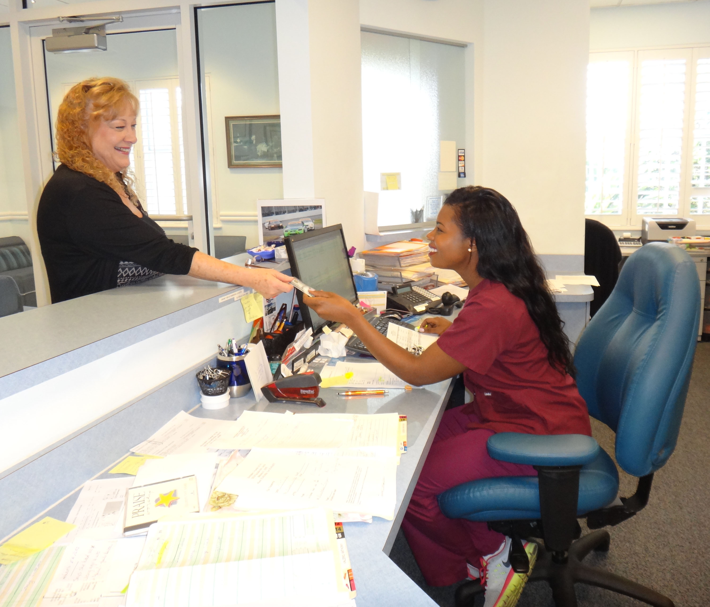
Figure 6-2:
A medical assistant accepting payment from a patient

Slide 26
Medical assistants
Programs usually last 1–2 years
Certificate, diploma, or Associate’s degree
Credentials:
  Certified Medical Assistant (by the AAMA)
  Registered Medical Assistant (by the AMT)
  Certified Clinical Medical Assistant (by the NHA)
  National Certified Medical Assistant (by the NCCT)
34% growth up to 2022
Average of $20,600 to $39,570 annually

Slide 27
Surgical technologists
Also called surgical technicians, operating room technicians, or scrubs
Duties include:
  Preparing operating rooms
  Setting up equipment and supplies
  Preparing and transporting patients
  Positioning patients
  Monitoring vital signs
  Assisting team with clothing
  Verifying patient information

Slide 28
Surgical technologists
  Pass instruments and supplies
  Account for everything used during surgery
  Assist in operating equipment
  Handle specimens
  Apply dressings
  Restock supplies
  Maintain homeostasis
  Assist with anesthesia
  Document procedures

Slide 29
Surgical technologists
Programs last 9–24 months
Certificate, diploma, or Associate’s degree
Certification preferred
Liaison Council on Certification for the Surgical Technologist (LCCST) exam
  Certified Surgical Technologist (CST) credential

Slide 30
Surgical technologists
Certification must be renewed every 4 years
Approved by the National Center for Competency Testing (NCCT), every 5 years
25% growth up to 2020
Averages $27,510 to 54,300 annually

Slide 31
Dentists
Specialize in teeth and mouth tissues
General practitioners or specialists
  Counsel patients
  Write prescriptions
  Fill cavities
  Remove tooth decay
  Examine X-rays
  Seal teeth
  Repair fractures
  Straighten teeth
  Extract teeth
  Create dentition models
  Take measurements
  Administer anesthetics

Slide 32
Types of dental specialties
Dental public health specialist
Endodontist
Oral/maxillofacial radiologist or surgeon
Oral pathologist
Orthodontist
Pediatric dentist
Periodontist
Prosthodontist

Slide 33
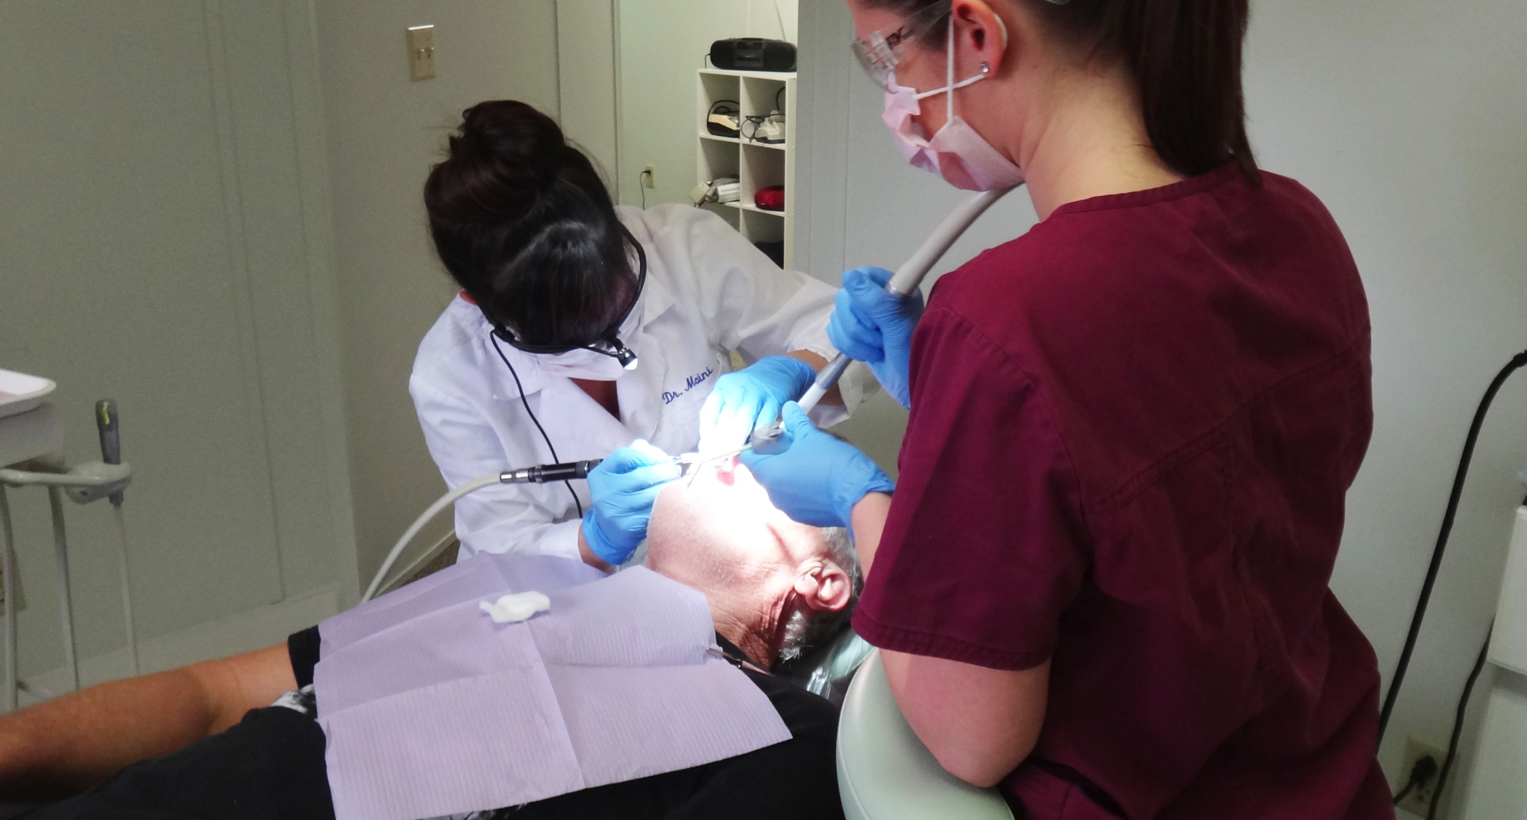
Figure 6-3:
A dentist performing a procedure on a patient

Slide 34
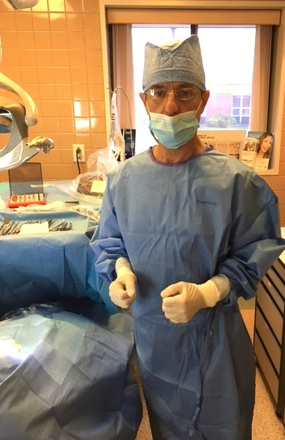
Figure 6-4: A dentist wearing protective garb

Slide 35
Dentists
Only about 15% are specialists
Dental school requires: Bachelor’s degree in Science, plus passing Dental Admissions Test
Competition for admission is very high
Usually 4 year programs, for:
  Doctor of Dental Surgery (DDS)
  Doctor of Dental Medicine (DMD)

Slide 36
Dentists
National Board Dental Examination
To specialize, 2–4 additional years of study
Residency of up to 2 years required
To teach or research, 2–5 years of additional training
16% growth up to 2022
Average just under $143,000 annually

Slide 37
Dental hygienists
Duties include:
  Educate patients about oral hygiene
  Oral examinations
  Recording of all findings
  Cleaning teeth
  Providing other types of preventive care
  X-rays
  Applying fluorides and other agents
  Sealing pits and fissures in teeth
  Certain states allow other job duties

Slide 38
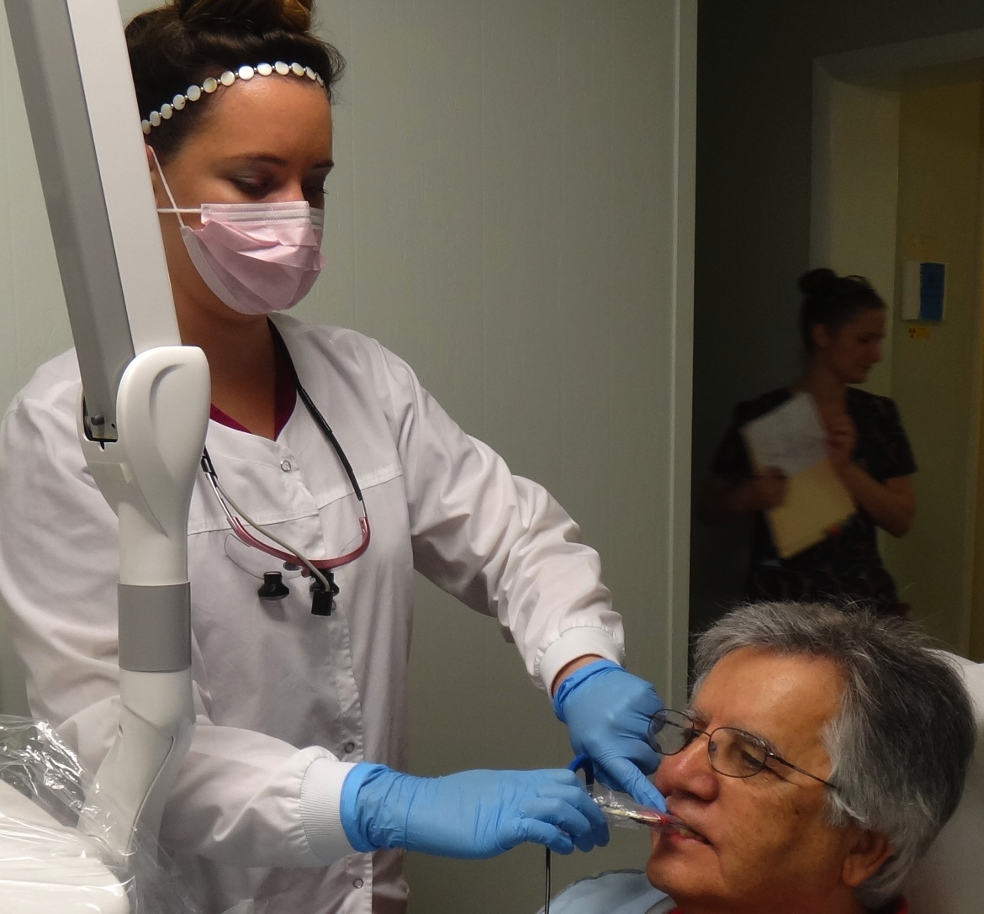
Figure 6-5:
A dental hygienist taking an X-ray

Slide 39
Dental hygienists
Nearly all hygienists work in dentist offices
Usually Associate’s degrees
Higher degrees for research, teaching, clinical practice
National Dental Examination, American Dental Association
Most states also require an exam on related legal topics

Slide 40
Dental hygienists
36% growth up to 2018
  One of the fastest growing health care occupations
Averages $49,190 to $97,390 annually
Benefits vary, based on:
  Practice setting
  Part- or full-time employment

Slide 41
Dental assistants
Variety of dental care, office, lab support work
  Assist dentists
  Work with patients and varied equipment
  Assist with imaging, anesthesia, polishing
  Help dentists and dental hygienists

Slide 42
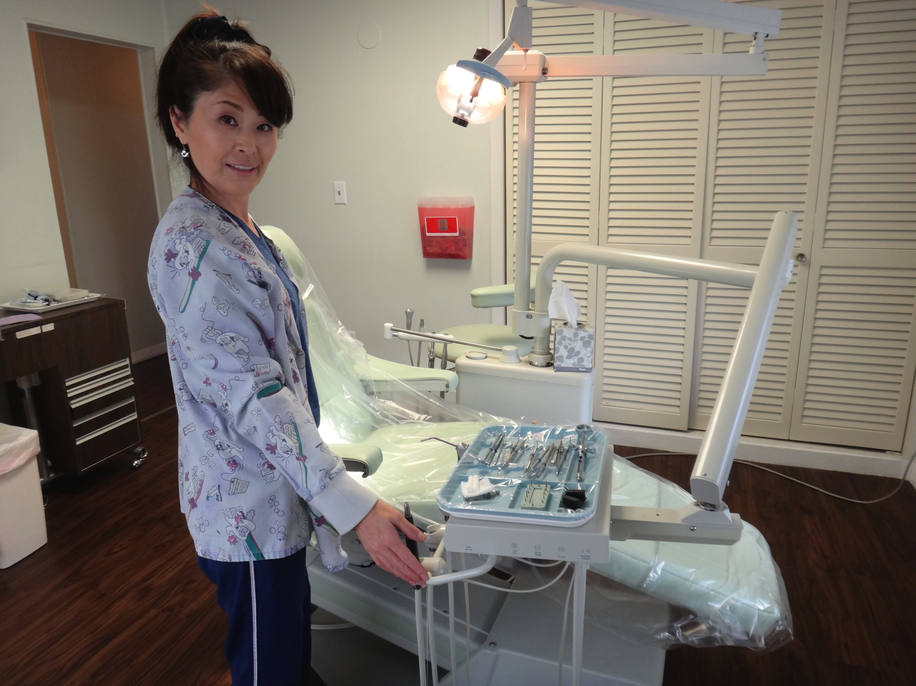
Figure 6-6: A dental assistant preparing a tray

Slide 43
Dental assistants
Usually work in dentist offices
Programs usually 1 year (certificate or diploma)
No licensure or certification required unless:
  Performing advanced activities
  Assisting in radiological procedures

Slide 44
Dental assistants
25% growth up to 2022
  One of the fastest growing occupations
Averages $24,580 to $49,540 annually
Benefits vary:
  More than 50% receive health and other benefits

Slide 45
Occupational therapists
Work with physicians, nurses, psychologists, others
Develop skills needed by each patient:
  Getting dressed, driving, walking, using the bathroom
Work with:
  Physically disabled (majority)
  Developmentally disabled
  Emotionally disabled
  Psychologically disabled

Slide 46
Occupational therapists
Master’s degree is usually required
Doctoral and Bachelor’s degrees also given
National licensing exam
Credential: Occupational Therapist Registered
Certification is available also (voluntary)

Slide 47
Occupational therapists
26% growth up to 2022
Averages $42,820 to $81,290 annually

Slide 48
Respiratory therapists and technicians
Therapists also known as respiratory care practitioners
Work with breathing or cardiopulmonary disorders
Interview, examine, and test patients
Instruct in using medications
Place patients onto mechanical ventilators
Supervise respiratory technicians

Slide 49
Respiratory therapists and technicians
Bachelor’s degree required for therapists
Licensure required in nearly all states
Certified Respiratory Therapist (CRT) or Registered Respiratory Therapist
21% growth up to 2022, mostly in hospitals
Average annual salary: $55,870

Slide 50
Respiratory therapists and technicians
Technicians usually need an Associate’s degree
  Limited demand due to most work being handled by respiratory therapists
Average annual wages: $47,810

Slide 51
Emergency medical technicians and paramedics
Provide fast, life-saving care
Treat, transport patients
Usually dispatched by 911 operators
Use specialized equipment such as:
  Devices to measure vital signs
  Backboards that immobilize patients

Slide 52
Emergency medical technicians and paramedics
Five levels:
  First responder
  EMT-basic
  EMT-intermediate (1985)
  EMT-intermediate (1999)
  Paramedic (provide most extensive care):
    Administer drugs
    Endotracheal intubations
    Read electrocardiograms

Slide 53
Emergency medical technicians and paramedics
Paid positions closer to metropolitan areas
Volunteer positions in more rural areas
Graduates must pass written, practical exam
Intermediate-level students:
  30 to 350 training hours
  Instruction on advanced airway devices, IV fluids, and certain drugs

Slide 54
Emergency medical technicians and paramedics
Advanced paramedic training:
  Anatomy, physiology, advanced medical skills
  1–2 years (Associate’s degree)
All EMTs must be certified
Most register with the NREMT every 2 years
19% growth up to 2022
Averages $20,690 to $54,690 annually

Slide 55
Optometrists
Main providers of vision care
Doctors of optometry:
  Examine, diagnose, test patients
  Prescribe contact lenses, eyeglasses, medications
  May provide vision therapy or rehabilitation
  Refer and educate patients
  Provide pre- or post-operative care
  Promote nutrition

Slide 56
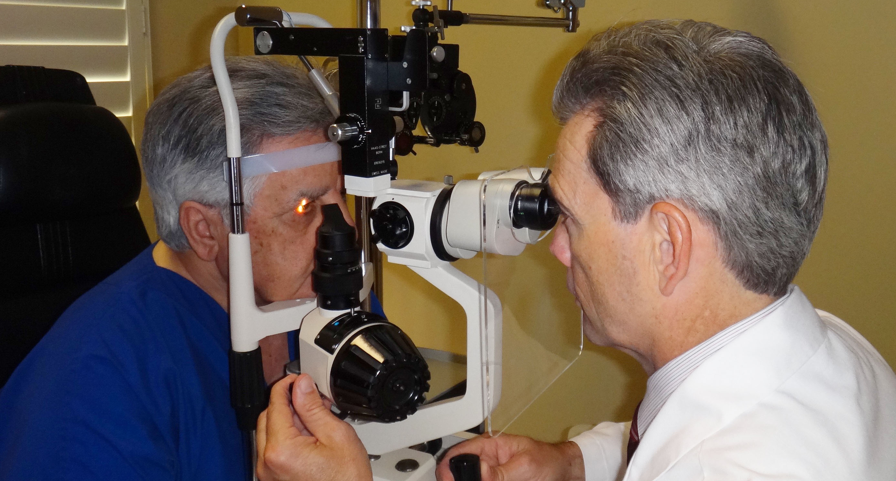
Figure 6-7: An optometrist examining a patient

Slide 57
Optometrists
Usually general practice; may specialize
Not ophthalmologists or dispensing opticians (who fit and adjust contact lenses or glasses)
Work in a variety of facilities
4-year Doctor of Optometry degree required
Highly competitive field due to lack of colleges

Slide 58
Optometrists
1-year postgraduate clinical residencies for specialists
Master degree or PhD for research or teaching
Licensure required, renewal every 1–3 years
24% growth up to 2022
Averages $78,000 to $169,115 annually

Slide 59
Ophthalmologists
Physicians who:
  Diagnose, treat eye diseases, injuries
  Perform eye surgery
  Prescribe contact lenses and glasses
  Specially trained on more complex eye conditions than optometrists
  Can prescribe a wider range of drugs

Slide 60
Ophthalmologists
4+ years of premedical undergraduate training
4 years of medical school
1 year of internship
3-year residency
Written Qualifying Exam
18% growth up to 2022
Averages $215,000 to $354,500 annually

Slide 61
Audiologists
Work with hearing, balance, or related ear problems
  Counsel about hearing loss
  Train in use of hearing aids
  Teach communication and listening strategies
  Fit devices
Some specialize to work with:
  Children
  Elderly
  Hearing impaired

Slide 62
Audiologists
Licensure required – varies with state
Master’a degree required
  Many states now require Doctoral degree (4 years)
Credential: AuD
  Some states do not allow dispensing of hearing aids unless separate Hearing Aid Dispenser license is obtained

Slide 63
Audiologists
Certificate of Clinical Competence in Audiology (CCC-A) may be earned
25% growth up to 2022
Averages $40,360 to $98,880 annually

Slide 64
Pharmacists
Dispense medications following prescriber guidelines
Less compounding of medications than in the past
In community or retail pharmacies
  Often counsel patients about products

Slide 65
Pharmacists
In hospitals
  Advise staff about drug selections and adverse effects
  Prepare sterile solutions
  Order supplies
  Handle administration
  Provide education
  May visit patients along physicians to aid in monitoring medication use (pharmacotherapists)

Slide 66
Pharmacists
Specialties:
  Home health care
  Cancer or psychiatric medications
  Nutrition support
Work with radiopharmaceuticals (nuclear pharmacists or radio-pharmacists)
Regulated by both state and federal boards
  About 61% work in retail pharmacies
  About 23% work in hospitals

Slide 67
Pharmacists
Licensure and several exams required
Doctor of Pharmacy (PharmD), usually 4 years
  Master of Science or PhD degree after PharmD if more experience is desired
Graduate studies in:
  Pharmaceutical chemistry
  Pharmacology
  Pharmaceutics
  Pharmacy administration

Slide 68
Pharmacists
1–2 year residency if intending to work in hospitals
Pharmacists who own their own pharmacies often seek a Master of Business Administration
Licensure required
Several exams, including
  North American Pharmacist Licensure Exam (NAPLX)

Slide 69
Pharmacists
Most states require:
  Multistate Pharmacy Jurisprudence Exam (MPJE) on pharmacy law
  Additional exams required by some states
Licenses transferred between all states except California
14% growth up to 2022
Averages $89,320 to $150,550 annually

Slide 70
Pharmacy technicians
Assist in:
  Preparation and compounding of medications
  Administration
  Labeling
  Customer service
Regulated by individual states
75% in retail pharmacies, 17% in hospitals
No national training standard exists

Slide 71
Pharmacy technicians
On-the-job training: 3–12 months
College: 6 months to 2 years
Certificate, diploma, or Associate degree
Internships often included
Most states require registration
Some require certification every 2 years
  Pharmacy Technician Certification Exam (PTCE)
  Exam for the Certification of Pharmacy Technicians (ExCPT)

Slide 72
Pharmacy technicians
20% growth up to 2022
Replacing pharmacy aids because job descriptions are enlarging
Averages $29,320 to $42,400 annually
Certified often earn more than non-certified

Slide 73
Dietitians
Along with nutritionists:
  Assist with meal selection and preparation
  Promote healthy eating
  Evaluate diets
Bachelor’s degree required
Licensure, certification, registration requirements vary between states

Slide 74
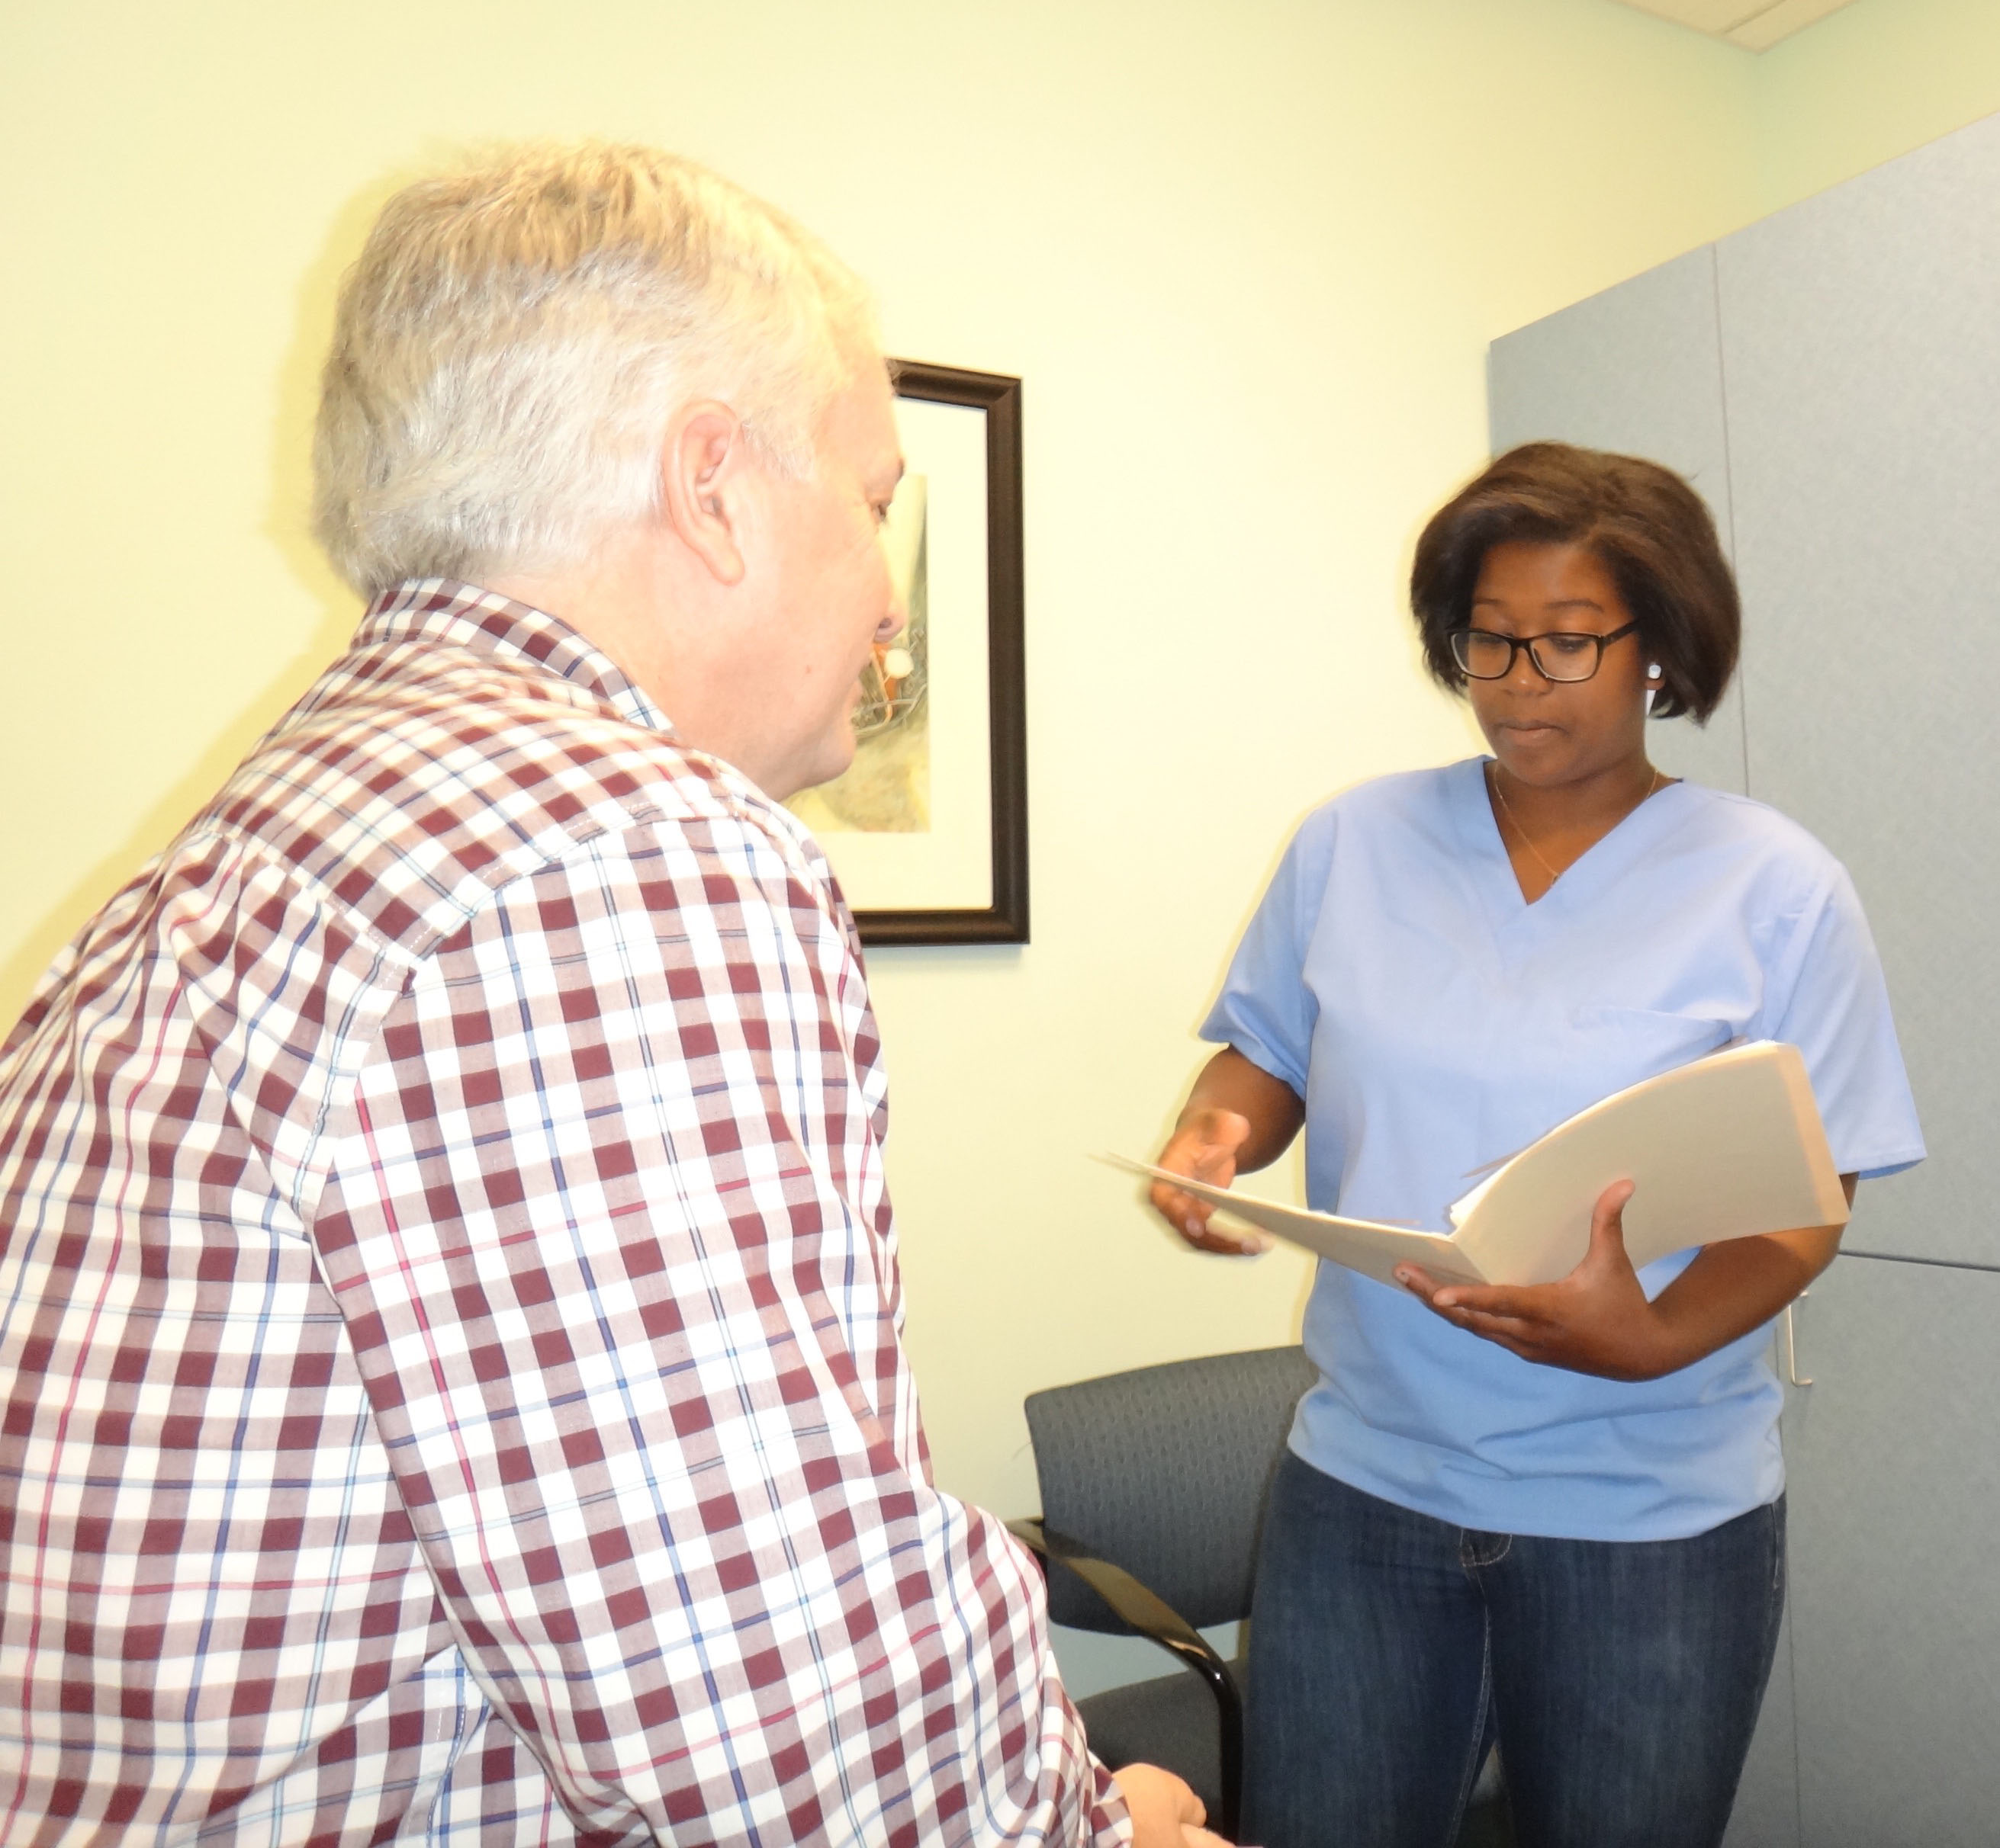
Figure 6-8:
A dietitian consulting with a patient

Slide 75
Types of dietitian specialties
Business
Clinical
Community
Consultant
Educator
Management
Research

Slide 76
Dietitians
Registered Dietitian credential is available
Supervised internships required for certification (4–5 years)
  Also, supervised practice internships (6 months to 2 years)
9% growth up to 2022
Averages $31,460 to $73,410 annually

Slide 77
Chiropractors
Treat neuromusculoskeletal problems
  Nerves, muscles, ligaments, tendons, bones
  Use spinal adjustments, manipulation, etc.
Doctor of Chiropractic (D.C.) degree required (3 years undergraduate; 4 years chiropractic)
Exam via National Board of Chiropractic Examiners
15% growth up to 2022
Average annual wage: $67,000

Slide 78
Physical therapists
Work with:
  Dysfunctions of movement
  Arthritis
  Stroke
  Heart disease
  Lower-back pain
  Cerebral palsy
  Fractures
  Head injuries

Slide 79
Physical therapists
Use therapeutic exercise, devices
Electrical therapies, physical agents
Joint or soft tissue mobilization
Bronchopulmonary therapies
Neuromuscular training or retraining
May specialize in:
  Children
  Orthopedics
  Elderly
  Neurological
  Athletes
  Cardiopulmonary

Slide 80
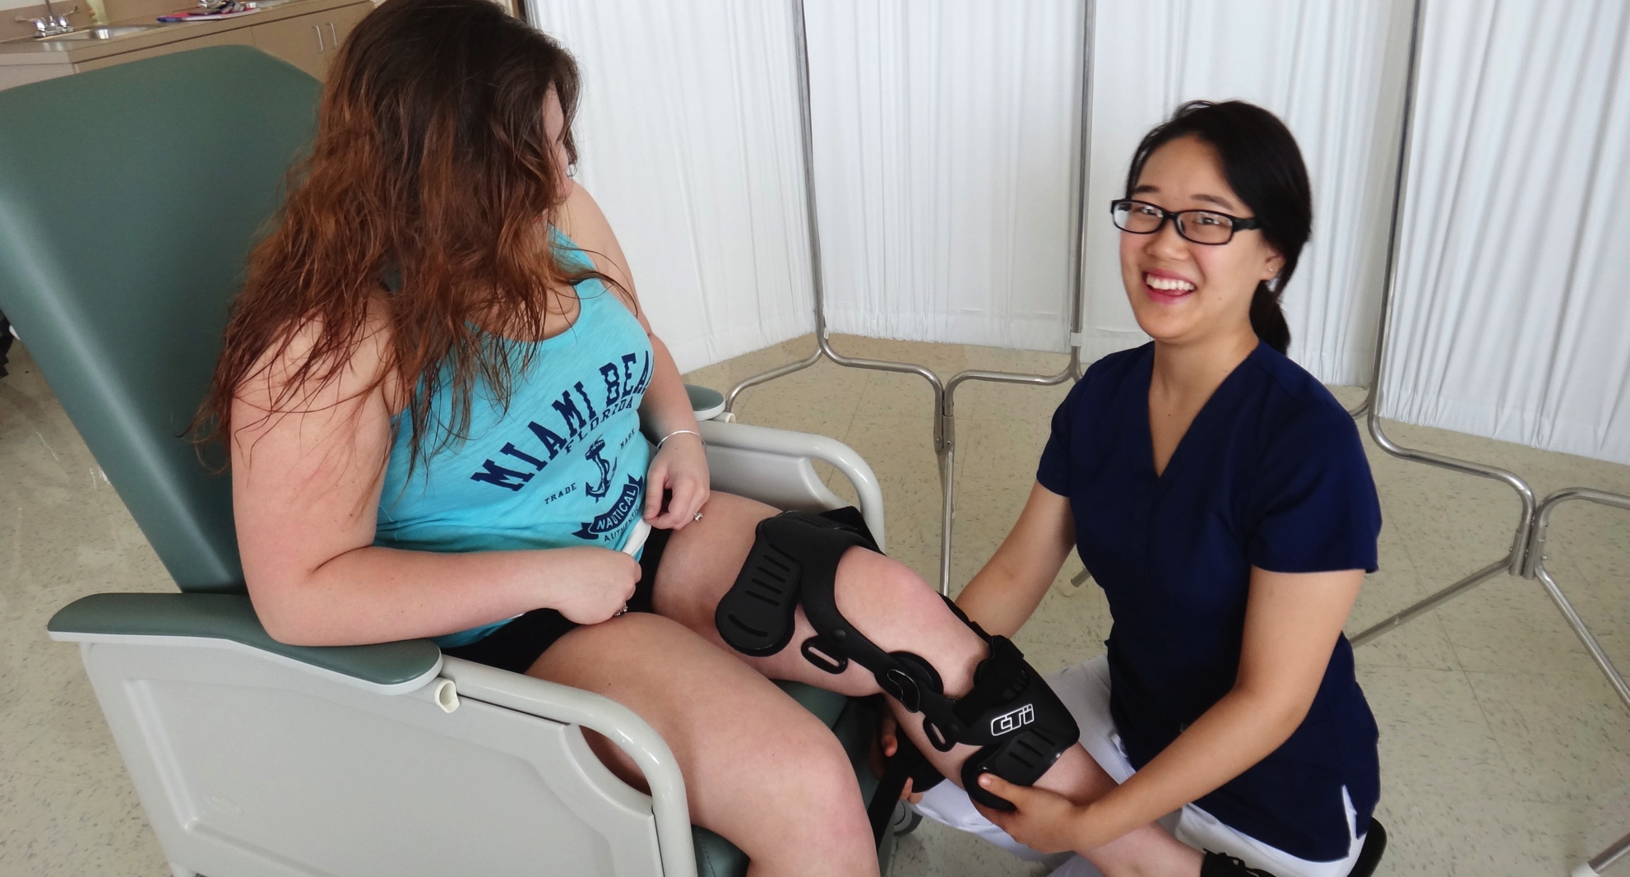
Figure 6-9: A physical therapist putting a knee brace on a patient

Slide 81
Physical therapists
Usually Doctoral degrees (3 years)
Also, Master’s degrees (2–2.5 years)
Licensure required
30% growth up to 2022
Averages $50,350 to $104,350 annually

Slide 82
Physical therapist assistants
Help therapists to provide treatments
  Demonstrate equipment usage
  Assist with exercises
  Give massages or electrical stimulation
  Apply traction or hot/cold packs
  Perform ultrasound
  Document information
Most states require an Associate’s degree

Slide 83
Physical therapist assistants
Must be certified in CPR and other first aid
Some states require licensing or registration
35% growth up to 2022
Averages $28,580 to $63,830 annually

Slide 84
Massage therapists
Manipulate soft body tissues:
  Improving joint mobility and range of motion
Base therapies on thorough medical histories
Specializations include:
  Deep-tissue massage
  Sports massage
  Swedish massage

Slide 85
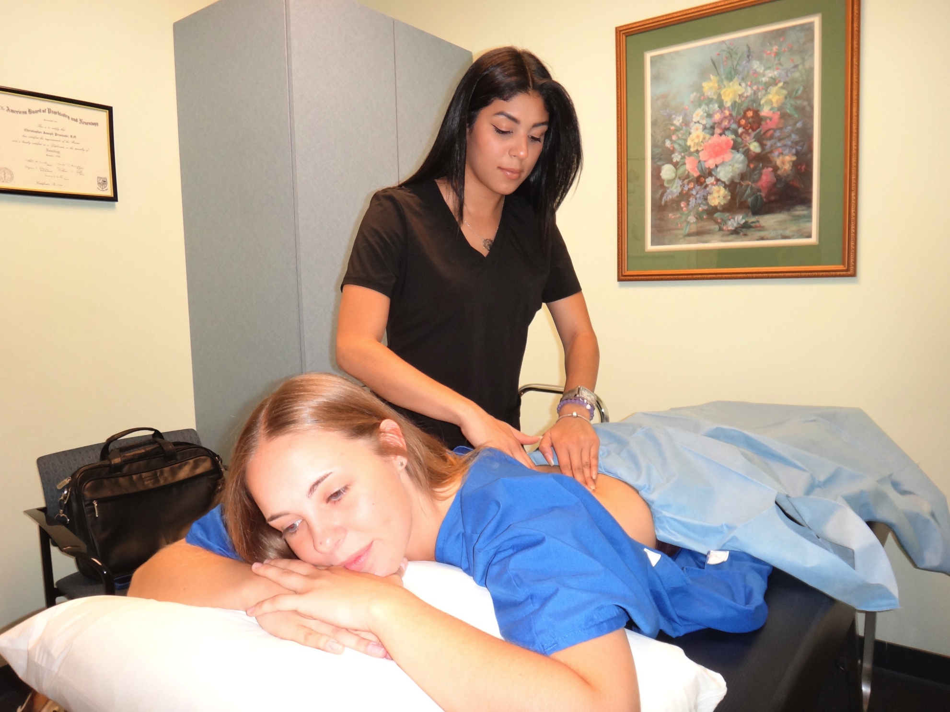
Figure 6-10:
A massage therapist working with a patient

Slide 86
Massage therapists
Sessions last 5 minutes to more than 1 hour
Often instruct patients about at-home techniques
23% growth up to 2022
Massage and Bodywork Licensing Exam (MBLEx)
Most states require licensure or certification

Slide 87
Massage therapists
Study areas:
  Anatomy
  Physiology
  Kinesiology
  Diseases and pathology
  Business management
  Ethics
All therapists transferred to “Board Certification”
  Since “National Certification” is no longer valid
Averages $41,790 annually

Slide 88
Psychologists
Study the mind and behaviors
  Identify causes of behaviors
  Prevent undesirable behaviors
  Solve problems related to behavior
Help diagnose, treat, and prevent mental illness
Considered a “scientific” (not “medical”) field

Slide 89
Psychologists
Study both individual and group behaviors
Work in many different types of facilities
Master or Doctoral (PhD or Doctor of Psychology – PsyD) degree required
  Bachelor degree allows individuals to assist
Licensure required

Slide 90
Types of psychologist specialties
Clinical
Counseling
Developmental
Educational
Engineering
Experimental/research
Industrial
Personnel
Psychometric
Rehabilitation
School
Social

Slide 91
Psychologists
Graduate programs are highly competitive
Licensing varies from state to state
All states require passing an examination
Nationally Certified School Psychologist (NCSP) recognized in USA
American Board of Professional Psychology
  Awards certification to Doctors of Psychology

Slide 92
Psychologists
Industrial and organizational psychologists: 53% growth up to 2022
For other areas: 12% growth up to 2022
Averages $42,230 to $120,670 annually

Slide 93
Medical social workers
Help people with personal and family problems, and relationships:
  Diseases
  Disabilities
  Housing
  Substance abuse
  Unemployment
  Domestic conflicts
  Research
  Advocacy
  Policy planning
  Other areas

Slide 94
Medical social workers
May be called licensed clinical social workers
Specialization areas:
  Schools
  Conflict resolution
  Child welfare
  Child Protective Services
  Family services

Slide 95
Medical social workers
Give support to people with:
  AIDS
  Alzheimer’s disease
  Cancer
  Other illnesses
Bachelor’s degree (or higher) required
Credentials: BSW, DSW, PhD
Requirements vary between states

Slide 96
Medical social workers
2 years or 3,000 hours of supervised clinical experience usually required
22% growth up to 2022
Averages $38,370 to $51,470 annually

Slide 97
Rehabilitation counselors
Evaluate and determine treatment for:
  Mental rehabilitation
  Physical rehabilitation
  Academic rehabilitation
  Vocational rehabilitation
Usually requires Master’s degree
Certificate or license may be required
20% growth up to 2022
Averages $33,880 annually

Slide 98
Diagnostic divisions of the health care system
Radiologists
Radiologic technologists
Cardiovascular technologists, technicians
Clinical laboratory technologists, technicians
Pathologists
Pathology assistants
Phlebotomists

Slide 99
Radiologists
Physicians who specialize in:
  Interpreting radiographs
  Showing various body tissues
MDs or DOs who complete 4-year residencies
Essential in diagnosing many conditions and disorders

Slide 100
Radiologic technologists
Work with more complicated equipment, including:
  Computed tomography (CT)
  Fluoroscopy equipment
  Mammography equipment
  Magnetic resonance imaging (MRI)

Slide 101
Radiologic technologists
Certificate, Associate’s, Bachelor’s programs
Most states require licensure
Voluntary certification is available
21% growth up to 2022
Averages $35,100 to $74,970 annually

Slide 102
Radiologic technicians
Provide diagnostic imaging exams
Place and program equipment
Prepare, educate, and position patients
Associate degree required
Licensure requirements vary
A few states require certification

Slide 103
Cardiovascular technologists
Assist physicians in diagnosis and treatment
Specialize in:
  Echocardiography
  Invasive cardiology (catheterizations)
  Vascular technology
Usually 2-year programs, but 4-year programs are becoming more popular
Average $48,984 annually

Slide 104
Cardiovascular technicians
Usually Associate’s degrees
Bachelor’s and certificate programs available
Licensure not usually required
Certification available, often preferred
24% growth up to 2022
Technicians average $29,270 annually

Slide 105
Clinical laboratory technologists
Assist pathologists in testing and treatment
Mostly employed in hospitals and labs
  Analyzing samples, chemicals
  Blood typing
  Drug detection
  Cell counting
  Specimen preparation
  Searching for abnormalities

Slide 106
Clinical laboratory technologists
Regularly use:
  Microscopes
  Cell counters
  Computerized or automated test equipment
  Electronic medical records

Slide 107
Clinical laboratory technologists
Technologist jobs generally more complex than technician jobs
  Supervise technicians in the lab
  Specialize in many different areas

Slide 108
Types of laboratory technologist specialties
Blood bank
Clinical chemistry
Cytotechnologist
Immunology
Microbiology
Molecular biology

Slide 109
Clinical laboratory technologists
Bachelor degree in medical technology or a life science
Competition high; lack of training programs
Various states require licensure or registration
National exam available
Doctoral degree usually required for lab directors
14% growth up to 2022
Averages $60,560 annually

Slide 110
Clinical laboratory technicians
Less complicated activities than technologists
  Prepare specimens
  Conduct manual testing
  May operate automated analyzers
  Specialties: Histotechnicians, Phlebotomists
Associate degree or certificate required, though some get on-the-job training

Slide 111
Clinical laboratory technologists and technicians
Licensure available, often leads to advancement toward becoming a technologist
30% growth up to 2022
Averages $40,750 annually

Slide 112
Phlebotomists
Draw blood, transport to labs, and test blood
Perform venipuncture and skin puncture
Need strong interpersonal skills to deal with apprehensive patients

Slide 113
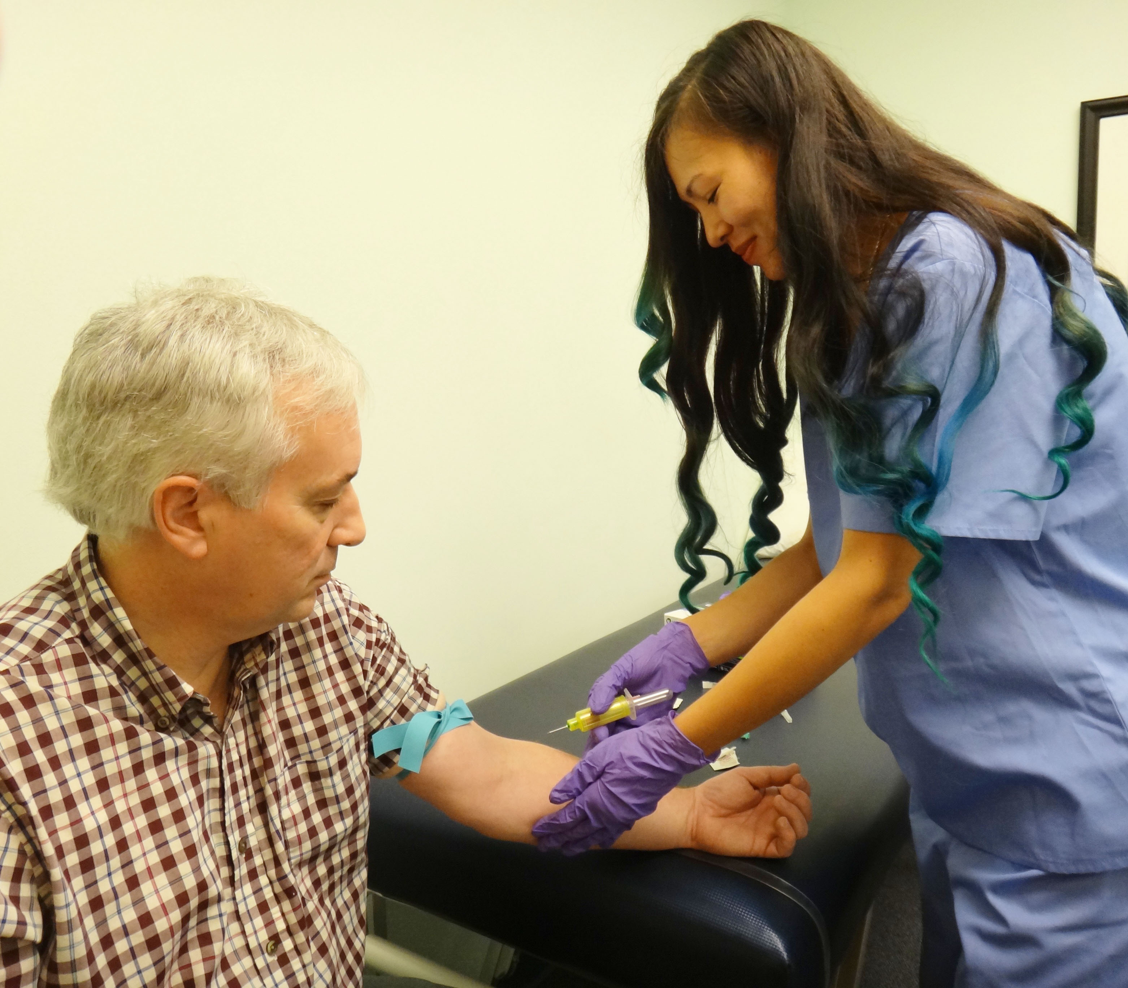
Figure 6-11: A phlebotomist performing venipuncture

Slide 114
Phlebotomists
High demand for phlebotomists
  Positions evolve to become part of other job titles
Usually: postsecondary non-degree award
May receive on-the-job training
Certificate or diploma programs usually less than 1 year

Slide 115
Phlebotomists
No licensure in most states, but employers prefer certification (via an exam)
27% growth up to 2022
Averages $32,000 annually

Slide 116
Pathologists
Physicians who specialize in:
  Diagnosis and study of disease, using lab methods
Residencies usually required
Board certification available
  Examine body fluids
  Toxicology tests
  Blood banks
  Test immune function
  Analyze cell and tissue samples

Slide 117
Pathologists
Medical degree, then specialized study
Certification via American Board of Pathology
18% growth up to 2022
Averages $174,544 annually

Slide 118
Pathology assistants
Supervised by pathologists:
  Prepare, dissecting surgical specimens
  Prepare, select tissue samples
  May also assist other departments
Certification is voluntary
Bachelor’s or Master’s degree required
30% growth up to 2022
Averages $58,640 annually

Slide 119
Health care management
Health care administrators
Health information technicians

Slide 120
Health care administrators
Manage, coordinate services in clinics, physician offices, hospitals, nursing facilities
Bachelor’s, Master’s, Doctoral degrees available
Certificate or diploma programs often less than 1 year in length
22% growth up to 2022
Averages $85,860 to $102,000 annually

Slide 121
Health information technicians
Also called medical records technicians
Manage and analyze information
  Always maintain confidentiality
Associate degree usually required
22% growth up to 2022
Averages $34,160 annually

Slide 122
Health care education
Health educators
School health educators

Slide 123
Health educators
Teach behaviors that promote wellness
Bachelor degree required
Employers often require Certified Health Education Specialist credential
21% growth up to 2022
Averages $48,790 annually

Slide 124
School health educators
Assist young people with healthy living skills
Usually participate in community programs
Bachelor’s or Master’s degree required
Meet regular teacher certification standards
18% growth up to 2022
Averages $41,830 annually

