Slide 1
Essential Personal Finance
Chapter 1
The necessity of private wealth
© 2017 Lien Luu, Jonquil Lowe, Jason Butler and Tony Byrne

Slide 2
Contents
Defining wealth
  Global distribution of wealth
Reasons why it is necessary to create wealth
  Push: increasing life expectancy, ageing population, diminishing role of government, employer and family
  Pull: relationship between wealth and health
How much money do you need in retirement?
Examples of students who became millionaires
Ways to create wealth
Conclusions

Slide 3
Chapter Topics
Defining wealth
Distribution of wealth
Reasons for need to create wealth
Ways to create wealth

Slide 4
Defining wealth
Wealth
Human capital
Financial capital

Slide 5
Wealth components in the UK
Wealthiest 10%
Least wealthy 50%
Figure 1.1 Wealth components in the UK
Source: ONS (2015a, p.9).

Slide 6
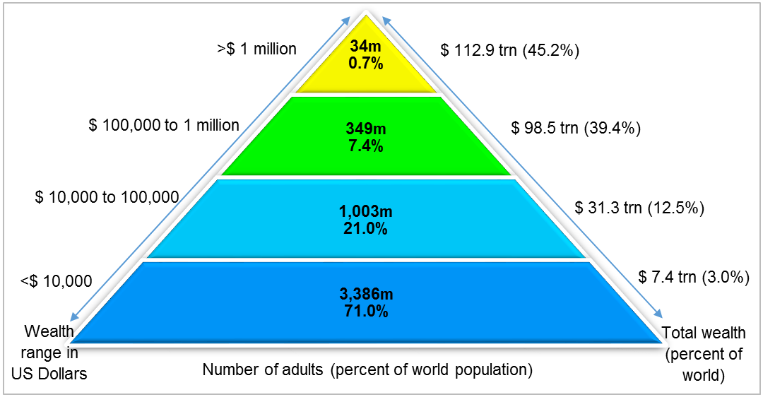
Global uneven distribution of wealth
Figure 1.2 Global distribution of wealth
Source: Adapted from Credit Suisse (2015, p.24).

Slide 7
Distribution of wealth in UK
Figure 1.4 Distribution of wealth in the UK
Source: Data from ONS (2015a).

Slide 8
The gap between the rich and poor in the UK
Figure 1.5 Distribution of household wealth in the UK
Source: ONS (2015a, p.3).

Slide 9
Life stages
Figure 1.6 Length of working life versus retirement

Slide 10
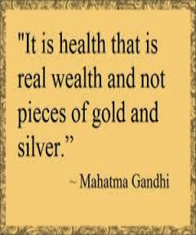
Reasons for need to build wealth
Increasing life expectancy
Gap between life and healthy life expectancy
Falling birth rates and ageing population
Diminishing role of government and employer in retirement provision
Diminishing role of family
Link between health and wealth

Slide 11
World’s great philanthropists
Table 1.2 The world’s great philanthropists
Source: www.therichest.com/celebnetworth/celebrity-lifestyle/giveaway/the-worlds-biggest-givers/.

Slide 12
Student millionaires
Table 1.4 Students turned millionaires in the UK
Source: www.savethestudent.org/make-money/uk-millionaires-where-and-what-they-studied.html.

Slide 13
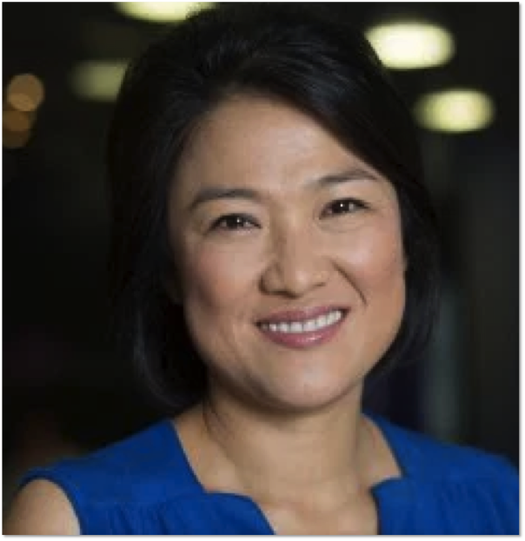
Zhang Xin
Came from poor and broken family
Went to Hong Kong when 14 and toiled in factory. Saved hard to buy plane ticket to England
Studied Economics at Sussex, then MA at Cambridge
Became billionaire through property

Slide 14
Guiding principles of wealth
Start saving
Control expenditures
Make the gold multiply
Guard your treasures from loss
Make your home a profitable investment
Insure your future income
Increase your ability to earn

Slide 15
Steps to build wealth
Desire
Desire to have wealth
Plan
Plan how this can be achieved
Act
Self-discipline, hard work, patience, risk taking, confidence
Figure 1.7 Steps to build wealth

Slide 16
Financial literacy
Financial literacy
More wealth
Fewer problems with debt

Slide 17
Financial planning
Planning
Those who plan for retirement have 3 times more wealth
Key to wealth accumulation

Slide 18
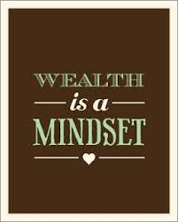
Conclusions
Demographic and social changes
Individuals need to take greater responsibility for own future
Wealth gives well-being benefits
Reduces burden on the State
Gives you life choices
And the power to help others

