Slide 1
Entrepreneurial Marketing: An Effectual Approach
Prof. Dr. E.J. Nijssen,
Eindhoven University of Technology
Available from Routledge at: https://www.routledge.com/Entrepreneurial-Marketing-An-Effectual-Approach/Nijssen/p/book/9781138712911
Session 7: Developing a marketing and sales programme

Slide 2
Objectives
Offer rational and guidelines for a 1–2-page marketing/sales plan
Content and concepts per marketing instruments (mix); also explain the specific challenges in the entrepreneurial context

Slide 3
Low cost sales/marketing program
Develop a 1-page plan as initial sales/marketing roadmap
Affordable loss requires lean approach of marketing and sales activities
Use creativity to compensate for limited resources
Account for both marketing & sales activities

Slide 4
Content of 1-page plan
Three areas and their relationship with marketing mix and sales
Developing customer value
Product attributes… start with minimum product; focus on offering solution and value created
Price… be careful making consessions; hard to reverse. Focus on benefits, not just cost argument
Building market presence
Promotion… use social media/free publicity and WOM; educate the market; provide relevant information/proof
Place… Strategic decision; focus on access; channel and need for VAR (value added resellers)
Customer development
Sales funnel… Invest significant part of funds to develop customers; focus on sales learning

Slide 5
Possible elements and structure
Market: Describe the market using Abell’s 3-D format
Target segment: Description of initial target segment
Positioning: Identify USPs; points of difference and parity. Identify reasons to believe
Objectives: Outline customer development objectives and specific marketing and sales goals (e.g., units sold, level of awareness)
Timing: Explain why the time is right for introduction and/or to discuss how to prepare customers for the new product
Means: Specify the marketing and sales budget available for the next period and allocate it
Marketing instruments: Specify content per instrument. Write down the logic behind choices made. Explain how synergy between these instruments is accomplished
Sales visits and execution: Identify lead customers or prospects to approach and visit? Develop sales presentation and message. Differentiate message for each member of decision making unit
Monitoring: Specify measures of control

Slide 6
Marketing levers for translating value proposition in marketing mix
Levers Customer effect (value)
Product/brand
Price
Place
Promotion
Core functional and emotional benefit
Cost for the customer
Convenience
Communication

Slide 7
Putting things in perspective: General evolution of marketing mix
Customer development process
Customer discovery
Customer validation
Customer creation
Company building
Product: Developed with lead user
Price: Thus, some indication. Yet market size unclear. So, problem estimating BEP. Be careful with discounts as hard to reverse
Promotion: Draw attention to concept; leveraging references; Approach and interest other innovators as second reality check
Place: Actively explore distribution options
Product: Design is now clear. Offer proof for functionality of product over benchmark. Decide on product range, but watch costs carefully
Price: Better understanding of specs and market forecast allow for improved price setting. Factor in margin for trade, service and marketing costs
Promotion: Step up awareness building. Add affection factor. Move from buzz to planned actions. Use WOM/references
Place: Make distribution arrangement and expand sales force
Product: Only product concept exists
Price: Little indication as specs unclear
Promotion: Draw attention to concept (free publicity, buzz)
Place: Think of distribution as part of business model. Also use trade fairs to find customers

Slide 8


Slide 9


Slide 10
Important marketing concepts and specific entrepreneurial context
Product

Slide 11
Entrepreneurial challenge
How to stimulate adoption of unproven product
Need to offer support for made (e.g., offer test results)
Product should be recognizable (e.g., ‘it should look like bicycle, not a cardboard box’)
Begin with minimum product
Positioning using main features
Need for experimentation with alternative product versions to identify key features/configuration
Mind your cost; limit product range
Design is key to success
Can increase product appeal
Recognizability/signature
Service
Carefully manage customer expectation
Prevent irritation if delays occur

Slide 12
Product attribute model (example)
Teenagers/ digital cameras | Beliefs (importance 1–5) | Evaluation (1–10)
Salient attributes |  | Disposable camera | First digital camera
Picture quality | 4 | Good (8) | Fair (6)
Flexibility | 3 | No/Low (2) | High (9)
Ability to forward picture to friends | 3 | Low (3) | High (7)
Total score* |  | 47 | 72
n
*: Total score = ∑(beliefs*evaluation)
i=1
Position based on strong, so called unique selling points

Slide 13
Design
Functional
Which features to include
Which features to exclude
Attractive
Design
Trade-off
Range (variation vs. cost)

Slide 14
Product line issues
Developing product line to address different customer groups
high
Line streching (upward - downward
Introduction (update, new version, etc.)
low
But also towards related products/services (breadth and depth)
line

Slide 15
Augmented product concept
Potential product
Augmented product/services
Basic product
Core benefit
The opportunity for product ‘extension’ via extra features and services holds ideas for alternative business models

Slide 16
Brand name
A brand is a name, sign, symbol intended to identify a particular organization’s product or service, and to differentiate it from those of competitors
Often project or firm names develop into brand name
However, it is good to reflect on
Geographical scope (appropriateness of name/meaning)
Line of products
Create positive assocations; prevent negative associations
Develop your brand concept and image

Slide 17
Brand architecture different branding strategies
Examples
Unilever
Ola
Magnum
Magnum
almond
Apple
iMac, iPhone
iPhone 4
Philips
Serial#
Corporate brand
Family brands
Individual brands
Individual item or models (modifier)
In B2B, brand generally is the firm name
Notes:
65

Slide 18
Service
Often delays occur
Over-optimistic planning
Development takes more time
Start-up production problems
Offer excellent solutions
Within 24 hours reply to complaints (preferrably within 8 hours)
Use three-stage approach
Explain the issue
Compensate emotionally: say you’re sorry, aim for best solution
Compensate financially: offer money back option

Slide 19
Some practical suggestions
Use prototyping and co-creation to determine/validate
Product concept
Right set of features
Begin with basic model and then develop product line
Make sure to meet customer expectation (offer adequate service/responses)
Choice of brand name is important

Slide 20
Important marketing concepts and specific entrepreneurial context
Price

Slide 21
Entrepreneurial challenge
Uncertainty about market and market size make
Estimating volume is difficult; as a result future costs, and thus prices, are hard to determine
Estimating breakeven point difficult, if not impossible
To stimulate cash flow entrepreneurs are inclined to decrease price. However,
Immediate decrease of profit (margin)
May cause downward spiral
Price is a quality signal particularly for unfamilar (reputationless) products and services, hence, an entrepreneurial firm benefits from high price
Important to factor-in all costs, for instance also retailer margin, after-sales service, marketing costs

Slide 22
Price objectives
Firm survival
Maximize market share (e.g., network product, crowed out competition, prevent entry)
Maximize profits (e.g., leverage your patent/ technological advantage, psychological pricing –9.99)
Product-quality leadership (positioning goal)
Other (e.g., not for profit)

Slide 23
Economic roots; impact of market structure
Monopoly
→ unique product→ high price/wider range
e.g., Nespresso cups
Oligopoly
e.g., chip machine manufacturers/semi conductors
Full competition
→ commodity → low price/small range
e.g., salt (commodities)
Monopolistic competition
→ brand differentiation → price premium
e.g., car market, cosmetics
Price level
commodity
Branded speciality

Slide 24
Estimating costs
Fixed costs are costs that do not vary with production or sales revenue, rent, heat, interest, salaries, development cost, etc. (i.e., overhead)
Variable costs vary directly with the level of production, e.g., raw materials, packaging materials, shipment

Slide 25
Determining demand
In case of radical innovation the market is uncertain
How to define the market? Is there a reference (competition/alternatives)?
How will the market evolve? → Forecasting volume
The consequence for break even point analysis?
Experience or learning curve
Cost per unit
Current cost level
Anticipating high volume allows for more aggressive pricing
Accumulated production

Slide 26
Determining demand ii
Price sensitivity
Inelastic vs. elastic demand
Impact of alternatives in the market place on elasticity?
High elasticity
Low elasticity
Δ price
Δ demand
Δ demand

Slide 27
Pricing methods
Cost-plus or markup pricing
Competitive pricing
Customer oriented pricing
Mixed methods

Slide 28
Acceptable price range
An expectation in the minds of customers regarding price levels for a product category
Customers are
Reluctant to buy below the acceptable price range for fear that the product will be inferior
Reluctant to buy above it because the expected benefit of the product is not worth the price

Slide 29
Price-sensitivity model
To analyze the data from the price-sensitivity model, cumulative frequency distributions should be derived and plotted in order to specify the price perceptions
The model distinguishes four price lines, accessed based on four questions (when too cheap, when too expensive, when not expensive enough, when not cheap enough)

Slide 30
Plot
The plot provides four intercept points known as
the indifference price point (IPP)
optimal price point (OPP)
point of marginal cheapness (PMC)
point of marginal expensiveness (PME)
The range of acceptable prices (RAP) is between PMC and PME and contains the vast majority of all competitive offerings in a mature market
The OPP maximizes the number of people who would consider the offering

Slide 31
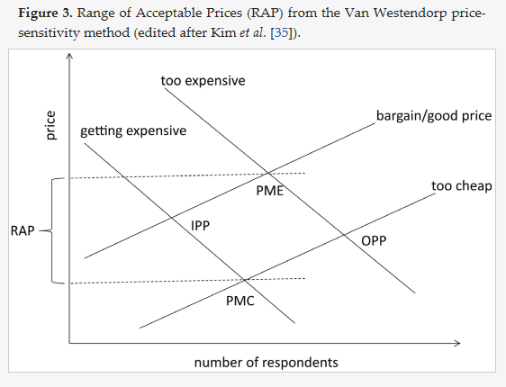
the indifference price point (IPP)
optimal price point (OPP)
point of marginal cheapness (PMC)
point of marginal expensiveness (PME)
For example see Cherunya, P. C., Janezic, C., and Leuchner, M. (2015). Sustainable supply of safe drinking water for underserved households in Kenya: Investigating the viability of decentralized solutions. Water, 7(10), 5437–5457.

Slide 32
Some practical suggestions
Do not immediately gravitate toward cost-plus pricing; understand the value of your product
Be careful with rebates and promotions as trend may be hard to reverse
Anticipate price reactions from competitors
Factor in all cost elements

Slide 33
Important marketing concepts and specific entrepreneurial context
Promotion

Slide 34
Entrepreneurial challenge
Creating awareness for reputationless company and product
Free publicity
Social media to generate discussion and create buzz
Preannouncement
Aim for being top-of-mind position
Ensure positive, correct brand associations
Generate and stimulate trial
Identify potential customers, for instance at fairs/trade shows
Sales people should
Educate the market
Provide feedback to developers

Slide 35
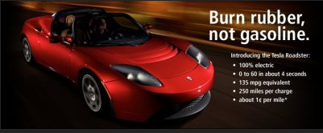
Example: Tesla preparing the market
Create interest; highlight problem you address
Create positive associations of electrical driving (speed, distance, environmental friendly)

Slide 36
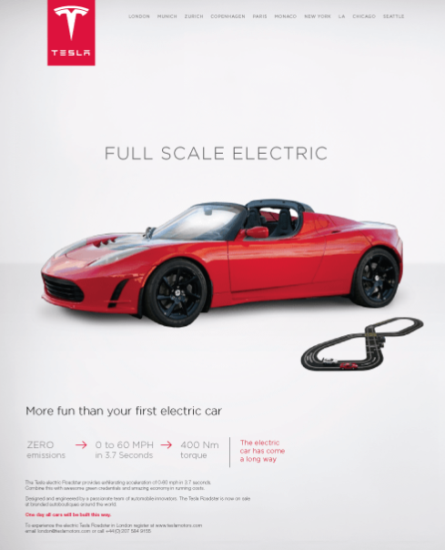

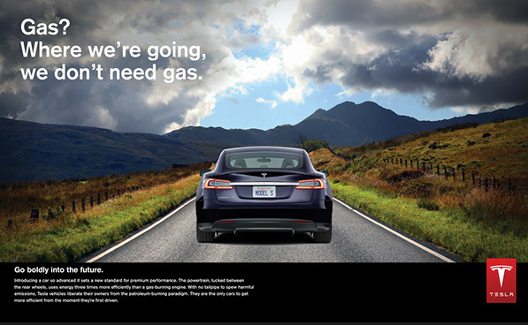
Create link to brand/company and explain how it works
Link to your company name/establish your name
(positive associations)
Explain how it works

Slide 37
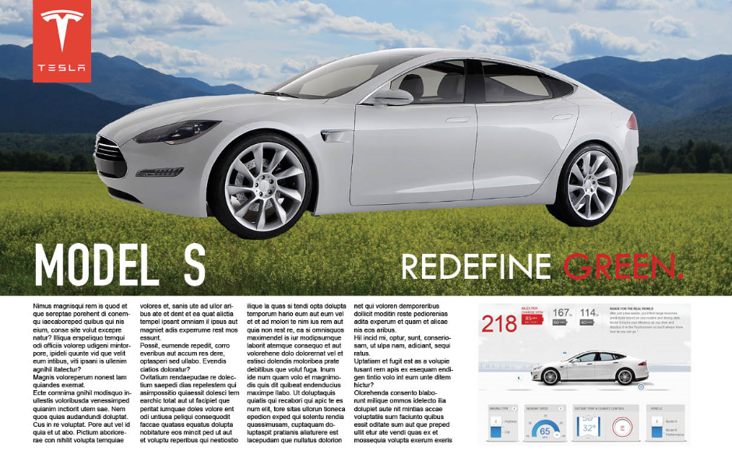
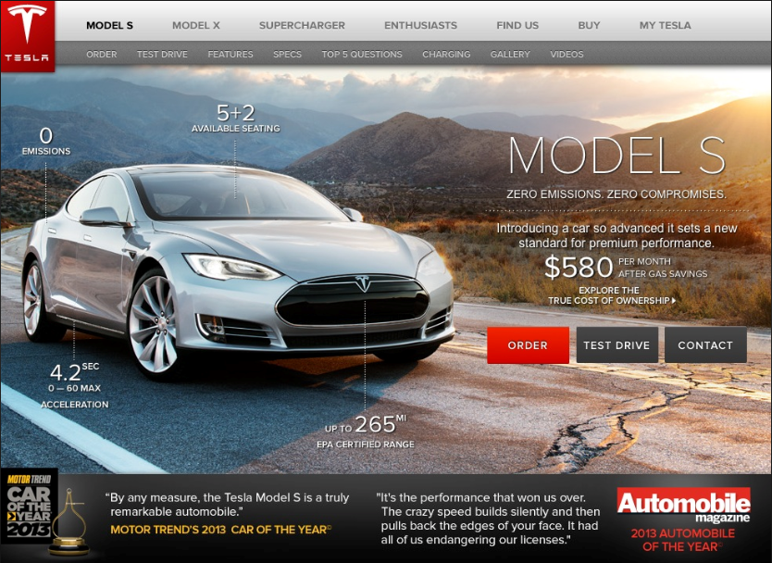


Moving customers further in the communication funnel
Detail by providing background and specific information
Focus on emotions/build preference
(closure effect)
Note the changes in communications. Type of pictures/message and amount of text provided

Slide 38
A basic communication model: AIDA
Market building communications
Attention
Interest
Desire
Action
Customer’s mental process for new product leading to behavioral consequences

Slide 39
Effectively advertising the solution that you provide
Customer’s begin state
Customer’s end state
Means (product as bundle of attributes)
Our product “Y” can help.
Its special attributes a, b, c offer benefits k, l, m.
–relaxed
–extra time
–happy
You [still] have problem “X”?
Problem solved
Demonstrate product/ service use

Slide 40
Promotion: Media for creating awareness
Advertising | Sales promotion | Direct marketing | Public relations
Print and broadcast ads Packaging Motion pictures Brochures/booklets Posters/leaflets Directories Billboards | Sampling Premiums and gifts Demonstration Fairs, trade shows Coupons/rebates Displays Contests, games, lotteries | Internet site Catalogs Mailings/email Telemarketing TV shopping | Press kits Speeches/seminars Annual reports Sponsoring Publication Community relations Events Company magazine
Social media
LinkedIn, blogs, Facebook, etc.

Slide 41
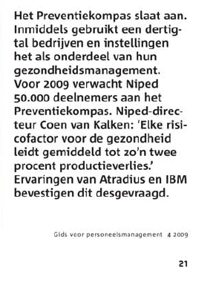

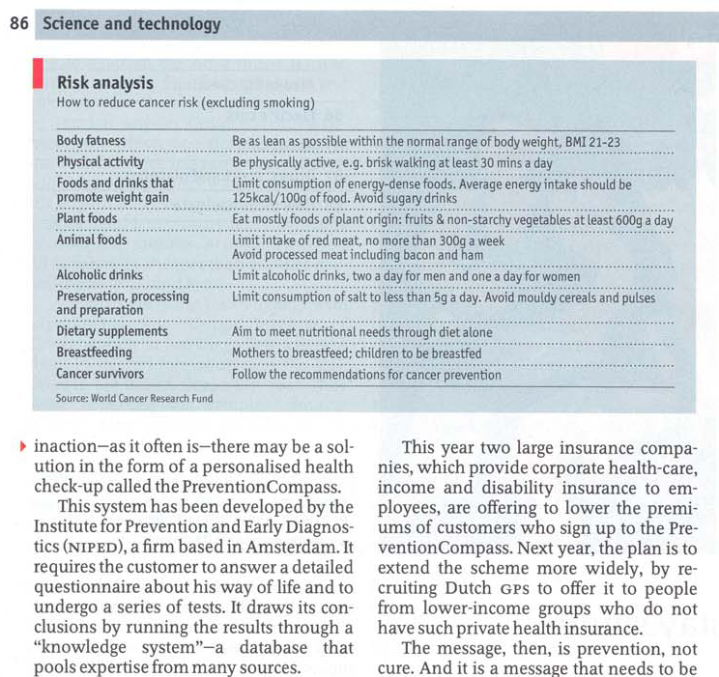
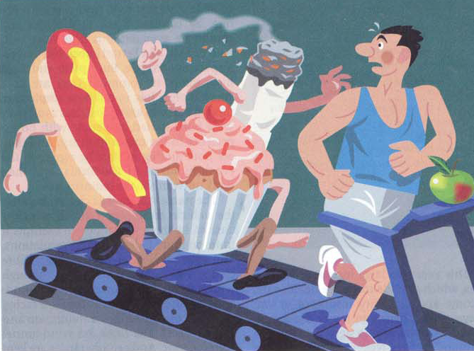
Free publicity example
How much control do you have over free publicity?

Slide 42
Direct marketing example
Dear Ed,
…We would like to let you know about our start-up. We are really excited and passionate about it. But, we will need your support!
Driven by our passion for quality healthy food, our love on exploring new tastes and our will to support small artisan producers that insist on quality, we founded Maryo Artisan Products. We aim to make Maryo a company that will form the single link between artisan producers of Greece and end-consumers in Europe. Our first product is a unique, very low acidity Extra Virgin Olive Oil produced in Agarathos monastery in Crete....This is our idea in a nutshell!
But we need some support. As we all know, the first people that will trust a new company and try their products are those that have some connection with the founders …
So, join our journey, support us by placing your order in our crowd funding page: http://igg.me/at/maryo-artisan-products… Another great way to help us will be to share our story within your circle!
Thank you so much!

Slide 43
Social media
Use social media to stimulate discussion (2-way), not to advertise (1-way communications)
Leverage your first-tier network to reach and involve second-tier contacts
Leveraging is very much part of effectual approach; identify who can help you and how, then follow up
Regarding the message
Keep it simple!
Simple messages spread across social networks more easily
Tell what’s new – the message must be relevant and newsworthy for people to want to tell others about it
Don’t make claims you can’t support – false claims kill buzz or, worse, lead to negative buzz
Ensure continuity in messages

Slide 44
Mere exposure effect
People have negative attitude towards most things that are new, i.e., things they don’t know
When exposed to multiple exposures they become more familiar
Recognition leads to liking ☺
Consistency in your message/approach is key

Slide 45
Some practical suggestions
Work on developing the awareness for your product; develop customer cognitions of the market
Build firm and brand awareness too
Be creative using free publicity and social media
Ensure developing the right, positive associations
Note: communications is a profession

Slide 46
Important marketing concepts and specific entrepreneurial context
Place

Slide 47
Entrepreneurial challenges
Gaining access to customers
Obtaining a good presence in the channel and market (Channel should also add value for end customer)
Understand channel member motives for purchasing and thus carrying your product
Circumventing channel blockage
→ internet, direct selling, VARs
Look for a committed partner but prevent becoming locked-in
Look for multichannel but prevent channel conflict
Consider alternative channel as part of a creative new business model

Slide 48
Place (distribution)
48
Distribution concerns the moving of products from provider to customer
Often involves a network to efficiently transport and reduce product quantities
Direct vs. indirect (compare short/long) channels
Channel shoud add value to product
Availability
Right time + quantity
Advice, installation

Slide 49
Note that distributors have their own needs
Why would distributor decide to carry your product?
Synergy with current customer or product portfolio
Expected profit
Market expansion (e.g., via upward or downward streching)
Prevent competition of making inroads
Fear of missing out on new trend
Enhance innovative image
Thus, you need separate pitch and marketing for distributors (next to pitch to final customers/users)

Slide 50
Channel decisions
Presence in the marketplace
# of distributors of your brand
Distribution coverage =
all distributors of product class
Turnover of product category of distributors of your brand
Market coverage =
Turnover of product category of all distributors
Market coverage
Selection indicator (SI) =
What is the quality of your representatives/distributors in the marketplace? Analysis can help understand and enhance
Distribution coverage

Slide 51
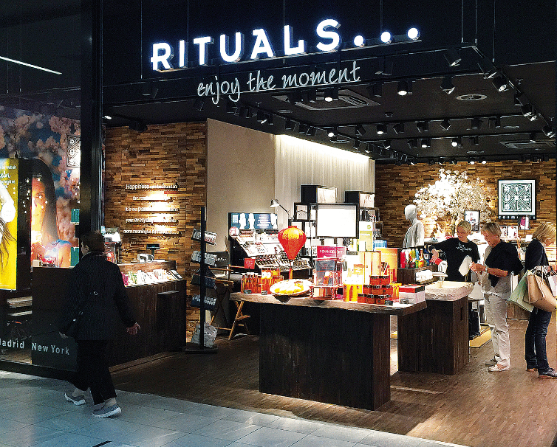

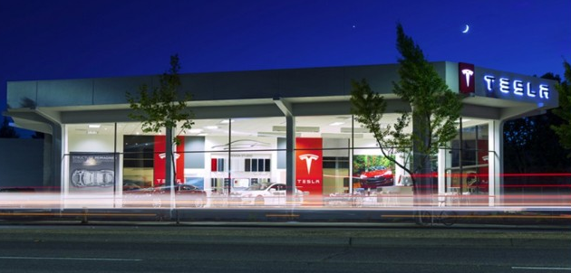
Building access/distribution
Internet
Cheap
Increased possibilities due to internet and new logistic services
Own stores
More exposure
More expensive
Will it attract enough people?
Other option is representative or dealer that includes an assortment

Slide 52
Channel decisions
Choose based on understanding of customer behavior
Where do your customers buy/shop?
How do they buy?
Which channels are still available? Which alternatives can you think of?
How can you make inroads and develop further?
Make the distributor your partner (win/win)

Slide 53
Some practical suggestions
Look for access to your customers; make use of available possibilities
Consider new, alternative channels to prevent the competition with established players
Be aware that quality and motivation of channels varies
Prevent getting locked in
In case of involving resellers/distributors, invest in excellent relationships

Slide 54
Lessons
A simple 1–2 page marketing/sales plan offers guidance and flexibility
To guide development of customer value (product/price), market presence (promotion/place), and customer development (sales) for target market
Be creative; use lean marketing and sales approach
Detailing core decisions
Product: Product features/positioning, product line decisions, branding issues. Begin with basic version of product.
Price: Rooted in economics theory. Different pricing methods can be used. Difficult instrument as visible and direct impact on cash flow/profit.
Promotion: Create market awareness for product and then for firm.
Place: Build market presence using options available. Align with customer behavior.

