Slide 1
Chapter 8
Learning from Textbooks

Slide 2
Agenda
Learning Objectives
5 Key Effective Reading Strategies
Strategies to Use Before Reading
Strategies to Use During Reading
Strategies to Use After Reading
Higher- and Lower-Level Questions
Creating Representations
Discussion
Chapter 9 Preview
© Routledge/Taylor & Francis 2016

Slide 3
Learning Objectives
Identify the 5 key strategies used by effective readers and how these strategies relate to self-regulation.
Differentiate between effective reading strategies used before, during, and after reading.
Understand the different levels of questions that can be used to study.
Practice creating higher- and lower-level questions.
Identify the 4 representations used to organize information from textbooks.
Practice creating representations.
© Routledge/Taylor & Francis 2016

Slide 4
5 Effective Reading Strategies Used by Skillful Readers
Determine importance.
Summarize information.
Draw inferences.
Generate questions.
Monitor comprehension.
© Routledge/Taylor & Francis 2016
Notes:
Exercise 8.1: Self-Observation: Assessing Reading Strategies

Slide 5
Strategies to Use BEFORE Reading
Preview the book for learning aids.
Survey the assignment before each reading session.
Read accompanying questions.
© Routledge/Taylor & Francis 2016
Notes:
Exercise 8.2: Understanding the Importance of Prior Knowledge

Slide 6
Strategies to Use DURING Reading
Think of the text as a conversation.
Turn headings into questions.
Highlight* and annotate.
Monitor comprehension.
© Routledge/Taylor & Francis 2016
Notes:
Exercise 8.2: Understanding the Importance of Prior Knowledge

Slide 7
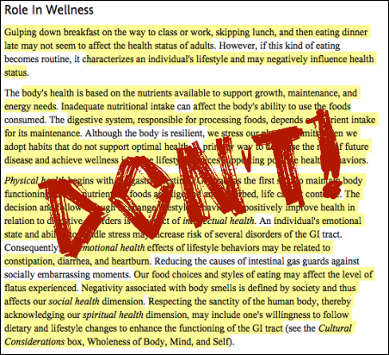
How does highlighting too much information affect working memory?
© Routledge/Taylor & Francis 2016
Notes:
Image found at: http://nbjenglish.wikispaces.com/NONFICTION+READING

Slide 8
Strategies to Use AFTER Reading
Answer the questions you generated.
Consider summarizing the material.
Consider outlining the material.
Consider representing the material.
© Routledge/Taylor & Francis 2016
Notes:
Exercise 8.3: Representations in Academic Content
Exercise 8.4: Self-Observation: Constructing Different Representations for the Material

Slide 9
Two Types of Question
Higher level
Lower level
9
Notes:
9

Slide 10
Bloom’s Taxonomy (Anderson and Krathwohl, 2001)
Create
Evaluate
Analyze
Apply
Understand
Remember
Higher level
Lower level
10
Notes:
10

Slide 11
IPS in Bloom’s Taxonomy
Create: How would you design a study routine that effectively maximizes working memory?
Evaluate: With the knowledge you now have of the IPS, assess whether or not students should be allowed to use their cell phones while studying. Why or why not?
Analyze: How are elaboration and organization similar and different?
Apply: What mnemonic could you use to remember the 6 components of self-regulation?
Understand: Why is it important to encode information we want to remember?
Remember: How long does information stay in the short-term sensory store?
Notes:
Have students create questions for all 6 levels for a topic previously covered (i.e., self-regulation, motivation, goal setting). .
11

Slide 12
The Advantages of Representations
Physical closeness of information
Clutter is reduced
Missing details are obvious
Big picture is developed
© Routledge/Taylor & Francis 2016

Slide 13
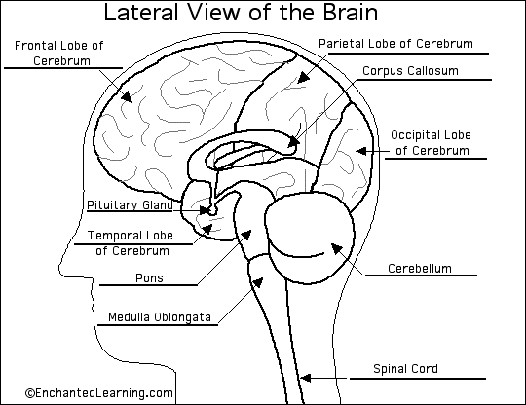
Hierarchy
Matrix
Sequence
Diagram
32

Slide 14
Discussion Questions
What strategies do you engage in before, during, and/or after reading a difficult text or article?
What new strategies are you willing to try?
What are the benefits of creating representations from your readings?
How could you implement the use of representations in your study routine?
© Routledge/Taylor & Francis 2016

Slide 15
Preview of Chapter 9: Learning in Class
After reading Chapter 9, you will be able to:
understand how to take effective class notes;
write effective mirror questions;
address common note-taking problems.
© Routledge/Taylor & Francis 2016
Notes:
Giving students a preview of the next unit/chapter is a great way to get them engaged in learning and support them in self-regulating.
NOTE: If you are using this book out of order (as recommended), you can find the preview of other chapters at the end of the PowerPoint for the previous chapter.

