Slide 1
Chapter 9
Learning in Class

Slide 2
Agenda
Learning Objectives
Note-Making Before, During, and After Class
Mirror and Summary Questions
Addressing Common Issues with Taking Notes in Class
Discussion
Chapter 10 Preview
© Routledge/Taylor & Francis 2016

Slide 3
Learning Objectives
Distinguish between strategies used to make notes before, during, and after class.
Differentiate between note-taking and note-making.
Compare and contrast mirror and summary questions.
Practice addressing common issues with taking notes in class.
© Routledge/Taylor & Francis 2016

Slide 4
How Can I Make Better Class Notes?
Before the lecture:
complete assigned readings;
review notes from the previous class;
bring all necessary materials;
sit toward the front of the room;
date and number each day’s notes.
Notes:
Exercise 9.1: Self-Observation: Analyzing Note-Taking Strategies

Slide 5
How Can I Make Better Class Notes?
During the lecture:
listen carefully and take notes focusing on main ideas and supporting details;
use abbreviations whenever possible;
use an indenting format.
Notes:
Exercise 9.1: Self-Observation: Analyzing Note-Taking Strategies

Slide 6
How Can I Make Better Class Notes?
After the lecture:
add any important information;
locate information you did not understand;
play a form of academic jeopardy;
underline key terms/phrases that trigger answers to questions;
read the terms/phrases to verify that they help you recall key information;
cover the notes and attempt to answer questions;
construct representations;
write a summary question.
Notes:
Exercise 9.2: Practicing the Note-Taking Strategy

Slide 7
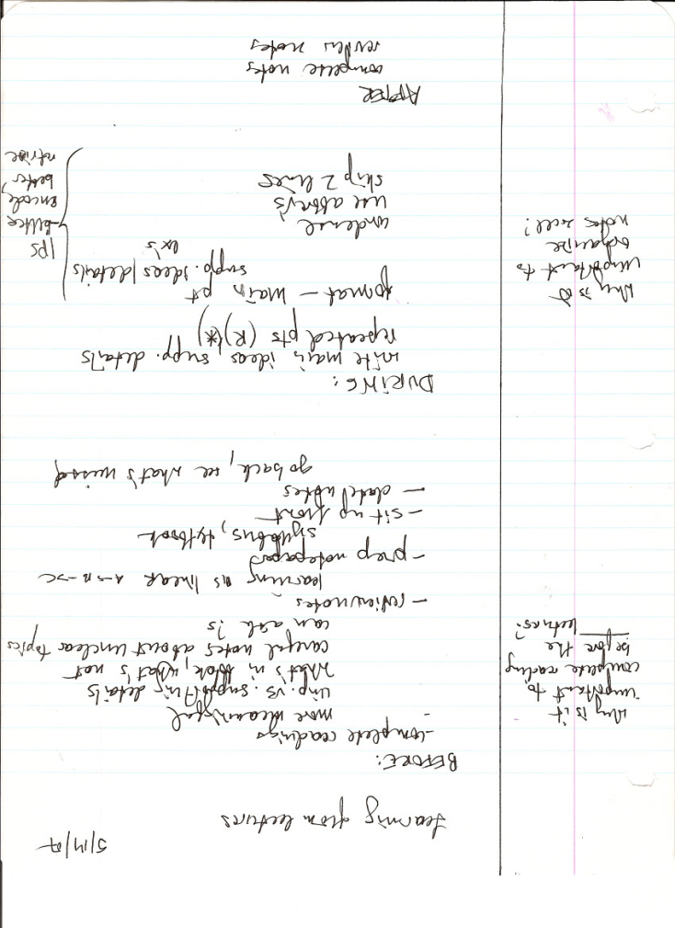
Note-Making
3-inch margin
Indenting format
Main points at the margin
  Indent
    Supporting ideas
      Examples
Skip 2 lines between topics
© Routledge/Taylor & Francis 2016

Slide 8
Mirror and Summary Questions
Mirror
  If the information in my notes was an answer to a question, what would the question be? (Unlimited quantity)
Summary
  What is one major question that reflects the purpose of today’s lecture? (usually no more than 1-2 per lecture)
© Routledge/Taylor & Francis 2016

Slide 9
Answer the following questions in your group.
Should I copy over my notes?
Should I take notes in my textbook?
Should I tape record the lecture?
Should I try to listen and not write when I don’t understand something?
I can’t write as fast as my professors talk. What should I do?
How can I better concentrate on the lecture?
How do I deal with an instructor who constantly wanders from one topic to another?
What can I do about all the technical terms in the lecture that I can’t spell?
Notes:
Exercise 9.3: Identifying the Different Levels of Questions in the Lectures

Slide 10
Discussion Questions
Are you note-making or just note-taking? How can you change your notes to make them more conducive to studying?
What strategies are you willing to implement before, during, after class?
© Routledge/Taylor & Francis 2016

Slide 11
Preview of Chapter 10:
Preparing for Exams
After reading Chapter 10, you will be able to:
  develop an effective study plan.
© Routledge/Taylor & Francis 2016
Notes:
Giving students a preview of the next unit/chapter is a great way to get them engaged in learning and support them in self-regulating.
NOTE: If you are using this book out of order (as recommended), you can find the preview of other chapters at the end of the PowerPoint for the previous chapter.

