Slide 1
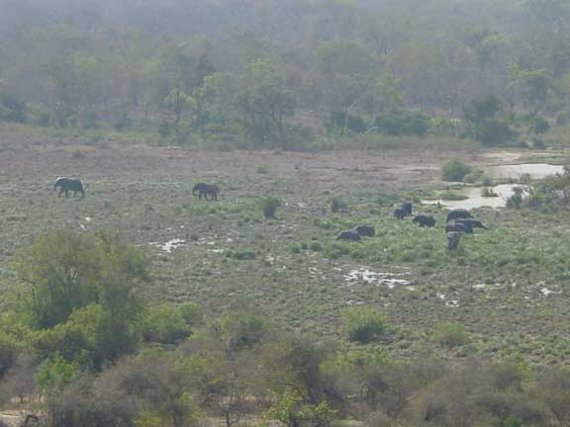
Sub-Saharan Africa
Ghana, Nigeria, D.R. Congo
Zimbabwe, Uganda
Senegal-Gambia
Republic of South Africa
Notes:
Chapter 10 (chapter 9 in previous editions) takes us to Sub-Saharan Africa, where our musical tour takes us to Ghana, Nigeria, the rainforests of the Congo region, Zimbabwe, Uganda, Senegal, and the Republic of South Africa

Slide 2
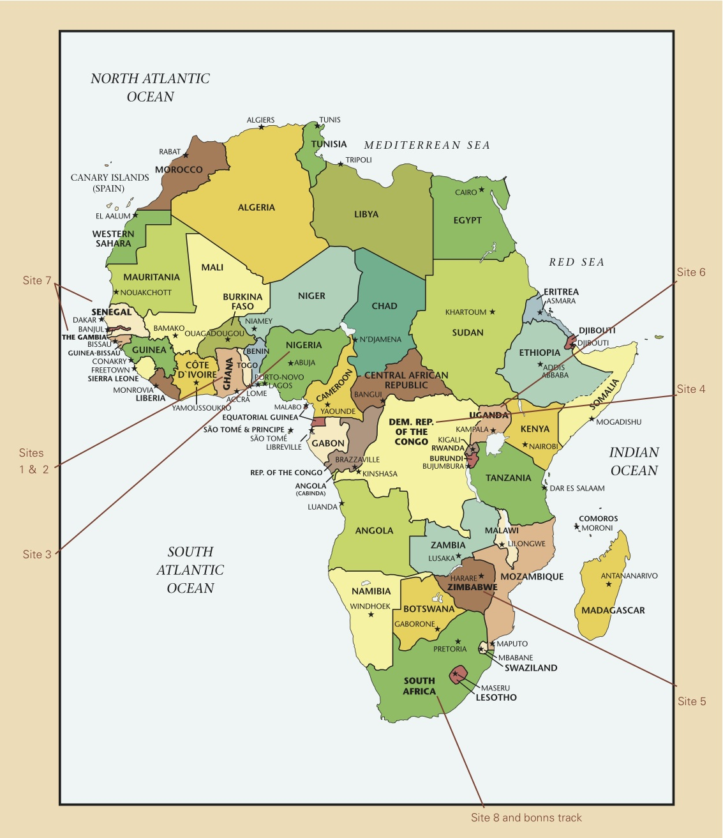
Africa Map
Notes:
Note that Africa is the second largest continent (Asia being first), although Mercator projection maps make it appear smaller, as discussed in chapter 1 lecture.

Slide 3
Background Preparation
Farming is a primary occupation
Cultural Zones:
  Pan-Arabic/Sahel/Sub-Saharan Africa
Nearly 3,000 separate ethnic groups
Modern politics
Notes:
While mining is a large industry and there are many major urban areas throughout Sub-Saharan Africa, most people still earn a living as farmers. Traditional housing (huts) is common and economic subsistence is community based.
The Pan-Arabic Zone stretches across northern Africa, including Morocco, Algeria, Tunisia, Libya, and Egypt.
The Sahel Zone is actually a political association of ex-French colonies, as well as Nigeria, but geographically speaking it refers to the region dominated by the Sahara desert. Though Senegal, and Nigeria are also considered part of Sub-Saharan Africa, the Sahel Zone includes Senegal, Mauritania, Mali, Burkina Faso, Niger, Nigeria, Chad, Sudan, Ethiopia, Eritrea, Djibouti, and Somalia.
Sub-Saharan Africa includes those countries south of the Sahara desert, essentially those not listed above. The countries in West Africa along the coast have many major urban centers and rich vegetation. Lush rainforests are still found in the Central region of Africa. The Kalahari desert is found in Botswana as well as Angola, South Africa, and Namibia.
Numerous ethnic groups are found in almost every country of Sub-Saharan Africa. Most countries are usually dominated by only a few, but many smaller groups co-exist within the same political boundaries. Language is typically linked to the ethnic group as well, e.g., the Zulu ethnic group speaks Zulu. Many Sub-Saharan Africans are multi-lingual, speaking several indigenous dialects as well as European languages, English and French being the most common.
The after-effects of European colonization are still quite evident in the modern politics of Sub-Saharan Africa. The political borders of many Sub-Saharan African nations were determined by European officials without the input of the indigenous population. Consequently, nations were created that divided peoples of the same ethnic group while combining peoples without a common ethnic background. While these groups peacefully co-exist in many nations, civil strife is a recurring problem in other nations. Dictators sometimes rise to power and natural disasters are continually exacerbated by ineffective political leadership. The African Union (Founded in 2002) is the most recent attempt to unify the political resources of the continent to raise its standing in the international community.

Slide 4
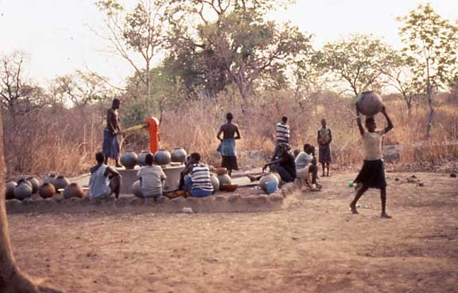
African Beliefs
Community is social focus
Community includes
living and ancestors
Animism prevalent
Music is a part of life
Notes:
While Western culture tends to emphasize individual identity over social identity, a common generalization is that Sub-Saharan Africans value the community over the success of any single person. This essence of the individual’s identity being wrapped up in his social relations is expressed in many common proverbs, such as “I am, because we are.” Many activities reflect this notion as well, such as eating from a communal bowl, community owned properties, such as musical instruments, raising children, as well as music and dance performance.
Animistic traditions are still quite prevalent, even in areas where modern religions, e.g., Islam or Christianity, dominate. Ancestral spirits are acknowledged in most areas and considered an everyday presence among the living.
Musical activity is found in most contexts. While some people “specialize” in music activity, especially for ritual occasions, a common assumption is that “anyone” can sing, dance, and play an instrument. You need not have “talent” to perform music competently, as is the general attitude in Western cultures. A oft-quoted proverb, “If you can talk, you can sing; if you can walk, you can dance,” reflects this belief.

Slide 5
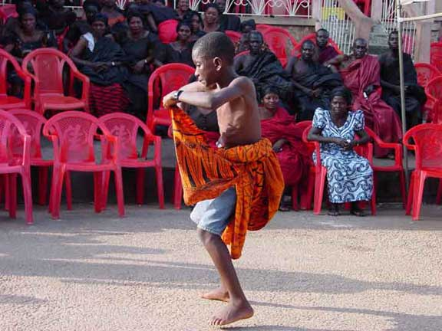
African Music Principles
Oral tradition
Focus on group over individual
Polyrhythm
Call and Response
Dance
A young Kete dancer from Ghana
Notes:
Music traditions are generally learned through observation. Some specialist traditions require initiation, but the use of notation to learn music performance is quite uncommon, limited primarily to European derived genres.
Though many individual performance traditions exist, music ensembles predominate in most areas, reflecting the general emphasis on social over individual identity.
Polyrhythmic organization is most typical of instrumental performance throughout Sub-Saharan Africa. This can be described as a “blending of rhythms” as opposed to pitches, e.g., harmony. The use of idiophones and membranophones is most common, especially in Western Africa, encouraging community participation. Polyrhythm is discussed in more depth in Site 1.
While vocal polyrhythm is found in some areas, e.g., pygmies, call and response is more typical. This type of organization encourages community participation.
Dance is ubiquitous in many areas. Some cultures do not have a separate term for instrumental music, singing, and dance, the three being considered part of the same activity. Dance activity also encourages community participation.

Slide 6
Ghana
Site 1: Polyrhythmic Ensemble
Site 2: “Talking” Drums
Notes:
Our visit to Ghana includes two types of traditional music, polyrhythmic ensemble performance and an introduction to the “talking” drum.
(Note: Palm Wine “Highlife” Song is now located on the textbook website.)

Slide 7
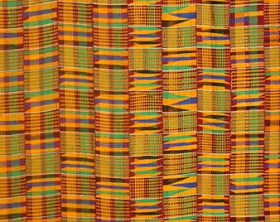
Arrival: Ghana
West Africa most familiar to outsiders
Kente cloth
Akan and other indigenous languages
Asante kente cloth
Notes:
West African culture is most familiar to Europe and America, consequently the world, due primarily to its geographic proximity to both continents. West African traditions are also widely known as most Africans brought as slaves to the Western hemisphere were from this region. Consequently, many West African cultural traditions, including music and dance performance, found in the Caribbean and Americas come from this area.
Kente cloth, the Asante colors in particular, is very popular among African Americans in the United States. This unique weaving pattern often represents specific ethnic groups found in Ghana. At one time, certain types of cloth were only worn by people of royal lineage. Today certain weaves are still sometimes worn to represent one’s social status.
Akan languages are the most common in Ghana. Asante, Fante, and Twi are the most common, though there are nearly twenty other Akan languages. Other major languages in Ghana include Ewe and Dagbani, as well as English.
The intricate weaving patterns of kente cloth can be used as an analogy to represent the intricate “interweaving” rhythms of Ghana’s polyrhythmic percussion ensemble traditions. Note squares that look similar, but have slight variations, creating an overall beautiful effect.

Slide 8
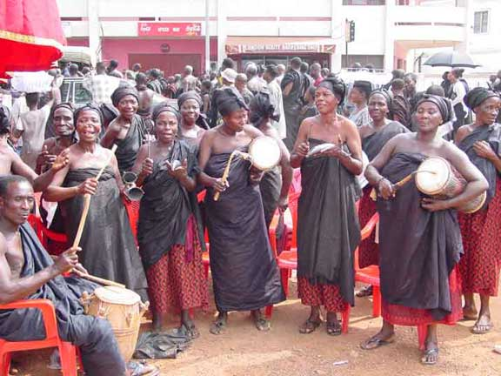
Site 1: Polyrhythmic Ensemble
First Impressions
  Rhythmic
  kaleidoscope
Aural Analysis
  Drums, rattles, bells
  Polyrhythm
  Call & response
An Adzewa group in Kumase, Ghana
Notes:
[PLAY AUDIO EXAMPLE, CD 2.19]
The essential beauty of Sub-Saharan African polyrhythmic drumming is the “kaleidoscope” of sound. Each time line pattern interweaves with others to create a rhythmically dense sound that at first seems very repetitive, but a deeper listening reveals subtle variations that keep the music constantly “turning” to create new interesting patterns.
There is a large variety of drums, rattles, and bells used in Ghanaian music to create polyrhythmic music. Many of the bells are “double” bells that can produce high and low sounds. The rattles are most often gourds with external beads, though many with internal seeds are found as well. Drums come in a great variety of sizes and most often fit the membrane face on a frame using pegs to tighten the drumhead. Drums may be played with a stick, hand or often both to create unique timbres. Polyrhythm can be considered a type of independent polyphony, as opposed to harmony or heterophony. The vocal organization of Call & Response is most common in Ghanaian singing.

Slide 9

Polyrhythm
Overall sound is rhythmically dense
Time-line patterns
  “Simple” individual patterns
  Complex combined whole
  Density referent – relationships, not meter
Notes:
Polyrhythmic music, no matter as an ensemble or a solo performance, tends to be quite “busy” or rhythmically dense. As a novice listener, finding “space” in this music is difficult, yet this is how Ghanaian musicians approach creating polyrhythmic music, “fitting” their unique pattern into the overall sound.
While the Ghanaian musician generally considers how their “simple” (often quite rhythmically challenging for a novice) pattern adds to the combined whole, the outsider can better appreciate the music if they initially try to deconstruct some of the individual patterns to hear how they fit with the overall. But just like Kente cloth, no one “weave” (timeline pattern) is all that interesting, but when the complex whole is observed, the patterns together make a colorful array of sound.
In deconstructing such music, it is useful to find the “density referent,” which is usually an instrument with a distinctive sound, such as a bell or handclaps, as in the audio example. The other rhythmic patterns often play in relation to this reference pattern. Keep in mind that this interplay of rhythmic patterns among instruments is the key approach Ghanaian musicians use to create music, rather than an implied meter as in Western music. A Westerner may “find” a meter in the music, such as 12/8, but that is the European mindset to organizing such music. The relationship between instruments is more important to a Ghanaian musician than following an abstract meter.
The table shows a simple cross-rhythm, discussed in the book. Often times it is easiest to orally demonstrate this pattern by patting hands on a table or lap while repeating the phrase “To-GE-ther (sounding both hands simultaneously on the second syllable), RIGHT, LEFT, RIGHT,” to establish the pattern.

Slide 10
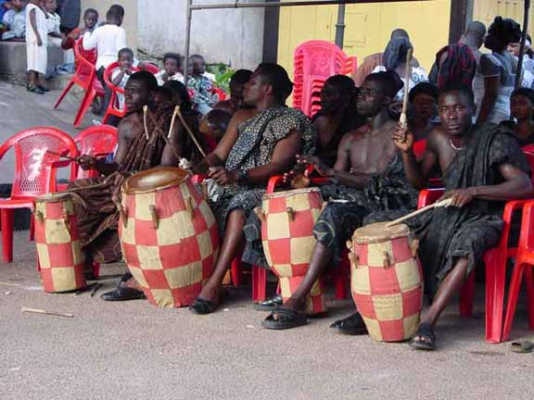
Cultural Considerations
Recreational bands
Formal and Informal contexts
Master drummers
A kete drum group at an Asante funeral
Notes:
“Recreational” bands are common throughout Ghana. Such bands may be organized as a “troupe” that always performs together and gets hired for performances, or they may be just community-based impromptu bands with no set personnel. Such ensembles play for both formal, e.g., royal funeral, and informal contexts, e.g., the marketplace.
Drum ensembles will inevitably have a “master” drummer who leads the ensemble. The master drummer is responsible for keeping everyone focused on playing their part, for inspiring musicians to play new rhythms, for calling out dancers, even praising onlookers, etc. Their rhythmic patterns are often less repetitive than those of the other musicians, which allows the master drummer more freedom to “play” with the music.

Slide 11
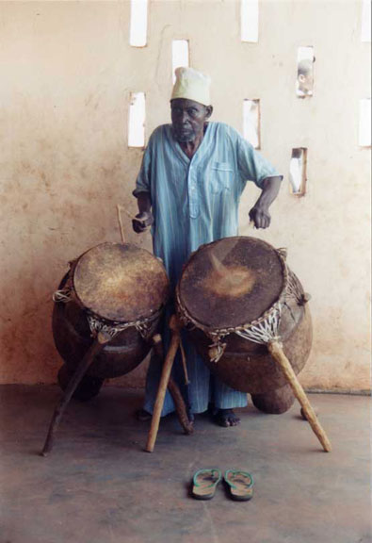
Site 2: “Talking” Drums
First Impressions
  Mimic drum
Aural Analysis
  Surrogate Speech:
    Tonal contour of language
    Speech rhythm
  Hi/Lo drums or one drum with multiple tones
A pair of atumpan “talking” drums
Notes:
[PLAY AUDIO EXAMPLE, CD 2.20]
First Impressions: Only a voice and drum are heard in this example. The drum seemingly mimics the sound of the vocalist.
Aural Analysis: Drum languages depend on two criteria: the tonal contours of the language and the rhythm of the speech. By mimicking these aspects, a drummer can “speak” with his drum and be understood by cultural insiders familiar with the combination of tones and rhythm.
Many Ghanaian languages are tonal, meaning that the inflection of the voice is as important to the meaning of a word as its phonetic sound. In order to imitate the tones, a drum must be able to produce at least two pitches so that a “high” and “low” sound can be used to imitate tonal inflection. A “rising” tone, for example, would be a combination of the two, from low to high. If you are familiar with the rhythm and tones of the cartoon theme song to “George of the Jungle,” this is a good way to demonstrate this concept. The listener must not only recognize the distinctive high-low pattern, but also have the cultural knowledge of the cartoon (or Brendan Fraser movie) to associate the musical pattern with the words of the song.

Slide 12
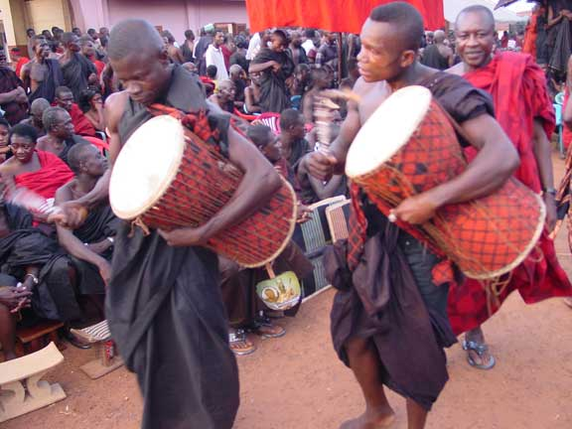
Cultural Considerations
Drums give words more power
Praise drumming
“Proverb” performance
Donno drums of the Asante Queen mother
Notes:
As is true in many parts of the world, music is believed to strengthen the efficacy of speech. In the “talking drum” traditions of Sub-Saharan Africa, this is especially true as these “surrogate speech” performances may entirely replace regular speech. Drums are often prized by royalty and can be the symbol of a chief’s power. In times of war, the enemy often sought to capture the chief’s royal drums in order to claim victory (much as Western armies tried to capture the opponent’s flag).
Such royal drums are often used for praising the chief, as well as ancestral spirits. The sound of the drum is believed to be heard in the spiritual plane and consequently performance on such drums is considered a sacred, or at the least a highly specialized activity. Using a drum to recite the powerful ancestral spirits of a family’s lineage is believed to bring those spirits into the presence of the community, thus “praise drumming” traditions are taken very seriously.
Often times, the patterns played on the drums involve the recitation of proverbs or poetry. The poetry itself often contains secondary meanings understood by cultural insiders. Thus, even non-natives who have learned to speak the language being performed on the drum may still be challenged to understand the deeper meaning of the poetry.

Slide 13
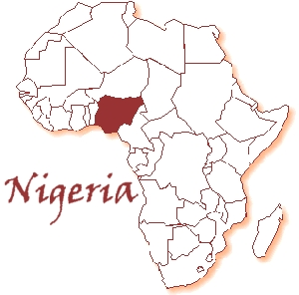
Arrival: Nigeria
Lagos – 3rd largest city in Africa
Diverse ethnic populations
  Hausa/Fulani, Igbo, Yoruba
Afro-Pop
Notes:
Similar to Ghana, Nigeria has a great amount of ethnic diversity, but is one of the most populous countries in Africa. By comparison, Ghana has roughly 24 million people, while Nigeria has over 155 million. More than half of these people live in the city of Lagos, which is the third largest city on the continent behind Cairo, Egypt; and Kinshasa, DRC (Democratic Republic of the Congo).
The majority populations of Nigeria include the Hausa/Fulani, Igbo, and Yoruba. The Yoruba are probably best known among these, as their cultural traditions are often cited as the root of many activities found in the Americas and Caribbean due to the colonial slave trade.
Many of Africa’s popular music genres, dubbed generically as “Afro-Pop” have centered in Nigeria. Afrobeat, created by Afropop icon, Fela Kuti, and Juju music, which we study in this chapter, are the two most significant genres, but other styles, such as Ghanaian Highlife or Congolese soukous, were also important popular genres through much of the twentieth century.

Slide 14
Site 3: Jùjú Popular Music
First Impressions
  Modern Instruments, e.g., electric guitar
  Polyrhythmic undercurrent
Aural Analysis
  Gan gan (hourglass pressure drum)
  Pedal steel guitar, electric organ
  Discernable beat
  English and Yoruba languages
Notes:
[PLAY AUDIO EXAMPLE, CD 2.21]
First Impressions: The use of electric guitars and keyboard quickly suggest that Juju is a popular music style. The polyrhythmic undercurrent is also an outstanding feature, along with the distinctive fluctuating timbre of the lead drum. Those familiar with popular world music might even recognize the voice of lead vocalist, King Sunny Adé, one of the most successful world music artists from Africa.
Aural Analysis: While the melodic instruments and voices are most prominent, there is a continuous undercurrent of polyrhythmic percussion throughout the performance. (See chapter 10:site 1 for further explanation of polyrhythm.) Most prominent of the percussion is the gan gan, an hourglass pressure drum found in a variety of sizes by different names (e.g., dundun) throughout much of West Africa. Such drums are especially common in Nigeria where they are found in a variety of traditional contexts. These drums “talk” by changing pitch during performance (see chapter 10:site 2 for further explanation of talking drums), often conveying the same message as the vocal lyrics, but also improvising solos. Other instruments that help to identify the genre are the use of an electric organ and pedal steel guitar, though the latter is not heard in this example.
Because this is a popular style, Juju music often has an easily discernable “duple meter” beat, which encourages its accessibility to a wider audience that may not be able to dance easily to the complex polyrhythms.
English is widely spoken in Nigeria, so many songs include English lyrics. Juju is originally associated with the Yoruba people, so this is the primary indigenous language sung by its most prominent artists.

Slide 15
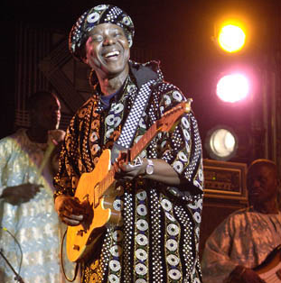
Cultural Considerations
Early Jùjú
King Sunny Adé (KSA)
Island Records
Notes:
Juju music began as a relatively small ensemble consisting of a few percussion instruments and a guitar. The main focus was on the lyrics, but as popular dance contexts thrived through the 1940s and 1950s, due in part to the success of Ghanaian Highlife music, many Nigerian musicians, such as I.K. Dairo, began to expand the ensemble to perform at such venues. The key distinguishing feature between Highlife and Juju at that time was a greater emphasis on polyrhythmic drumming and the incorporation of the “talking drum” as a solo instrument.
During the 1960s, King Sunny Adé established a Highlife band, but transitioned to Juju as Nigerian nationalism encouraged this music as an expression of cultural identity. KSA added features, such as the pedal steel guitar, and became well-known for his electric guitar solos and vibrant stage shows. His royal lineage also brought him great attention, as musicians are generally considered to have low social status. His prolific output of recordings peaked with his signing to Island Records, an internationally recognized music label best known for introducing Bob Marley to global audiences. While his tenure with Island was short-lived, KSA has continued to produce successful recordings among world music enthusiasts for over forty years.

Slide 16
Central Africa
Site 4: Pygmy Music
Notes:
Pygmy populations living traditional lifestyles are found throughout the rainforest region of Central Africa.

Slide 17
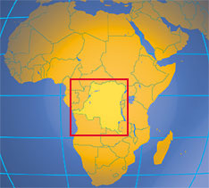
Arrival: Democratic Republic of the Congo
Rainforests of Central Africa
Unknown Pygmy population
Nomadic egalitarian societies
Notes:
The rainforests of Central Africa spread throughout the DRC (formerly known as Zaire), as well as the Republic of the Congo. Kinshasa is the largest city in the region and numerous ethnic groups are found. Best known of these are the various pygmy ethnic groups.
Many urban dwellers consider the pygmies a “mystical” population, though there are many urbanites who have regular contact with pygmy groups for economic trade. Estimates place the pygmy population between 40,000 and 600,000, though the former is more likely. Pygmy populations are known for their short stature, averaging less than five feet in height. There are several different pygmy ethnic groups, the Mbuti (heard in the audio example), studied by Colin Turnbull in the 1960s, being the best known.
Anthropologists have been fascinated with many aspects of pygmy culture. Pygmy communities are often cited as the premiere example of a “nomadic egalitarian society.” Nomadic societies frequently move their dwellings according to the availability of resources. An egalitarian society is one in which each member plays an “equal” role. As such, there is no chief or social hierarchy, though individuals may take on a leadership role dependent on context, e.g., a young man may lead a hunting party or an elder a spiritual ritual.

Slide 18
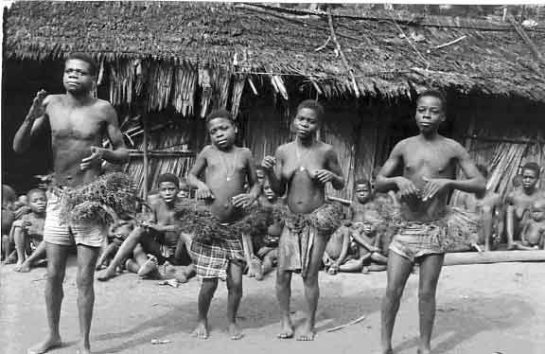
Site 4: Pygmy Music
First Impressions
  Interweaving
  “Hoots and hollers”
Aural Analysis
  Vocal polyrhythm
  Minimal percussion
  Call & response
Pygmies of the Bangombe ethnic group
Notes:
[PLAY AUDIO EXAMPLE, CD 2.22]
First Impressions: Each vocal line consists of utterances that interweave with other group members. These often sound like “hooting,” rather than singing as text is not generally associated with the verbalizations.
Aural Analysis: Although pygmy populations are often far from contact with outside music traditions, they still create music using polyrhythm. In this case, however, voices dominate, rather than instruments. While some performers organize the vocals in the typical call and response pattern, others repeat short phrases that interlock with other vocal performers to create a thick rhythmically dense music. Small drums or rattles are sometimes used in addition to the voices, but full instrumental ensembles are not often found.

Slide 19
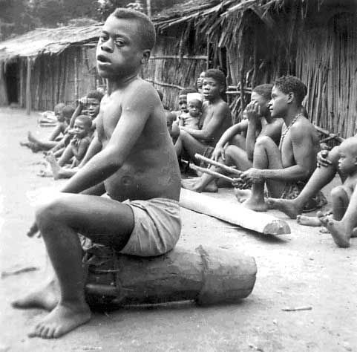
Cultural Considerations
Portable instruments
Communal performance
Animistic beliefs
A pygmy drummer of the Bagombe ethnic group
Notes:
Heavy instruments would be a burden to carry from place to place, so the voice is the primary instrument among nomadic pygmy groups, along with small portable instruments, such as a drum, bell, or rattle.
Performances are usually a community activity with each person contributing to the whole. Ethnomusicologists often consider this “equal participation” in musical performance as a reflection of pygmy egalitarian social structure.
Most performances are done in connection with spiritual activities. Animistic beliefs revolving around the rainforest, as well as lunar cycle, dominate Pygmy belief systems.

Slide 20
Uganda
Site 6: Akadinda Xylophone
Notes:
The akadinda is but one of many xylophone traditions found throughout Sub-Saharan Africa.

Slide 21
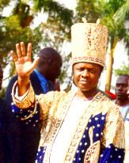
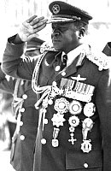
Arrival: Uganda
Kabaka Muwenda Mutebi II of Buganda
(b.1955)
Lake Victoria
Kingdom of Buganda
Idi Amin (r.1971-1979)
Dictator Idi Amin (1923 - 2003)
Notes:
Lake Victoria is the second largest freshwater lake in the world (Lake Superior in the USA is the first). The region’s known history dates to the 4th century AD where it was a major crossroads between the Nilotic and Bantu peoples who traded via the Nile River that flows from Lake Victoria.
The most powerful kingdom to arise was that of Buganda, which had its origins in the late 14th century, but came to dominate the region primarily during the 19th century. Buganda is believed to have two kings, one human, the other spiritual. The spiritual king is represented by a pair of royal drums, while the human king is responsible for secular affairs. This kingdom still exists within the larger nation of Uganda, which derives its name from Buganda.
Achieving independence from British colonial rule in 1962, the country saw a series of political coups, the most notorious of these led by the dictator Idi Amin. During the 1970s, his leadership caused the deaths of roughly 300,000 people and the forcible exile of nearly the entire East Indian population of the country. Uganda consequently fell into economic despair from which it is still trying to recover.

Slide 22
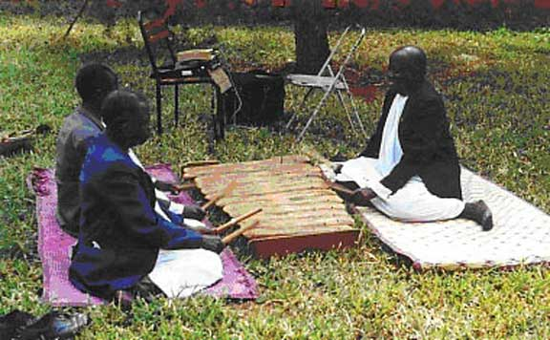
Site 6: Akadinda
First Impressions
  Super-dense
  “rush hour” rhythm
Aural Analysis
  Akadinda
  Triple interlocking patterns
Akadinda performers
Notes:
[PLAY AUDIO EXAMPLE, CD 2.24]
The akadinda is a log xylophone with between seventeen and twenty-two bars. The performers sit opposite each other, striking the ends of the bars to create interweaving patterns. While similar traditions exist elsewhere in Uganda, the akadinda is unique for its triple interlocking patterns, while duple is more typical of other similar xylophone traditions, e.g., amadinda. The rhythmic density of akadinda performance can approach nearly six hundred beats per minute.
Akadinda “ensembles” are sometimes found utilizing individual instruments of different ranges.

Slide 23
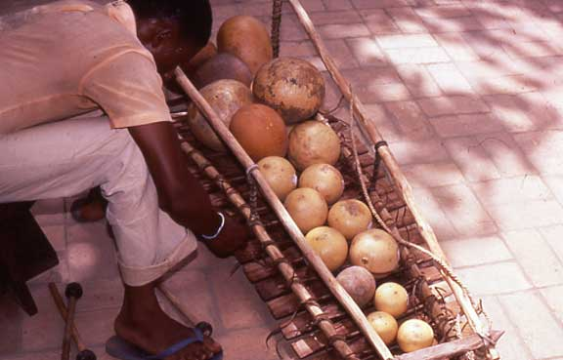
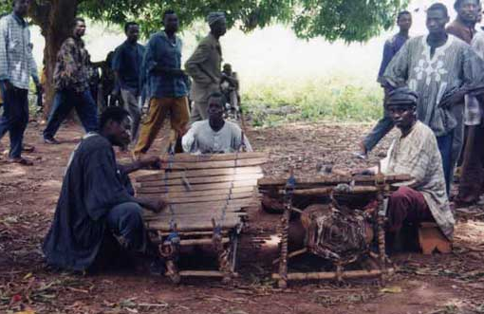
Cultural Considerations
Royal instrument
Other xylophones
Gourd resonators of a balafon from Senegal
Gyil xylophones from Ghana
Notes:
The akadinda is typically associated with music of the court. This music, like many court traditions, is often used to praise the king (kabaka) and his royal lineage. In this way, the akadinda can act as a surrogate speech instrument, similar to the “talking drums.”
The most closely associated tradition is performance on the amadinda, which uses double interlocking patterns (the same amount of “time” would have only two pulses instead of three) and has only twelve pitches. The embaire, also uses double interlocking patterns but only utilizes seven pitches; it is played in the same manner with performers on either side of the pitch bars.
Xylophones are common instruments throughout Sub-Saharan Africa. Most use wooden pitch bars (keys) suspended over a resonator. The most common type has a gourd resonator for each individual bar, as with the balafon pictured above. Often times a small membrane is placed over a hole in the resonator to produce a “buzzing” timbre typical of a variety of instruments found in Sub-Saharan Africa. Other xylophones use the earth itself as a resonator. Polyrhythm is inevitably the manner in which xylophone traditions are musically organized.

Slide 24
Senegal-Gambia
Site 7: Jali with Kora
Notes:
Senegal-Gambia is often referred to as a single entity because the two areas are culturally so similar.

Slide 25
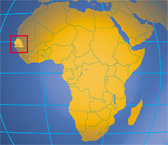
Arrival: Senegal-Gambia
Former French & British colonies
Mandinka ethnic group
Jali as oral historian
Notes:
As was typical of European colonization, the political borders of Senegal and Gambia were determined by geographic features rather than cultural considerations. In the case of Gambia (the smallest country on the African continent), it was colonized by the British who wanted control of the Gambia river that runs through the center of the region. The surrounding country, Senegal, was colonized by the French.
The predominant ethnic group of the region is the Mandinka, descendants of the Mali Empire that dominated the region from the 14th to 17th centuries. Mandinka peoples are found in almost every country of West Africa.
Though found in many places throughout Sub-Saharan Africa, the jalolu (plural of jali) are perhaps the best known of oral historians. While Western culture relies on empirical evidence to determine history, the Mandinka rely on a jali to recount the history of their people. These musician-historians are given a very low social status so that they can “praise” people of nearly any social strata, but they are much respected by royalty and common folk alike. A common proverb suggests their significance, “When a jali dies, a library has burned to the ground.”

Slide 26
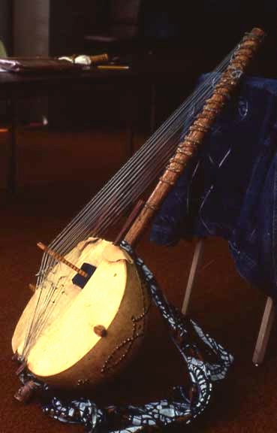
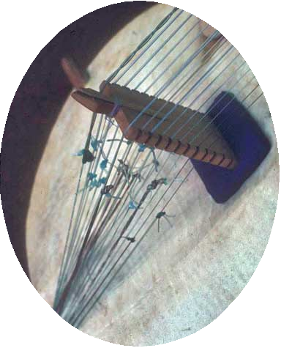
Site 7: Jali with Kora
First Impressions
  Churning
  underlying harp
  Declamatory vocal
Aural Analysis
  Kora
    Kumbengo
    Birimintingo
  Syllabic singing
Kora and
close-up of bridge
Notes:
[PLAY AUDIO EXAMPLE, CD 3.1]
First Impressions: The two features of this music are the instrument, a harp-like sound that churns continuously throughout the performance, and the voice, where each phrase sounds more like a declamation than a melody.
Aural Analysis: The kora is classified as a lute-harp. A lute due to its basic construction (body & neck), but harp as the plane of strings runs perpendicular, rather than parallel, to the face of the resonator. Roderic Knight, a specialist in kora performance, suggests the term “bridge-harp” to describe the instrument. The slide shows a close-up of the bridge, revealing two sets of strings. The strings are tied to the neck by leather straps that are twisted for tuning. Performers generally sit on the ground.
The music has two basic features, the kumbengo, which is an underlying polyrhythmic pattern, and the birimintingo, which are the solo “flourishes” a performer plays when not singing. The instrument is played with only the thumbs and forefingers. The pitches of the strings alternate in scale degree from one side to the next so that the birimintingo can be played more quickly. The kumbengo is generally maintained throughout the performance, underlying the singing as well as birimintingo solo passages.
The vocalist sings during the purely kumbengo sections. The singing style often sounds like shouting with a descending melodic contour. The jali shows his skill as a musician during the birimintingo and his skill as an oral historian/praise singer during the kumbengo sections.

Slide 27
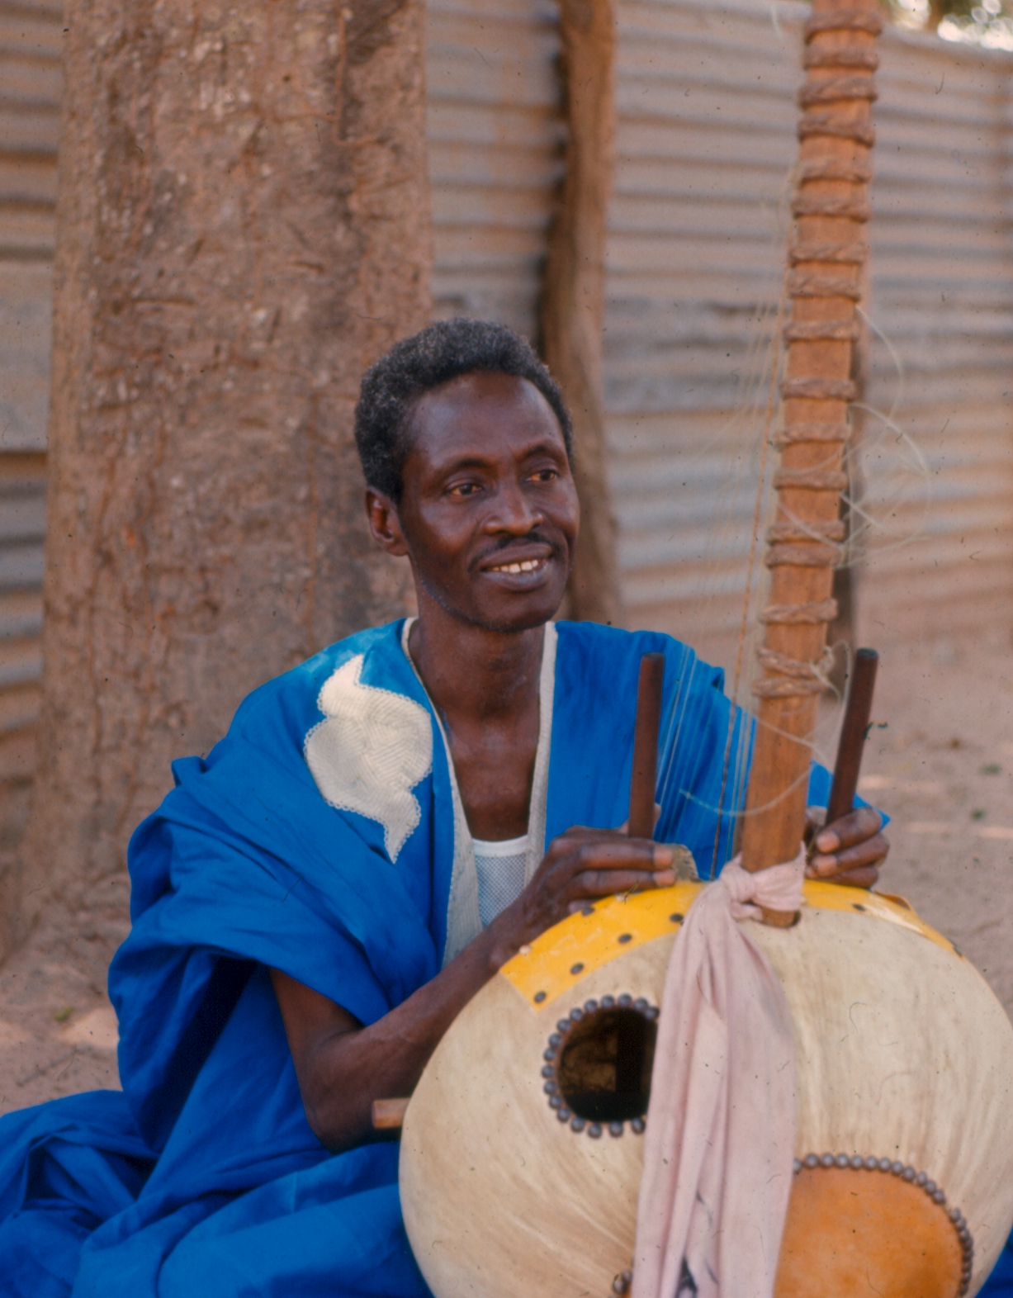
Cultural Considerations
Praise-singing
“Spraying”
Griot - modern jali
Jali playing kora
Notes:
While the jali’s main function is as an oral historian, the manner in which he recounts the history of the Mandinka people or specific family lineages is through “praise-singing.” A person’s surname generally indicates their family’s role within society. For example, the name “Smith” is common in the United States. This name is a shortened form of “Blacksmith,” which is an occupation mostly outdated. Yet, a person named Smith undoubtedly had an ancestor whose role in society was as a blacksmith. Thus, the name indicates to the jali a family history that he can sing about, if known.
When a jali praises a person’s name and family lineage, the recipient of such praises is expected to “spray” or “shower” him with money as a sign of respect to the jali as well as the praised ancestors. This is in part how a jali earns a living. The jali necessarily has a low social status so that they can praise the names of almost anyone. Nevertheless, the jali’s ability to recount hundreds, if not thousands of years of history is greatly admired and to some extent viewed as a near “supernatural” power. When the jali sings praises to an ancestor, that ancestors spirit is present within the community. If a person fails to “spray” the jali appropriately, he risks offending not only the jali, but the ancestor spirits, potentially angering them which risks causing ill to the community.
An interesting occurrence is to find that jalolu are sometimes buried in trees, the belief being that any negative intentions a jali may have had at his death will be overridden by the positive energy of the tree, typically considered a highly spiritual entity.
The French term “griot” is often found in reference to jalolu. Griot means “wandering minstrel,” and the modern jali frequently finds himself living in this itinerant manner. Many jalolu were once employed by the royal families of the Mandinka. When the British and French colonized the region, many of these kingdoms lost their wealth and could no longer patron the jalolu. Thus, the musicians were forced to wander from town to town praising names of less wealthy patrons in order to survive.

Slide 28
Republic of South Africa
Site 8: Mbube Vocal Choir
Notes:
The Republic of South Africa is often referred to simply as “South Africa.”

Slide 29
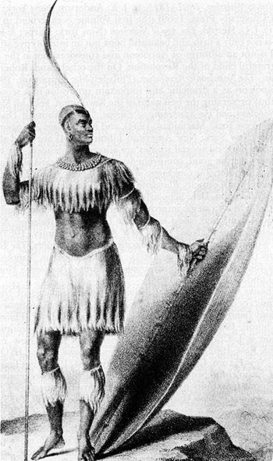
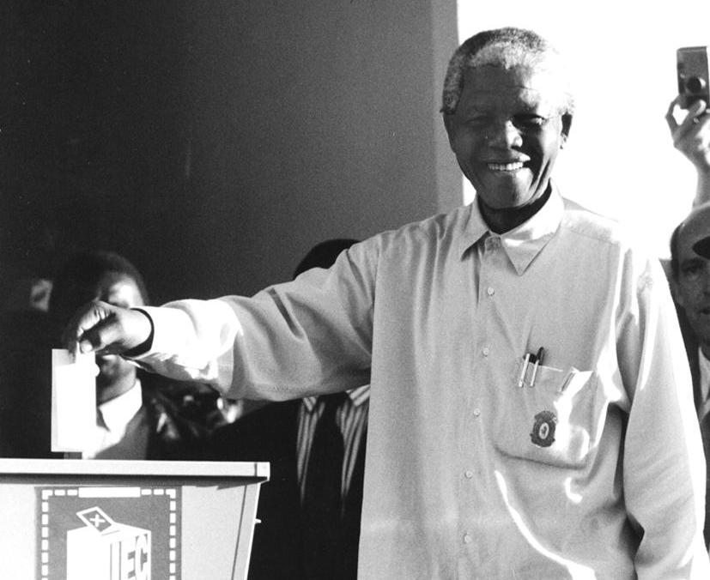
Arrival: South Africa
Afrikaners
Shaka Zulu (1787-1828)
Apartheid
Nelson Mandela
and the ANC
Shaka Zulu (1787 - 1828)
Nelson Mandela (b.1918)
votes in South Africa’s
first democratic elections
Notes:
Twice the size of Texas, South Africa is populated by many different ethnic groups with eleven official languages and several more unofficial ones. European colonization began with the Dutch and later the British. Those of Dutch descent are referred to as Afrikaners and speak Afrikaans, a language derived from Dutch and particular to South Africa, as well as parts of Namibia. The Afrikaners were Protestant Calvinist Christians with very strict attitudes towards the indigenous populations of the region. When the British began arriving in the early 1800s, many Afrikaners migrated north in hopes of maintaining their strict social and religious practices.
This was also the period when the great warrior king, Shaka Zulu lived. He established one of Sub-Saharan Africa’s most powerful kingdoms, reigning over regions in modern South Africa and neighboring countries. Shaka’s warriors are believed to have defeated the encroaching Afrikaners on several occasions, which has helped him attain a mythological status among many Zulu today.
In modern history, the policy of racial segregation, known as Apartheid, is most notable. For decades, this institutionalized segregation system kept non-European descended populations in economic and social poverty. While these populations were not “slaves,” they were often forced to work and live in appalling conditions.
Founded in 1912, the African National Congress (ANC) began seeking a nonviolent end to the racial discrimination. Most famous among their leaders was Nelson Mandela (b.1918) who was imprisoned in 1962 and finally released in 1990 after increasing internal political turmoil in South Africa and rising international pressure. Apartheid laws were soon abolished and Nelson Mandela became the first black President of South Africa in 1994 after an overwhelming victory in the country’s first democratic elections.

Slide 30
Site 8: Mbube Vocal Choir
First Impressions
  Deep and lush choir
Aural Analysis
  “Controller” and “Chord”
  Emphasis on lower range
  Frequent tempo changes
Notes:
[PLAY AUDIO EXAMPLE, CD 3.2]
First Impressions: Purely vocals, mbube choirs have a deep sound with lush harmonies.
Aural Analysis: Vocal polyphony pre-dates the arrival of European colonialists in South Africa. Call and Response is still prevalent, but the response consists of “harmony” with an emphasis on the lower range of voices. The call is performed by the “Controller” and the “Chord” is the term used for the group response. Of particular note are the “swooping” effects of the voices. Instruments are generally absent, though dance is often an important feature of performance. Rhythmic changes often occur from section to section within a piece. This adds vibrancy to the music, but is not “polyrhythm,” merely a shift in meter or tempo.

Slide 31
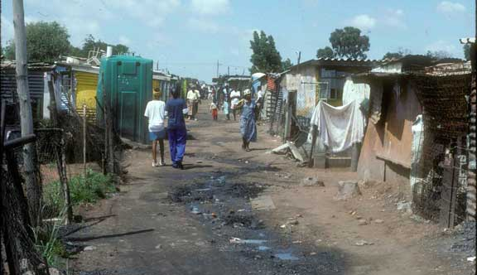
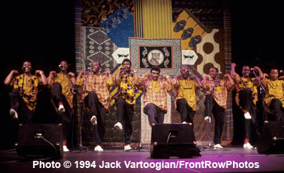
Cultural Considerations
Townships
Mbube competitions
Iscathamiya
Soweto Township near Johannesberg, South Africa
Ladysmith Black Mambazo
Notes:
Mbube choirs are strongly associated with South Africa’s townships. During the period of Apartheid, a township was a segregated area for non-whites who worked in various industries owned by the European-descended populations, such as mining. These residential areas were seriously impoverished and still bear the marks of military presence, e.g., barbed wire surrounding the camp.
Among the Zulu, singing competitions became popular beginning in the 1930s. These high energy performances involved high stepping dance movements derived from Zulu traditional dances and often incorporated lyrical content directed at the plight of the workers.
Most famous among these mbube choirs was a group from Ladysmith, known as Black Mambazo. The latter term means “axe” and was a reference to their ability to “chop down” the competition. They developed a softer style of mbube singing described as iscathamiya, meaning “walk like a cat (stealthily),” a reference to their modified high stepping dance that did not utilize the typical loud stomp on the ground performed by other mbube choirs. Ladysmith Black Mambazo gained international fame when they were featured on American artist Paul Simon’s album, Graceland, which won numerous grammy awards in 1986. They continue to be one of the most successful international world music groups. A bonus audio track from their grammy award winning album, Raise Your Spirits Higher, is included on the CDs of the textbook (third edition - CD 3.3).

