Slide 1
NST - Our educational travel company
We have booked this tour through the educational travel company, NST.
We travelled with this company on our last trip to Holland and we were very happy with the service they provided and therefore have chosen to travel with them again on our trip to Germany.

Slide 2
Tour objectives
On the trip, pupils will:
Get the chance to visit a European country and experience the culture of that country
take part in cultural and educational visits, and other , hopefully, interesting and fun activities.
visit this area of the Rhineland and attractions including visits to nearby towns and the city of Cologne.
experience travelling from here to France by coach and ferry and travel through France, (Belgium) and Germany,
spending time with other pupils and teachers in a different, hopefully, relaxing and enjoyable setting.

Slide 3
Germany trip - Rheinland
Departure Friday 26 June, 11am
(all timings to be confirmed)
Travel by executive coach (Parks of Hamilton)
Cross channel ferry – Dover to Calais (departure Sat 27 June 1.50am)
Estimated arrival in Bad Salzig Sat 27 June 11am
Five days in Germany for activities and visits
Return ferry Calais – Dover Thu 2 July 1.30 am
Return to school Thursday 2 July, 3pm

Slide 4
Accommodation
Hotel Apostelhof in Bad Salzig by the river Rhein
Part of the Boppard/Bad Salzig tourist region
Nearest cities – Bonn and Cologne (Köln)

Slide 5
Bingerstraße 17
56154 Bad Salzig, Germany
Overview
A simple, family-run hotel set in a small town on the banks of the Rhine. The owners are very experienced in handling youth groups and a warm welcome is assured.
Local Rating
Simple 2 star equivalent
Capacity
110 guests over 3 floors (including the ground floor). The hotel comprises 2 buildings There are 18 rooms in the hotel and 14 rooms in the annexe behind the main building. Groups are usually accommodated together in one building. There is also 1 single room and a 4 bedded room that can be used for drivers, situated behind the annexe.
Inspected as part of NST’s Safety Management

Slide 6
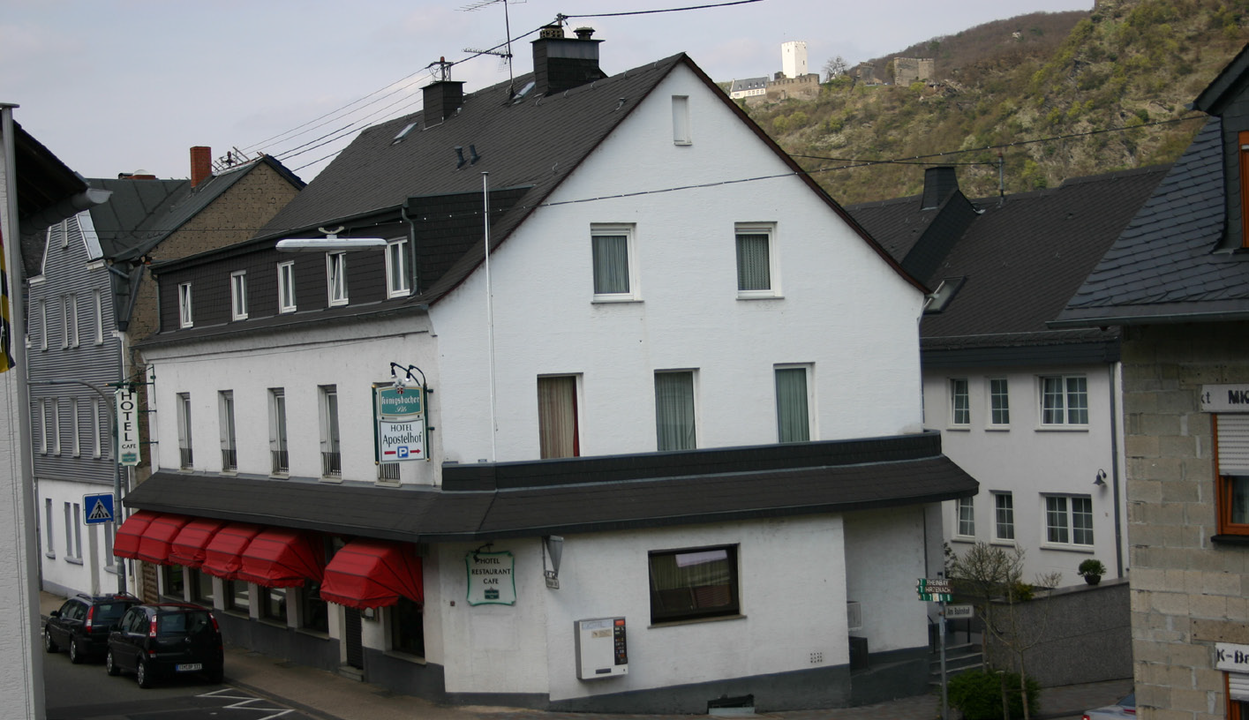
Hotel Apostelhof

Slide 7
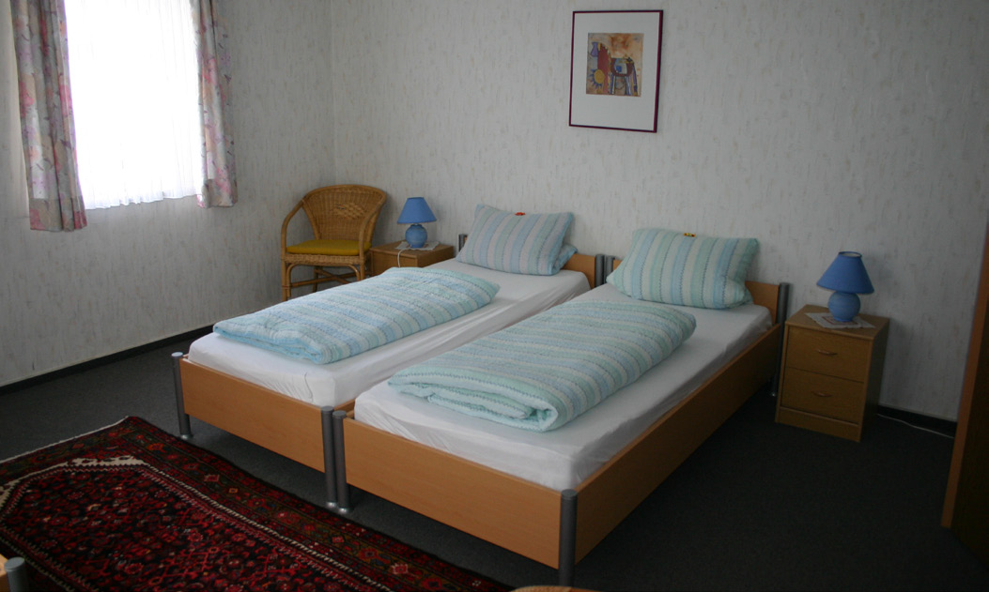
bedroom

Slide 8
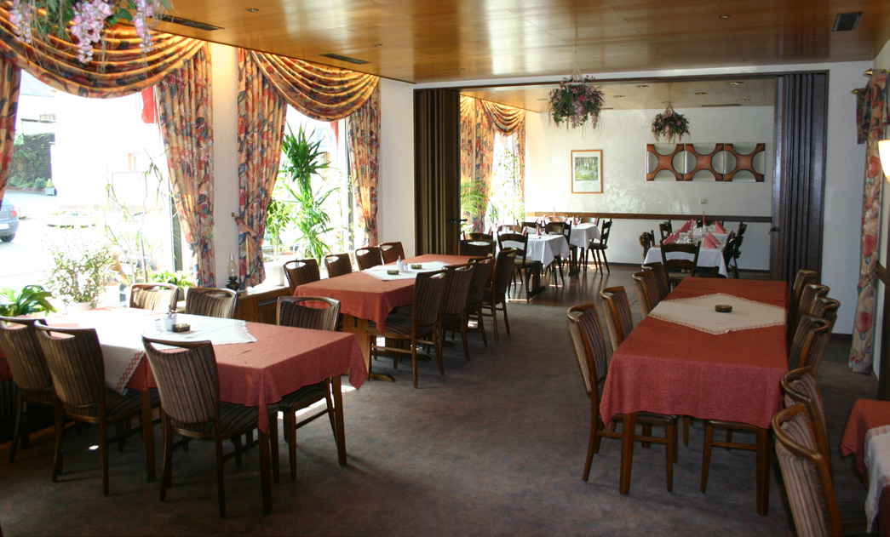

Slide 9
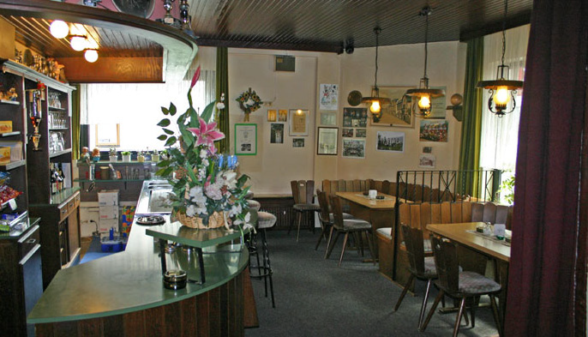

Slide 10
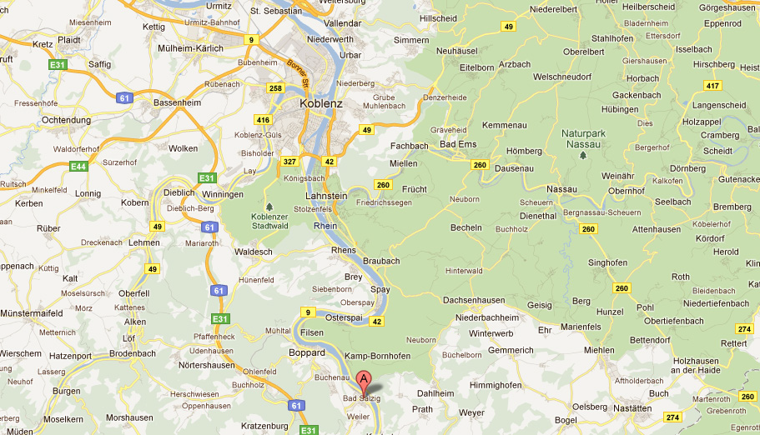

Slide 11
Accommodation Facilities
• Reception
• Bar and restaurant
• Meeting room
• Play area/small park approximately 10 minutes on foot
from the hotel
• Skittle/bowling alley
• Discos and karaoke evenings may be arranged in the restaurant upon request (please bring your own iPods)
• Groups may use the restaurant for study or recreational purposes, this area can be divided into 3 separate rooms
• Parking for two coaches is available 50 metres from the hotel
Student Rooms
• 3-5 bedded rooms, (can be made up of singles, bunk beds, and/or double bed frame with two single mattresses and duvets)
• En-suite facilities
• TV
Staff Rooms
• Twins/singles
• En-suite facilities
• TV

Slide 12
Possible itinerary
This is only a suggested itinerary and we would appreciate your ideas and suggestions.
Saturday
Boat from Bad Salzig to Boppard
Wee train round Boppard
Chair lift trip up hill / views of Rhine and area
Or a cycle on cycle path by river
Perhaps – Kaffee und Kuchen (cake and coffee at a coffee shop)

Slide 13
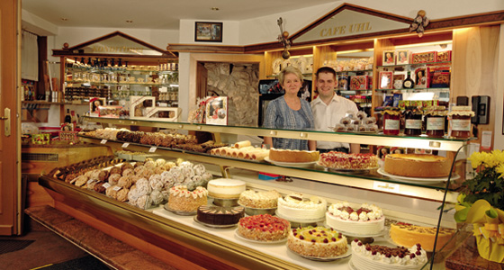

Slide 14
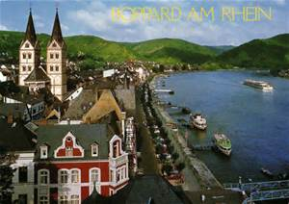
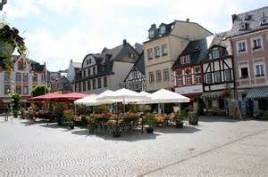
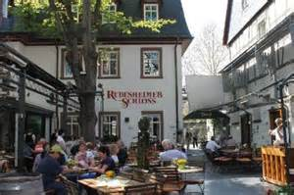

Slide 15
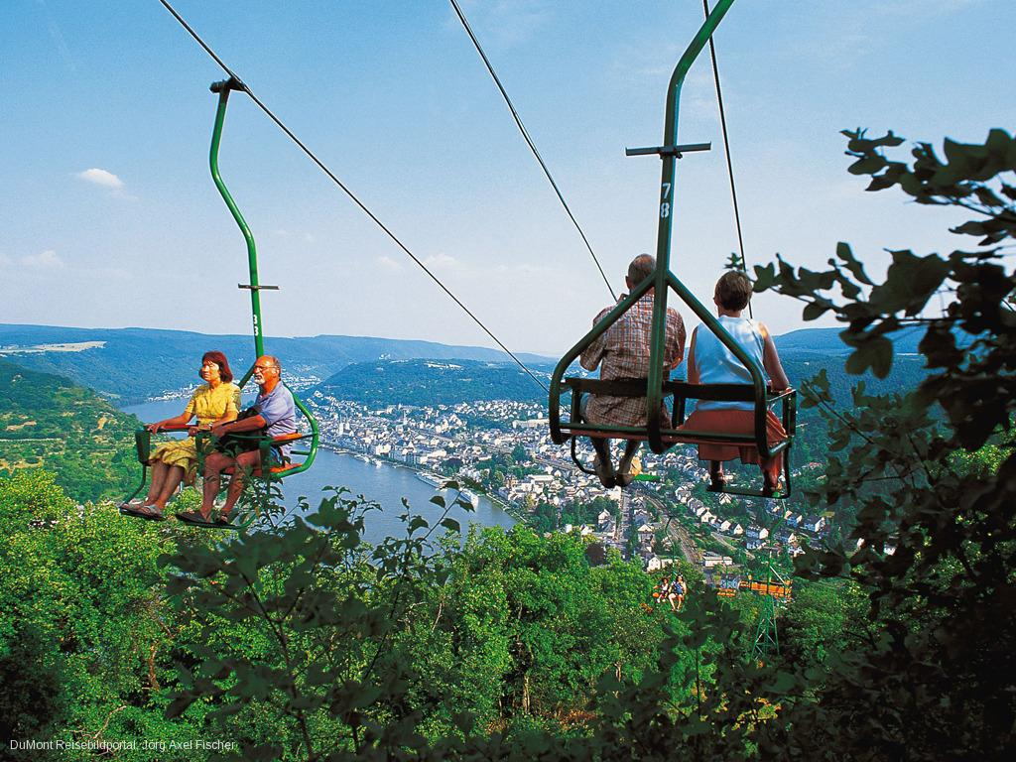

Slide 16
Sunday
Trip to Volcano park
http://vulkanpark.com/en/geyser-andernach
Boat trip to Geyser Andernach
The world´s tallest cold water geyser
Pin up Bowling alley in Koblenz
Also available – billiards and minigolf

Slide 17
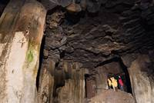
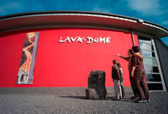
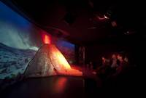
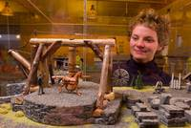
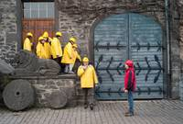
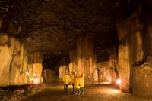

Slide 18
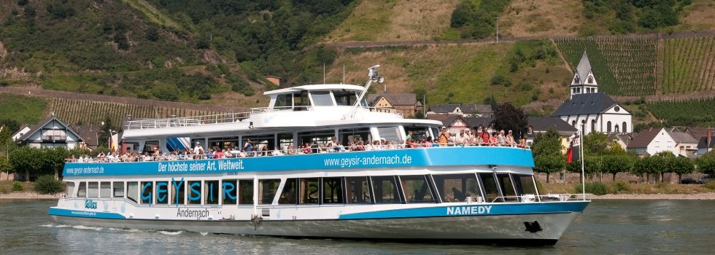

Slide 19
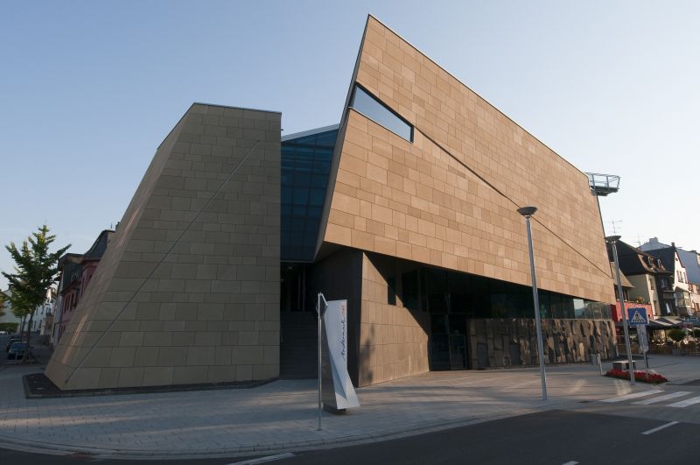

Slide 20
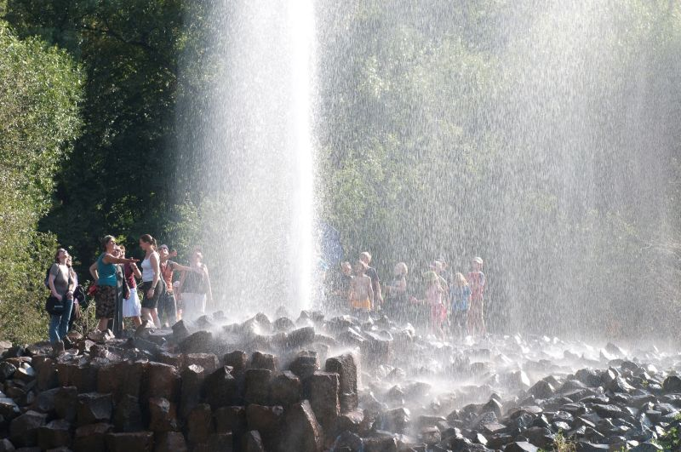

Slide 21
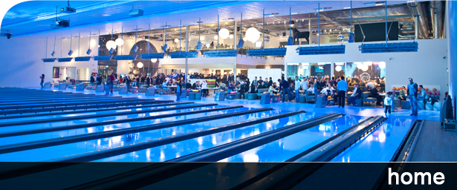
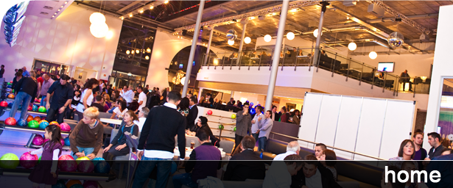

Slide 22
Monday
A visit to Cologne
Lots of possibilities…
Visit Cologne cathedral, visit Cathedral tower
Tour of Cologne football stadium
Visit Cologne chocolate museum
Shops!!
Zoo

Slide 23
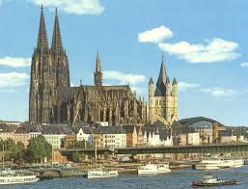
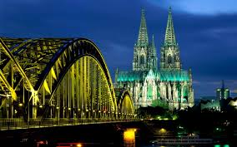
This giant Gothic cathedral, which until its completion in 1880 had been under construction for over 500 years, is perhaps Germany's most famous religious structure and includes two huge towers that serve as the defining symbol of Cologne's skyline.

Slide 24
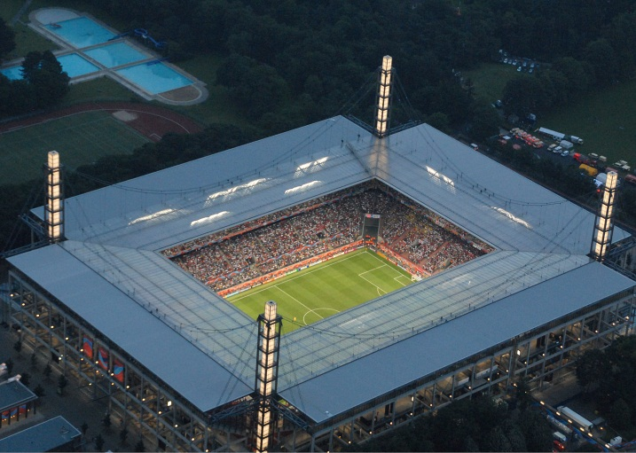
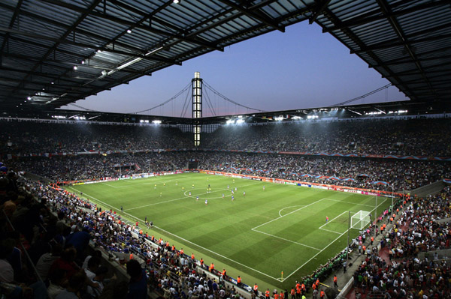
The RheinEnergieStadion is a football stadium in Cologne, North Rhine-Westphalia, Germany. It was built on the site of the two previous Müngersdorfer stadiums. It is the home of the local Bundesliga team, 1. FC Köln. The stadium was one of the 12 hosting the 2006 FIFA World Cup. The stadium's name comes from a contract with the local power supplier RheinEnergie AG.

Slide 25
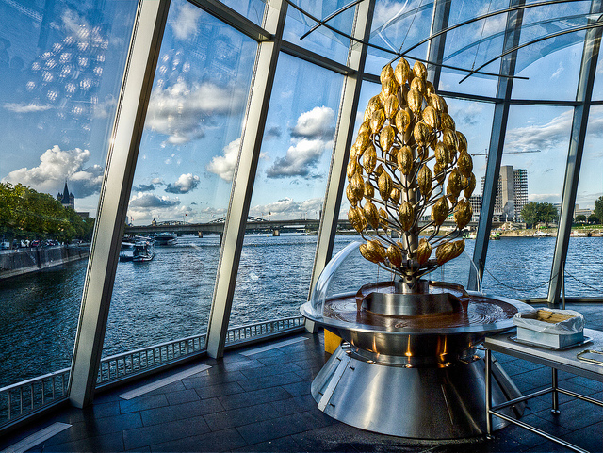
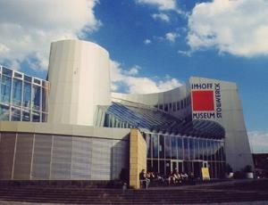
Make sure you save time to visit the wonderful Lindt World of Chocolate Museum because it is well worth a visit. You can’t miss the huge and modern museum, which looks much like a ship, located right on the river front, just a short walk from the Cologne Cathedral. Pay your admission and begin your journey through the three exhibition levels which take you on a tour through 3,000 years of the history of chocolate, all the way from Aztec chocolate makers to the modern Lindt chocolate candies. The smell of chocolate permeates the building – it’s probably the best-smelling museum in the world!

Slide 26
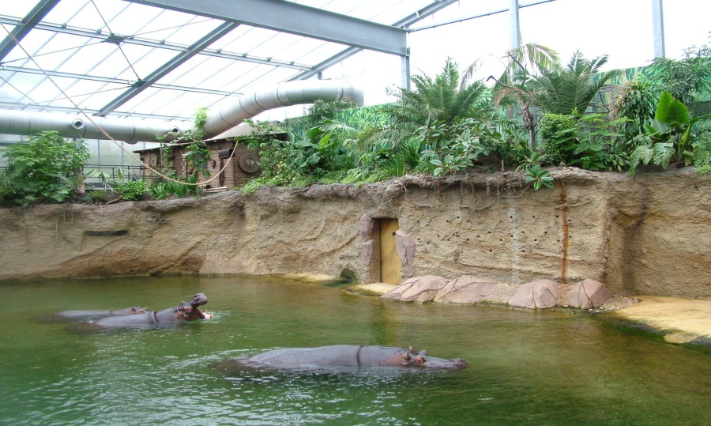

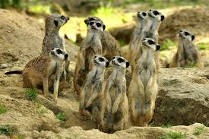
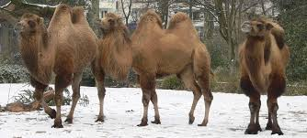

Slide 27
Tuesday
Visit Koblenz
Visit Ehrenbreitstein Fortress by Cable car
Shopping in Koblenz
Rhine gardens and outdoor swimming pool in Oberwerth island

Slide 28
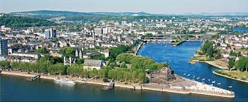
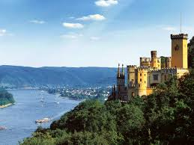
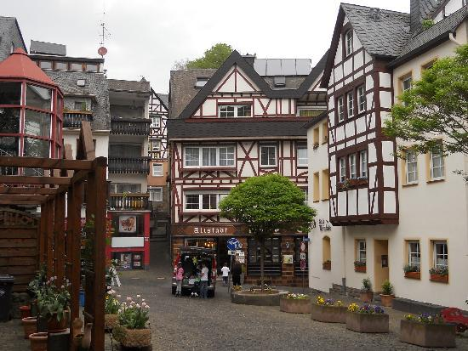
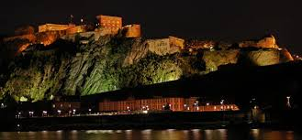

Slide 29
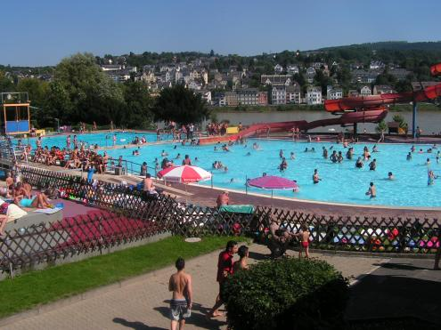

Slide 30
Wednesday
Depart hotel for day in Phantasialand theme park
Depart theme park late afternoon and travel to Calais for ferry to Dover

Slide 31
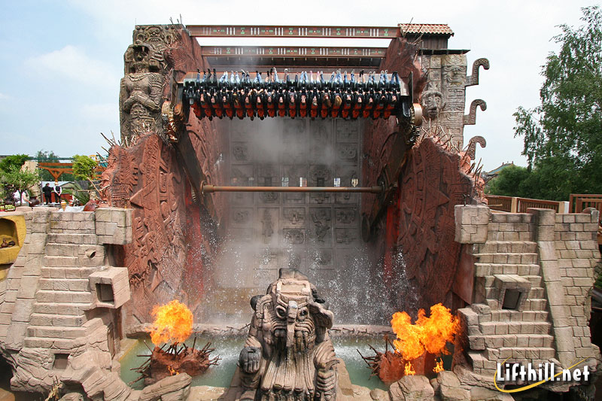

Slide 32
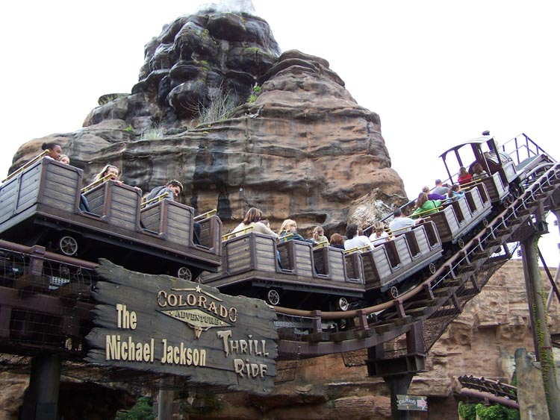

Slide 33
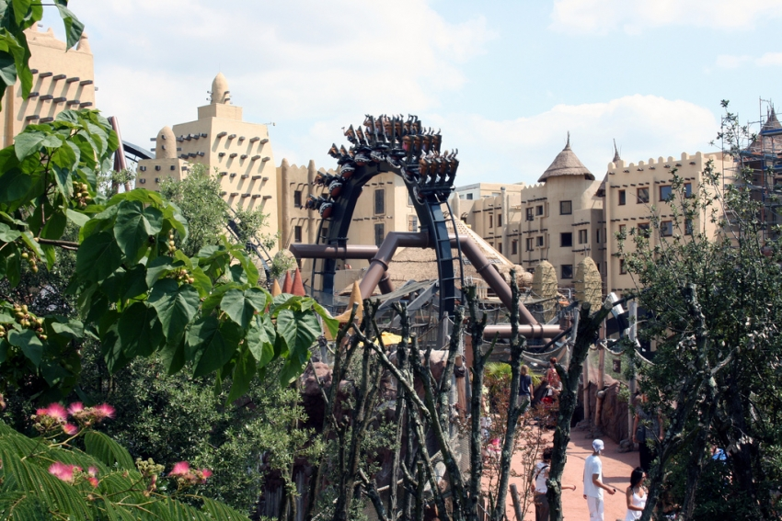

Slide 34
Evening activities
Use of pin bowl/skittle alley in hotel
Discos
Quizzes
Films
Stroll in town
Visit bowling alley

Slide 35
activities
None of the activities are set in stone.
We would like to base our itinerary round what the pupils and their parents/ carers would like so we would welcome your ideas

Slide 36
Travel tips - Passports
All students travelling must hold a full passport which is valid till after the date of our return. If a new passport is needed, it is recommended that you apply at least 10 weeks before we depart although you can usually get a passport within 4 weeks at less busy times.
Website:www.passports.gov.uk

Slide 37
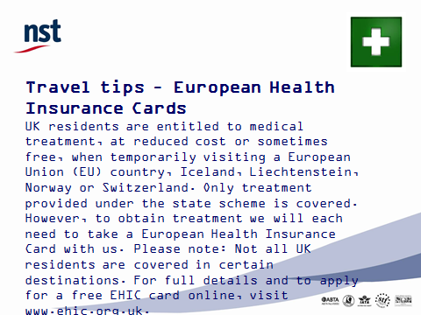

Slide 38
Spending money
The currency in Germany is the Euro.
Some parents/carers prefer that staff look after their child’s money to make sure that they do not lose it or spend it all too soon and we are happy to do this.

Slide 39
Travel tips - Packing
What to take on the tour:
one holdall or case, preferably with wheels and not too heavy
a piece of hand-luggage with stuff for the bus/ ferry -magazines, snacks, I pod…
A more detailed list of items to take will be given nearer the time of the trip

Slide 40
Next payment
We would appreciate if you could make your payments up to £150 by the 27th of February if you have not already done so.
Final payment - The balance of the visit will need to be paid in full by the first week back after the Easter holidays and no later than Tuesday 21 April as the travel company would like full payment sent to them by Friday 24 April.
The total cost of the trip is £364

Slide 41
Fundraising
The school has made a contribution of £3000 from school funds equating to £75 per child to the trip.
This has come from various fundraising events such as the Bag packing event in Morrisons and the School open day

