Slide 1
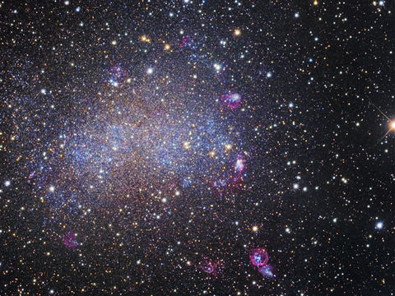
Algebra
Number
Data
Shape

Slide 2

Algebra
Brackets
Two Brackets
Solving Equations
Collecting like terms
Simplifying
2 sided equations
Simultaneous equations
Solving simultaneous equations graphically
Factorising
Curved Graphs
Sequences
The Nth term
Quadratic Sequences
Substituting
Formulae
Quadratic Equation
Factorising Quadratics
Algebraic Fractions
Trial and Improvement
Inequalities
Laws of Indices
Parallel and Perpendicular lines
Finding the Gradient
Writing Expressions
y=m x + c
Home

Slide 3

Shape
Area of Circles
Circumference
Area of triangles
Circle theory Double angle
Circle theory triangles
Circle theory angles connected by a chord
Circle theory cyclic quads
Circle theory tangents
Perimeter
Sin and Cos
Sin, cos and tan
Sin, cos and tan 2
Sine rule
Cosine rule
Sine and cosine rules
Trig- missing angles
Angles in a triangle
Angles on a straight line and around a point
Angles on parallel lines
Angles in Polygons
Interior and Exterior angles
Polygons- finding sides
Construction
Worded Pythagoras
Reflection 1
Reflection 2
Translation
Rotation
3D Pythagoras
Pythagoras
Plans and Elevations
Home

Slide 4
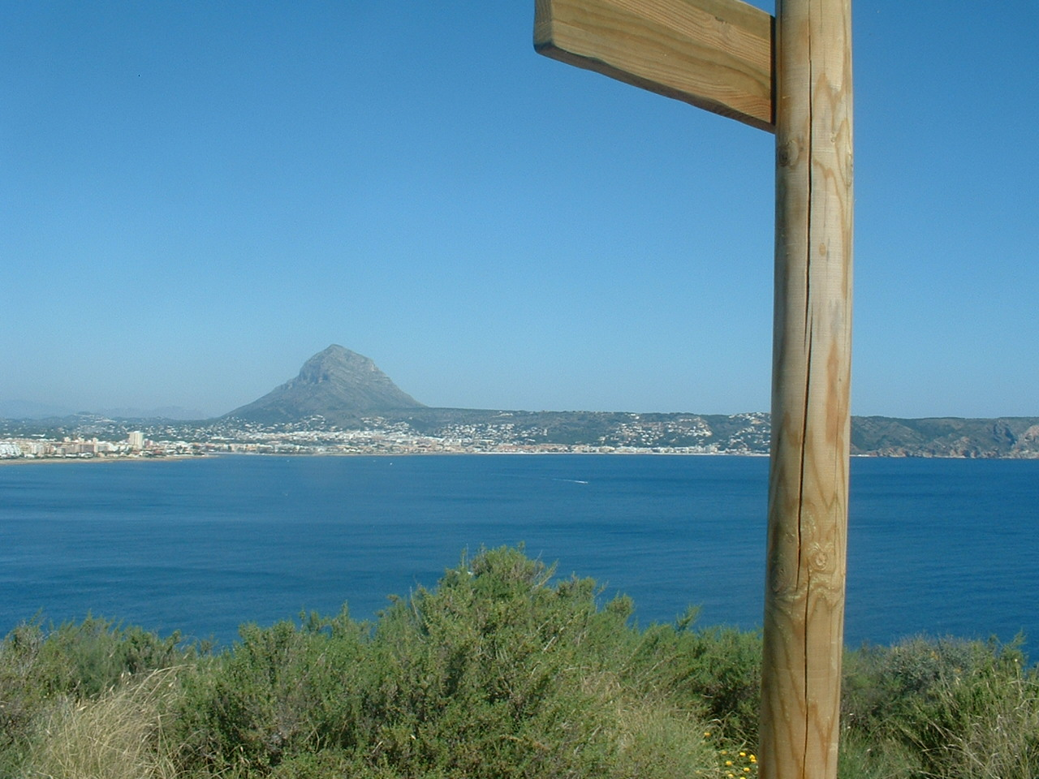
Data
Mean
Mean, Mode, Median and Range
Median and range
Mean from tables
Mean from group tables
Tree Diagrams
Sampling
Mutually Exclusive Events
Listing Outcomes
Histograms
Cumulative frequency
Reading Pie Charts
Reading Pie Charts 2
Drawing Pie Charts 1
Drawing Pie Charts 2
Scatter Graphs
Box and Whisker plots
Sample Space Diagrams
The Probability Scale
Probability as Fractions
Stem and Leaf Diagrams
Relative Frequency
Reading Bar Charts
Drawing Bar Charts
Home

Slide 5

Number
Adding, subtracting decimals
BIDMAS
Adding and subtracting fractions
Direct Proportion
Factors
Factor Trees
Directed Numbers
Directed Numbers 2
Equivalent Fractions
FDP
Finding %
Ratio
HCF and LCM
Indirect Proportion
Limits
Multiplying and dividing decimals
Multiplying and Dividing Fractions
Multiples
Ordering Decimals
Ordering Fractions
Percentage Increase
Reverse Percentage
Rounding dp
Rounding sig fig
Standard form
Home

Slide 6
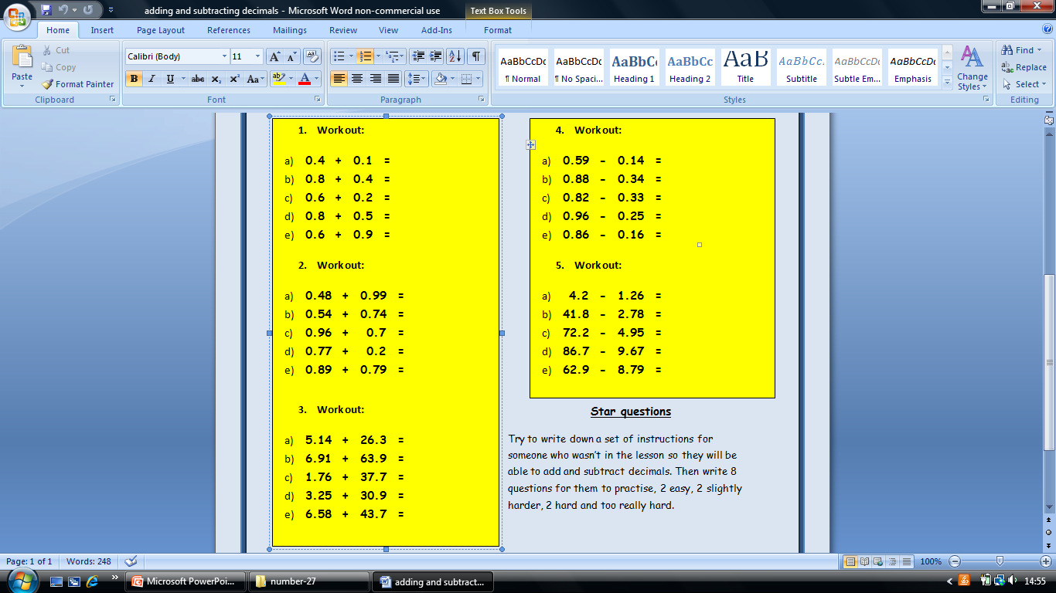
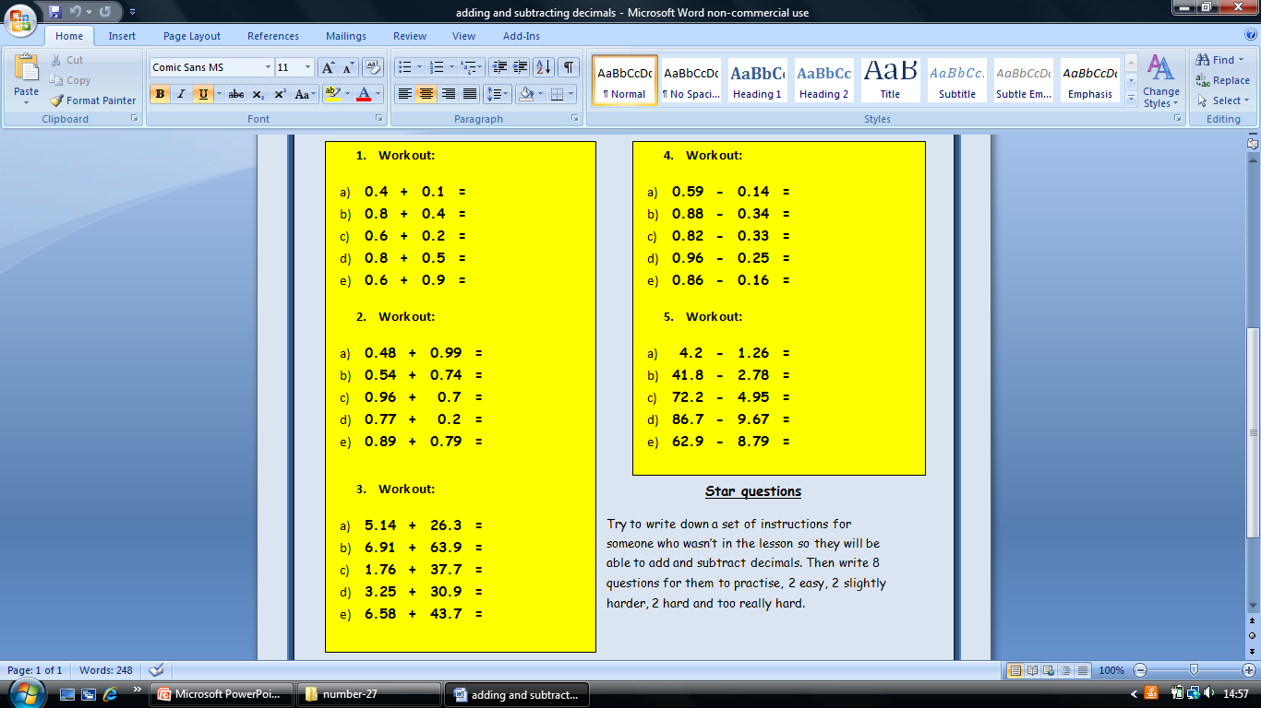
Adding and Subtracting Decimals
ANSWERS
0.5
1.2
0.8
1.3
1.5
1.47
1.28
1.66
0.97
1.68
31.44
70.81
39.46
34.15
50.8
0.45
0.54
0.49
0.71
0.7
2.94
39.02
67.25
77.03
54.11
Home

Slide 7
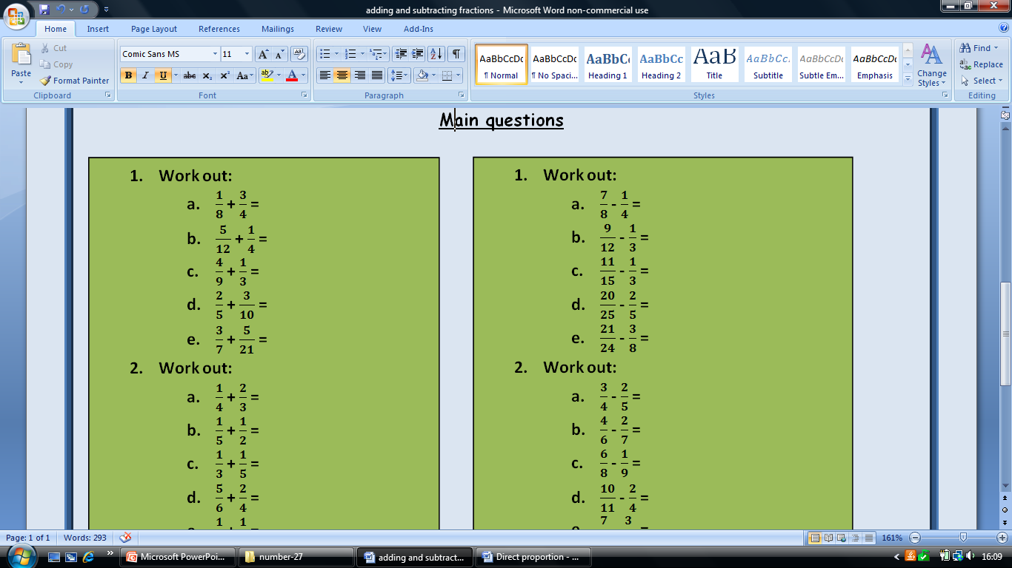
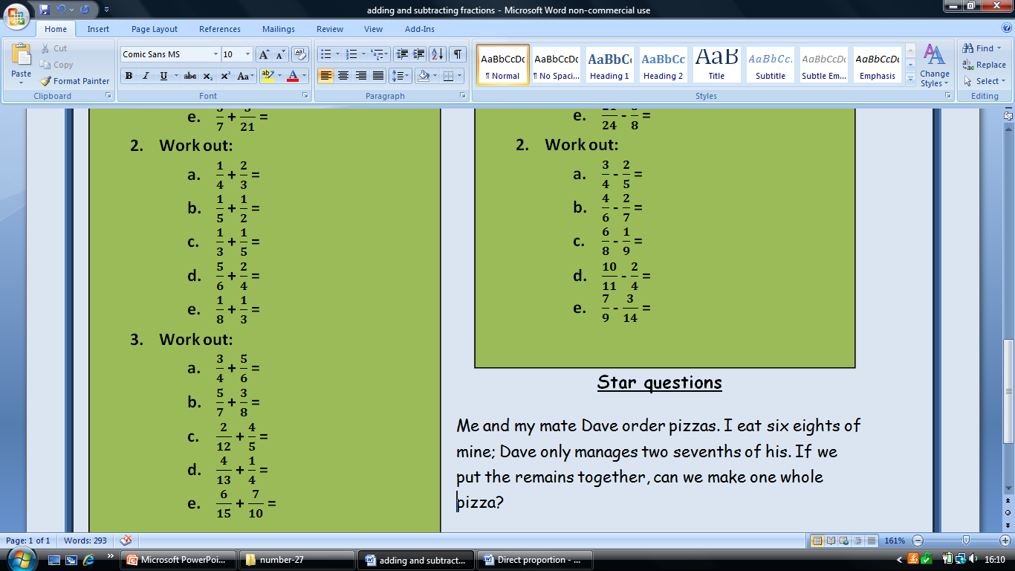
Adding and Subtracting Fractions
7/8
8/12
7/9
7/10
2/3
11/12
7/10
8/15
16/12 or 1 ¼
11/24
1 7/12
1 5/56
29/30
29/52
1 1/10
5/8
5/12
1/3
2/5
1/2
7/20
8/21
23/36
9/22
71/126
Home

Slide 8
Adding and Subtracting Decimals
Answers
0.5
1.2
0.8
1.3
1.5
1.47
1.28
1.66
0.97
1.68
31.44
70.81
39.46
34.15
50.8
0.45
0.54
0.49
0.71
0.7
2.94
39.02
67.25
77.03
54.11
Home

Slide 9
Direct Proportion
Answers
A=2B
V=4M
T=5S
Y=17X
H=12M
N=2P
C=1.5B
B=44
C=45
z=11y
y=7
z=1.1
N=3L
L=1.2
N=1.5
If A is directly proportional to B, write an equation in the form A=kB linking the two variables if when A= 8 B= 4.
All of the variables below are directly proportional, write an equation linking them:
V= 12 when M =4
T= 5 when S=1
Y= 34 when x=2
H=48 when M=4
P= 5 when N=10
B is directly proportional to C, when B is 18 C is 27.
Write an equation linking B and C
Find B when C= 66
Find C when B = 30
Z is directly proportional to Y, when Z =55, Y=5
Write an equation linking Z and Y
Find Y when Z = 77
Find Z when Y=0.1
N is directly proportional to L, when N=1.8 L =0.6
Write an equation linking N and L
Find L when N= 3.2
Find N when L=0.5
Home

Slide 10
Bidmas
24
3
2
20
10
1
26
22
1
19
0
2
9
5
1
26
25
20
17
5
1
1
2
A)
(3 + 3 ) x 4
4 x 2 – 5
(5 + 7) ÷ 6
5 x 3 + 5
(9 – 4 ) + 5
1 + 1 – 1
2 x (15 – 2)
(5 x 4 ) + 2
(8 + 2 ) ÷ 10
(21 x 1 ) – 2
B)
(1 + 14) – (5 x 3 )
(10 + 6 ) ÷ (4 x 2)
(1 + 2 ) x (6 – 3)
(2 x 6 ) – (14 ÷ 2)
(7 x 2) ÷ ( 20 – 6)
(3 x 10) – (2 x 2)
(9 x 5) – ( 2 x 10)
C)
(3 x 3 – 4 ) x (2 + 2)
2 x (13 – 4) – (23 ÷ 23)
3 x (1 + 4) – (5 x 2)
4 x (3 + 2) – ( 24 – 5)
7 x ( 4 ÷ 2 ) ÷ ( 3 x 5 -1 )
((9 + 7 x 3 ) ÷ 10) – 1
Home

Slide 11
Factors and HCF
ANSWERS
1,2,4,5,10,20
1,2,3,4,6,8,12,24
1,3,9,27
1,2,4,8,16,32
1,2,4,5,8,10,20,40
1,2,5,10,25,50
1,2,4,6,7,8,14,28,56
1,2,3,4,5,6,10,12,20,24,30,40,60,120
1,2,4,5,10,20,40,50,100,200
2,3,5,7,11,13,17,19,23,29 (10 of them)
18
5
6
27
15
90
96
39
Find all the factors of the following numbers:
20
24
27
32
40
50
56
120
200
2 only has 2 factors (1 and 2), how many numbers can you find between 1 and 30 which have exactly 2 factors? (these are called prime numbers)
Find the highest common factors of the following pairs of numbers:
18 and 54
25 and 45
12 and 18
27 and 108
30 and 75
Find the HCF of these pairs of numbers:
90 and 450
96 and 480
39 and 195
Home

Slide 12
Factor Trees
Answers
2²x5
3 x 2³
3 x 2⁴
2 x 3² x 5
3⁴
2 x 5²
3 x 5²
2³ x 3 x 5
2³ x 5²
2³ x 3² x 5²
Draw factor trees for the following numbers:
20
24
48
90
81
50
75
120
200
1800
2. Using your factor trees from question 1, write the numbers as products of their prime factors .
Home

Slide 13
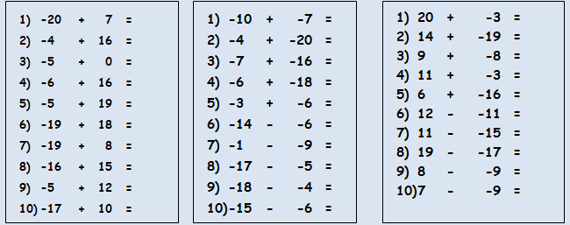
Directed Numbers
ANSWERS
-13
12
-5
10
14
-1
-11
-1
7
-7
-17
-24
-23
-24
-9
-8
8
-12
-14
-9
1) 17
2) -5
3) 1
4) 8
5) -10
6) 23
7) 26
8) 36
9) 17
10) 16
Home

Slide 14
Directed Numbers 2
I am £250 into my overdraft (☹) but then I get paid £535, how much will I have in my bank account?
The temperature at the North Pole is -17°C; luckily the temperature in my living room is 40°C warmer than that, what is the temperature in my living room?
I have £32 and each month for 4 months I have to pay £15 to my mobile phone, if I don’t put any money into my account, how far will I be into my overdraft?
I jump out of a plane 125m above the ocean, I travelled 191m before I stop, how far am I from the surface of the water?
I am playing air hockey with my friend, because I am amazing I agree start on -9 points, we play first to 14, how many points do I need to score?
285
23
-28
66
23
Home

Slide 15
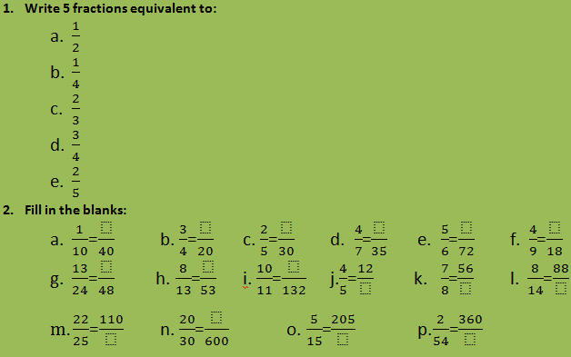
Equivalent Fractions
2.
4
15
12
20
60
8
26
32
120
15
64
154
125
400
615
9720
Home

Slide 16
Ratio
There are 10 girls and 15 boys in a class, what is the ratio of girls to boys in its simplest form?
There are 14 cats and 16 dogs in an animal shelter, what is the ratio of cats to dogs in its simplest form?
There 22 caramels and 55 fudges in a bag of sweets, what is the ratio of caramels to fudges in its simplest form?
Simplify these ratio to their simplest forms:
48:60
45:75
63:108
25:40:80
24:56:96
120:180:600
320:400:440
Archie and Charlie share their Thomas the tank engine toys in the ratio 1:4, how many do they each get if they have:
10 toys b.30 toys c.45 toys
Tom and Jerry share sweets in the ratio 2:3, how many do they each get if they share:
20 sweets b.30 sweets c.55 sweets
Sue and Linda share some money in the ratio 3:7, how many do they each get if they share:
£30 b.£60 c.£90
Mike, Dave and Henry share some little bits of blue tack in the ratio 1:2:3, how many do they each get if they share:
60 pieces b.72 pieces c.300 pieces
ANSWERS
2:3
7:8
2:5
4:5
3:5
7:12
5:8:16
3:7:12
2 and 8
6 and 24
9 and 36
8 and 12
12 and 18
22 and 33
9 and 21
18 and 42
27 and 63
10 and 20 and 30
12 and 24 and 36
50 and 100 and 150
Home

Slide 17
Finding Percentages
Some percentages I can find easily by doing a single sum, what single sums can I do to find:
10% b. 50% c.25%
If I know 10% how can I find:
5% b. 1% c. 20 % d. 90%
If I know 50% how can I find:
5% b. 25%
Find:
30% of 250 b. 40% of 500 c. 15% of 220 d. 75% of 84
Find:
35% of 440 b. 65% of 450 c. 16% of 220 d. 82% of 96
Find:
94% of 640 b. 8% of 520 c. 27% of 220 d. 53% of 96
Compare you methods for the questions above with a partner, where they the same ?
ANSWERS
divide by 10
divide by 2
divide by 4
half the answer
divide by 10
double
multiply by 9 or subtract 10% from original quantity
divide by 10
half 50%
75
200
33
63
154
292.5
35.2
78.72
601.6
41.6
59.4
50.88
Home

Slide 18
Equivalent Fractions
Answers
2.
4
15
12
20
60
8
26
32
120
15
64
154
125
400
615
9720
Home

Slide 19
HCF and LCM
Find the Highest Common Factor of these numbers:
18 and 30
15 and 20
16 and 24
12 and 36
20 and 30
28 and 70
39 and 65
38 and 57
Find the Lowest Common Multiple of these numbers
6 and 7
4 and 6
5 and 8
10 and 4
16 and 5
14 and 21
2.2 and 5
0.4 and 7
6
5
8
12
10
14
13
19
42
12
40
20
80
42
55
14
Home

Slide 20
Indirect Proportion
If A is indirectly proportional to B and when A= 5 B= 6 :
Find k
Write an equation linking A and B
Find A when:
B=3
B=15
Find B when:
A=1
A=-3
If A is indirectly proportional to B and when A= 7 B= 12 :
Find k
Write an equation linking A and B
Find A when:
B=4
B=6
Find B when:
A=10
A=2
If A is indirectly proportional to B and when A= -4 B= 10 :
Find k
Write an equation linking A and B
Find A when:
B=-8
B=10
Find B when:
A=-1
A=-0.5
4. If A is indirectly proportional to B and when A= 24 B= 0.5 :
Find k
Write an equation linking A and B
Find A when:
B=6
B= -3
Find B when:
A= -2
A= 100
k=30
A x B=30
A=20
A=2
B=30
B=-10
k=84
A x B=84
A=21
A=14
B=8.4
B=42
k=-40
A x B=-40
A=5
A=-4
B=40
B=80
k=12
A x B=12
A=2
A=-4
B=-6
B=0.12
Home

Slide 21
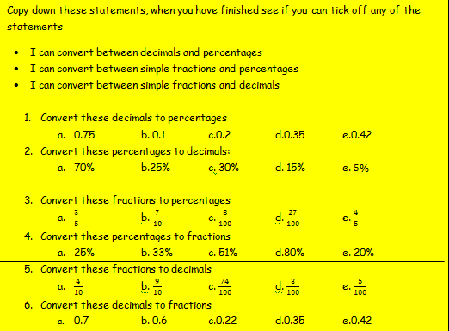
Fractions, Decimals and Percentages
75%
10%
20%
35%
42%
0.7
0.25
0.3
0.15
0.05
60%
70%
8%
27%
80%
¼
33/100
51/100
4/5
1/5
0.4
0.9
0.74
0.03
0.05
7/10
3/5
11/50
7/20
21/50
Home

Slide 22
Limits
These numbers have been rounded to the nearest 10, write down the largest and smallest values they could be:
50
80
110
These numbers have been rounded to the nearest whole number, write down the upper and lower limits:
3
17
23
100
-3
These lengths have been rounded to the nearest 10th of a cm, write the upper and lower limits:
12.5cm
21.7cm
35.8cm
52.1cm
80.4cm
4) A field is 100m wide and 120m long, both lengths have been rounded to the nearest metre.
a) Find the perimeter and area of the field if these measurements are accurate
b) Find the largest and smallest possible perimeter
c) Find the largest and smallest possible area.
5) A rectangle has it’s area rounded to the nearest whole number, it becomes 40cm². One side of the rectangle is exactly 10cm; find the maximum and minimum lengths the other length could have.
6) Two lengths of wood are stuck together and their combined length is rounded to the nearest mm and it is 14.9cm, one length is rounded to the nearest mm and is 7.1cm. Find the minimum and maximum length of the other length.
Answers
45 and 54.9999999..
75 and 84.999....
105 and 114.9999...
2.5 and 3.4999...
16.5 and 17.4999...
22.5 and 23.49999...
99.5 and 100.4999..
-3.499999 and -2.5
12.45 and 12.55
21.65 and 21.75
35.75 and 38.5
52.05 and 52.15
80.35 and 80.45
p=44om and area= 12000m²
largest= 442m smallest=438m
largest= 12110.25m² smallest=11890.25m²
smallest- 3.95cm largest- 4.05cm
6. largest- 7.9cm smallest- 7.7cm
Home

Slide 23
Multiples
C. List 3 numbers which are in:
3 and 4 times tables
3 and 5 times tables
10 and 4 times tables
9 and 2 times tables
12 and 10 times tables
A. List the first 5 multiples of:
5
7
12
14
19
B. What is the:
9th multiple of 8
7th multiple of 6
12th multiple of 12
11th multiple of 10
13th multiple of 5
5th multiple of 13
5,10,15,20,25
7.14.21.28.35
12,24, 36, 48, 60
14,28,42,56,70
19,38,57,76,95
72
42
144
110
65
65
12,24,36
15,30,45
20,40,60
18,36,54
60,120,180
30
56
8
18
30
65
60
80
42
210
D. What is the lowest common multiple of:
5 and 6
7 and 8
4 and 8
9 and 6
10 and 6
E. What is the lowest common multiple of:
13 and 5
15 and 12
16 and 10
14 and 21
21 and 70
Home

Slide 24
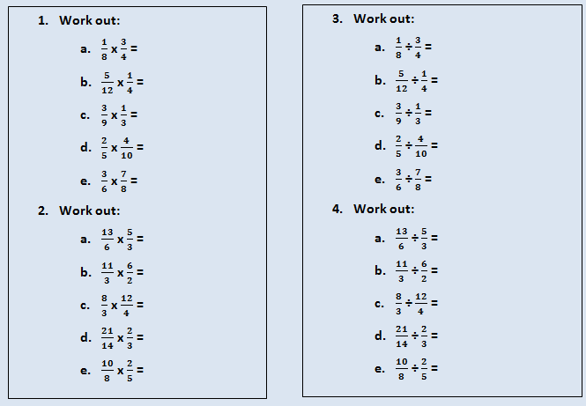
Multiplying and dividing fractions
Answers
3/32
5/48
1/9
4/25
7/16
65/18
11
8
1
1/2
4/24 or 1/6
20/12 or 5/3
1
1
24/42 or 4/7
39/30 or 13/10
22/18 or 11/9
32/36 or 8/9
63/28
50/16 or 25/8
Home

Slide 25
Multiplying and dividing decimals
Answers
5.6
3.5
0.6
2.4
0.9
0.1
0.28
0.08
0.81
0.06
0.57
0.8
0.75
0.34
0.91
0.594
5.044
6.059
0.506
6.15
1.
0.8
0.6
0.8
0.4
0.6
2.
8
9
9
7
4
3.
11
200
21
6
1100
Multiplying
Dividing
1
3.2 ÷ 4
4.8 ÷ 8
7.2 ÷ 9
2.4 ÷ 6
1.8 ÷ 3
2
5.6 ÷ 0.7
6.3 ÷ 0.7
2.7 ÷ 0.3
4.9 ÷ 0.7
2.8 ÷ 0.7
3
1.65 ÷ 0.15
24 ÷ 0.12
27.3 ÷ 1.3
0.03 ÷ 0.005
0.99 ÷ 0.0009
1 | a) | 0.8 | x | 7 | =
 | b) | 0.5 | x | 7 | =
 | c) | 0.1 | x | 6 | =
 | d) | 0.6 | x | 4 | =
 | e) | 0.3 | x | 3 | =
2 | a) | 0.2 | x | 0.5 | =
 | b) | 0.4 | x | 0.7 | =
 | c) | 0.8 | x | 0.1 | =
 | d) | 0.9 | x | 0.9 | =
 | e) | 0.6 | x | 0.1 | =
3 | a) | 1.9 | x | 0.3 | =
 | b) | 1.6 | x | 0.5 | =
 | c) | 1.6 | x | 0.5 | =
 | d) | 1.7 | x | 0.2 | =
 | e) | 1.3 | x | 0.7 | =
4 | a) | 5.4 | x | 0.11 | =
 | b) | 5.2 | x | 0.97 | =
 | c) | 8.3 | x | 0.73 | =
 | d) | 4.6 | x | 0.11 | =
 | e) | 8.2 | x | 0.75 | =
Home

Slide 26
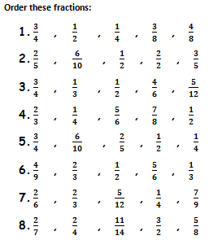
Ordering Fractions
ANSWERS
1/4 3/8 ½ and 4/8 3/4
2/5 ½ 3/5 and 6/10 2/29
1/3 5/12 1/1 4/6 3/4
1/4 1/2 2/3 5/6 7/8
1/4 2/5 1/2 6/10 3/4
1/3 4/9 1/2 2/3 5/6
2/6 1/4 5/12 2/3 7/9
2/7 2/4 5/8 11/14 3/2
Home

Slide 27
Percentage Increase/Decrease
ANSWERS
319.5
434.52
177.5
636.16
727.04
134.40
157.20
186
195
239.88
73.50
77.91
91.49
162
220.32
90
322.56
368.64
97.20
81.60
25.20
31.80
69.60
5687.50
4976.56
333.91
Explain how you would use a calculator to increase an amount by a given percent.
Increase the following amounts by 42%
£225
£306
£125
£448
£512
A TV costs £120, how much will it cost if its price is increased by:
12%
31%
55%
62.5%
99.9%
Simon puts £70 in a bank, each year the money in his bank increase by 5.5%, how much does he have in:
1 year
2 years
5 years?
5. Explain how you would use a calculator to decrease an amount by a given percent.
6. Decrease the following amounts by 28%
£225
£306
£125
£448
£512
7. A TV costs £120, how much will it cost if its price is decreased by:
19%
32%
79%
73.5%
42%
8. A car bought for £6, 500 depreciates in value by 12.5% each year, how much will it be worth after:
1 year
2 years
5 years?
Home

Slide 28
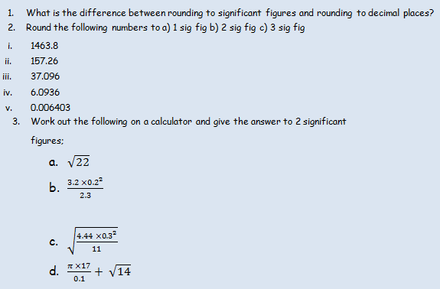
Rounding to Significant Figures
Main
When you are rounding to decimal places you start counting after the decimal point, but with significant figures you start counting at the first non zero number
1000 1500 1460
200 160 157
40 37 37.1
6 6.1 6.09
0.006 0.0064 0.00640
4.7
0.058
0.19
540
Home

Slide 29
Rounding to Decimal Places
Round the following numbers to a) 1 decimal place b) 2 decimals places c) 3 decimal places
a) 1.463884266
b) 1.572660902
c) 3.783345228
d) 6.3931313
e) 0.640368898
f) 0.326119942
g) 4.249504359
h) 4.44692939
i) 1.447852851
j) 0.069143754
Work out the following on a calculator and give the answer to 2 decimal places; 3.104 x 5.938 2.99 x 8.82 7.1537÷ 3.111 14.77²
ANSWERS
1.5 1.46 1.464
1.6 1.57 1.573
3.8 3.78 3.783
6.4 6.39 6.393
0.6 0.64 0.640
0.3 0.33 0.326
4.2 4.25 4.250
4.4 4.45 4.447
1.4 1.45 1.448
0.1 0.07 0.069
18.43
26.37
2.30
219.15
3.67
Home

Slide 30
Reverse Percentages
What would you multiply an amount by to increase it by:
15%
25%
4%
0.5%
13.5%
Find the original prices of these prices that have been increased by the given percentage:
Cost= £49.5 after 10% increase
Cost= £74.75 after 15% increase
Cost= £61 after 22% increase
Cost= £104 after 30% increase
Cost= £120 after 50% increase
I have £252 in my bank account; this is due to me earning 5% interest on what I originally had put in. How much money did I have originally in my bank account?
4. What would you multiply an amount by to decrease it by:
15%
25%
4%
0.5%
13.5%
5. Find the original prices of these items that have been decreased by the given percentage:
Cost= £72 after 10% decrease
Cost= £93.5 after 15% decrease
Cost= £39 after 35% decrease
Cost= £4 9fter 40% decrease
Cost= £67.50 after 55% decrease
6. A Cars value has dropped by 11.5% it is now worth £3053.25, what was it worth when it was new?
Answers
1.15
1.25
1.04
1.005
1.135
45
65
50
80
80
240
0.85
0.75
0.96
0.995
0.865
80
110
60
15
150
3450
Home

Slide 31
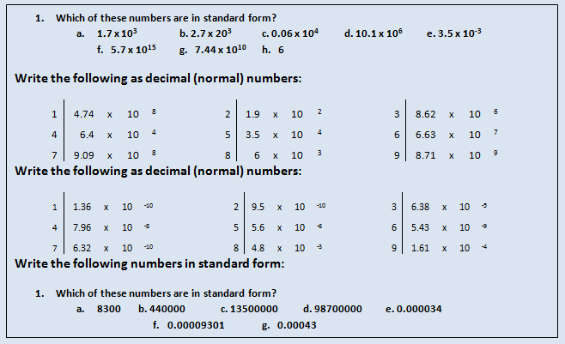
Standard Form
Answers
a,e,f,g
474000000
190
8620000
64000
35000
66300000
909000000
6000
8710000000
0.000000000136
0.00000000095
0.00000638
0.0000000796
0.0000056
0.00000000543
0.000000000632
0.00048
0.000161
8.3 x 10³
4.4 x 10⁵
1.35 x 10⁷
9.87 x 10⁷
3.4 x 10⁻⁵
9.301 x 10⁻⁵
4.3 x 10⁻⁴
Home

Slide 32
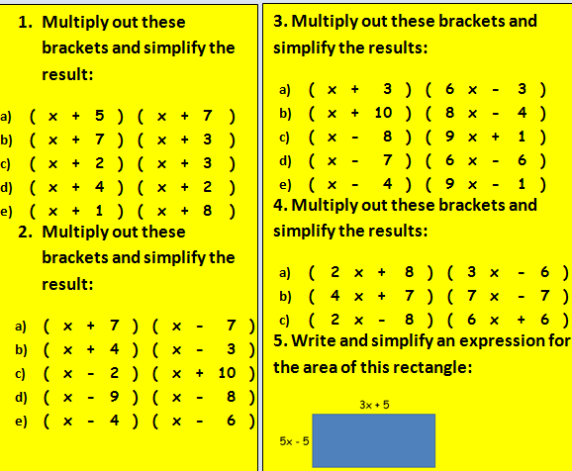
Two Brackets
Answers
x2+12x+35
x2+10x + 21
x2 + 5x + 6
x2 + 6x + 8
x2 + 9x + 8
x2 – 49
x2 + x – 12
x2 + 8x -20
x2 -17x + 72
x2 -10x + 24
6x2+15x – 9
8x2 + 76x -40
9x2-71x – 8
6x2 – 48x + 42
9x2 – 37x + 4
6x2 + 12x – 48
28x2 + 21x -49
12x2 -36x – 48
15x2 + 10x – 25
Answers
x2+12x+35
x2+10x + 21
x2 + 5x + 6
x2 + 6x + 8
x2 + 9x + 8
x2 – 49
x2 + x – 12
x2 + 8x -20
x2 -17x + 72
x2 -10x + 24
6x2+15x – 9
8x2 + 76x -40
9x2-71x – 8
6x2 – 48x + 42
9x2 – 37x + 4
6x2 + 12x – 48
28x2 + 21x -49
12x2 -36x – 48
15x2 + 10x – 25
Home

Slide 33
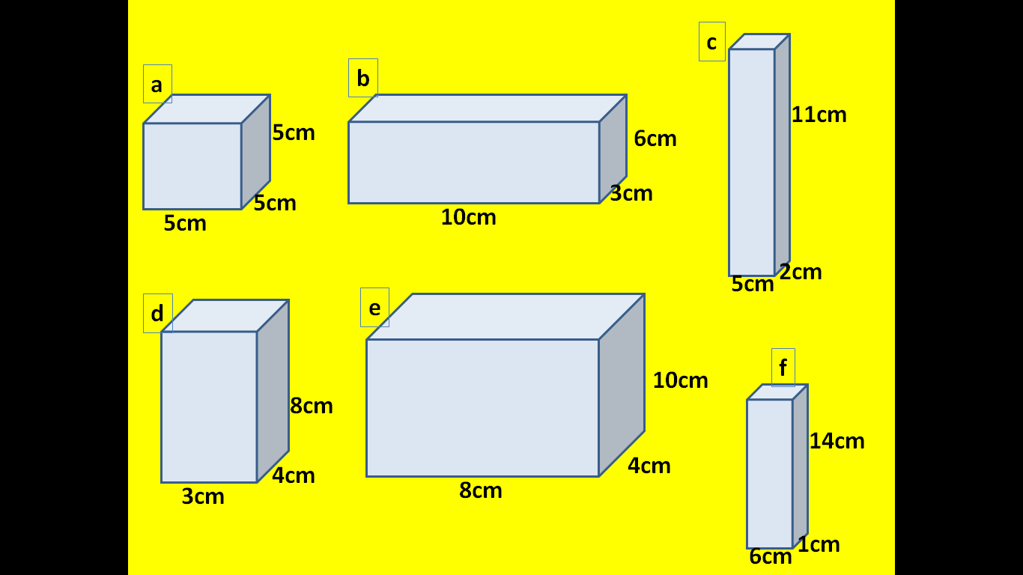
3D Pythagoras
Find the length of the longest diagonal of these cuboids
Answers
11.2cm
12.0cm
12.2cm
9.4cm
13.4cm
15.2cm
Home

Slide 34
Find the Perimeter of these shapes
Answers
21cm
17cm
8cm
4cm
5cm
5cm
9cm
9cm
4cm
8cm
8cm
4cm
8cm
4cm
9cm
7cm
15cm
5cm
12cm
11cm
All of these shapes are regular
Answers
16cm
25cm
72cm
39cm
96cm
110cm
42cm
3cm
10cm
Answers
26cm
26cm
30cm
25cm
36cm
4cm
5cm
12cm
13cm
3cm
Home
11cm
8cm

