Slide 1


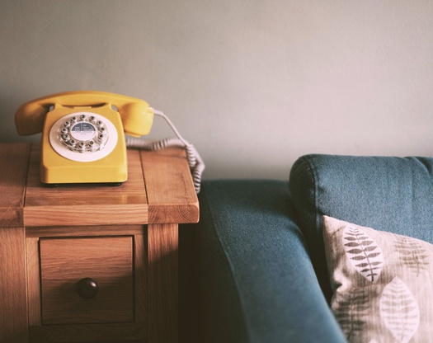

The Digital Phone Switchover
What you need to know
What is the digital phone switchover?
The UK’s telephone network is changing.
Between now and January 2027 most telephone providers will be moving their customers from old analogue landlines over to new upgraded landline services using digital technology. This means services that rely on the old landline system such as home phones, telecare and health devices will need to be compatible.
How will it affect me/what do I need to do?
If you have any concerns or questions, please contact your telecoms provider directly.
The good news is – your landline isn’t going anywhere and for most consumers and businesses, this change will be straightforward. In fact, many customers are already making the switch when they upgrade to fibre broadband.
Your telecoms provider (for
example,Vodafone or BT) should contact
you before the switchover to check in and
discuss what you need to do to make sure
any reliant services you may have aren’t
affected. However, we’re encouraging
everyone to know what to expect.
The change may be as simple as plugging
your phone into a broadband router rather
than the phone socket on the wall, or you
Do you or someone you know depend on their landline and/or use a telecare device connected to a phone line?
If yes, then please contact the Telecare Team at Orkney Islands Council.
Tel: 01856 873 535. Extension 2635
may be given a new router to do this.
Please note that your provider will move you
to a digital service before January 2027. If
you care for a vulnerable person, please
keep an eye out for correspondence notifying
of a switch over date.

Slide 2


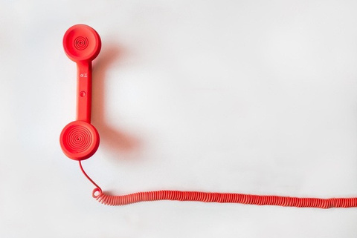
The Digital Phone Switchover
What you need to know
Other Devices
If you have other devices connected to your phone line that you may have purchased, such as alarm systems, you might need to upgrade your device to make sure it is compatible.
If you are unsure about how a device in
your home or business might be affected, it
is recommended you contact the equipment
supplier or device manufacturer to find out
whether it will remain functional on a digital
phone line.
People who use health monitoring or
telecare devices should check if the
switchover will affect how they work.
In a Power Outage
Digital landlines cannot carry an electrical power connection, so in the event of a power cut they will not work. If you have a mobile phone this can still be used, but if you’ve no other means of calling the emergency services your telecoms provider will offer a solution to allow calls to be made to emergency services.
You should tell your telecoms provider
now if you have no other way of making
emergency calls.
Scams
There have been incidents reported of scammers contacting vulnerable users in relation to digital migration. Communication providers or telecare services will never call you to ask for money.
Key Points To Remember
Contact is usually by letter and charges are
only applied to normal invoices. If you are
in any doubt as to the authenticity of a
caller, just hang up and call your
communications or telecare provider to
report the incident, using a trusted phone
number, such as the one on the bill.
If you have any queries or have no means of making emergency calls you need to contact your communications provider.
If you have a telecare alarm please contact the telecare team at Orkney Islands Council: 01856 873 535 Extension: 2635
Check with the appropriate equipment
manufacturers if you have any other
devices supported by your existing
telephone line (such as intruder alarms) to
check it will work digitally.
Most telecare alarm providers will have upgrade plans, if your phone line has or is
due to be upgraded by your
communication provider let them know.

