Slide 1
Campaign for Wild Spaces CaWS

Slide 2
Why are we here tonight?

Slide 3
To protect the back shore and the sea defences

Slide 4
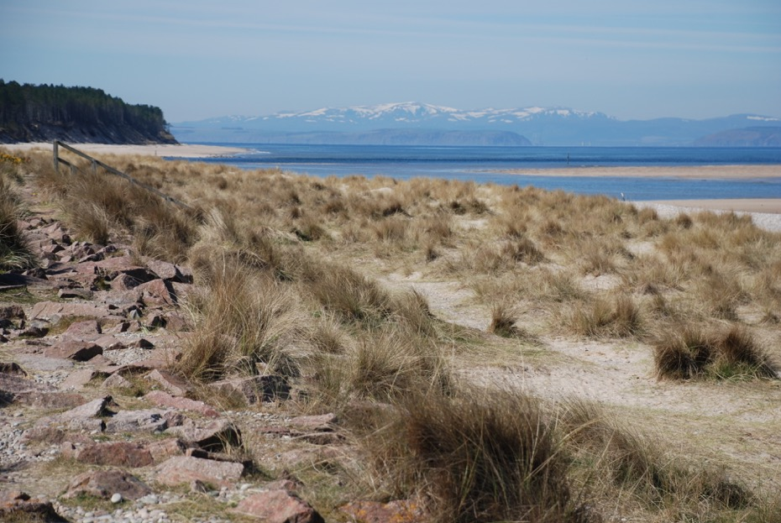

Slide 5
We feel that the Moray Councillors wrongly allowed a planning decision on this space.

Slide 6
After 175 objections
A petition of 81 signatures
A consultation by the Findhorn and Kinloss CC.
A recommendation to refuse by MC Planning Dept

Slide 7
It was passed by Moray Councillors
8 votes to 6
Councillors for approval
Divers Lab Elgin South, Wright Con Heldon & Laich, Howe SNP Fochabers, Mc Donald SNP Buckie, Warren SNP Buckie, McConachie SNP Speyside and Glenlivet, Paul SNP Speyside and GlenLivet, Murdoch, Ind Speyside and Glenlivet.

Slide 8
Councillors for refusal
Tuke I Heldon Laich, Cowe I Heldon & Laich, Cowie I Buckie,
Alexander, I Forres, Mclean SNP Forres, Ross Con Fochabers

Slide 9
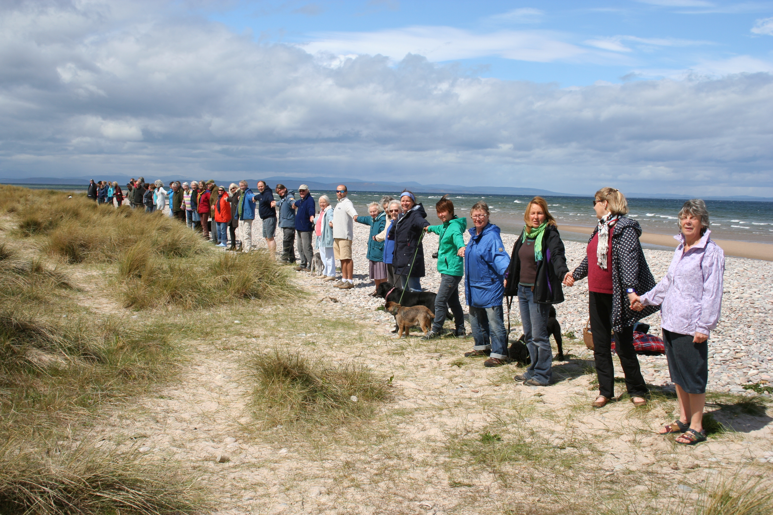

Slide 10
Christine and I visited Moray Council but they just shrugged their shoulders and said nothing could be done

Slide 11
We looked at other avenues, ombudsman, MSP, etc and although we got sympathy it seemed the only way forward was Judicial Review

Slide 12
Rumours
Nobody except the 4 petitioners will be responsible for expenses should this petition fail.
We are not petitioning against beach huts, we are petitioning against the wrong interpretation of the E4 designation which states
THAT THE PROPOSAL SHOULD BE FOR A PUBLIC USE THAT CLEARLY OUTWEIGHS THE VALUE OF THE GREEN SPACE
Any other good ones? I’ve heard a few.

