Slide 1
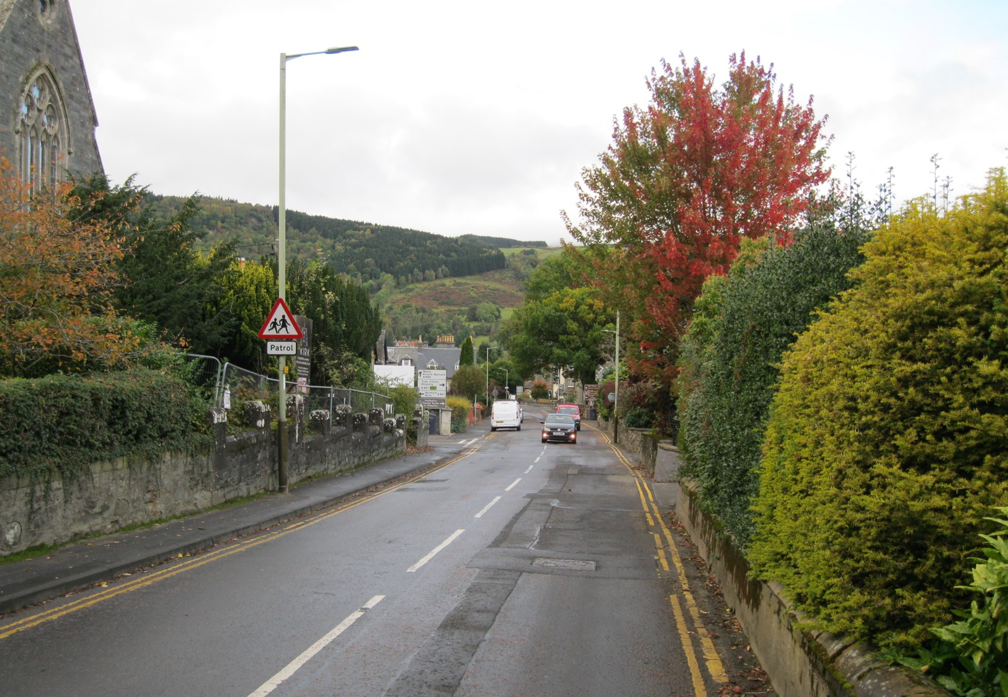
Community Survey Results
Results of the survey of Community Attitudes to Road Safety in Aberfeldy, April 2023

Slide 2
Outline
Why ask?
Survey Construction
Methodology
Results
Where next

Slide 3
Why Ask?
New Approach to Agreeing priorities for projects being worked
Meeting bringing together PKC Officers, Highland Ward Councillors and Action Partnership Representatives set
Wish to have a wider view of local priorities to take into that meeting

Slide 4
Survey Construction
Used Google Forms and paper equivalent
Simple approach – hope to gain more responses
Basically three questions:
  Is road safety a priority?
  Which are the most important hazards to tackle?
  Which other hazards not on the list need to be tackled?
The 5 most significant hazards in the view of the Road Safety Group (RSG) was the basis for the survey

Slide 5
Methodology
Link to the digital option widely published and shared with contacts
Road Tested with a few people before launch and updated
Paper equivalent developed and offered through three outlets:
  The Co-op
  The Library
  Locus centre / AiC
Results combined for presentation
Total Response 89 (83 online, 6 paper)

Slide 6
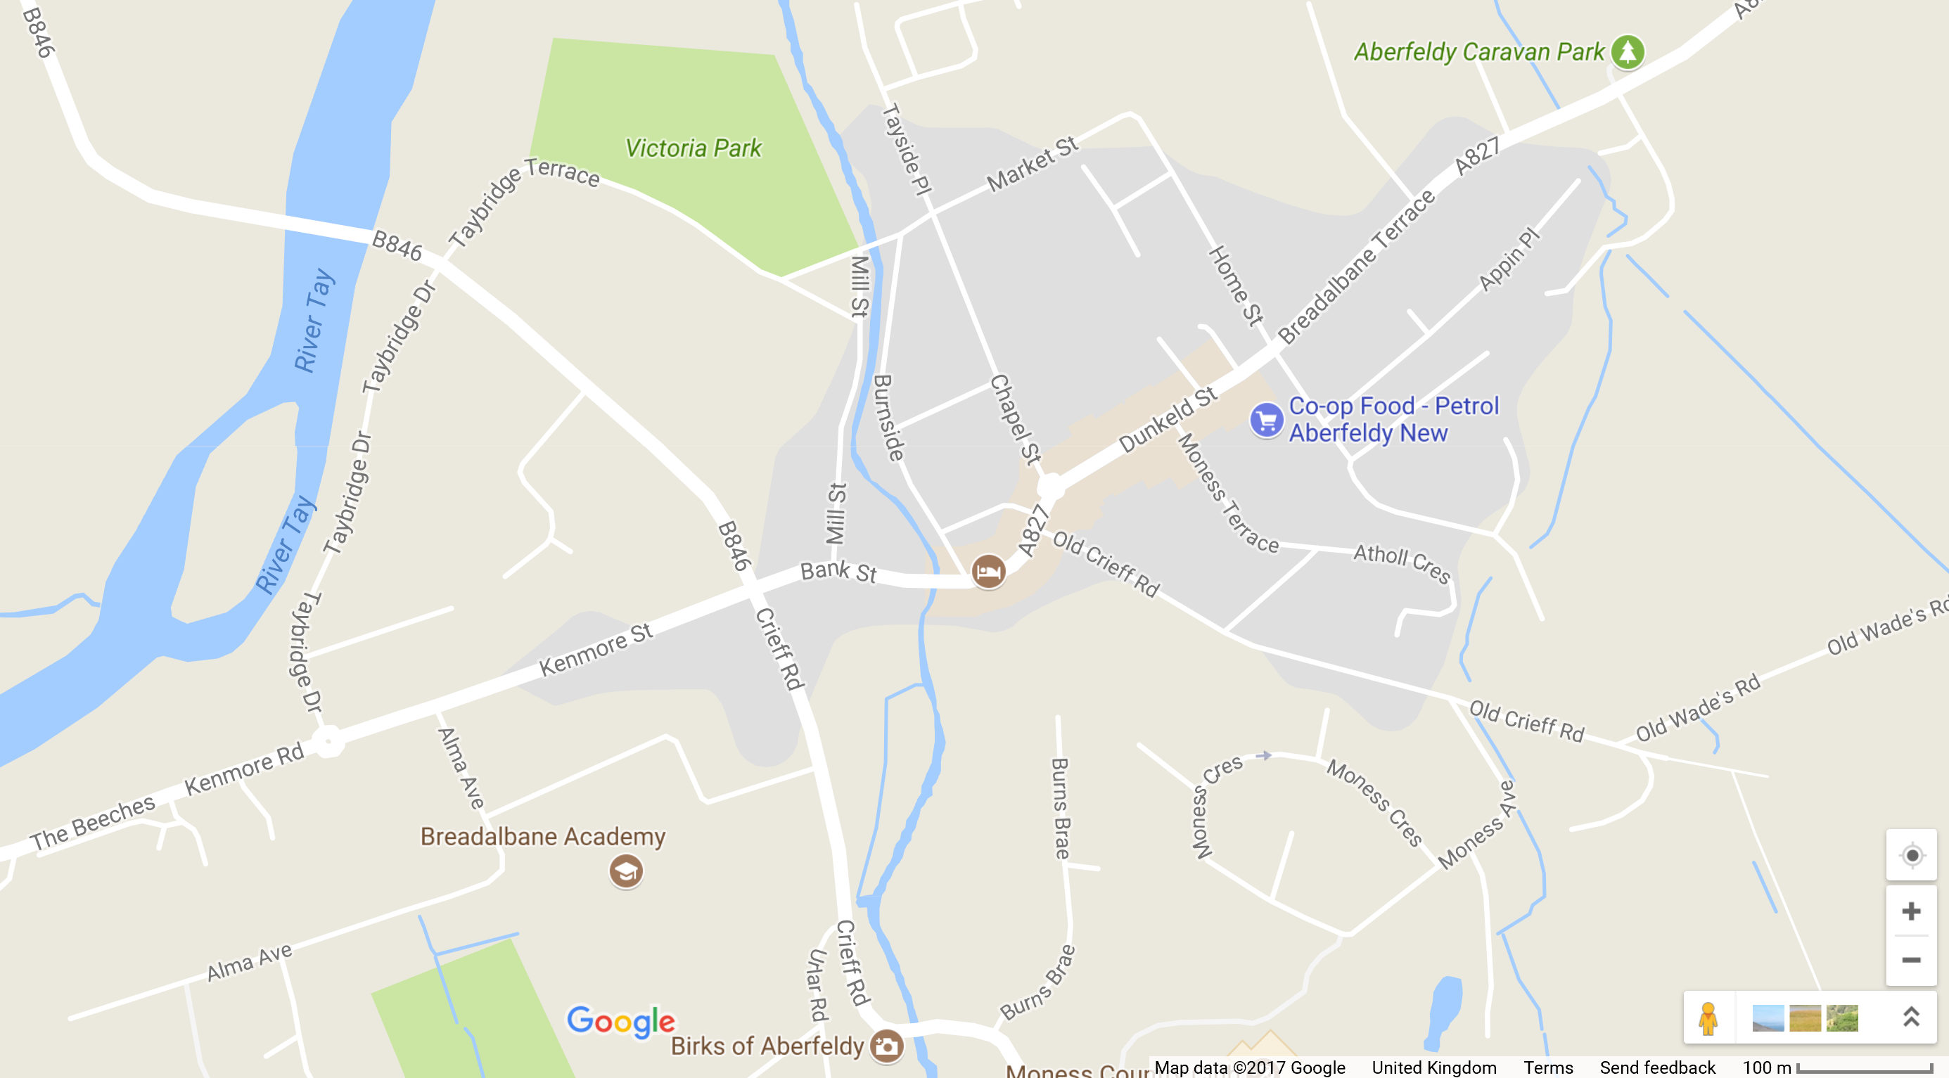
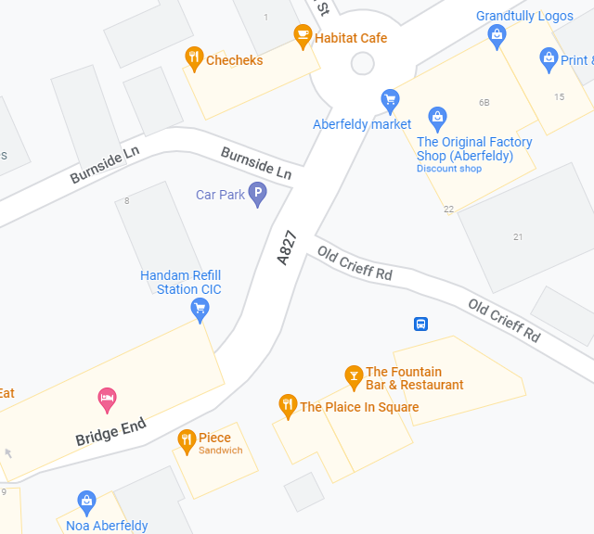
ACC RSG View of Priority Targets
Victoria Park main entrance; safety issue
Tayside Crescent playpark; safety issue
Blind exit from Taybridge Terrace onto Taybridge Road
Safer parking in shopping area –loading bays?
Crieff Road buildout and the Urlar Road junction
Re-categorise these DYLs to be no loading or unloading?

Slide 7
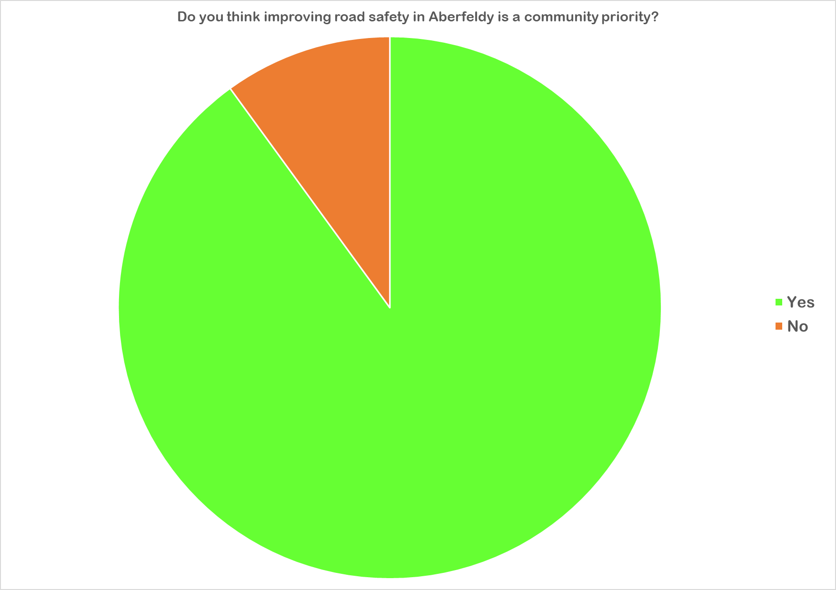
90.0%

Slide 8
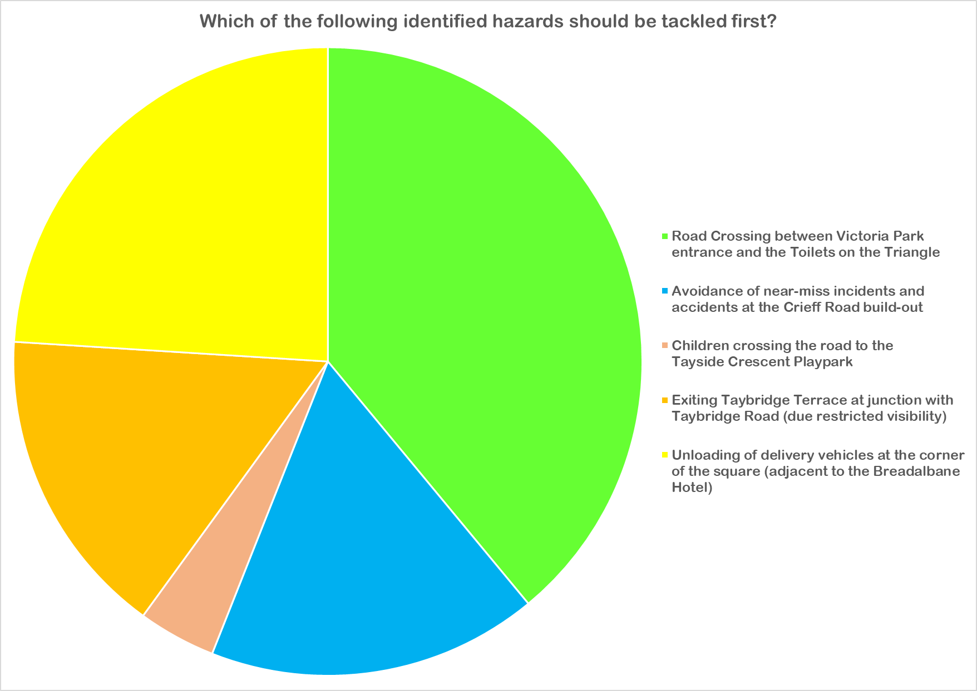
39.0%

Slide 9
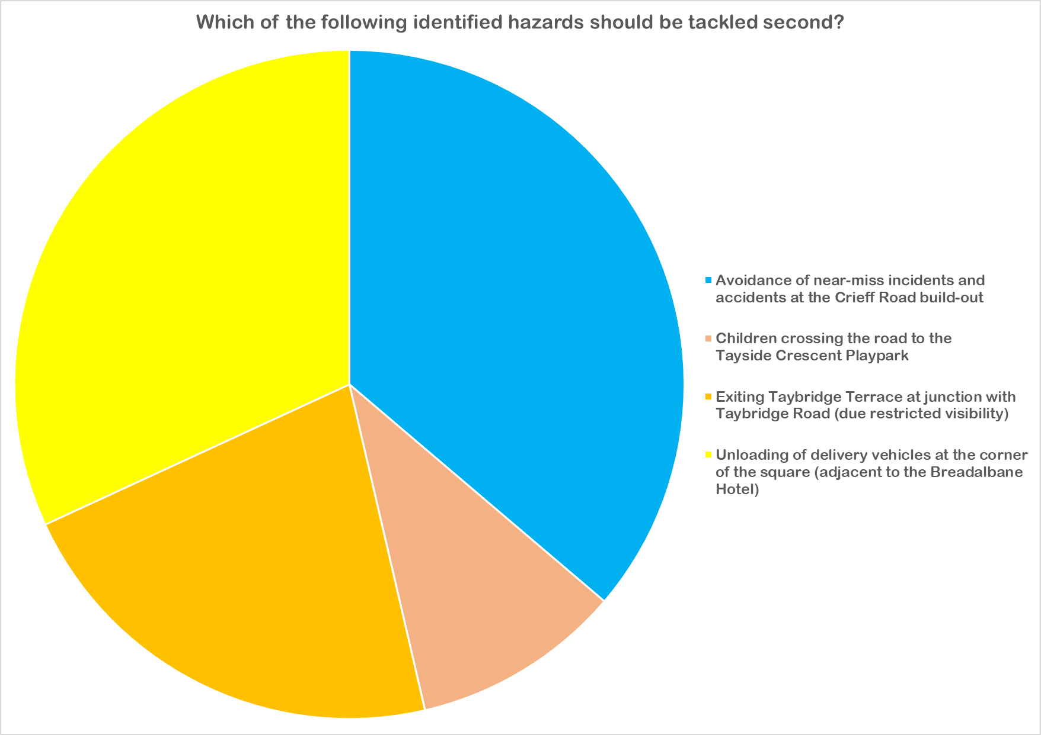
36.2%

Slide 10
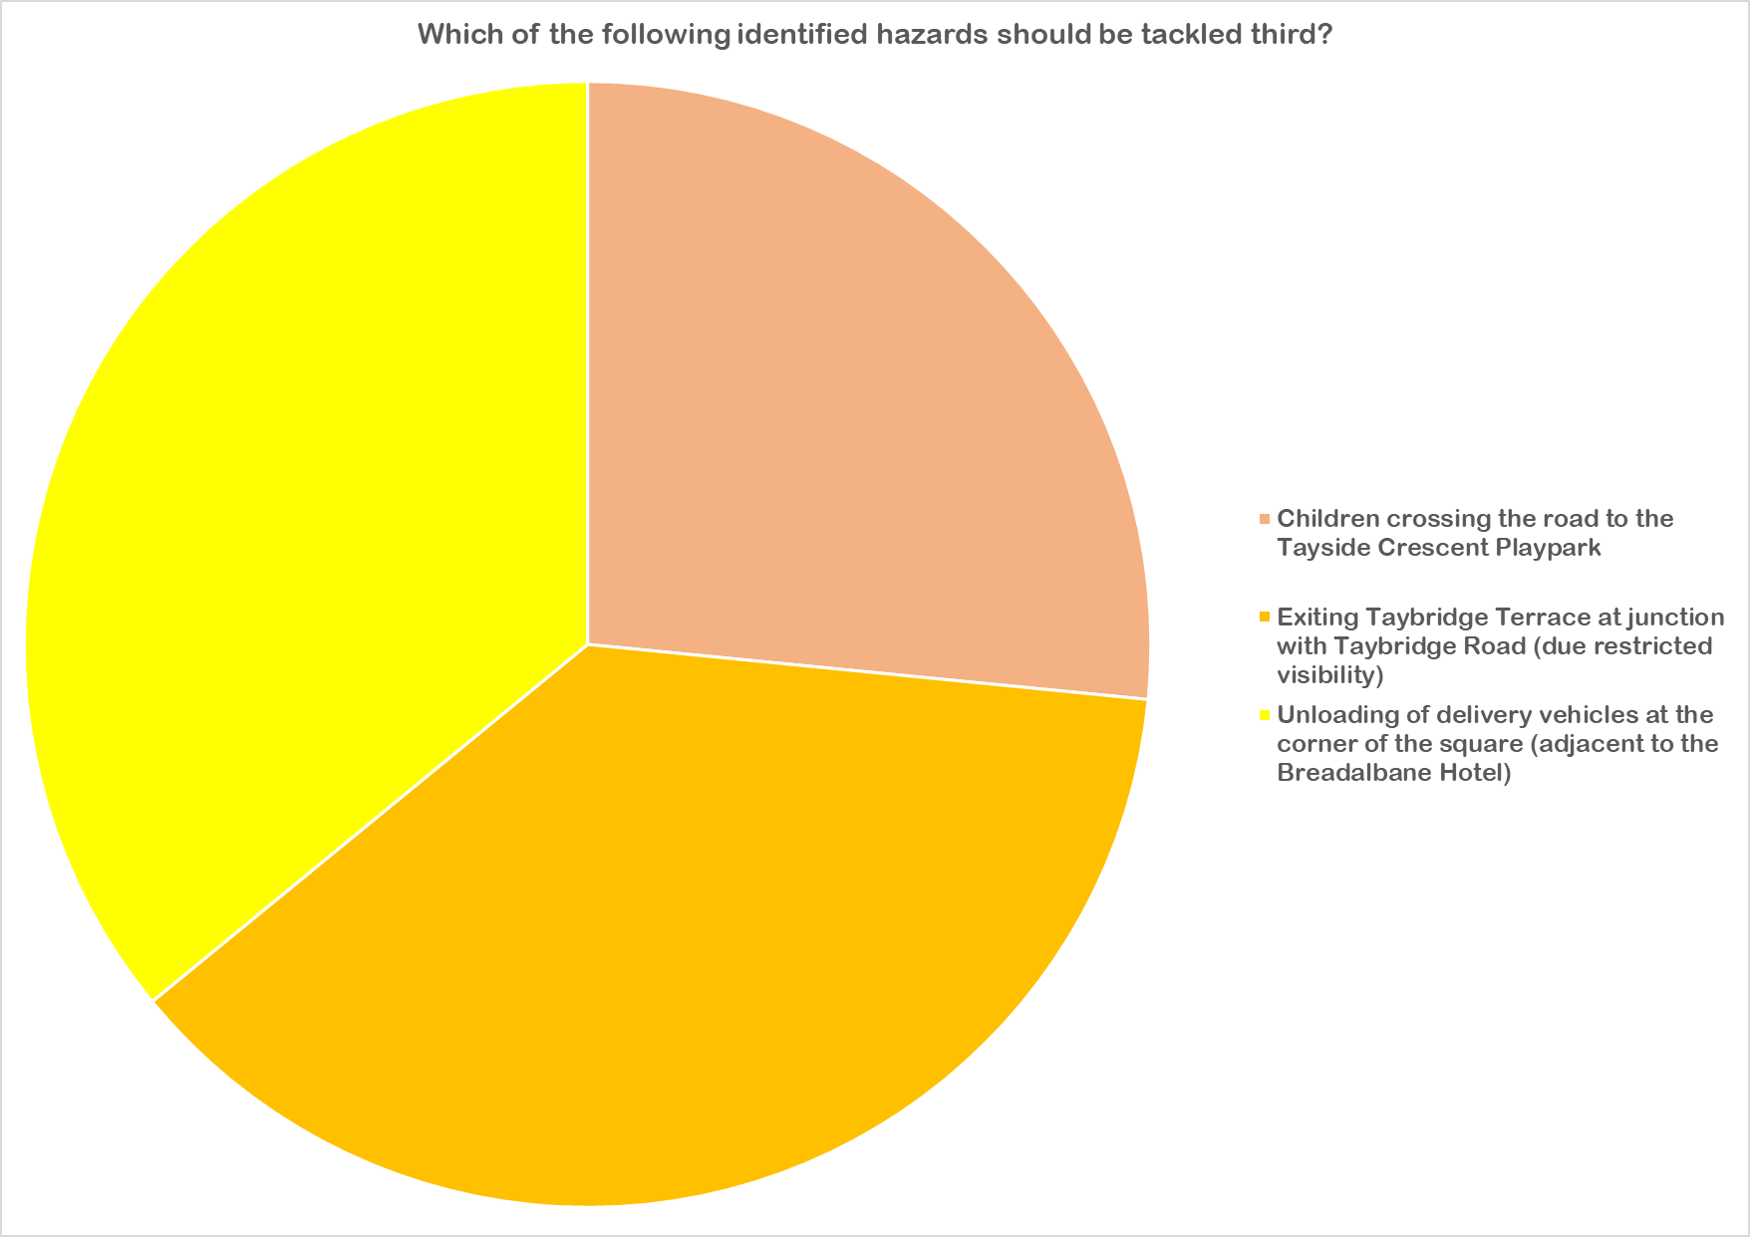
37.5%

Slide 11
Question 3 Responses
31 Online responses and 5 paper responses
These were sorted on 17 categories
Most common themes:
  Speeding on Kenmore Street
  Parking on Dunkeld Street
  Speeding generally
  Issues around the campus
Other notable comments:
  Electric scooter use
  Timing of traffic lights for the diagonal cross

Slide 12
Outcome Summary
No I priority – Improving safety at the entrance to Victoria Park
No 2 priority – Avoidance of Near Miss incidents at the Crieff Road Build-out
No 3 priority – Improving safety at the junction of Taybridge Drive and Taybridge Terrace
Most common issue in write in responses was excessive speeding

Slide 13
Where Next?
Meeting scheduled for May 4th
Goal to establish this as a quarterly practice
Main aim is to find new way of working making community concerns of greater weight in the process
The Highland Action Partnership RSG will re-iterate the priority list that it has developed
For Aberfeldy that remains the Victoria Park Entrance issue

