Slide 1
Welcome to
Year 3

Slide 2
Meet the Year 3 Team
Class Teachers: Mrs Tavender (Mon-Thurs)
Mrs Dobbs (Wed p.m. & Fri)
Teaching Assistants: Mrs Draper, Mrs Green,
& Miss Alba
Day | Morning | Afternoon
Mon | Mrs Tavender Mrs Draper & Miss Alba | Mrs Tavender Mrs Green
Tues | Mrs Tavender Mrs Draper & Miss Alba | Mrs Tavender Mrs Green
Wed | Mrs Tavender Mrs Draper & Miss Alba | Mrs Dobbs
Thurs | Mrs Tavender Mrs Draper & Miss Alba | Mrs Tavender Mrs Green
Fri | Mrs Dobbs Mrs Draper & Miss Alba | Mrs Dobbs Mrs Green

Slide 3
Daily Routines
Gates to school open at 8:40am and close at 8:50am.
Please help your children to be independent coming into school by saying goodbye at the steps and letting them come into class on their own.
Break time is 10:45 - 11:00am - children may bring a fruit/veg snack - no nuts or strawberries please.
At the end of the day Y3 come out to the bottom playground.
The children must come and say goodbye to me (or Mrs Dobbs) before they come to you.
If you need to see me, after school is best or send a note/email in.
Reminder: children are not allowed to play on any of the playground equipment before or after school.

Slide 4
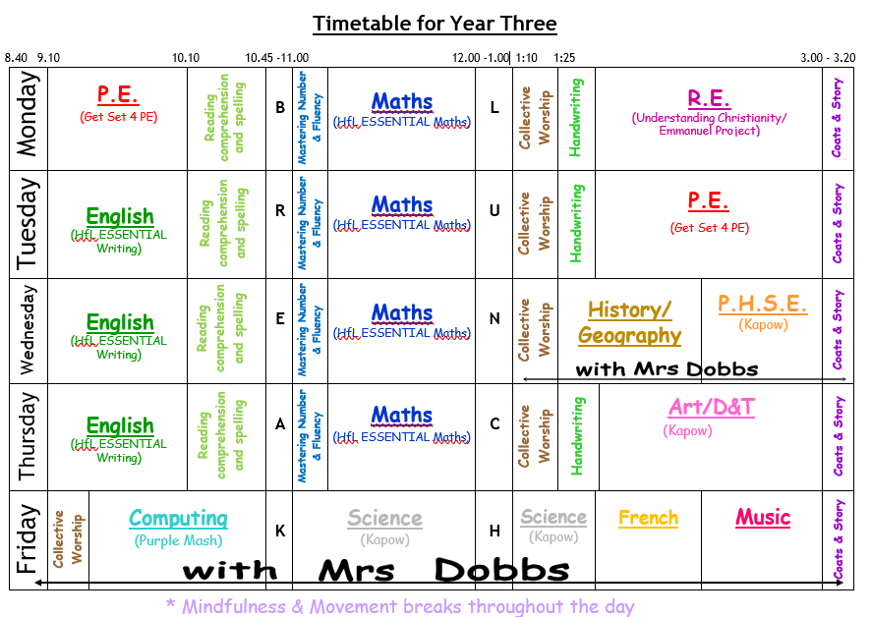
Timetable
This is an outline and subject to change.
Couple of changes – CW, Comprehension, snack before play
Very packed week – expectations are high!

Slide 5
Values
Our school values are:
Autumn 1: Respect
Autumn 2: Joy
Spring 1: Love
Spring 2: Forgiveness
Summer 1: Kindness
Summer 2: Courage
These will be taught through all the different subjects and collective worship.

Slide 6
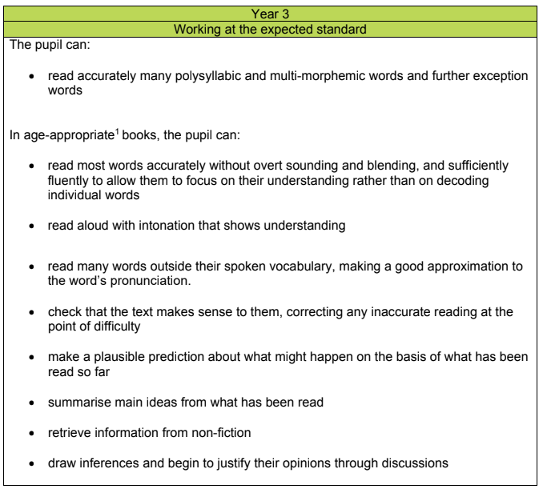

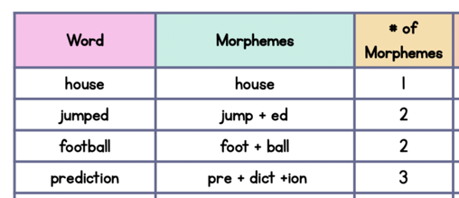
Reading Expectations

Slide 7

Reading list on website Scholastic books

Slide 8


Slide 9
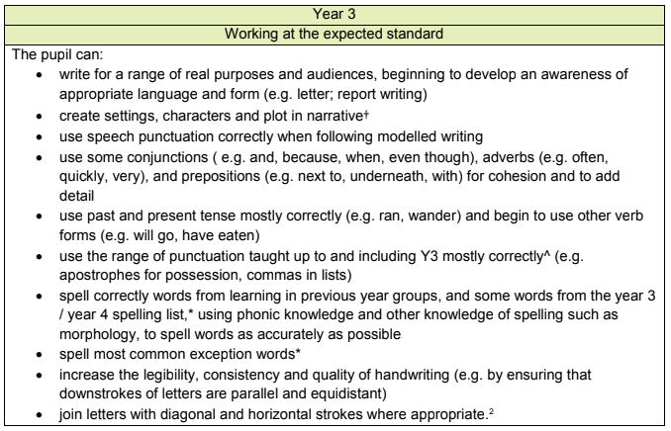
Writing Expectations

Slide 10
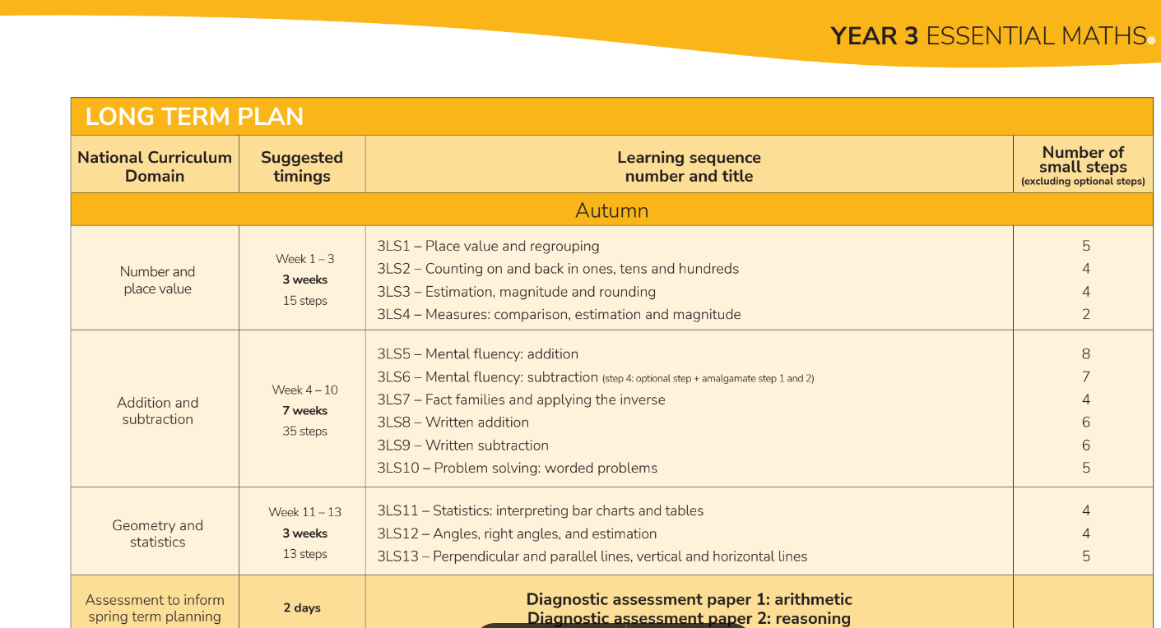
Maths Expectations
Herts Essential Maths scheme - Spiral curriculum
Number and Place Value
Addition and subtraction
Multiplication and division
Measurement and statistics
Geometry
Decimals
Fractions
Problem solving

Slide 11
P.S.H.E.
(Physical, social, health education)
P.S.H.E. is taught through a scheme of work called Jigsaw.
Jigsaw is a mindful approach to PSHE and brings together Personal, Social, Health Education, emotional literacy, social skills and spiritual development in a comprehensive scheme of learning.
Jigsaw is designed as a whole school approach, with all year groups working on the same theme (Puzzle) at the same time.
Term 1: Being Me in My World
Term 2: Celebrating Difference (including anti-bullying)
Term 3: Dreams and Goals
Term 4: Healthy Me
Term 5: Relationships
Term 6: Changing Me (including Sex Education)

Slide 12
P.E.
P.E. will be every Monday and Tuesday
Children can come to school in their school P.E. kits.
They will be outside as much as possible so need full named school P.E. kits including trainers and tracksuits/joggers.
Earrings and jewellery cannot be worn for P.E.
Please remove earrings on P.E. days. If children have earrings on they will be asked to remove them so please ensure they are able to do this independently.

Slide 13
Homework
Homework will be sent out on GC each Thursday to be completed and returned each Tuesday.
Children should complete homework in their Homework book and it should be well presented.
They should bring their Homework book in on Tuesdays and put it in the box to be looked at.
Homework consists of Maths, Spelling and Reading tasks.
Reading should be done every day and should be logged in the children’s Reading Record.
Support is available at Homework club on Friday afternoons with Mrs Dobbs. Please sign up via the office.
In summary
Every day = reading
Every week = Homework sheet (Maths, Reading task & Spelling)

Slide 14
Dates for your Diary
Parents’ Evening: Wednesday 21st October
Thursday 22nd October
Half term: Monday 26th October – Friday 30th October
Occasional Day: Monday 30th November
Break up: Friday 18th December

Slide 15


Finally
Useful website
https://home.oxfordowl.co.uk/at-school/year-3-at-primary-school/
If there is anything you would like to let us know or ask us about please do so via the class email
year3@stmarys916.herts.sch.uk
I will also be on the playground at the end of day pick up or you can send a note in with the children.
Thank you

