Slide 1

The sequencing thread of Geographical themes throughout the key stages
Human interaction with the physical world
Tectonic Hazards affecting people and place
River Landscapes
The challenge of natural hazards
Physical Landscapes in the UK
Tectonic processes and hazards
The water cycle
Theme 1
Weather and Climate
Ecosystems- Tropical rainforests and hot deserts
What role do we play in the escalation of climate change?
The Living World
The Carbon Cycle
Theme 2
How does Farming differ across the world?
How do we manage resources?
How did superpowers grow?
Resource management: Food
The Water Cycle
The Carbon Cycle
Theme 3
Geographical enquiry: Physical
Geographical enquiry: Humans
NEA: Geographical Enquiry
NEA: Geographical Enquiry
How do we represent planet earth?
How can we use GIS to fight crime?
What is our place in the world?
Theme 4
International Development
Urban Issues and Challenges
The Changing Economic World
Globalisation
Global Development - Migration, Identity and Sovereignty
Where do people live and why?
The world of work
Theme 5
The human and physical landscapes of Russia
Why has Asia's population boomed?
What is life like in Africa?
Rio de Janeiro
Issue Evaluation: Exam pre-release
Theme 6

Slide 2
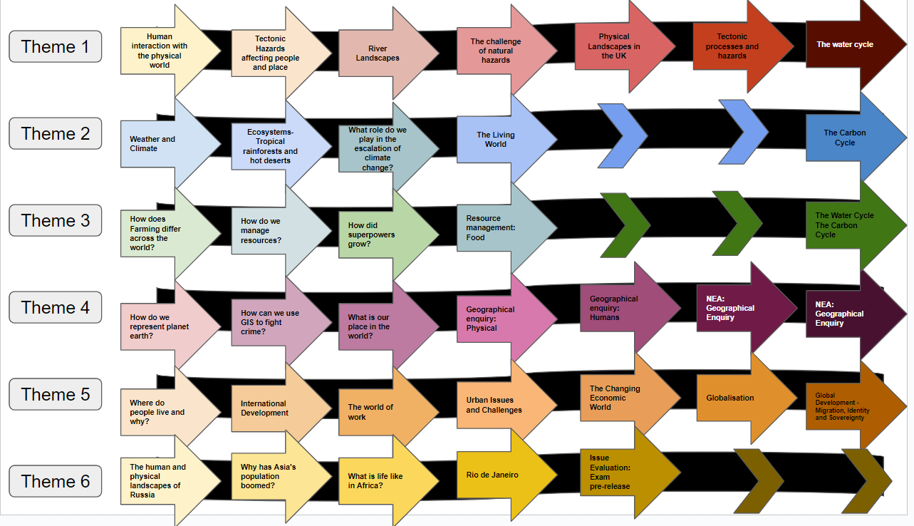
The sequencing thread of geographical themes throughout the key stages
7
8
9
10
11
12
13

